Slide 1
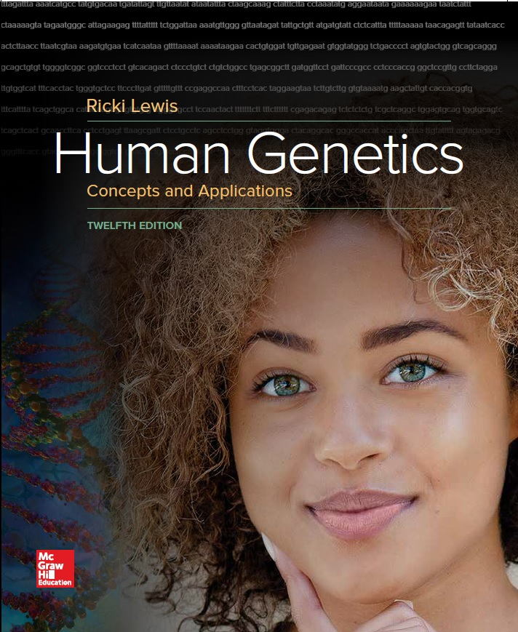
Human Genetics Concepts and Applications
Twelfth Edition
Chapter 8
Genetics of Behavior
© McGraw-Hill Education. All rights reserved. Authorized only for instructor use in the classroom. No reproduction or further distribution permitted without the prior written consent of McGraw-Hill Education.

Slide 2
Learning Outcomes (1 of 3)
Identify the physical basis of behavioral traits in the brain.
Explain how genes can affect behavior.
Describe how studies on dogs led to discovery of a narcolepsy gene in humans.
Explain how mutations in the period 2 gene disrupt sleep-wake cycles.
Describe development of intelligence tests.
List causes of intellectual disability.
State the two identifying characteristics of drug addiction.

Slide 3
Learning Outcomes (2 of 3)
Discuss genetic and neurological evidence that drug addiction is a biological phenomenon.
Explain how people can be addicted to drugs that are derived from plants.
Describe two types of receptors that are implicated in drug addiction.
Explain how genes control neurotransmitter abnormalities that lie behind major depressive disorder.
Explain how the genetics of bipolar disorder is complex.

Slide 4
Learning Outcomes (3 of 3)
Explain how schizophrenia differs from the mood disorders.
Discuss how synaptic pruning can unite environmental and genetic contributions to elevating the risk of developing schizophrenia.
List factors that increase the risk of developing autism.
Explain three ways to use exome or genome sequence data to discover genes that contribute to autism.
Discuss the role of neurexins and neuroligins in causing some cases of autism.

Slide 5
Behavior
Complex continuum of emotions, moods, intelligence, and personality
Occurs in response to environmental factors, but how we respond has genetic underpinnings
Behavioral genetics considers nervous system function and variation
Including mood and mind

Slide 6
PTSD
Reaction to traumatic physical harm or perceived threat of harm
Causes anxiety flashbacks and avoidance of memories of event
Inappropriate activation of stress hormones. Combat, diseasters, crimes and disturbing events.
Developed PTSD were abused children who had the gene FKBP5
In abused, methyl groups on the gene were absent
With decreased methylation, stress hormones (glucocorticoids) malfunctioned
The body was unable to react and adapt to stress
Epigenetic change occurred in white blood cells as well as neural progenitor cells
When it happened early in development it lasts a lifetime and may be passed on to the next generation.

Slide 7
Neurotransmission

Slide 8
Behavioral Genetics
Uses empirical risk, twin studies, and adoption studies
Association studies with SNPs and analysis of specific mutations that are present in individuals with the behavior
Genetic studies of behavioral disorders are challenging traditional psychiatric classification
Disorders may lie on a continuum with many genes having input

Slide 9
Prevalence of Behavioral Disorders in the U.S. Population (1 of 2)
Table 8.1 12-Month Prevalence of Some Behavioral Disorders in the U.S. Adult Population
Condition | Prevalence (%)
Anxiety | 18.0
Social phobia | 6.8
Posttraumatic stress disorder | 3.5
Generalized anxiety disorder | 3.1
Obsessive compulsive disorder | 1.0
Panic disorder | 2.7
Autism spectrum disorders (children) | 1.5
Eating disorders | 3.0
Anorexia nervosa | female 0.9, male 0.3
Binge eating | 1.2
Bulimia nervosa | 0.3

Slide 10
Prevalence of Behavioral Disorders in the U.S. Population (2 of 2)
Condition | Prevalence (%)
Mood disorders | 9.5
Major depressive disorder | 6.7
Bipolor disorder | 2.6
Schizophrenia | 1.1
Data from the National Institute of Mental Health

Slide 11
Sleep
Vital behavior of unknown function
Without sleep animals die
Twin studies indicate 4 of the 5 stages of sleep have a hereditary component
Fifth stage, REM sleep, is associated with dreaming and so reflects input of experience more than genes

Slide 12
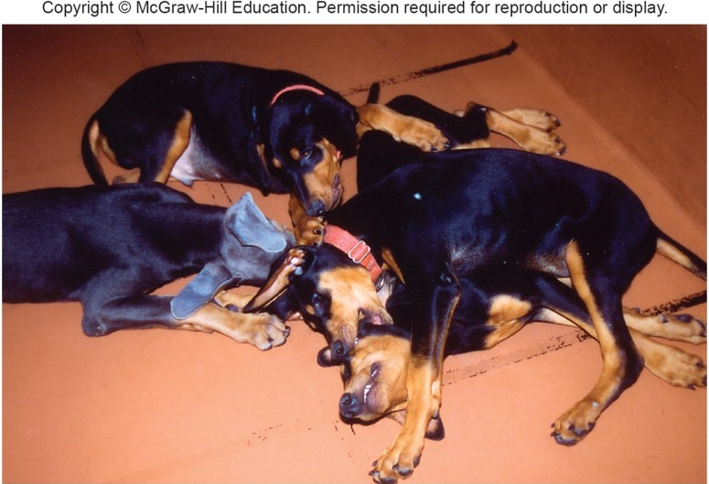
Narcolepsy with Cataplexy
Daytime sleepiness with tendency to rapidly fall asleep (narcolepsy) and periods of muscle weakness (cataplexy)
Genetic basis was first identified in dogs, then humans
© Stanford University Center for Narcolepsy

Slide 13
Familial Advanced Sleep Phase Syndrome
Disorder characterized by a very unusual sleep-wake cycle
Affected members of a large family enabled researchers to identify the first clock gene in humans
Period 2 gene on chromosome 2 enables a person to respond to day and night environmental cues

Slide 14
Intelligence
Complex and variable trait subject to multiple genetic, environmental influences, and intense subjectivity
Refers to the ability to reason, learn, remember, synthesize, deduce, and create
Intelligence quotient (IQ) test was first developed in France in 1904
Predicts academic success of developmentally disabled children

Slide 15
IQ Test
Later modified at Stanford University to assess white, middle-class Americans
IQ is normally distributed around a mean of 100
Below 50—Severe mental retardation
50–70—Mild mental retardation
85–115—Average intelligence
Above 115—Above average intelligence
Tests verbal fluency, mathematical reasoning, memory, and spatial visualization ability
g value measures a general intelligence factor that represents the inherited portion of IQ
Environment has less of an influence on IQ as a person ages

Slide 16
Success and IQ
IQ has been a fairly accurate predictor of success in school and work.

Slide 17
Drug Addiction
Compulsively seeking and taking a drug despite knowing its adverse effects
Characteristics:
Tolerance—Need to take more of a drug to achieve the same effect
Dependence—Onset of withdrawal symptoms with cessation of drug
Heritability is 0.4–0.6
Twin and adoption studies support role of genes in drug addiction.
Produces long-lasting changes in the brain
Brain changes that contribute to addiction are in the limbic system

Slide 18
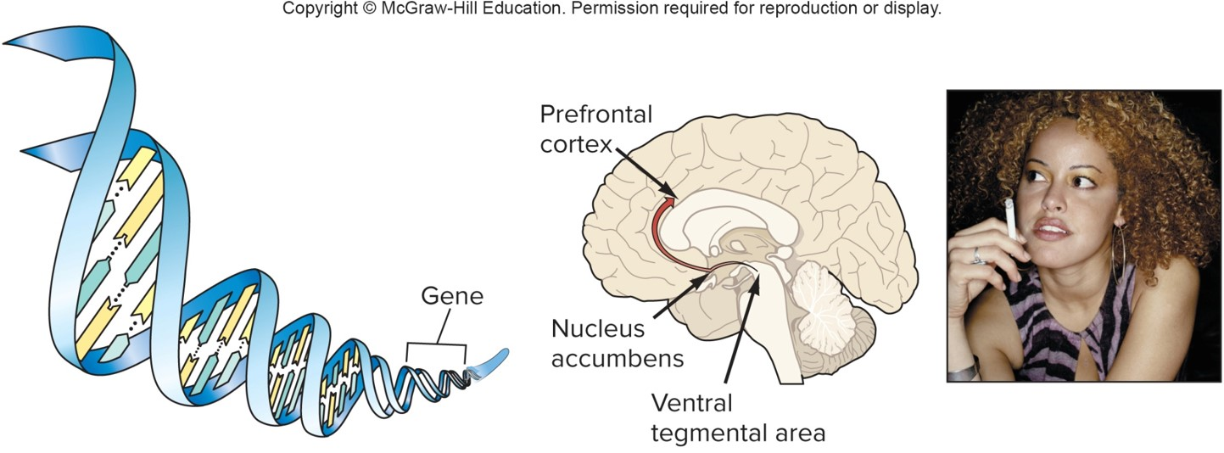
Events of Addiction (1 of 2)
© Ryan McVay/Getty Images RF

Slide 19
Events of Addiction (2 of 2)
Drug
Alcohol
Nicotine
Cocaine
Changes in expression of genes that control signal transduction; neurotransmitter synthesis; receptor abundance and activity
Changes in brain circuitry (neuron connections) in limbic system
Changes in behavior; dependence; tolerance

Slide 20
Proteins Involved in Drug Addiction
Enzymes involved in biosynthetic pathways of neurotransmitters
Neurotransmitter-reuptake transporters
Cell-surface receptors
Members of signal transduction pathways in postsynaptic neuron

Slide 21
Drugs of Abuse
Abused drugs are often derived from plants
Cocaine, opium, and tetrahydrocannabinol (THC), the main ingredient in marijuana
Chemicals bind receptors in human neurons
Endorphins and enkephalins are the human equivalents of opiates
Relieve pain

Slide 22
Candidate Genes for Drug Addiction
Nicotine binds a receptor that normally binds acetylcholine, causing dopamine release and pleasure
Candidate genes for addiction include those that encode the:
Dopamine D(2) receptor
Nicotine receptor parts
Protein neurexin-1
Ferries nicotinic receptors to neuron’s surface

Slide 23
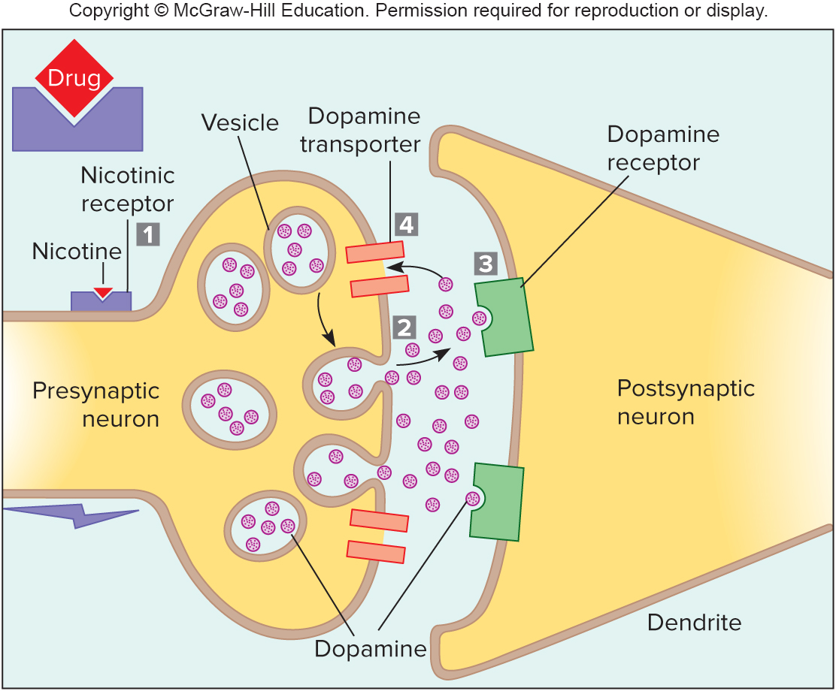
Fig. 8.5

Slide 24
Mood Disorders
Represent the extremes of normal behavior
Types:
Major depressive disorder—Marked by unexplained lethargy, sadness, and chronic depression
Bipolar disorder—Marked by depression interspersed with mania

Slide 25
Major Depressive Disorder
Affects 6% of the U.S. population
Likely cause is a deficiency of the neurotransmitter serotonin
Affects mood, emotion, appetite, and sleep
Many antidepressant drugs are selective serotonin reuptake inhibitors (SSRIs)

Slide 26
Bipolar Disorder
Also called manic depression
Affects 1% of the population
Associated with several chromosome sites
Genetic roots are difficult to isolate

Slide 27
Schizophrenia (1 of 5)
Loss of ability to organize thoughts and perceptions—withdrawal from reality
Worldwide—1% affected
Typically early adult onset
Progression
Difficulty in paying attention, memory and learning difficulties, psychosis (delusions and hallucinations)

Slide 28
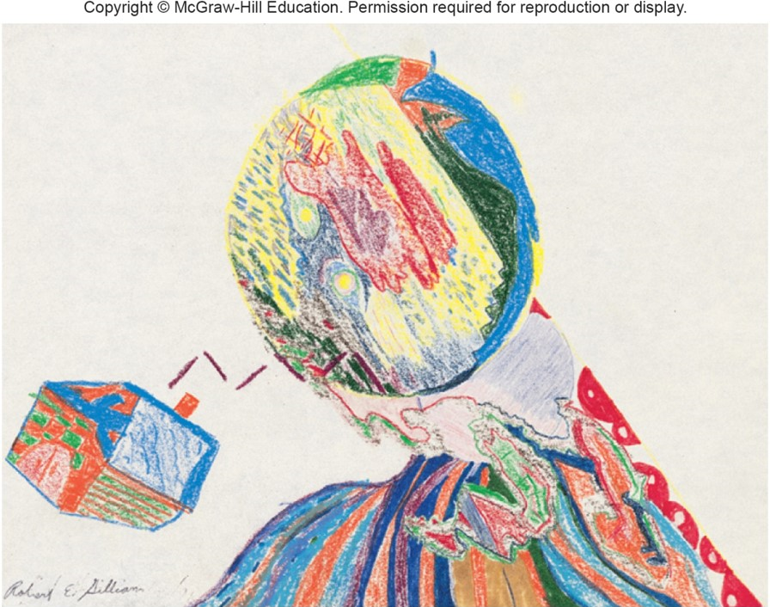
Schizophrenia (2 of 5)
Disjointed drawings by schizophrenic patients display the characteristic fragmentation of the mind.
© Robert Gilliam

Slide 29
Schizophrenia (3 of 5)
Heritability of 0.8 and empiric risk values indicate a strong genetic component for schizophrenia.
Table 8.2 Empiric Risks for Schizophrenia
Relationship | Risk
MZ twin | 48%
DZ twin | 17%
Child | 13%
Sibling | 9%
Parent | 6%
Half sibling | 6%
Grandchild | 5%
Niece/nephew | 4%
Aunt/uncle | 2%
First cousin | 2%
General population | 1%

Slide 30
Schizophrenia (4 of 5)
Dozens of genes may interact with environmental influences to cause this disease.
Environmental influences include birth complications, fetal oxygen deprivation, herpesvirus infection at birth, and traumatic brain injury or malnutrition in the mother.
Infections during pregnancy is a well-studied environmental factor causing schizophrenia.
It is not the infection that sets the stage for later schizophrenia, but the maternal response to it.
High levels of the cytokine interleukin-8 are associated with a child developing schizophrenia.

Slide 31
Schizophrenia (5 of 5)
An important new gene finding associated with schizophrenia are the C4 genes associated with the compliment system.
Certain variants of the C4A genes are much more common among individuals with schizophrenia.
The C4A variant gene causes too much pruning of synaptic connections in the brain.
Microglial cells bind to C4A protein tags to perform the pruning.

Slide 32
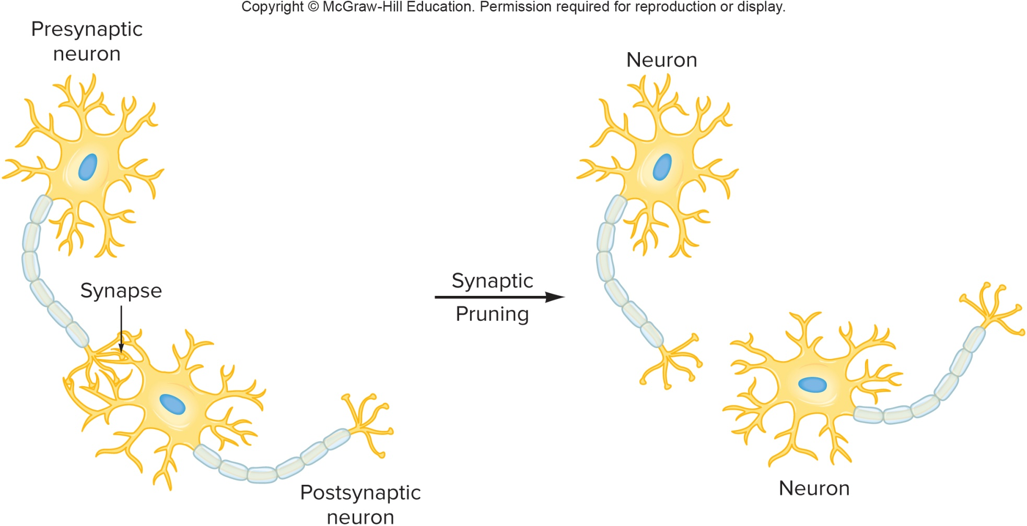
Synaptic Pruning (1 of 2)

Slide 33
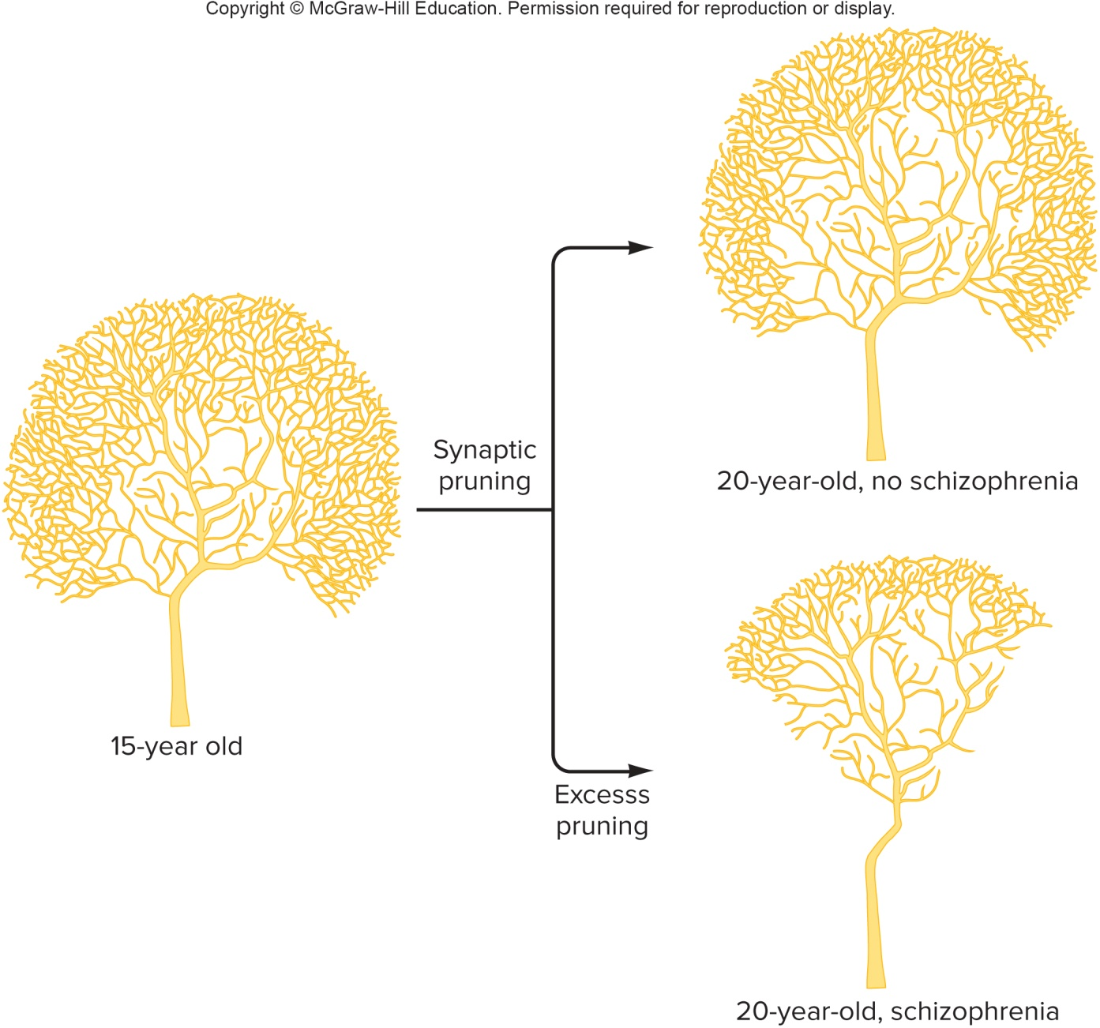
Synaptic Pruning (2 of 2)

Slide 34
Autism (1 of 2)
Spectrum of disorders:
Characterized by loss of language, communication, and social skills beginning in early childhood
Seizures and mental retardation may occur
Affects 3–6 children out of every 1000
Strikes four times as many boys as girls
Although 70 percent of people with autism have intellectual disability, others may be very intelligent

Slide 35
Autism (2 of 2)
More than 30 genes so far have been associated with autism.
Two genes in particular may finally explain how autism develops.
Encode the cell adhesion proteins neurexins and neuroligins
Proteins strengthen synaptic connections in neurons associated with learning and memory
In about 15 percent of people with autism, the condition is part of a syndrome.

Slide 36
Table 8.3 Famous People Who Had Autistic Behaviors
Person | Characteristics
Albert Einstein | Did not like to be touched Difficulty learning in school Awkward in social situations
Charles Darwin | Preferred letter writing to face-to-face interactions Fixated on certain objects and topics
Emily Dickinson | Heightened sense of smell Preferred white clothing Reclusive Fascinated with flowers
Michelangelo | Limited interests but obsessed with work Poor communication and social skills Relied on rigid routines

Slide 37
Understanding Autism

Slide 38
Syndromes That Include Autism
Table 8.4 Genetic Syndromes That Include Autism
Syndrome | Gene | Phenotype (in addition to autism)
Joubert syndrome | INPP5E | Missing brain structure (“molar tooth sign”), abnormal breathing, abnormal eye movement, cognitive impairment
Phenylketonuria | PAH | Severe intellectual disability if remedial diet is not followed
PTEN macrocephaly syndrome | PTEN | Large head, cancer predisposition
Smith-Lemli-Opitz syndrome | DHCR7 | Intellectual disability, self-injury, poor temperature regulation, disturbed sleep
Timothy syndrome | CACNA1C | Webbed fingers and toes, heart defects, unusual facial features, developmental delay
Tuberous sclerosis 1 | TSC 1 | Seizures, tumors, skin lesions

Slide 39
End of Presentation

