Slide 1
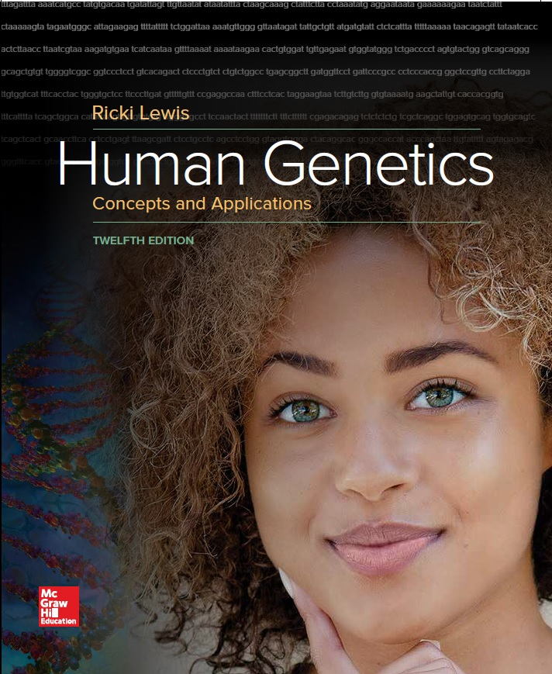
Human Genetics Concepts and Applications
Twelfth Edition
Chapter 5
Beyond Mendel’s Laws
© McGraw-Hill Education. All rights reserved. Authorized only for instructor use in the classroom. No reproduction or further distribution permitted without the prior written consent of McGraw-Hill Education.

Slide 2
Learning Objectives (1 of 2)
Explain the effect of the lethal alleles on Mendelian ratios.
State how DNA structure underlies multiple gene variants.
Distinguish among complete dominance, incomplete dominance, and codominance.
Distinguish epistasis from allele interactions.
Describe how penetrance, expressivity, and pleiotropy affect gene expression.
Explain how a phenocopy can appear to be inherited.

Slide 3
Learning Objectives (2 of 2)
Describe the mode of inheritance of a mitochondrial trait.
Explain how mitochondrial DNA differs from nuclear DNA.
Explain how linked traits are inherited differently from Mendelian traits.
Discuss the basis of linkage in meiosis.
Explain how linkage is the basis of genetic maps and genome-wide association studies.

Slide 4
Exceptions to Mendel’s Law
Mendel’s traits showed two distinct forms
Most genes do not exhibit simple inheritance
Genotypic ratios persist but phenotypic ratios may vary due to outside-the-gene influences:
Multiple alleles
Other nuclear genes
Nonnuclear genes
Gene linkage
Environment

Slide 5
Lethal Alleles (1 of 5)
Lethal genotype causes death before the individual can reproduce.
Removes an expected progeny class following a specific cross
Double dose of a dominant allele may be lethal.
Examples
Achondroplastic dwarfism
Mexican hairless dogs

Slide 6
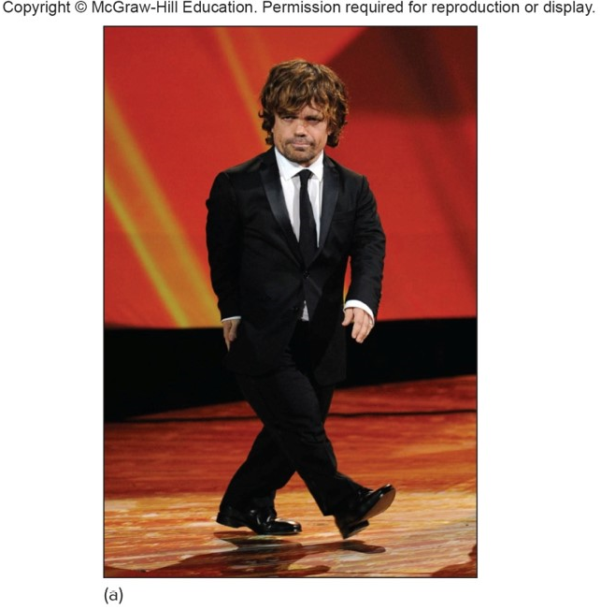
Lethal Alleles (2 of 5)
a: © Kevin Winter/Getty Images

Slide 7
Lethal Alleles (3 of 5)
Alleles
a = normal height (wild type)
A = achondroplasia (mutant)
Genotypes | Phenotypes
AA | lethal
Aa | achondroplasia
aa | normal height

Slide 8
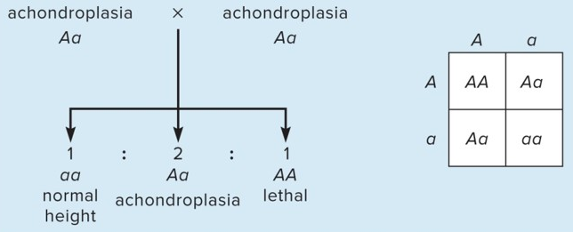
Lethal Alleles (4 of 5)
Cross 1
1/4 die as embryos (AA)
Of survivors:
2/3 = achondroplasia (Aa)
1/3 = normal height (aa)

Slide 9
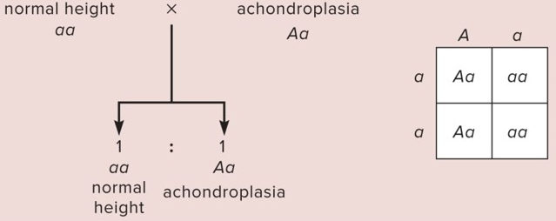
Lethal Alleles (5 of 5)
Cross 2
All survive:
1/2 = achondroplasia
1/2 = normal height

Slide 10
Multiple Alleles
Individual carries two alleles for each autosomal gene.
Gene can have multiple alleles because its sequence can deviate in many ways.
Different allele combinations can produce variations in the phenotype.
PKU gene has hundreds of alleles resulting in four basic phenotypes.
CF gene has over 1500 alleles.

Slide 11
Incomplete Dominance (1 of 2)
Heterozygous phenotype is between those of the two homozygotes
Example: Familial hypercholesterolemia (FH)
Heterozygote has approximately half the normal number of receptors in the liver for LDL cholesterol
Homozygous for the mutant allele totally lacks the receptor, and so their serum cholesterol level is very high

Slide 12
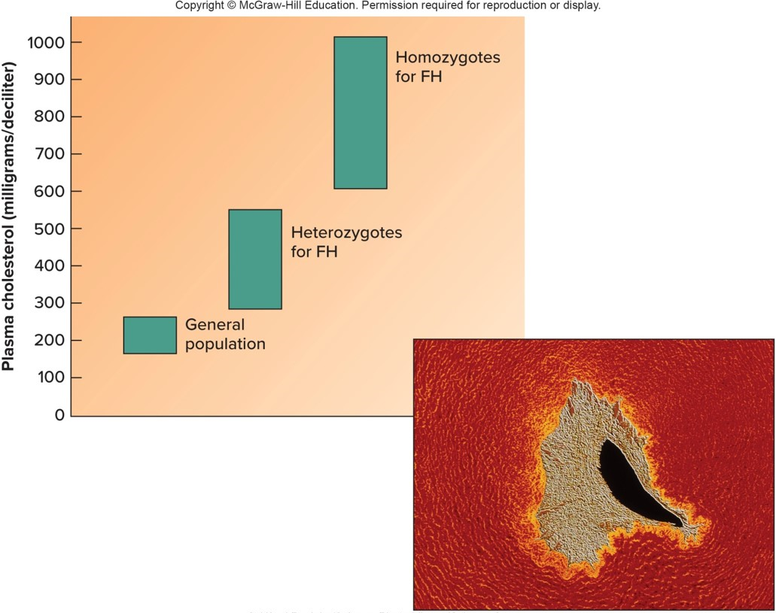
Incomplete Dominance (2 of 2)
© Alfred Pasieka/Science Photo Library/Science Source

Slide 13
Codominance
Heterozygous phenotype results from the expression of both alleles.
ABO gene encodes a cell surface protein.
I^{A} allele produces A antigen.
I^{B} allele produces B antigen.
i (I^{O}) allele does not produce antigens.
Alleles I^{A} and I^{B} are codominant, and both are completely dominant to i.

Slide 14
ABO Blood Types Illustrate Codominance

Slide 15
Offspring from Parents with Blood Type A and Blood Type B

Slide 16
Epistasis
Phenomenon where one gene affects the expression of a second gene.
Example: Bombay phenotype
H gene is epistatic to the I gene
H protein places a molecule at the cell surface to which the A or B antigens are attached
hh genotype = no H protein
Without H protein the A or B antigens can not be attached to the surface of the RBC
All hh genotypes have the phenotype of type O, although the ABO blood group can be anything (A, B, AB, or O)

Slide 17
Penetrance and Expressivity
Penetrance: All-or-none expression of a single gene
Expressivity: Severity or extent
Genotype is incompletely penetrant if some individuals do not express the phenotype
Phenotype is variably expressive is symptoms vary in intensity among different people

Slide 18
Pleiotropy
Phenomenon where one gene controls several functions or has more than one effect
Example: Porphyria variegate
Affected several members of European Royal families, including King George III
Varied illnesses and quirks appeared to be different unrelated disorders

Slide 19
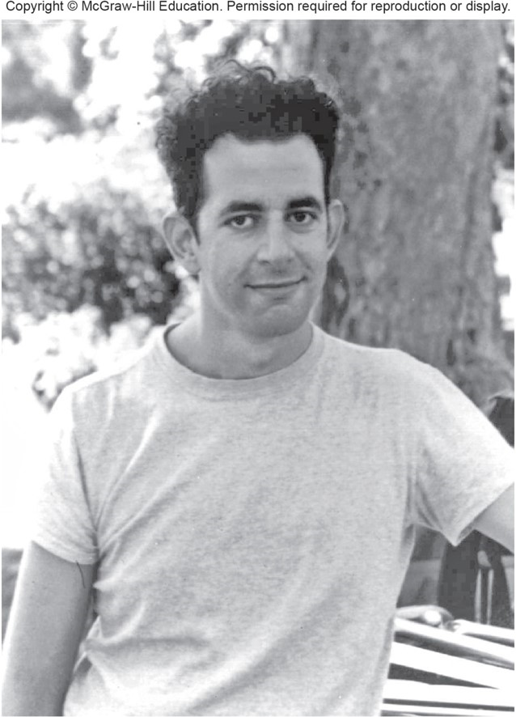
Marfan Syndrome is Pleiotropic
© Columbia University, ho/AP Images

Slide 20
Genetic Heterogeneity
Different genes can produce identical phenotypes.
Hearing loss—132 autosomal recessive forms
Osteogenesis imperfecta—At least two different genes involved
Alzheimer’s disease—At least four different genes involved
Genes may encode enzymes that catalyze the same biochemical pathway, or different proteins that are part of the pathway.

Slide 21
Many Routes to Blindness

Slide 22
Phenocopy
Trait that appears inherited but is caused by the environment
May have symptoms that resemble an inherited trait or occur within families
Examples:
Exposure to teratogens
Thalidomide causes limb defects similar to inherited phocomelia
Infection
AIDS virus can be passed from mother to child, looking like it is inherited

Slide 23
The Human Genome Sequence Adds Perspective
Revealed that complications to Mendelian inheritance are more common than originally thought
Terms like epistasis and genetic heterogeneity are beginning to overlap and blur
Example: Marfan syndrome
Interactions between genes also underlie penetrance and expressivity
Example: Huntington disease

Slide 24
Table 5.1 Factors That Alter Single-Gene Phenotypic Ratios (1 of 2)
Phenomenon | Effect on Phenotype | Example
Lethal alleles | A phenotypic class does not survive to reproduce. | Achondroplasia
Multiple alleles | Many variants or degrees of a phenotype are possible. | Cystic fibrosis
Incomplete dominance | A heterozygote’s phenotype is intermediate between those of the two homozygotes. | Familial hypercholesterolemia
Codominance | A heterozygote’s phenotype is distinct from and not intermediate between those of the two homozygotes. | ABO blood types
Epistasis | One gene masks or otherwise affects another’s phenotype. | Bombay phenotype
Penetrance | Some individuals with a particular genotype do not have the associated phenotype. | Polydactyly
Expressivity | A genotype is associated with a phenotype of varying intensity. | Polydactyly

Slide 25
Table 5.1 Factors That Alter Single-Gene Phenotypic Ratios (2 of 2)
Phenomenon | Effect on Phenotype | Example
Pleiotrophy | The Phenotype includes many symptoms, with different subsets in different individuals. | Marfan syndrome
Phenocopy | An environmentally caused condition has symptoms and a recurrence pattern similar to those of a known inherited trait. | Infection
Genetic heterogeneity | Genotypes of different genes cause the same phenotype. | Osteogenesis imperfecta

Slide 26
Mitochondrion (1 of 2)
Organelle providing cellular energy
Contains small circular DNA called mtDNA—37 genes without noncoding sequences
No crossing over and little DNA repair
High exposure to free radicals
Mutation rate is greater than nuclear DNA

Slide 27
Mitochondrion (2 of 2)
Mitochondrial genes are transmitted from mother to all of her offspring.

Slide 28
Mitochondrial DNA
Cell typically has thousands of mitochondria, and each has numerous copies of its mini chromosome.

Slide 29
Mitochondrial Disorders
Mitochondrial genes encode proteins that participate in protein synthesis and energy production
Several diseases result from mutations in mtDNA
Examples:
Mitochondrial myopathies—Weak and flaccid muscles
Leber optical atrophy—Impaired vision
Ooplasmic transfer technique can enable woman to avoid transmitting a mitochondrial disorder

Slide 30
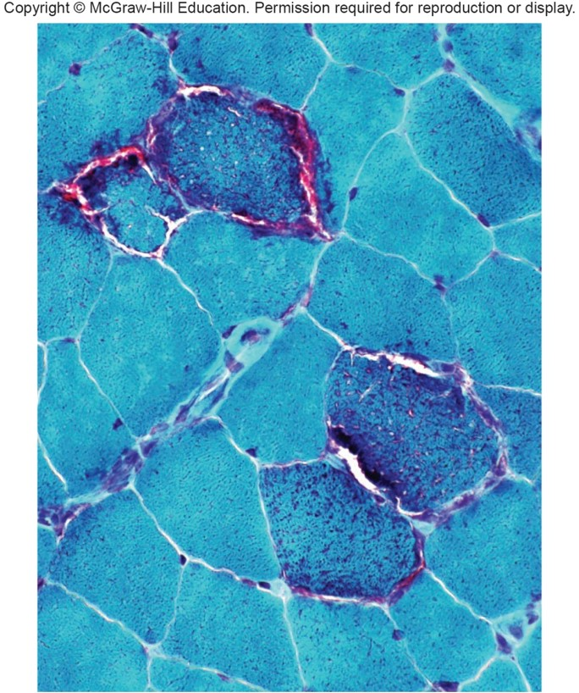
Appearance of Skeletal Muscle Fibers in Mitochondrial Disease
Courtesy of Alan Pestronk, MD

Slide 31
Heteroplasmy (1 of 2)
Condition where the mtDNA sequence is not the same in all copies of the genome
Mitochondrion will have different alleles for the same gene
At each cell division, the mitochondria are distributed at random into daughter cells
If an oocyte is heteroplasmic, differing number of copies of a mutant mtDNA may be transmitted
Phenotype reflects the proportion of mitochondria bearing the mutation

Slide 32
Heteroplasmy (2 of 2)

Slide 33
Mitochondrial DNA Reveals Past
mtDNA provides a powerful forensic tool used to:
Link suspects to crimes
Identify war dead
Support or challenge historical records
Example—Identification of the son of Marie Antoinette and Louis XVI
mtDNA is likely to survive extensive damage and cells have many copies of it

Slide 34
Linkage (1 of 3)
Genes that are close on the same chromosome are said to be linked.
Linked genes do not assort independently in meiosis.
Usually inherited together when the chromosome is packaged into a gamete
Do not produce typical Mendelian ratios

Slide 35
Linkage (2 of 3)

Slide 36
Linkage (3 of 3)

Slide 37
Recombination
Chromosomes recombine during crossing over in prophase I of meiosis.
New combinations of alleles are created.
Parental chromosomes have the original configuration.
Recombinant chromosomes have new combinations of alleles.

Slide 38
Crossing Over Disrupts Linkage

Slide 39
Allele Configuration Is Important
Cis—Two dominant or two recessive alleles are on each chromosome.
Trans—One dominant and one recessive allele are on each chromosome.

Slide 40
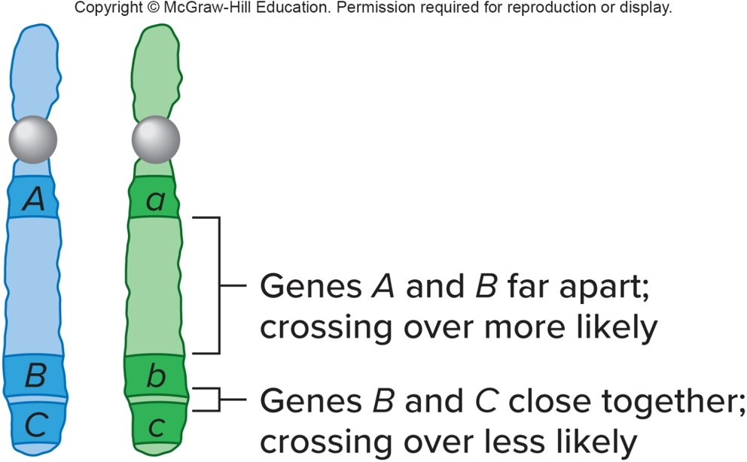
Frequency of Recombination (1 of 2)
Correlation between cross over frequency and gene distance is used to construct linkage maps.

Slide 41
Frequency of Recombination (2 of 2)
Based on percentage of meiotic divisions that result in breakage of linkage between parental alleles
Proportional to the distance between the two genes recombining

Slide 42
Linkage versus Nonlinkage (Independent Assortment)

Slide 43
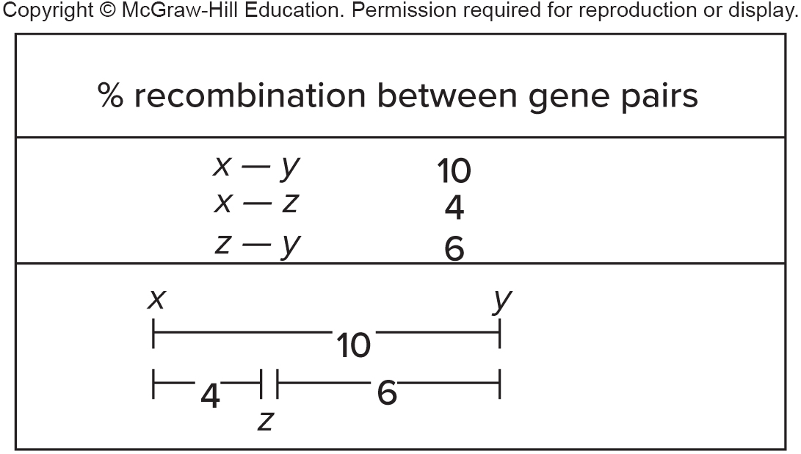
Linkage Maps
Diagram indicating the relative distance between genes
1% recombination = 1 map unit = 1 centimorgan (cM)
Map distances are additive

Slide 44
Linkage Disequilibrium (LD)
Nonrandom association between DNA sequences
Inherited together more often than would be predicted from their frequency
Human genome consists of many LD blocks where alleles stick together
Interspersed with areas where crossing over is prevalent

Slide 45
Solving Linkage Problems
Genes for Nail-patella syndrome (N) and the ABO blood type (I) are 10 map units apart on chromosome 9.
Greg and Susan each have Nail-patella syndrome. Greg has type A and Susan type B blood. What is the probability that their child has normal nail and knees and type O blood?

Slide 46
Inheritance of Nail-Patella Syndrome
ni sperm would have to fertilize the ni oocyte
Using the product rule, the probability of a child with nnii genotype is 0.45 × 0.05 = 0.025 or 2.25%

Slide 47
Genetic Markers
DNA sequences that serve as landmarks near genes of interest
Were used starting in 1980 in linkage mapping
Used in genome-wide association studies

Slide 48
LOD Score
Indicates the tightness of linkage between a marker and a gene of interest
Likelihood that particular cross over frequency data suggests linkage rather than inheritance by chance
LOD scores of 3 or higher signifies linkage
Observed data are 1000 times more likely to be due to linkage than chance

Slide 49
Haplotype (1 of 2)
Set of DNA sequences inherited on one chromosome due to linkage disequilibrium
Make it possible to track specific chromosome segments in pedigrees
Disruptions of a marker sequence indicate cross over sites

Slide 50
Haplotype (2 of 2)

Slide 51
End of Presentation

