Slide 1
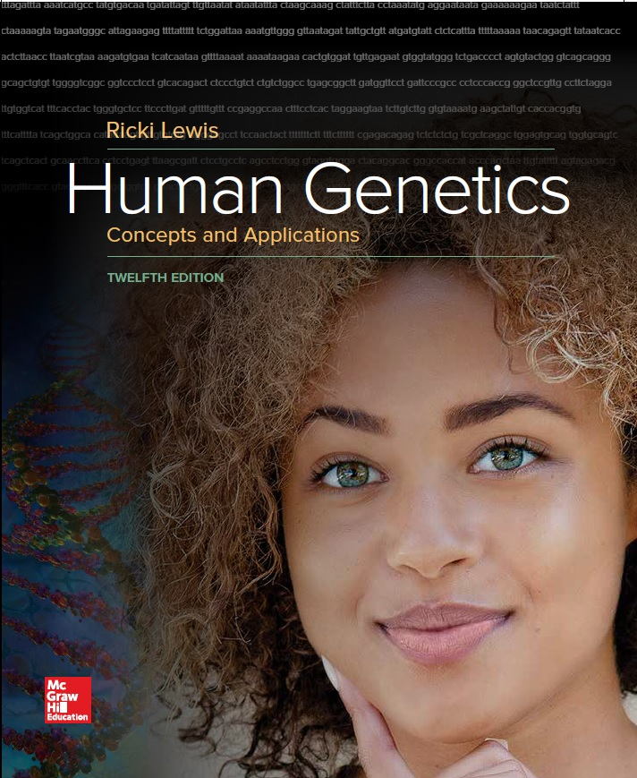
Human Genetics Concepts and Applications
Twelfth Edition
Chapter 4
Single-Gene Inheritance
© McGraw-Hill Education. All rights reserved. Authorized only for instructor use in the classroom. No reproduction or further distribution permitted without the prior written consent of McGraw-Hill Education.

Slide 2
Learning Outcomes (1 of 2)
List the characteristics that distinguish single-gene diseases from other types of diseases.
Describe how Mendel deduced that recessive traits seem to disappear in hybrids.
Define and distinguish heterozygote and homozygote; dominant and recessive; phenotype and genotype.
Explain how the law of segregation reflects the events of meiosis.
Indicated how a Punnett square is used to track inheritance patterns.
Explain how a gene alone usually does not solely determine a trait.

Slide 3
Learning Outcomes (2 of 2)
Distinguish between autosomal recessive and autosomal dominant inheritance.
Explain how Mendel’s experiments followed the inheritance of more than one gene.
Explain how the law of independent assortment reflects the events of meiosis.
Explain how pedigrees show single-gene transmission.
Explain how exome and genome sequencing can reveal whether a sick child with healthy parents inherited two autosomal recessive mutations or has a new dominant mutation.

Slide 4
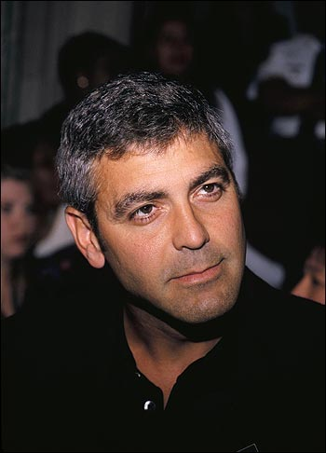
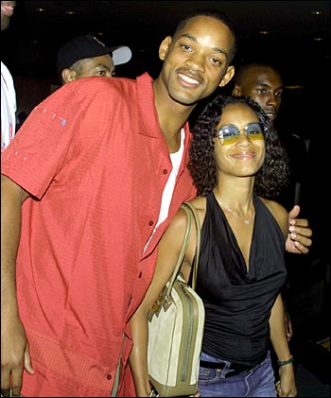

Slide 5
Characteristics of a Single-Gene Disease
In families the probability can be deduced by knowing how the affected person is related to a family member.
Tests can sometimes predict the risk of developing symptoms.
The disease may be much more common in some populations than others.
Some single-gene diseases have modes of inheritance, such as cystic fibrosis.

Slide 6
Following the Inheritance of One Gene
Modes of inheritance are the patterns in which single-gene traits and disorders occur in families.
Huntington’s disease is autosomal dominant.
Affects both sexes and appears in every generation
Cystic fibrosis is autosomal recessive.
Affects both sexes and can skip generations through carriers

Slide 7
Mendel’s Experiments (1 of 3)
Described the units of inheritance and how they pass from generation to generation
Mendel had no knowledge of DNA, cells, or chromosomes
His laws of inheritance explain trait transmission in any diploid species
Conducted experiments from 1857 to 1863 on traits in 24,034 plants

Slide 8
Mendel’s Experiments (2 of 3)
Deduced that consistent ratios of traits in the offspring indicated that plants transmitted distinct units
Analyzed genetic crosses of peas
P₁ Parental generation
F₁ First filial generation
F₂ Second filial generation

Slide 9
Mendel’s Experiments (3 of 3)
True-breeding—Offspring have the same trait as parent.
Example—Short parents produce all short offspring.
The observed trait is dominant.
The masked trait is recessive.
Monohybrid cross follows one trait.
Self-crossed plants are hybrids.

Slide 10
Mendel Studied Transmission of Seven Traits in the Pea Plant

Slide 11
Figure 4.2

Slide 12
Monohybrid Cross
Experiments confirmed that hybrids hide one expression of a trait, which reappears when hybrids are self-crossed.
Mendel speculated that each elementen was packaged in a separate gamete.
Law of segregation is Mendel’s idea that elementen separate in the gametes.

Slide 13
Mendel’s First Law—Segregation (1 of 3)
Reflects the actions of chromosomes and the genes they carry during meiosis
Homozygous carry same alleles TT or tt
Heterozygous carry different alleles Tt
Genotype = Organism’s alleles
Phenotype = Outward expression of an allele combination
Wild Type = Most common phenotype
Recessive or dominant

Slide 14
Mendel’s First Law—Segregation (2 of 3)
Mutant phenotype = Variant of a gene’s expression that arises when the gene undergoes mutation
Mendel observed the events of meiosis
Two copies of a gene separate with the homologs that carry them when a gamete is produced
At fertilization, gametes combine at random

Slide 15
Mendel’s First Law—Segregation (3 of 3)

Slide 16
Mendel’s Data
Table 4.1 Mendel’s Law of Segregation
Experiment | Total | Dominant | Recessive | F₂ Phenotypic Ratios
Seed form | 7,324 | 5,474 | 1,850 | 2.96:1
Seed color | 8,023 | 6,022 | 2,001 | 3.01:1
Seed coat color | 929 | 705 | 224 | 3.15:1
Pod form | 1,181 | 882 | 299 | 2.95:1
Pod color | 580 | 428 | 152 | 2.82:1
Flower position | 858 | 651 | 207 | 3.14:1
Stem length | 1,064 | 787 | 277 | 2.84:1
 |  |  |  | Average = 2.98:1
Notes:
Copyright © McGraw-Hill Education. Permission required for reproduction or display.

Slide 17
Punnett Square
Represents how genes in gametes join if they are on different chromosomes

Slide 18
Test Cross (1 of 2)
A monohybrid cross yields:
A 1 “uppercase T, uppercase T” : 2 “uppercase T, lowercase t” : 1 “lowercase t, lowercase t” genotypic ratio, and
A 3 tall : 1 short phenotypic ratio
Mendel distinguished the “uppercase T, uppercase T” from “uppercase T, lowercase t” tall plants with a test cross
Cross an individual of unknown genotype with a homozygous recessive individual

Slide 19
Test Cross (2 of 2)

Slide 20
Single-Gene Inheritance
Single-gene disorders are rare.
Phenotypes associated with single genes are influenced by other genes and environmental factors.

Slide 21
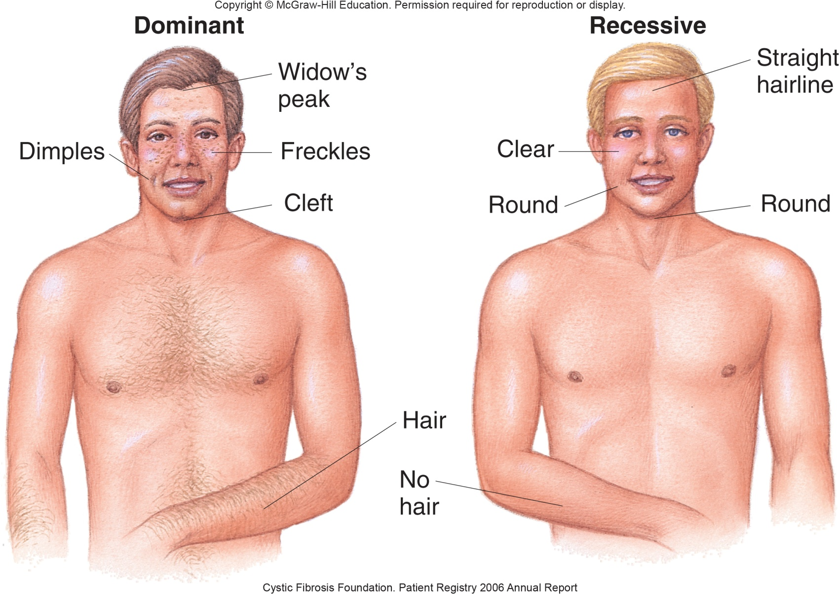
Inheritance of Some Common Traits
Box, Figure 1

Slide 22
Eye Color (1 of 2)
People differ in the amount of melanin and number of melanosomes.
Have the same number of melanocytes
The surface of the back of the iris contributes to the intensity of eye color.
OCA2 confers eye color by controlling melanin synthesis. (Eumelanin and pheomelanin)
HERC2 controls expression of the OCA2 gene

Slide 23
Eye Color (2 of 2)

Slide 24
Modes of Inheritance
Rules that explain the common patterns of single-gene transmission
Passing of a trait depends on whether:
Determining gene is on an autosome or on a sex chromosome
Allele is recessive or dominant
Autosomal inheritance can be dominant or recessive

Slide 25
Table 4.2 Comparison of Autosomal Dominant and Autosomal Recessive Inheritance
Autosomal Dominant | Autosomal Recessive
Males and females affected, with equal frequency | Males and females affected, with equal frequency
Successive generations affected until no one inherits the mutation | Can skip generations
Affected individual has an affected parent, unless he or she has a de novo mutation | Affected individual has parents who are affected or are carriers (heterozygotes)
Notes:
Copyright © McGraw-Hill Education. Permission required for reproduction or display.

Slide 26
Autosomal Dominant Inheritance

Slide 27
Criteria for Autosomal Recessive Traits
Males and females can be affected.
Affected males and females can transmit the gene, unless it causes death before reproductive age.
Trait can skip generations.
Parents of an affected individual are heterozygous or have the trait.
Conditions likely to occur in families with consanguinity.

Slide 28
Solving Genetic Problems
Follow these five general steps:
List all genotypes and phenotypes for the trait.
Determine the genotypes of the parents.
Derive possible alleles in gametes.
Unite gametes in all combinations to reveal all possible genotypes.
Repeat for successive generations.

Slide 29
On the Meaning of Dominance and Recessiveness
Knowing whether an allele is dominant or recessive is important in determining risk inheriting a particular condition.
Reflect the characteristics or abundance of a protein
Recessive traits are due to “loss of function.”
Recessive disorders tend to be severe, produce symptoms earlier than dominant disorders
Dominant traits arise from “gain of function.”

Slide 30
Loss or Gain of a Function

Slide 31
Mendel’s Second Law—Independent Assortment (1 of 2)
Considers two genes on different chromosomes
The inheritance of one does not influence the chance of inheriting the other
Two genes that are far apart on the same chromosome appear to independently assort
Numerous crossovers take place between them

Slide 32
Mendel’s Second Law—Independent Assortment (2 of 2)

Slide 33
Plotting a Dihybrid Cross

Slide 34
Probability
The likelihood that an event will occur
Product rule—Probability of simultaneous independent events equals the product of their individual probabilities
Predicts the chance of parents with known genotypes to produce offspring of a particular genotype
Example—Consider the probability of obtaining a plant with wrinkled, green peas (genotype rryy) from dihybrid (RrYy) parents

Slide 35
Product Rule
Do the reasoning for one gene at a time, then multiply the results.

Slide 36
Using Probability to Track Three Traits

Slide 37
Pedigree Analysis (1 of 2)
For researchers, families are tools; the bigger the family, the easier it is to discern modes of inheritance.
Pedigrees are symbolic representations of family relationships and the transmission of inherited traits.

Slide 38
Pedigree Analysis (2 of 2)

Slide 39
An Unusual Pedigree
A partial pedigree of Egypt’s Ptolemy dynasty showing:
Genealogy not traits
Extensive inbreeding

Slide 40
Pedigree—Marriage of First Cousins

Slide 41
Importance of Pedigrees Today
Helps families identify the risk of transmitting an inherited illness
Starting points for identifying and describing, or annotating, a gene from the human genome sequence
Meticulous family records are helping researchers follow the inheritance of particular genes

Slide 42
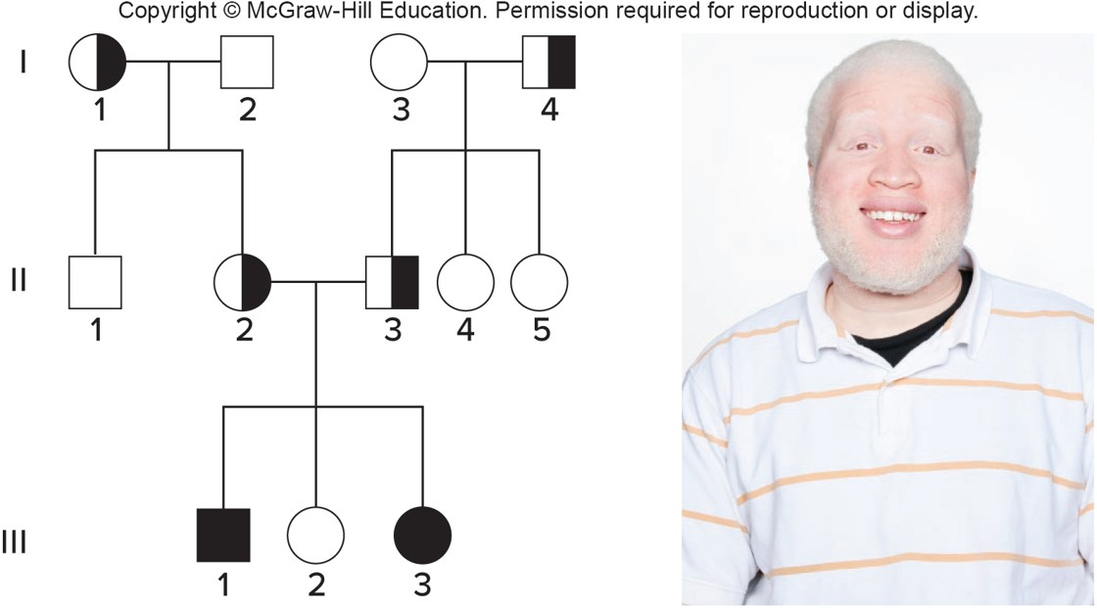
Autosomal Recessive Trait
Albinism = Deficiency in melanin production
Parents are inferred to be heterozygotes
© Paul Buarns/Getty Images RF

Slide 43
Autosomal Dominant Trait
Does not skip generations, can affect both sexes
Polydactyly = Extra fingers and/or toes

Slide 44
An Inconclusive Pedigree
This pedigree can account for either an autosomal dominant or an autosomal recessive trait
Passed in an autosomal dominant mode

Slide 45
Conditional Probability
Pedigrees and Punnett squares apply Mendel’s laws to predict the recurrence risks of inherited conditions
Example:
Taneesha’s brother Deshawn has sickle cell disease
What is the probability that Taneesha’s child inherits her mutant allele and be a carrier?

Slide 46
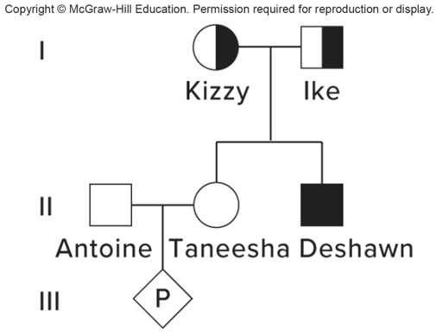
Making Predictions (1 of 3)
Taneesha’s brother, Deshawn, has sickle cell disease.

Slide 47
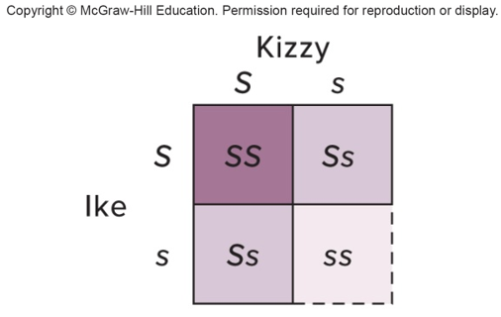
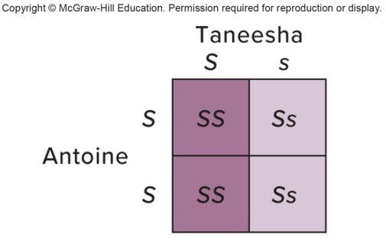
Making Predictions (2 of 3)
Probability that Taneesha is a carrier: 2/3
If Taneesha is a carrier, chance that fetus is a carrier: ½
Total probability = 2/3 × 1/2 × 2/3

Slide 48
Making Predictions (3 of 3)
Probability Taneesha is a carrier = 2/3
Probability child inherits sickle cell allele = 1/2
Probability child carries sickle cell allele from her = 2/3 × 1/2 = 1/3
Taneesha is not affected and cannot be ss
Taneesha and Deshawn’s parents must be heterozygous

Slide 49
End of Presentation

