Slide 1
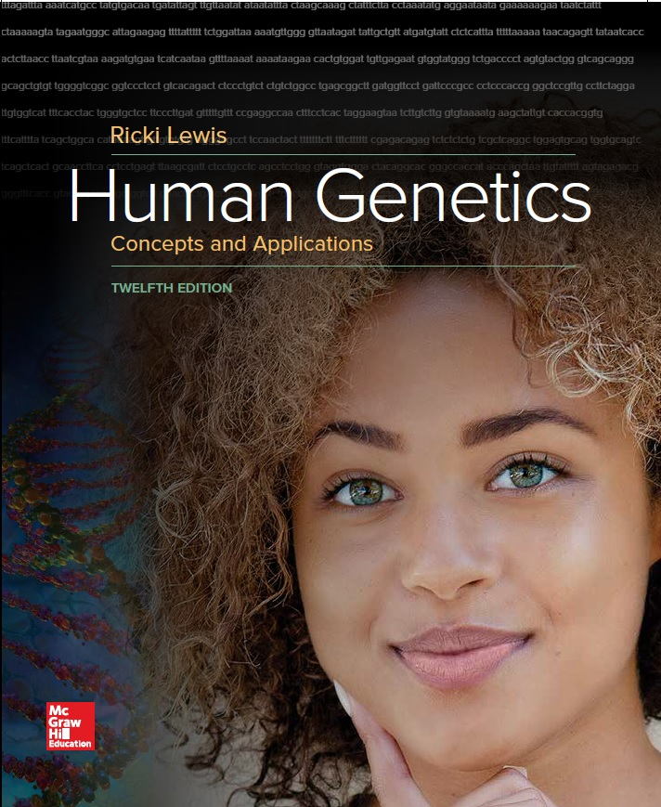
Human Genetics Concepts and Applications
Twelfth Edition
Chapter 3
Meiosis, Development, and Aging Cells
© McGraw-Hill Education. All rights reserved. Authorized only for instructor use in the classroom. No reproduction or further distribution permitted without the prior written consent of McGraw-Hill Education.

Slide 2
Learning Outcomes
Describe the structures of the male and female reproductive systems.
Explain why meiosis is necessary to reproduce.
Summarize the events of meiosis.
List the steps in sperm and oocyte formation.
Describe early prenatal development.
Explain how the embryo differs from the fetus.
Define critical period.
List some teratogens.
Describe common diseases that begin in adulthood.
Explain how rapid aging syndromes occur.

Slide 3
Human Development
Genes orchestrate our physiology after conception through adulthood.
First cell forms when a sperm from a male and an oocyte from a female join.
Sperm and oocytes are gametes.
Each reproductive system has:
Paired structures, called gonads
Tubular structures that transport these cells
Hormones and secretions that control reproduction

Slide 4
The Male Reproductive System (1 of 2)
Sperm cells are made in the seminiferous tubules of the testes.
Sperms mature, stored in the epididymis.
The prostate gland, seminal vesicles, and bulbourethral glands add secretions to form the seminal fluid.
Sperm from each ductus deferens exit through the urethra and out the penis.

Slide 5
The Male Reproductive System (2 of 2)

Slide 6
The Female Reproductive System (1 of 2)
Oocytes mature in the ovaries.
Each month, an ovary releases an oocyte into one of two uterine tubes.
The oocyte is fertilized, it continues to the uterus where it divides and develops.
If it is not fertilized, the body expels it, along with the uterine lining via the menstrual flow.
Hormones control the cycle of oocyte maturation and the preparation of the uterus to nurture a fertilized ovum.

Slide 7
The Female Reproductive System (2 of 2)

Slide 8
Meiosis (1 of 2)
Gametes form from special cells called germ line cells
Cell division that halves the chromosome number
Homologous pairs have the same genes in the same order but carry different alleles, or variants, of the same gene
Gametes are haploid and somatic cells are diploid for each chromosome
Absence of meiosis could lead to genetically overloaded cells
Mixes up trait combinations
Provides genetic diversity which can enable a population to survive an environmental challenge

Slide 9
Meiosis (2 of 2)
Consists of two divisions:
Meiosis I = The reduction division
Reduces the number of chromosomes from 46 to 23
Meiosis II = The equational division
Produces four cells from the two produced in Meiosis I
Note = Each division contains a prophase, a metaphase, an anaphase, and a telophase

Slide 10
Table 3.1 Comparison of Mitosis and Meiosis
Mitosis | Meiosis
One division | Two divisions
Two daughter cells per cycle | Four daughter cells per cycle
Daughter cells genetically identical | Daughter cells genetically different
Chromosome number of daughter cells same as that of parent cell (2n) | Chromosome number of daughter cells half that of parent cell (1n)
Occurs in somatic cells | Occurs in germline cells
Occurs throughout life cycle | In humans, completes after sexual maturity
Used for growth, repair, and asexual reproduction | Used for sexual reproduction, producing new gene combinations
Notes:
Copyright © McGraw-Hill Education. Permission required for reproduction or display.

Slide 11
Overview of Meiosis

Slide 12
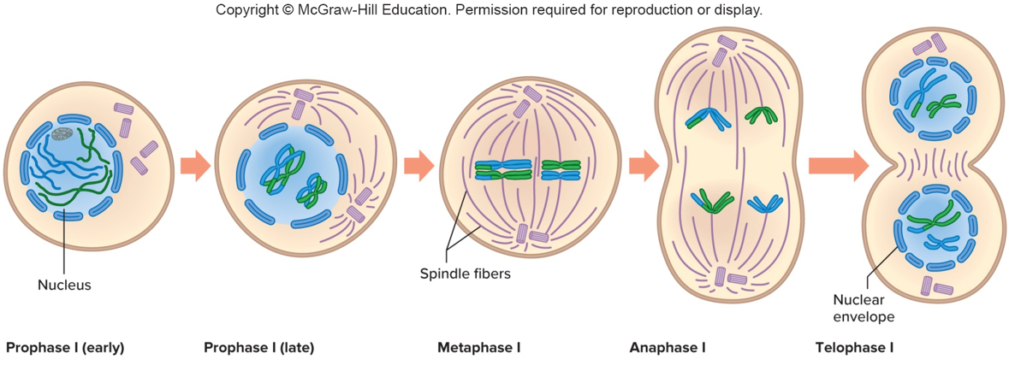
Meiosis I (1 of 2)
Prophase I (early)
Synapsis and crossing over occurs.
Prophase I (late)
Chromosomes condense, become visible. Spindle forms. Nuclear envelope fragments. Spindle fibers attach to each chromosome.
Notes:
Copyright © McGraw-Hill Education. Permission required for reproduction or display.

Slide 13
Meiosis I (2 of 2)
Metaphase I
Paired homologous chromosomes align along equator of cell.
Anaphase I
Homologous chromosomes separate to opposite poles of cell.
Telophase I
Nuclear envelopes partially assemble around chromosomes. Spindle disappears. Cytokinesis divides cell into two.

Slide 14
Prophase I (1 of 2)
A spindle forms.
Homologs pair-up and undergo crossing over.
Chromosomes condense.
Synapsed chromosomes separate but remain attached at a few points.

Slide 15
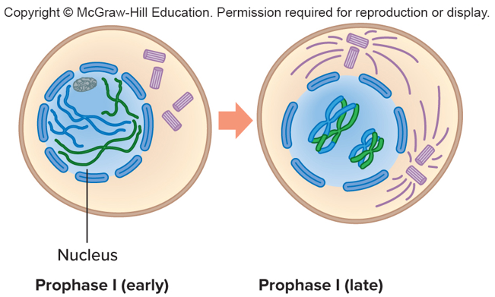
Prophase I (2 of 2)
Prophase I (early)
Synapsis and crossing over occurs.
Prophase I (late)
Chromosomes condense, become visible. Spindle forms. Nuclear envelope fragments. Spindle fibers attach to each chromosome.

Slide 16
Crossing Over

Slide 17
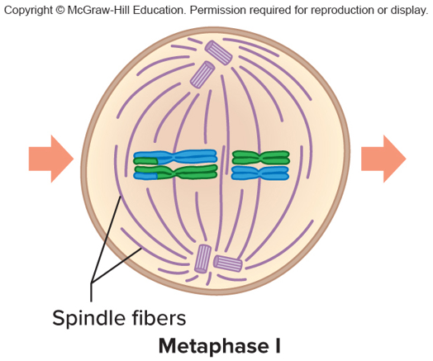
Metaphase I
Homologous pairs align along the equator of the cell.
Random alignment of chromosomes causes independent assortment of the genes that they carry.
Metaphase I
Paired homologous chromosomes align along equator of cell.

Slide 18
Independent Assortment

Slide 19
Anaphase I and Telophase I (1 of 2)
Homologs separate in anaphase I
Move to opposite poles by telophase I
Centromeres of each homolog in meiosis I remain together

Slide 20
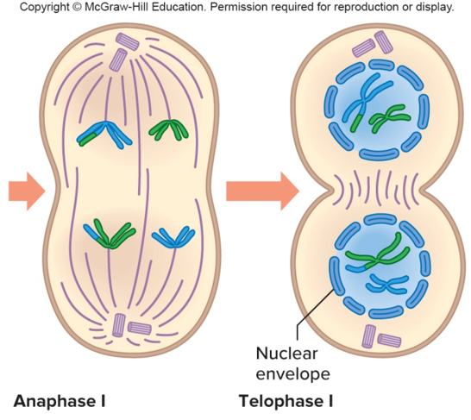
Anaphase I and Telophase I (2 of 2)
Anaphase I
Homologous chromosomes separate to opposite poles of cell.
Telophase I
Nuclear envelopes partially assemble around chromosomes. Spindle disappears. Cytokinesis divides cell into two.

Slide 21
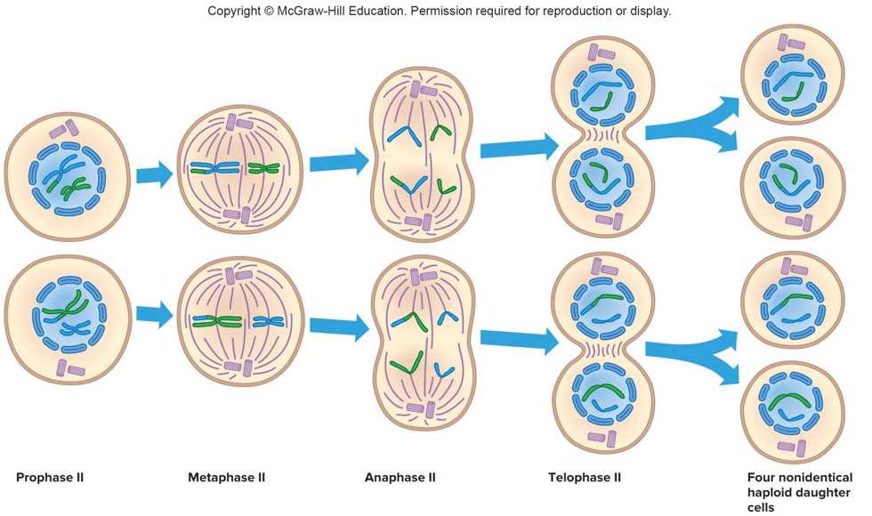
Meiosis II (1 of 2)
Prophase II
Nuclear envelope fragments. Spindle forms and fibers attach to both chromosomes.

Slide 22
Meiosis II (2 of 2)
Metaphase II
Chromosomes align along equator of cell.
Anaphase II
Sister chromatids separate to opposite poles of cell.
Telophase II
Nuclear envelopes assemble around two daughter nuclei. Chromosomes decondense. Spindle disappears. Cytokinesis divides cells

Slide 23
Prophase II and Metaphase II
Chromosomes are again condensed and visible.
Chromosomes align along the equator of the cell.

Slide 24
Anaphase II and Telophase II
Centromeres divide
Newly formed, unreplicated chromosomes, move to opposite poles
Nuclear envelope reforms
Separate into individual cells

Slide 25
Results of Meiosis
Four haploid cells
Each carry a new assortment of genes and chromosomes that hold one copy of the genome

Slide 26
Spermatogenesis (1 of 4)
A diploid spermatogonium divides by mitosis to produce a stem cell and another cell that specializes into a mature sperm.
In meiosis I, the primary spermatocyte produces two haploid secondary spermatocytes.
In meiosis II, each secondary spermatocyte produces two equal-sized spermatids.
Spermatids then mature into a tadpole-shaped spermatozoa.

Slide 27
Spermatogenesis (2 of 4)

Slide 28
Spermatogenesis (3 of 4)

Slide 29
Spermatogenesis (4 of 4)

Slide 30
Paternal Age Effect (1 of 2)
“Paternal age effect” conditions arise from stem cells in the testis that divide every 16 days, from puberty on, offering many opportunities for dominant DNA mutations.
Mutations in the fibroblast growth factor receptor (FGFR) arise more frequently in the testicles as a man ages.
This skews meiosis, producing problems in skeletal growth.

Slide 31
Paternal Age Effect (2 of 2)
Table 3.2 Paternal Age Effect Conditions
Disease | Phenotype
Achondroplasia | Short-limbed dwarfism (see figure 5.1a)
Crouzan syndrome | Premature fusion of skull bones in infancy, causing wide-spaced and bulging eyes, beaked nose, short upper lip, small upper jaw, and jutting lower jaw
Multiple endocrine neoplasia 2 | Cancers of thyroid, parathyroid, and adrenal glands
Pfeiffer syndrome | Premature fusion of skull bones in infancy, short and fused fingers and toes
Thanatophoric dysplasia | Severe short-limbed dwarfism
Notes:
Copyright © McGraw-Hill Education. Permission required for reproduction or display.

Slide 32
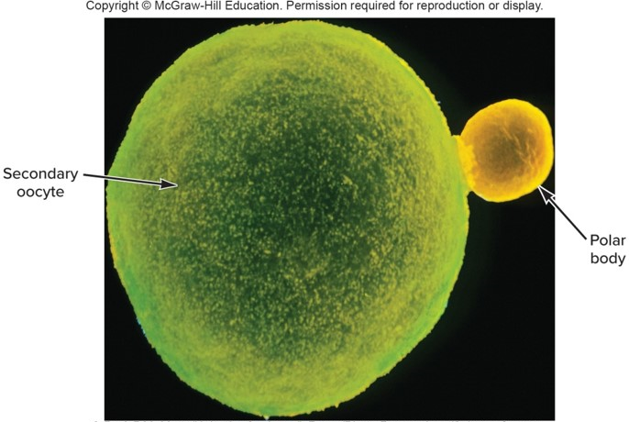
Oogenesis (1 of 4)
Begins with a diploid oogonium
In meiosis I, primary oocyte divides unequally forming a small polar body and a large secondary oocyte
In meiosis II, the secondary oocyte divides to form another polar body and a mature ovum
© Prof. P.M. Mottza/Univ. “La Sapienza”, Rome/Photo Researchers/Science Source

Slide 33
Oogenesis (2 of 4)
Unlike spermatogenesis, oogenesis is a discontinuous process.
Oocytes arrest at prophase I until puberty.
After puberty, meiosis I continues in one or several oocytes each month but halts again at metaphase II.
Meiosis is only completed if the ovum is fertilized.

Slide 34
Oogenesis (3 of 4)

Slide 35
Oogenesis (4 of 4)

Slide 36
Prenatal Human
Considered an embryo for the first 8 weeks
From the start of week 9 until birth it is a fetus

Slide 37
Fertilization (1 of 2)
Union of sperm and oocyte
In the female, sperm are capacitated and drawn to the oocyte
Acrosomal enzymes aid sperm penetration
Chemical and electrical changes in the oocyte surface block entry of more sperm
Two genetic packages meet and merge, forming a zygote

Slide 38
Fertilization (2 of 2)

Slide 39
Cleavage
A period of frequent mitotic divisions
Resulting early cells are called blastomeres
Developing embryo becomes a solid ball of 16+ cells called a morula
The ball of cells hollows out to form a blastocyst

Slide 40
Blastocyst
Inner cell mass develops into the embryo.
Trophoblast secrete human chorionic gonadotropin that prevents menstruation.
A sign of pregnancy
Implantation in the uterus occurs around day 7.

Slide 41
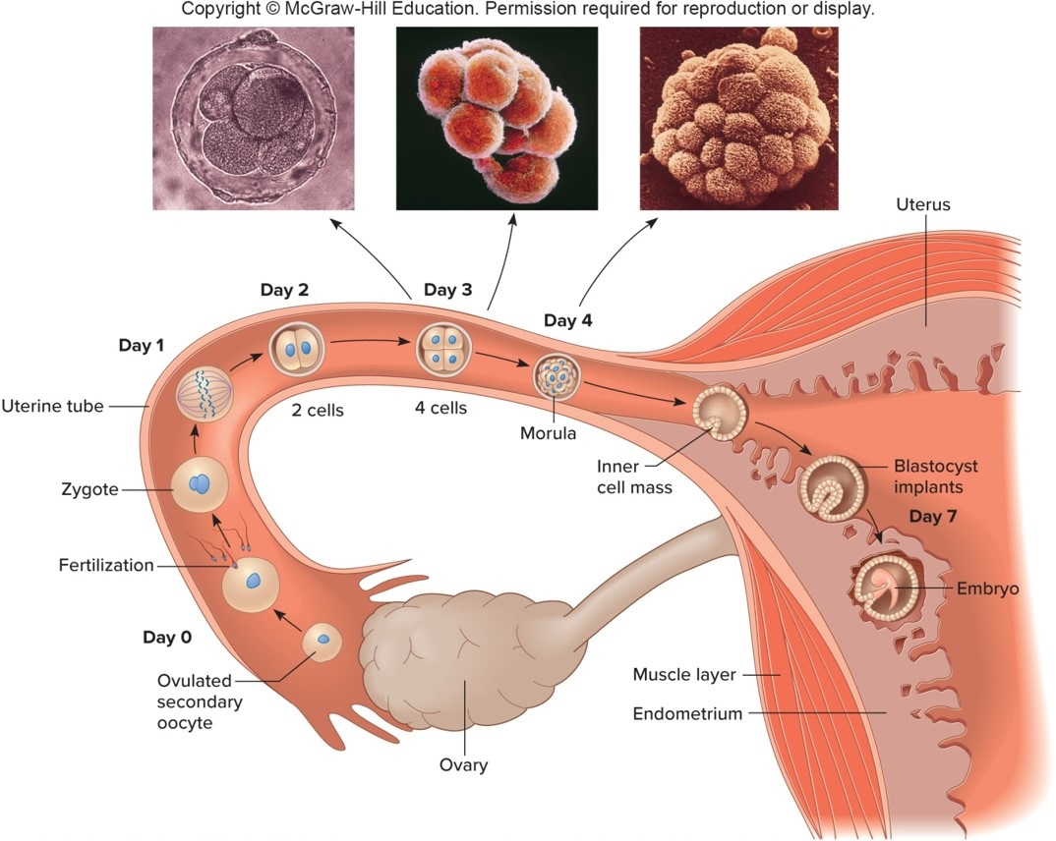
From Ovulation to Implantation
(left): © Petit Format/Nestle/Photo Researchers/Science Source; (middle): © P.M. Motta & J. Van Blerkom/SPL/Science Source; (right): © Petit Format/Nestle/Photo Researchers/Science Source

Slide 42
Embryo Formation
The primary germ layers form in the 2nd week after fertilization:
Ectoderm (outermost layer)
Mesoderm (middle layer)
Endoderm (innermost layer)
This three-layered structure is the gastrula
Cells in each layer begin to form specific organs controlled by homeotics

Slide 43
Supportive Structures
Structures that support and protect the embryo include:
Chorionic villi
Yolk sac
Allantois
Umbilical cord
Amniotic sac
By 10 weeks the placenta is fully formed

Slide 44
The Primordial Embryo

Slide 45
Stages of Early Prenatal Development
Table 3.3 Stages and Events of Early Human Prenatal Development
Stage | Time Period | Principal Events
Fertilized ovum | 12 to 24 hours following ovulation | Oocyte fertilized; zygote has 23 pairs of chromosomes and is genetically distinct
Cleavage | 30 hours to third day | Mitosis increases cell number
Morula | Third to fourth day | Solid ball of cells
Blastocyst | Fifth day through second week | Hollowed fluid-filled ball forms trophoblast (outside) and inner cell mass; which implants and flattens to form embryonic disc
Gastrula | End of second week | Primary germ layers form
Notes:
Copyright © McGraw-Hill Education. Permission required for reproduction or display.

Slide 46
Multiple Births
Dizygotic twins (Fraternal)
Two sperm fertilize two oocytes
Same genetic relationship as any two siblings
Monozygotic twins (Identical)
Arise from a single fertilized ovum
Three types of MZ twins can form, depending upon when the fertilized ovum or very early embryo splits
Exposed to slightly different uterine environments

Slide 47
Types of Identical Twins

Slide 48
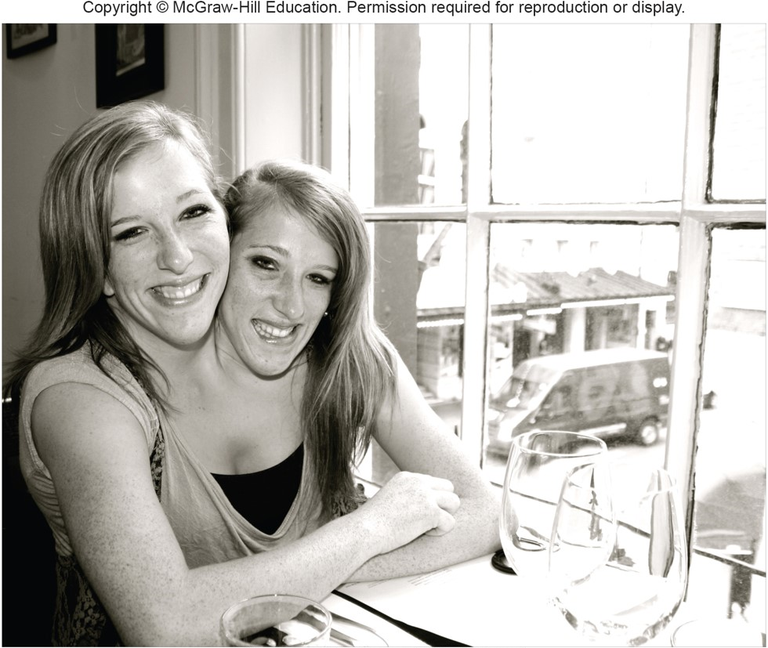
Conjoined Twins
Courtesy of Brittany and Abigail Hensel

Slide 49
The Embryo Develops (1 of 2)
Organogenesis is the transformation of the simple three germ layers into distinct organs
During week 3, a band called the primitive streak appears along the back of the embryo
Followed by the connective tissue progenitor cells, notochord, neural tube, heart, central nervous system, arms, legs and other organ rudiments
By week 8, all the organs that will be present in the newborn have begun to develop

Slide 50
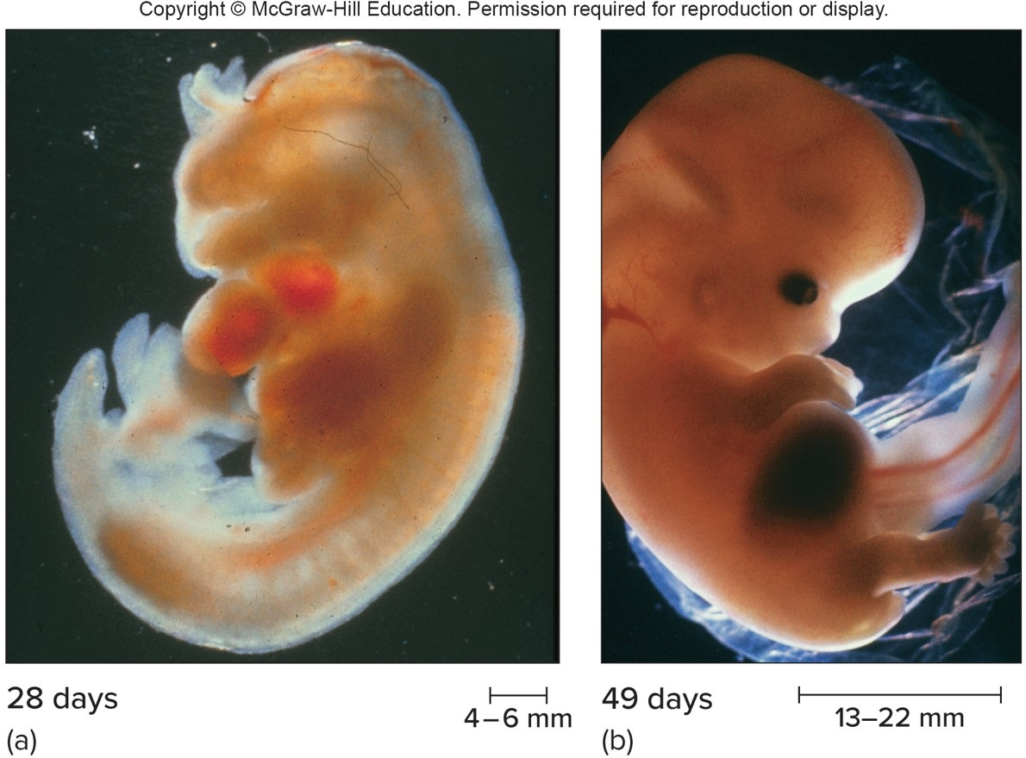
The Embryo Develops (2 of 2)
a: © Petit Format/Nestle/Photo Researchers/Science Source; b: © Petit Format/SPL/Photo Researchers/Science Source

Slide 51
The Fetus Grows (1 of 2)
During the fetal period, body proportions approach those of a newborn
Bone replaces softer cartilage
Nerve and muscle functions become coordinated
Sex organs become more distinct by week 6
By week 12, sucks thumb, kicks, makes fists and faces, and has the beginnings of teeth

Slide 52
The Fetus Grows (2 of 2)
Vocal cords will be formed by 18 weeks.
By the end of the second trimester, the woman feels distinct kicks and jabs and may detect fetal hiccup.
In the final trimester, fetal brain cells link into networks as organs elaborate and grow, and fat fills out the skin.
The digestive and respiratory systems mature last.

Slide 53
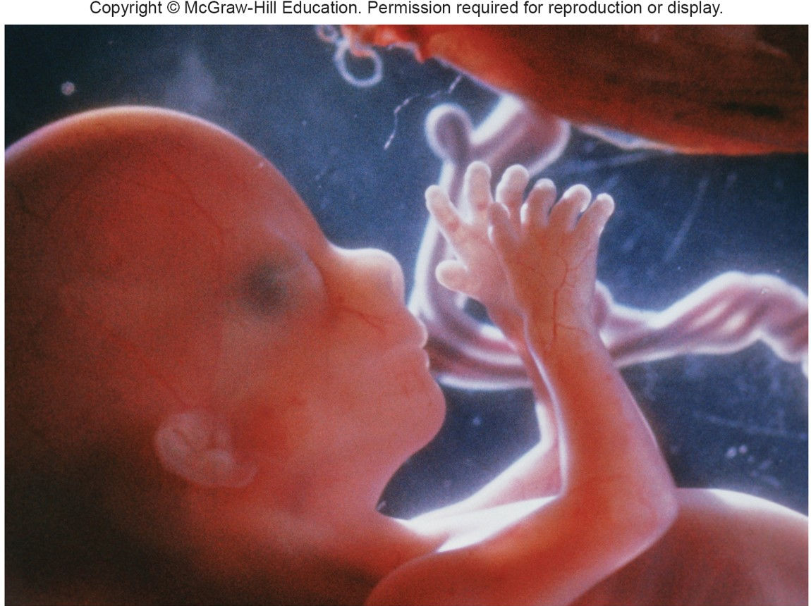
16-Week Fetus
© Nestle/petit Format/Science Source

Slide 54
Birth Defects
Time when genetic abnormalities, toxic substances, or viruses can alter a specific structure is critical period
Most birth defects develop during the embryonic period
More severe than those that arise during the fetal period
Some defects can be attributed to an abnormal gene

Slide 55
Critical Periods of Development

Slide 56
Teratogens
Chemical or other agents that cause birth defects
Cause of birth defects due to exposure to a drug depend upon a woman’s genes
Examples:
Thalidomide
Cigarettes and alcohol
Nutrients—Vitamins
Occupational hazards
Viral infections

Slide 57
Fetal Alcohol Syndrome

Slide 58
Birth Defects Due to Viruses
Viruses are small enough to cross the placenta and reach a fetus.
Some viruses that cause mild symptoms in an adult, such as the chicken pox virus, may devastate a fetus.
Men can transmit viral infections during sexual intercourse.
The Zika virus is carried in the semen.
The Zika virus can cause microcephaly.

Slide 59
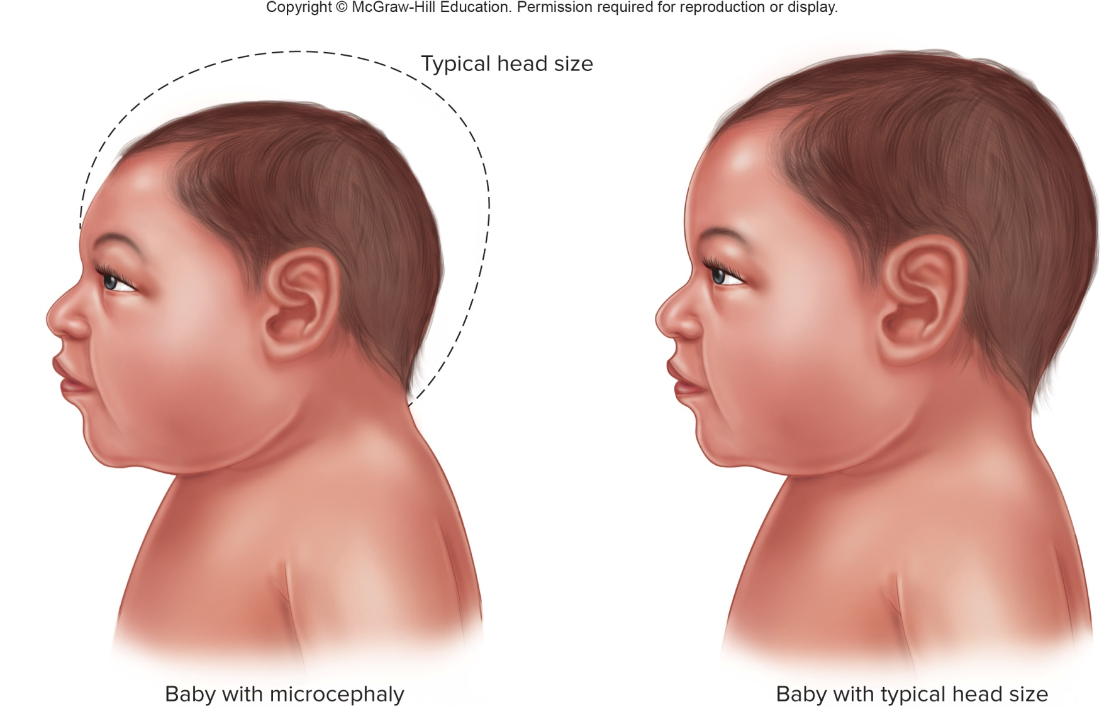
Zika Virus Birth Defects

Slide 60
Aging—Adult-Onset Inherited Disorders
Genes may impact health throughout life.
Environmental factors can affect how certain genes can create risks that appear later.
Single-gene disorders that strike in childhood tend to be recessive.
Dominantly inherited conditions affect health in early to middle adulthood.

Slide 61
Disorders That Resemble Accelerated Aging
Genes control aging both passively and actively.
Most severe rapid aging disorders are the segmental progeroid syndromes, vary in severity.
Hutchinson-Guilford pregoria syndrome

Slide 62
Table 3.4 Premature Aging Syndromes
Disease | Incidence | Average Life Span
Ataxia telangiectasia | 1/60,000 | 20
Cockayne syndrome | 1/100,000 | 20
Hutchinson-Gilford progeria syndrome | <1/1,000,000 | 13
Rothmund-Thomson syndrome | <1/100,000 | Normal
Trichothiodystrophy | <1/100,000 | 10
Werner syndrome | <1/100,000 | 50
Notes:
Copyright © McGraw-Hill Education. Permission required for reproduction or display.

Slide 63
Is Longevity Inherited?
Aging reflects genetic activity and a lifetime of environmental influences
Families and genetically isolated populations with many aged members have:
Gene variants
Shared environmental influences
Genome comparisons among centenarians to others are revealing genes that influence longevity

Slide 64
Table 3.5 Longevity Genes
Gene | Protects Against | Population Studied
Apoliprotein C3 (APOC-3) | Hypertension, diabetes | Ashkenazi Jews
 | Cardiovascular disease | Amish
Bitter taste receptor (TAW2R16) | Poisoning, digestive problems | Calabria, Italy
Cholesteryl ester transfer protein (CETP) | Cardiovascular disease | Ashkenazi Jews
Forkhead box O3 (FOXO3) | Cancer, cardiovascular disease | Japanese-Americans
Growth hormone receptor (GHR) | Diabetes, cancer | Ecuador, Israel
Uncoupling proteins (UCP 2, 3, 4) | Oxidative damage, poor energy use | Calabria, Italy
Notes:
Copyright © McGraw-Hill Education. Permission required for reproduction or display.

Slide 65
End of Presentation

