Slide 1
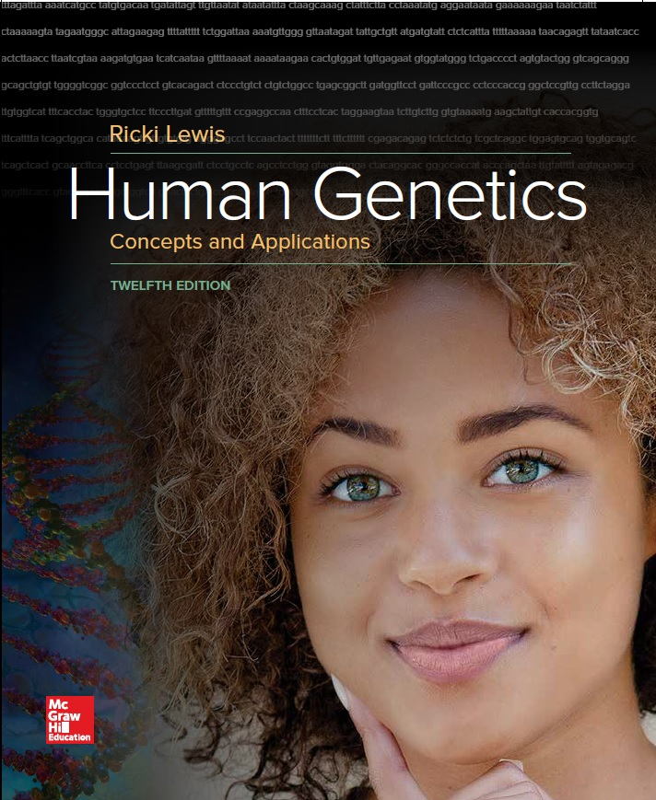
Human Genetics Concepts and Applications
Twelfth Edition
Chapter 1
What Is in a Human enome?
© McGraw-Hill Education. All rights reserved. Authorized only for instructor use in the classroom. No reproduction or further distribution permitted without the prior written consent of McGraw-Hill Education.

Slide 2
Learning Outcomes (1 of 2)
Explain what genetics is, and what it is not.
Distinguish between gene and genome.
Define bioethics.
List the levels of genetics.
Explain how DNA is maintained and how it provides the information to construct a protein.
Explain how a mutation can cause a disease.
Define exome.
Distinguish between Mendelian and multifactorial traits.
Explain how genetics underlies evolution.
List some practical uses of DNA information.

Slide 3
Learning Outcomes (2 of 2)
Explain how DNA information can be considered with other types of information to learn about maintaining health and treating disease.
Distinguish between traditional breeding and genetically modifying organisms.
Describe a situation in which exome sequencing can be useful.
Explain how investigating genomes extends beyond interest in ourselves.

Slide 4
What Is Genetics?
It is the study of inherited traits and their variation.
Certain difficult-to-define human characteristics might appear to be inherited if they affect several family members, but may reflect shared genetic and environmental influences.
It can be considered at several levels, from DNA, to genes, to chromosomes, to genomes, to individuals, to families and populations.

Slide 5
Genes (1 of 2)
Units of heredity
Biochemical instructions that tell cells how to manufacture certain proteins
Consists of deoxyribonucleic acid (DNA)
Traits are produced by an interaction between genes and their environment

Slide 6
Genes (2 of 2)
Alleles are variants of genes
Changes in DNA sequence that distinguish alleles arise by mutation
Mutations in sperm or egg cells are passed on to the next generation
Mutations may be positive, negative, or neutral

Slide 7
The Genome
Is the complete set of genetic instructions characteristic of an organism
Includes protein-encoding genes and other DNA sequences
Genomics is a field that analyzes and compares genomes of different species

Slide 8
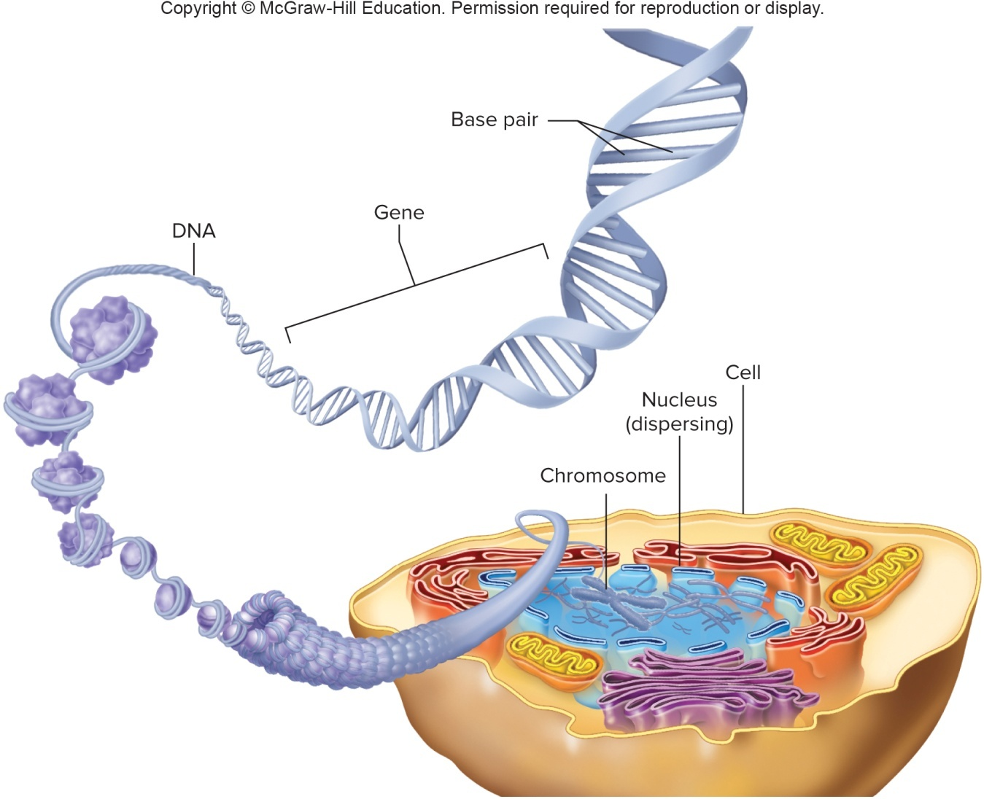
Levels of Genetics

Slide 9
Bioethics
Addresses moral issues and controversies that arise in applying medical technology
Bioethicists confront concerns that arise from new genetic technology

Slide 10
Deoxyribonucleic Acid (DNA)
Components:
Phosphate
Sugar
Base: Adenine (A) Thymine (T) Cytosine (C) Guanine (G)
Each consecutive three DNA bases is a code for a particular amino acid

Slide 11
The DNA Double Helix

Slide 12
Ribonucleic Acid (RNA)
Produced by transcription process
Copies the sequence of part of one strand of a DNA molecule into a related molecule
Three RNA bases in a row attract another RNA that functions as a connector, bringing in a particular amino acid
Amino acids align to form a protein

Slide 13
From Gene to Protein to Person
DNA is transcribed into messenger RNA.
Messenger RNA is translated when three of its RNA bases attract another type of RNA that functions as a connector, bringing in a particular amino acid.
The amino acids align and link like snap beads, forming a protein.

Slide 14
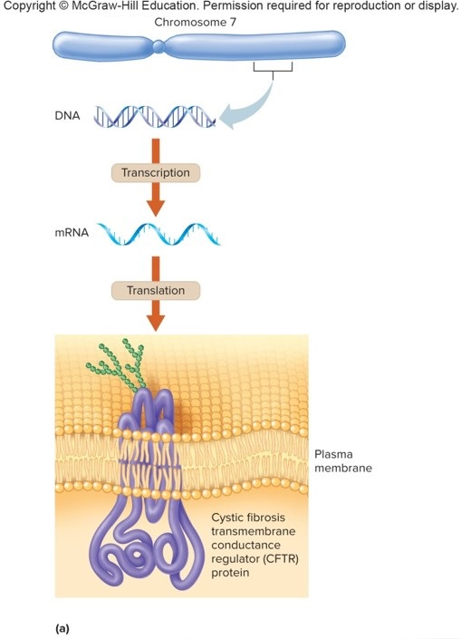
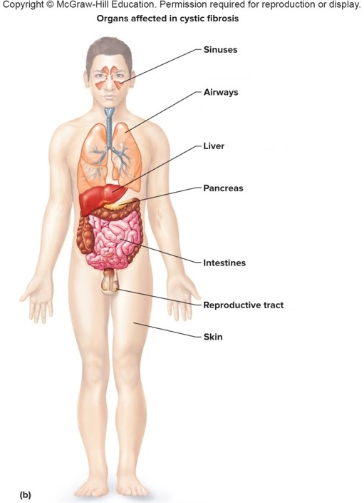
The Language of Life: DNA to RNA to Protein (1 of 3)
Source: Data from “Reverse genetics and cystic fibrosis” by M. C. lannuzi and F. S. Collins. American Journal of Respiratory Cellular and Molecular Biology 2:309-316 [1990]

Slide 15
The Language of Life: DNA to RNA to Protein (2 of 3)
Organs affected in cystic fibrosis
Sinuses
Inflammation, infection, and polyps.
Airways
Mucus-clogged bronchi and bronchioles. Respiratory infections.
Liver
Blocked small bile ducts impair digestion.
Pancreas
Blocked ducts prevent release of digestive enzymes, impairing digestion. Diabetes is possible.

Slide 16
The Language of Life: DNA to RNA to Protein (3 of 3)
Intestines
Hard stools may block intestines.
Reproductive tract
Absence of ductus deferens.
Skin
Salty sweat.

Slide 17
The Human Genome
Only 1.5% of our DNA encodes protein
About 20,325 protein-encoding genes, DNA sequences comprise the exome
Genes known to cause disorders or traits are cataloged in a database
Online Mendelian Inheritance in Man (OMIM)
Annotation—Ongoing effort to understand what individual genes do

Slide 18
Chromosomes
Composed of DNA and protein
A human somatic cells have 23 pairs of chromosomes
22 pairs of autosomes
A pair of sex chromosomes
Females have two X chromosomes
Males have one X and a Y

Slide 19
Mutation
A mutation can alter a protein, causing symptoms.
The condition Cystic Fibrosis is caused by a mutation in the CFTR gene.
The mutation causes the replacement of the amino acid glycine with aspartic acid at a specific site.
This alters the CFTR protein, leading to Cystic Fibrosis.

Slide 20
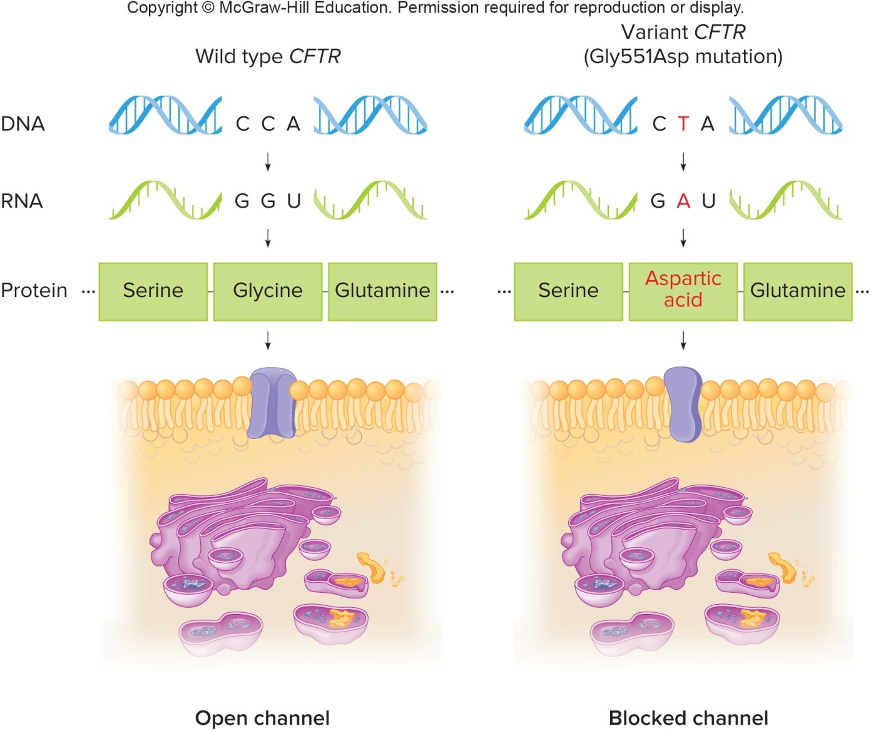
Mutation of Cystic Fibrosis

Slide 21
Traits
Mendelian traits are caused by a single gene.
Multifactorial traits are determined by one or more genes and environmental factors.

Slide 22
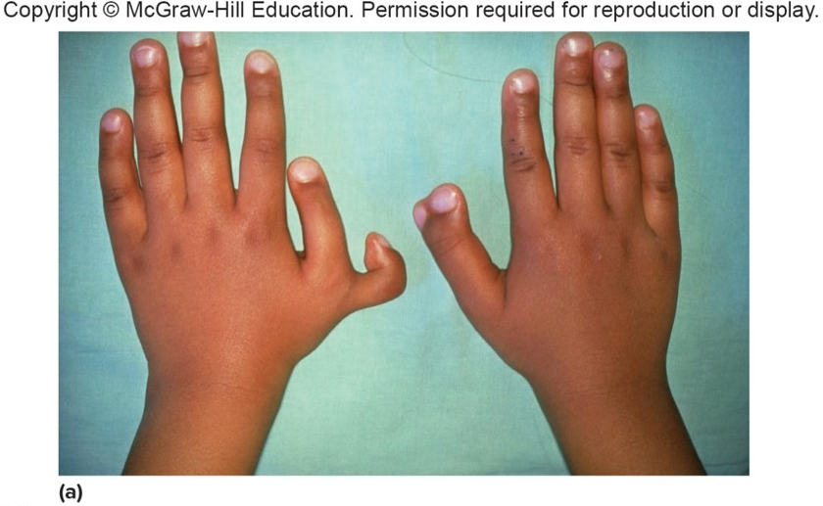
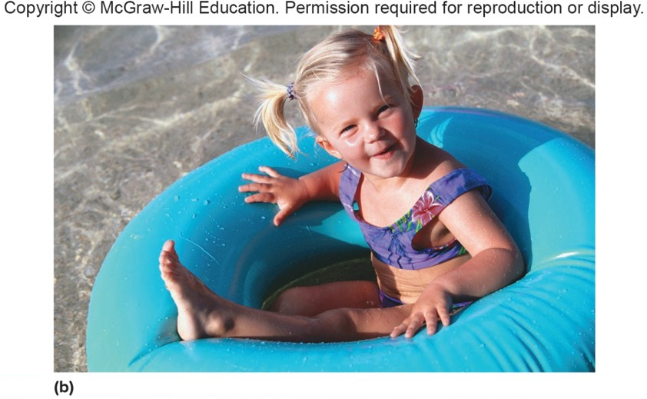
Mendelian Versus Multifactorial Traits
a: © Lester V. Bergman/Getty Images
b: © Steve Mason/Getty RF

Slide 23
Cells
A human body contains approximately 37 trillion cells.
All cells except RBCs contain the entire genome.
Use of different subsets of genes to manufacture proteins drives differentiation of distinctive cell types.
Stem cells are less specialized and provide a reserve supply of cells.

Slide 24
Individual
Genotype refers to the alleles present
Phenotype is the visible trait
Dominant allele is expressed if the individual carries just one copy
Recessive allele must be present on both chromosomes of a pair to be expressed

Slide 25
The Family
Individuals are genetically connected into families.
Charts called pedigrees depict the members of a family.
Indicate which individuals have particular inherited traits

Slide 26
A Population
Is a group of individuals that can have healthy offspring together
The gene pool is the sum of all alleles in a population
Evolution is the changing allelic frequencies in populations over time

Slide 27
Evolutiaon
Evolution of species and family patterns of inherited traits show divergence from shared ancestors.
Genome comparisons among species reveals evolutionary relationships.
The more similar the sequences are, the more recent the divergence from a common ancestor.
98% of human DNA sequences are shared with chimpanzees.

Slide 28
Applications of Genetics
Genetics impacts many areas of our lives.
DNA profiling compares DNA sequences among individuals to establish or rule out identity, relationships, or ancestry.
In the field of conservation genomics, tiny amounts of DNA in fur, feathers, or feces of rare or elusive species is used to sequence their genomes and learn more about the species.

Slide 29
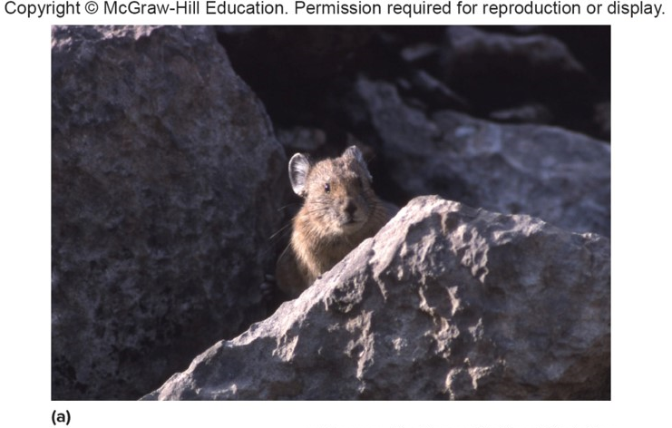
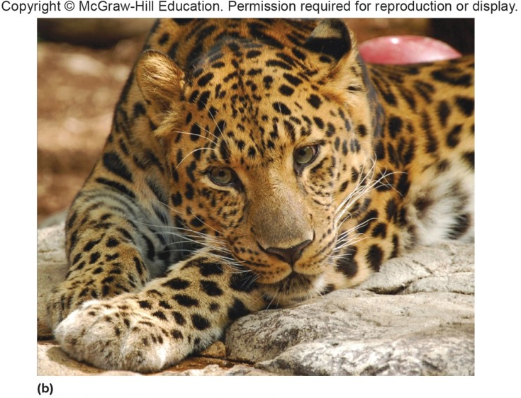
Conservation Genomics
a: Source: Jim Peaco/National Park Service
b: © Destinyweddingstudio/Shutterstock

Slide 30
Application of Genetics—DNA Profiling
Identification of victims of natural disasters or terrorist attacks
Matching the DNA of suspects to samples left at the crime scene
Helping adopted individuals locate blood relatives

Slide 31
Applications of Genetics—History and Ancestry
DNA analysis can clarify details of history
Revealing the offspring of Thomas Jefferson and Sally Hemmings
Provide views into past epidemics by detecting genes of the pathogens
Revealed the presence of malaria in the analysis of DNA of king Tutankhamun’s mummy

Slide 32
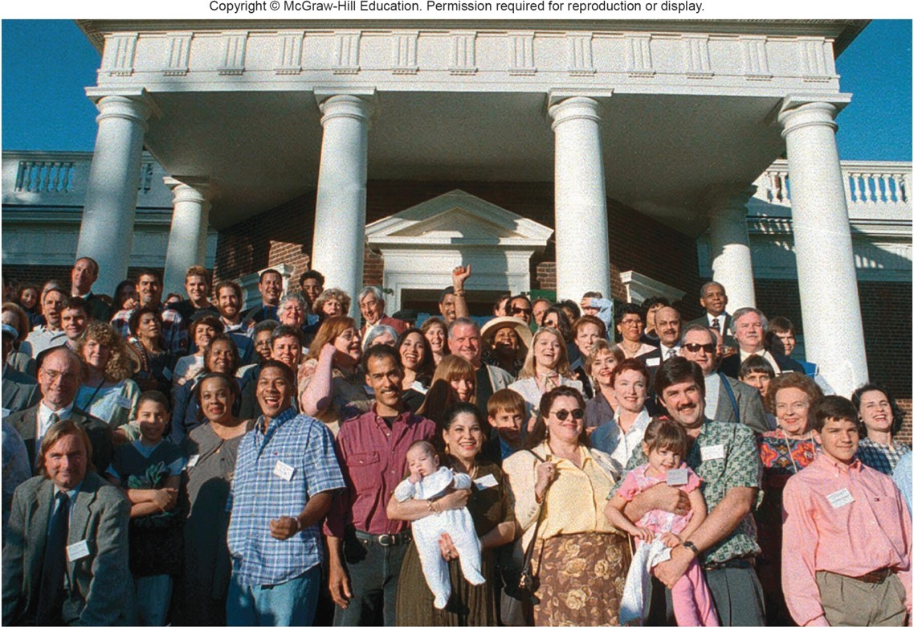
History and Ancestry
© Leslie Close/AP Images

Slide 33
Health Care (1 of 2)
Diseases are viewed as the consequence of complex interactions among genes and environmental factors.
Some people are more susceptible to contracting certain infections than others due to inherited differences in immunity.
Genes affect how people respond to particular drugs.
Pharmacogenomics is a field that identifies individual drug reactions based on genetics.

Slide 34
Health Care (2 of 2)
Gene expression refers to whether a gene is turned on or off from being transcribed and translated into protein.
Tracking gene expression can reveal new information about diseases and show how diseases are related to each other.
Precision medicine is a medical approach that consults DNA information to select drugs that are most likely to work and have the least side effects in a particular individual.
This medical approach examines the individual’s genome, diet, exercise, environment, and microbiome.

Slide 35
The Microbiome
The microbiome is the symbiotic relationship between an individual’s genome, diet, lifestyle factors, and the many microbes in the body.

Slide 36
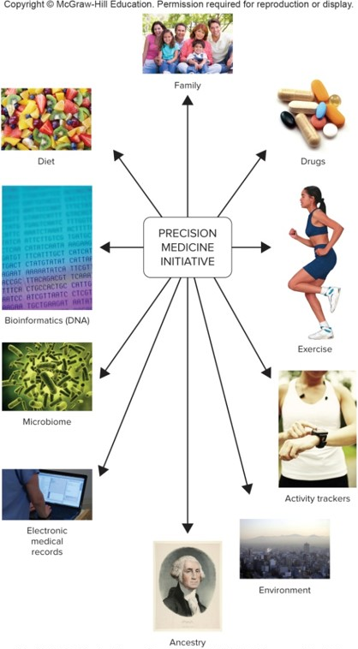
Precision Medicine
(Family): © Stockbroker/Alamy; (Drugs): © Dan Wilkie/Getty Images; (Exercise): © Glyn Jones/Corbis; (Activity trackers): © Disuke Martis /Getty Images; (Environment): © Phototreat/Getty Images; (Ancestry): Courtesy Yale University Library; (Electronic medical records): © McGraw-Hill Higher Education, Inc.; (Microbiome): © Disuke Martis/Getty Images; (Bioinformatics (DNA)): © Getty/ Stockphoto;(Diet): © Babaz/Shutterstock

Slide 37
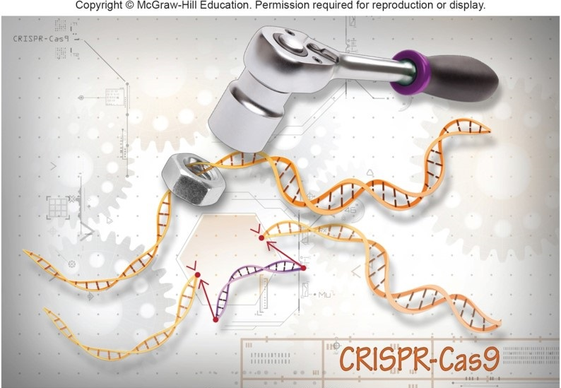
Genome Editing
Ernesto del Aguilo, III, NHGRI
Genome editing is a newer technology that is used to remove, replace, and or add specific genes into the cells of any organism.

Slide 38
Exome Sequencing
It determines the order of DNA bases of all parts of the genome that encode proteins.
The exome consists of approximately 20,325 genes.
The information is compared to databases that list many variants (alleles) and their associations with specific phenotypes, such as diseases.

Slide 39
Global Perspective on Genomes (1 of 2)
Metagenomics is a field that involves sequencing all of the DNA in a habitat.
Shows how species interact, and may yield new drugs and reveal novel energy sources
Described life in the Sargasso Sea
Several projects are exploring biodiversity with DNA tags to bar-code species.

Slide 40
Global Perspective on Genomes (2 of 2)
Social issues that parallel scientific progress
Equal access to genetic tests and treatments
Misuse of genetic information
Abuse of genetics to cause harm
Genetics and genomics are spawning technologies that may vastly improve the quality of life

Slide 41
A Global Perspective
Human genome information has tremendous potential for the entire globe.
World organizations are discussing how nations can share new diagnostic tests and therapeutics.
Individual nations are adopting guidelines to use genetic information to suit their strengths.

Slide 42
End of Presentation

