Slide 1
Number
Male Ratio .515
Female Ratio .527
2016 Ratio: Trunk : Height

Slide 2
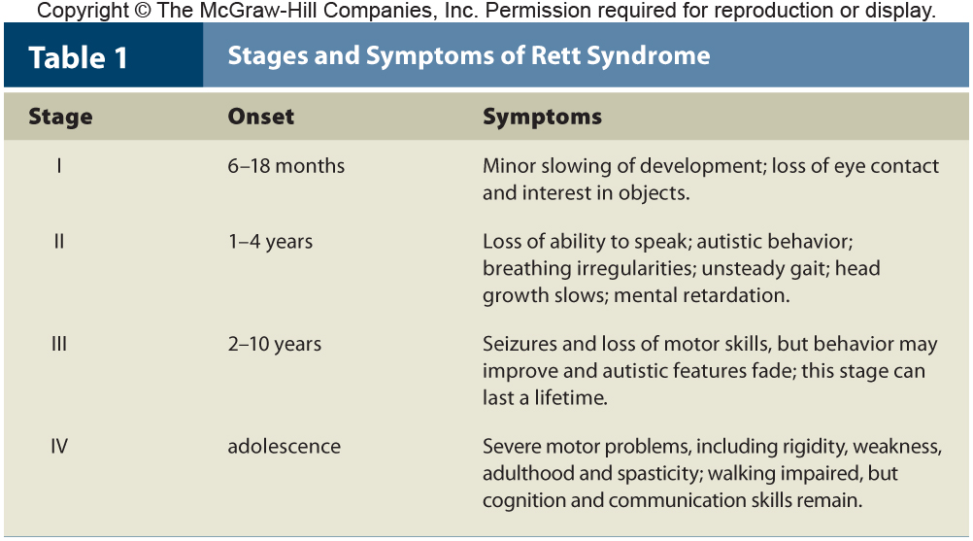
Rett Syndrome-Sex Linked?
Dominant-
Not passed from Parent to child
Gene mutates in sperm or
Mother passed the gene but did not express it.

Slide 3
Gout-(Unwalkable disease)
Uric Acid build up
3 SNP associated with gout
Genes affect kidneys ability to excrete uric acid
All six genes-8 to18 percent risk

Slide 4
Chronic Fatigue Syndrome
Too Little stress hormone cortisol
Too much serotonin-sleepy
3 genes associated with syndrome

