Slide 1
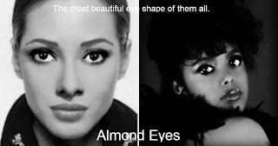
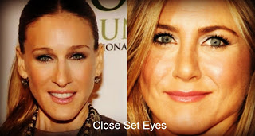
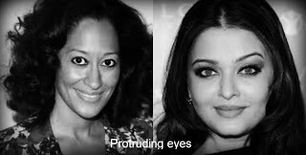
Eye Characteristics
Eye Size: Large, medium, small
Distance apart: Close, medium, wide
Shape: Almond, round
Lid: fold, hooded, monolid
Slantedness: straight, up, down.

