Slide 1
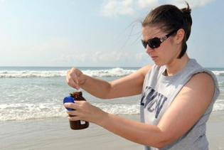
 | UNCW Exchange Student Pre-Arrival Checklist
Done | Date | Action
 | 15-Mar | Submit Course Requests
 | SOON | Schedule Visa Appointment
 | Anytime | Connect with other students
 | Anytime | Packing suggestions
 | 1-May | Reserve on-campus housing
 | 1-May | Request a student mentor (optional)
 | 1-May | Request a host family (optional)
 | May 1 - Continuing | Regularly check UNCW email
 | May 23 - June 10 | Select Meal Plan
 | 1-Aug | Request Airport Pick-up
 | 1-Aug | Submit Immunization Form
 | 1-Aug | Purchase or Waive UNCW health Insurance
 | 18-Aug | Move-in to your on-campus housing
 | August 19 - 20 | Attend exchange student orientation
 | 29-Aug | Pay UNCW bills
 | See also My Important Info (pg. 2) & My Login Screens (pg. 3)

Slide 2
My Important Info
Name
UNCW ID number
Email address |  |  | @uncw.edu
DOB-PIN
On-Campus room assignment
Postal Address
 | UNCW Station CB#
 | 601 S. College Rd.
 | Wilmington, NC 28403
 | USA
See also My Pre-Arrival Checklist (pg. 1) and My login Info (pg. 3)

Slide 3
My Login Screens – Password Reminders
OWA – Outlook Web Access
Use Outlook Web Access to view your email and write to your professors and peers. Email is also available through mySeaport.
my Seaport
Use mySeaport to view campus announcements, class announcements, and housing information. Email and Seanet is also available through mySeaport.
SeaNet
Use Seanet to view your class schedule, check your bills, view your student records, register for courses, and Financial Aid.
SeaNet can also be accessed through mySeaport.
International Services Online Forms
Used for forms relating to UNCW International Programs, request airport pick-up, request a host family, student mentor, etc.

