Slide 1
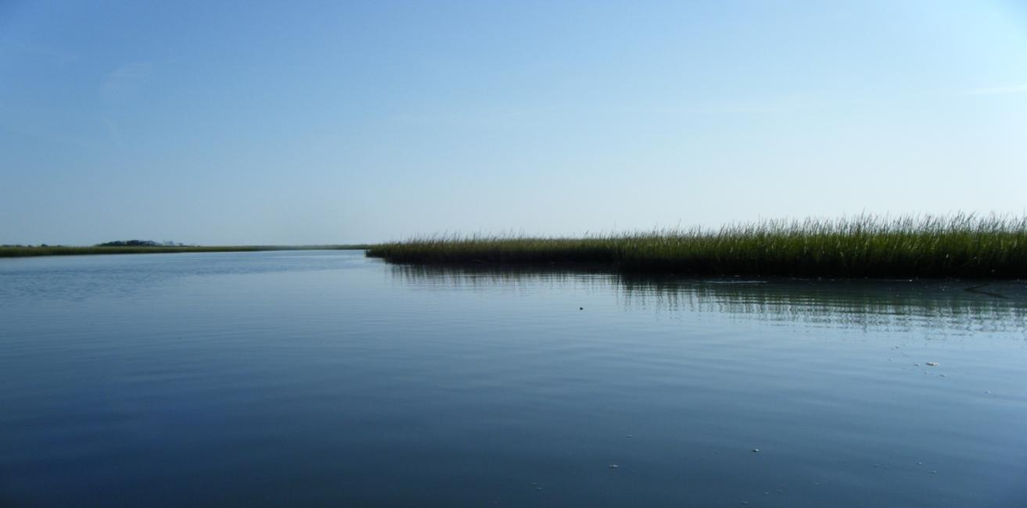
Use of Headcount Surveys to Estimate the Relative Abundance of Diamondback Terrapins (Malaclemys terrapin centrata) at Masonboro Island, North Carolina
April Alford Final Project 595

Slide 2
Overview
Introduction to Diamondback Terrapins
Visual Encounter Surveys
Methods and Site Significance
Results
Discussion
Future Research
Notes:
Brief overview of Presentation:
Brief introduction to Diamondback Terrapins. I will not go into all the characteristics of terrapins. I will just give the highlights.
Introduce Visual Encounter Surveys and there significance
Methods and Site Significance of Masonboro Island
Results of the study
Discussions
Areas for future research

Slide 3
Introduction to Diamondback Terrapins
Adapted to survive in salt marsh and estuarine habitats
Home range extends from MA to TX
Life span of at least twenty years
Exhibit sexual dimorphism
Females may lay two clutches per season
Strong site fidelity
Notes:
Diamondback terrapins are the only North American turtles that are specifically adapted to survive in salt marsh and estuarine habitats.
Their home range extends as far North as Massachusetts and as far south as Texas
Terrapins have a life span of at least twenty years, with some researchers expecting that they can live beyond forty years.
Terrapins exhibit sexual dimorphism with females weighing three to four times more than males. Females also have larger heads and smaller more narrow tails. Females also reach sexual maturity later in age than males.
Nesting occurs from April through July and females may lay two clutches per season with varying clutch sizes.
Exhibit strong site fidelity meaning they stay close to home or have a small home ranges.

Slide 4
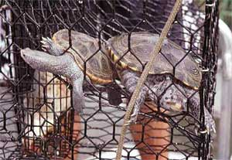
Threats to Diamondback Terrapins
Human consumption
Habitat degradation
Mortality associated with recreational and commercial crab pots
Nest predation
Wetlands Institute
Notes:
There are a variety of factors that led to the decline of the diamondback terrapin.
Terrapins were a major protein sources for the Continental Army and for slaves in tidewater plantations. In the late 1800’s terrapin soup became very popular and you can find recipes for it in old cookbooks. This led to the creation of mass harvesting operations and by the beginning of the 20th century many local populations were extinct. Prohibition significantly reduced consumer demand because sherry is an important component of the soup.
Habitat Degradation has reduced terrapin populations. More humans want to live at the coast ever year resulting increased coastal development. Female terrapins are forced to cross busy roads in search of suitable areas to nest. Roger Wood and Rosalind Herlands documented that 4,020 terrapins were killed on Cape May Peninsula, NJ from 1989 to 1995.
Terrapins have also declined due to mortality associated with commercial and recreational crab pots. Terrapins enter crab pots for food or to follow other terrapins and are unable to exit. Crab pots must be monitored frequently to prevent terrapins from drowning. Crowder et al. found from his research that terrapins could survive in a crab pot without air for a maximum of 5 hrs. Ghost crab pots (abandoned crab pots) are the most detrimental to terrapins because they are never monitored and therefore have a high mortality rate. Dorcas et al. (2007) conducted a mark/recapture study in S.C and concluded that crab pots alter the sex ratio and age distribution of terrapins by catching mostly juveniles and adult males.
4. Terrapins are also threatened due to nest predation. Raccoons and foxes eat terrapin eggs.

Slide 5
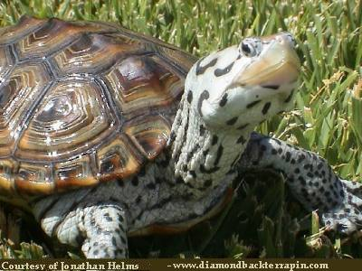
Carolina Terrapin (Malaclemys terrapin centrata)
Ranges from Cape Hatteras, NC to Northern Florida
Listed as a species of special concern in NC
Long-term population data is needed
Notes:
There are seven subspecies of diamondback terrapins that are characterized by dissimilarities in carapace morphology and body coloration. Diamondback terrapin subspecies, Carolina terrapin also known as Southern Diamond (Malaclemys terrapin centrata) ranges from Cape Hatteras N.C to Northern Florida.
In NC the carolina terrapin is listed as a species of special concern because long-term population data is lacking in many areas of the state.
Mark/recapture data is needed to assess Carolina terrapin population trends. These studies are both labor intensive and time consuming and not always applicable in research situations.
There is a alternative method to mark/recapture studies called visual encounter surveys.

Slide 6
Visual Encounter Surveys
Alternative method to mark/recapture
Determine relative abundances and estimate population densities over time
Appropriate for terrapin monitoring because terrapins surface often to breathe and bask in the sun
Notes:
Visual encounter surveys are an alternative method to mark/recapture studies.
This particular methodology can determine relative abundances of terrapins and estimate population densities over time.
Visual encounter surveys are appropriate for terrapin monitoring b/c terrapins surface frequently to breathe and bask in the sun.

Slide 7
Objectives
To conduct a visual encounter survey at Masonboro Island, NC
Determine relative abundance of the Carolina terrapin in area water bodies
Examine tidal fluxes to establish the most ideal tide to perform visual encounter surveys
Notes:
A visual encounter survey was conducted at Masonboro Island, North Carolina to determine the relative abundance of diamondback terrapins in area water bodies.
They are known to inhabit the area, yet their population size is unknown.
The purpose of this study is to provide sound data to the North Carolina National Estaurine Research Reserve (NCNERR) on the relative abundances of terrapins at the Masonboro Island Research Reserve component.
Tidal fluxes were also examined to establish the most ideal tide to perform visual encounter surveys.

Slide 8
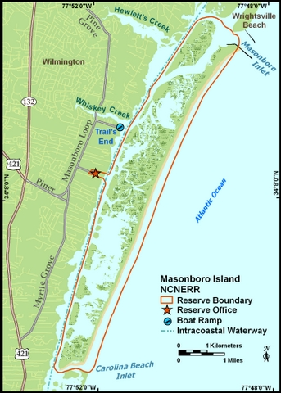
Masonboro Island
Largest undisturbed barrier island in southern NC
Protected under the NCCR and NCNERR
Used for recreational and research purposes
Contains ideal terrapin habitats
North Carolina Coastal Reserve, 2007
Notes:
Masonboro Island is located 5 miles southeast of Wilmington, NC and is the largest undisturbed barrier island in southern NC.
Masonboro Island is protected under the North Carolina Coastal Reserve and the North Carolina National Estuarine Research Reserve.
Masonboro Island is only accessible by boat and is utilized for recreational and research purposes.
The island is approximately 8.4 miles long and contains a variety of ecosystems.
The predominate ecosystem at Masonboro Island is the intertidal salt marsh. Terrapins utilize this are for foraging of crustaceans and polychaete worms. Juveniles also use the salt marsh to burrow under Spartina alterniflora.
The other two communities that terrapins might inhabit are the sand dune and ocean beach. Terrapins would use these areas to nest.

Slide 9
Methods
Headcount surveys were conducted from June through September 2009
Performed at least weekly sometimes more frequent along an established route
Typically involved two people in kayaks
Gathered GPS coordinates, time, tide, morphological characteristics, and duration
Notes:
A visual encounter survey, also referred to as a headcount survey, was conducted at Masonboro Island, NC from June through September 2009.
Headcounts were performed at least weekly sometimes more frequent along an established route that consisted of the intracoastal waterway, channels, creeks, and one large bay.
Headcount surveys typically involved two people in their own individual kayaks.
These surveys consisted of gathering GPS coordinates of every terrapin that surfaces, time, tide, morphological characteristics, and duration (the number of times resurfacing occurred).

Slide 10
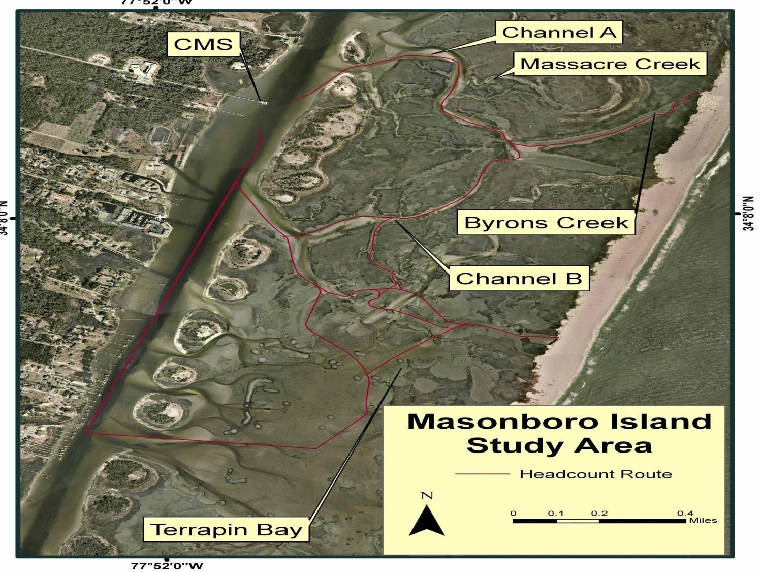
Notes:
This is a map of the Masonboro Island Study Area.
We always departed from the Center for Marine Science dock
For analysis purposes the study area was separated into five locations: Channel A, Massacre Creek, Channel B, and Terrapin Bay.
Terrapin Bay was not included in every headcount survey because of weather conditions and navigation issues.
The GPS coordinates obtained in the field were used to map the exact location of diamondback terrapins in the study area.
This data was also utilized to determine the relative abundances of diamondback terrapins at the five locations.
The GPS coordinates of each terrapin and corresponding tide will be examined to decide the ideal tide for performing headcount surveys.

Slide 11
Results
68 terrapin observations
Byrons creek (n=30) had the most observations
Terrapin Bay had the second highest number of observations
Notes:
68 Terrapin observations occurred during headcount surveys from June through September 2009.
Byron’s Creek (n=30) had the highest # of terrapin observations.
Terrapin Bay (n=12) had the second highest # of terrapin observations.

Slide 12
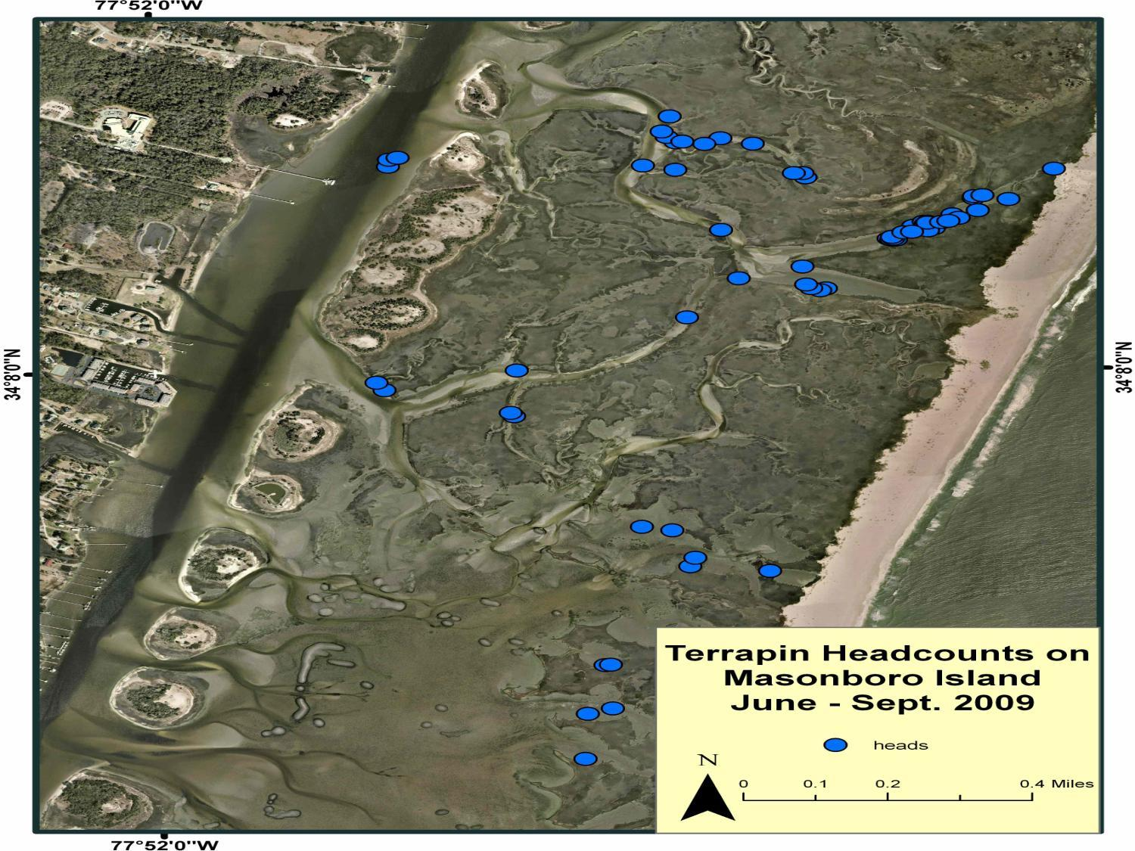
Notes:
This map depicts where are the terrapins were found in the study area. Notice that most of the terrapins were found in Byrons creek and in terrapin bay. They are more scattered in Terrapin Bay but this is because the area is so large. Also notice that Massacure Creek contains terrapins.

Slide 13
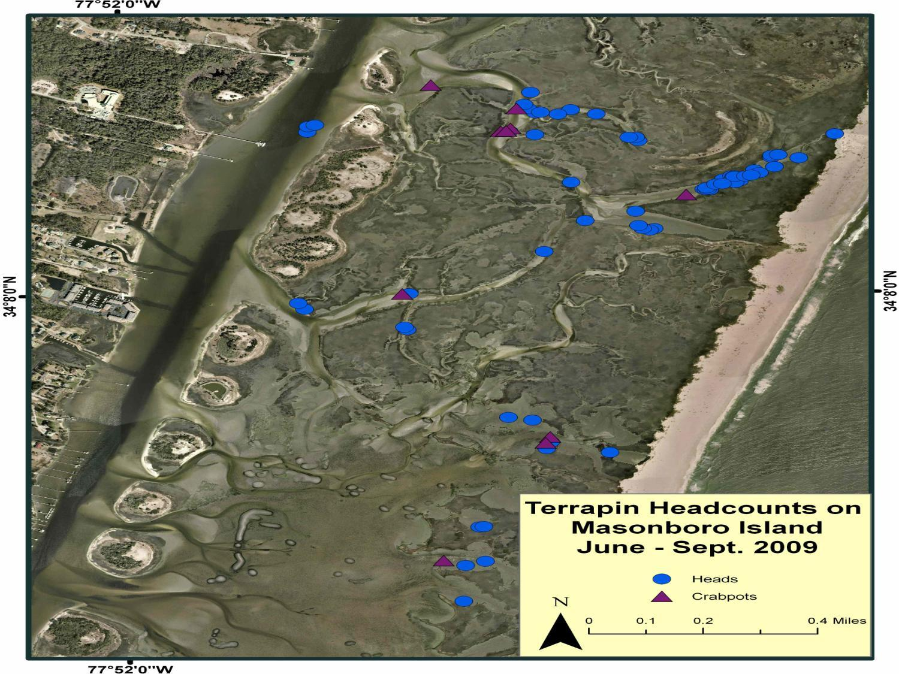
Notes:
This map also illustrates the exact location of each terrapin observation in the study area. Notice that this map also includes crab pots. The purple diamond illustrates where crab pots are located in the study area. This map demonstrates that terrapins inhabit areas where crab pots are found, thus putting their lives in danger.

Slide 14
Relative Abundance
Defined as the # of terrapin observations/# of sampling days
Byrons Creek (1.25) and Terrapin Bay (1.20) had highest relative abundance
Channel A had the lowest relative abundance (0.13).
Notes:
Relative abundance was defined as the # of terrapin observations per # of sampling days.
Byrons Creek (1.25) and Terrapin Bay (1.20) had the highest relative abundances.
Channel A had the lowest relative abundance (0.13).

Slide 15
Terrapin Observations/Tide
Highest # of terrapin observations were on ¼ ebb tide (n=25) and ½ ebb tide (n=22)
Least # of terrapin observations were on ¼ flood tide (n=0) and ¾ flood tide (n=2)
Notes:
Terrapin observations per tide were also examined. The highest number of terrapin observations were on 1/4 ebb tide (n=25) and ½ ebb tide (n=22).
The least number of terrapin observations were on ¼ flood tide (n=0) and ¾ flood tide (n=2).

Slide 16
Terrapin Observations in Each Creek/Tide
Notes:
Terrapin Observations in Each Creek per Tide
At ¼ ebb tide terrapin observations occurred in all locations.
½ ebb was the second highest tide to observe terrapins in all locations except Channel A.

Slide 17
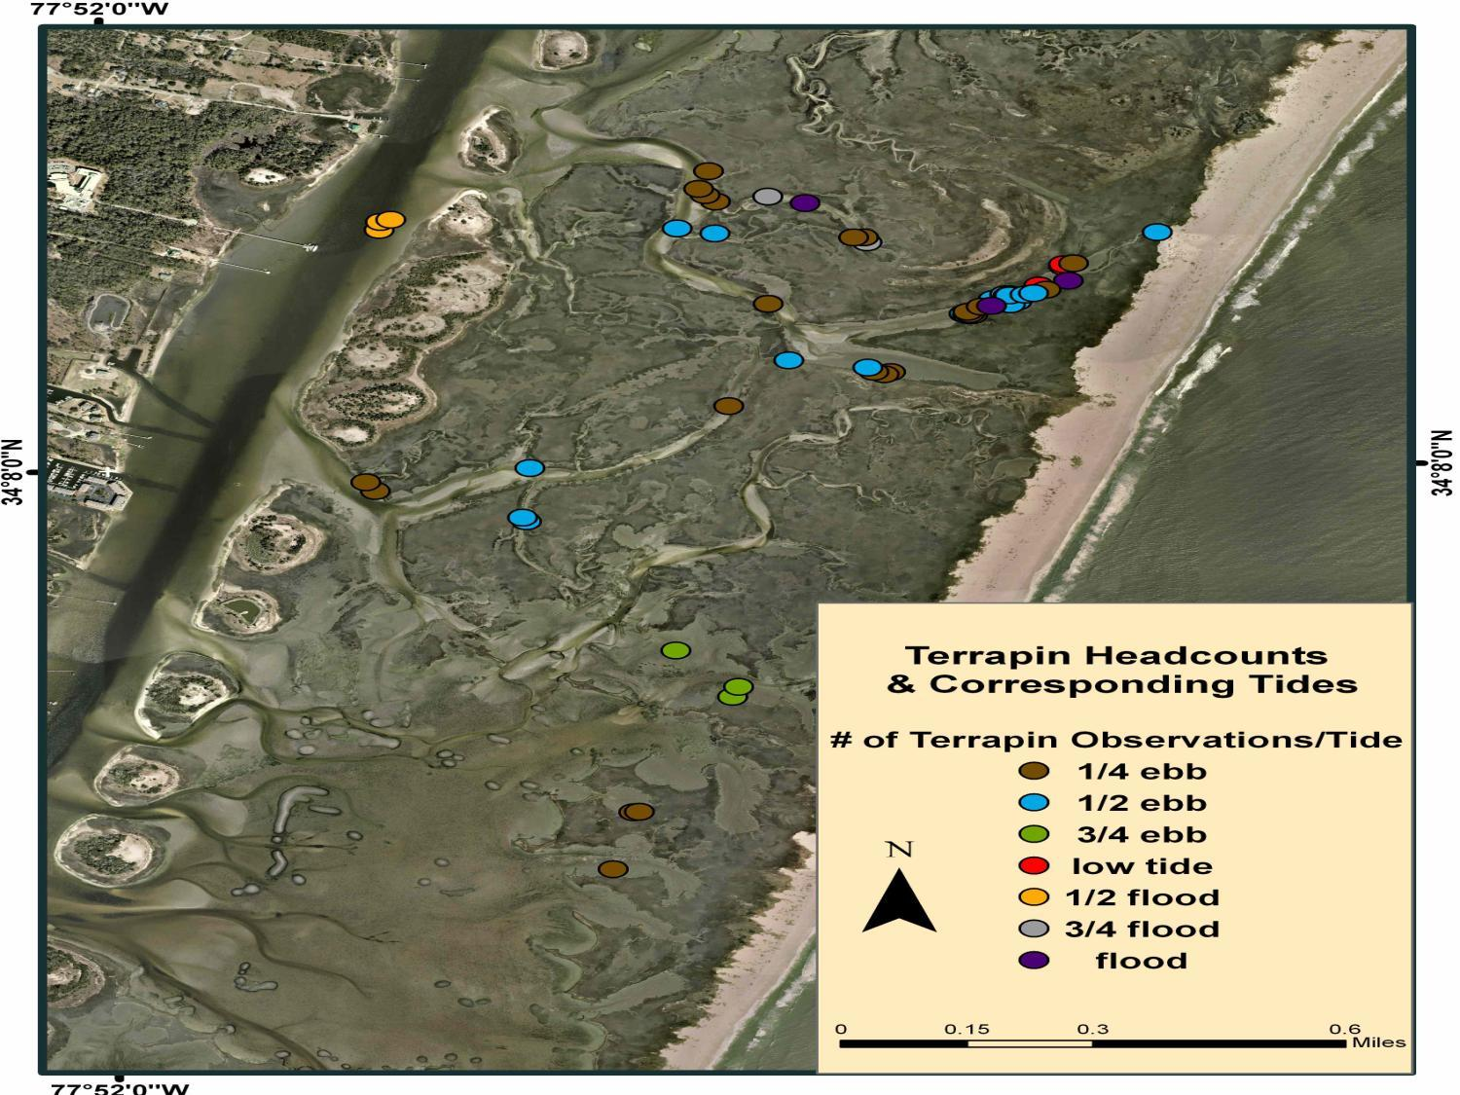
Notes:
This map is the same map that you have previously seen except that now each terrapin observation has a corresponding tide associated with it.
As I stated earlier ¼ ebb (brown circles) and ½ ebb (blue circles) have the highest number of terrapin observations.
The next map will show a closer view of Byrons Creek because when it is zoomed out to show the whole study area it hard to visual this particular area.

Slide 18
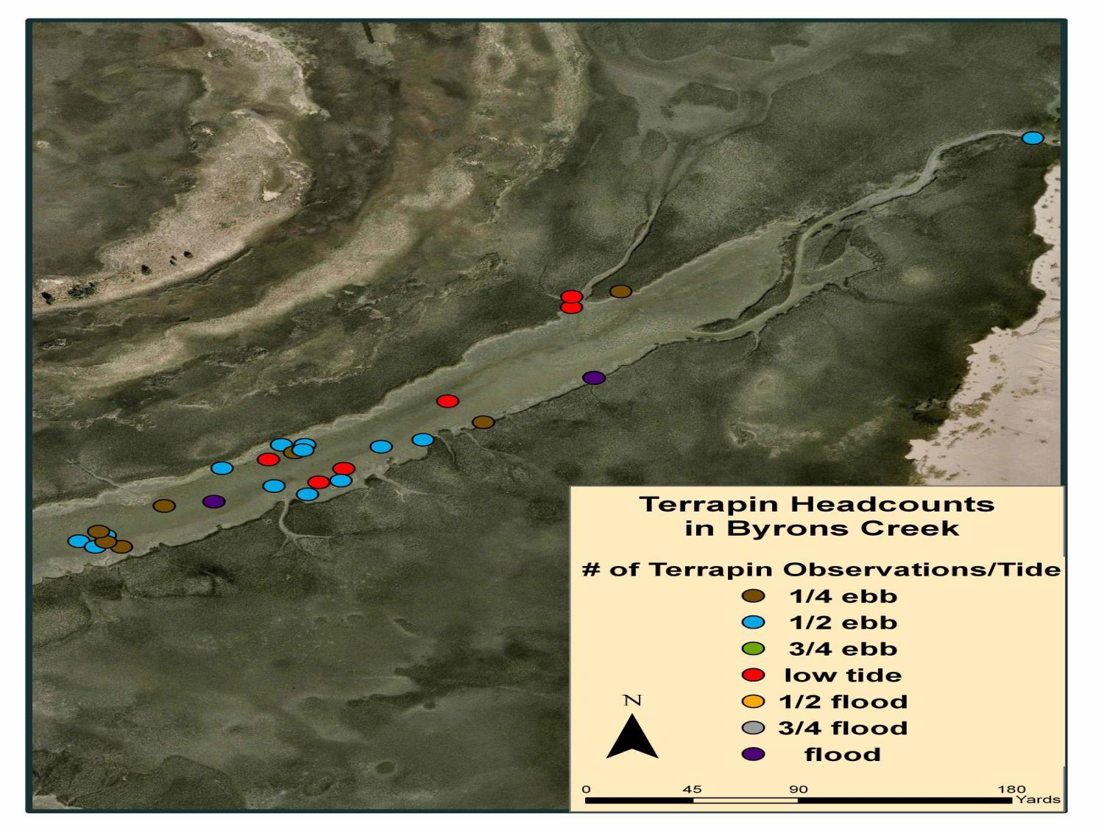
Notes:
1. This map shows a closer view of Byrons Creek. Most terrapin observations occurred at ½ ebb (blue circle) and ¼ ebb (brown circle)

Slide 19
Discussion
Headcount surveys require less sampling effort and capital
Study should be performed to reveal the relationship between relative abundance and population size
Harden et. al (2009) found a positive correlation between # of terrapins observed up and down the creek combined with the # of terrapins captured (R²=0.538)
Notes:
Headcount surveys require less sampling effort and capital than mark/recapture studies. Therefore they are a more convient method to analyze population trends over time.
Headcount surveys not only estimate relative abundance but also evaluate population densities.
If relative abundance is utilized on a large scale, an intensive study should be performed to reveal the relationship between relative abundance and population size.
Harden et. al conducted a headcount survey from 2005 to 2007 in concurrence with a mark/recapture study on Kiawah Island, SC. Found a positive correlation between number of terrapins observed up and down the creek, combined with the number of terrapins captured (R2=0.538)
A mark/recapture study similar to the Kiawah Island study need to be initiated in the Masonboro Island study area to quantify the relationship between relative abundance and population size.

Slide 20
Discussion
Byrons Creek and Terrapin Bay had the highest relative abundances
Channel A had the lowest relative abundance perhaps due to morphology of the channel
The ideal tide to perform headcount surveys is a falling tide.
Notes:
Byrons Creek and Terrapin Bay had the highest relative abundances
Byrons Creek is an ideal habitat for terrapins because it is surrounded by Spartina alterniflora and contains one of their favorite foods periwinkle snails
Channel A had the lowest relative abundance perhaps due to morphology of the channel.
One can infer from the results that the highest terrapin population densities are located in Byrons Creek and Terrapin Bay. However, a mark/recapture study needs to be conducted in conjuction with head-count surveys to quantify this hypothesis.
The resulted depicted that the ideal tide to perform head-count surveys is a falling tide. Flood tides are diamondback terrapins prime foraging time and most active tide of the day. Therefore, visual encounter surveys at Masonboro Island should be performed within 3 hrs. after a flood tide. These results are different from other studies that found that low tide is the ideal tide to conduct the surveys. At Masonboro Island the study area contains minimal water during low tide making navigation impossible.

Slide 21
Future Research Needs
Visual encounter surveys are beneficial
A continuation of these surveys for multiple years may reveal long term population trends
Mark/recapture study at Masonboro Island would analyze population densities by determining sex ratios and age distributions of local terrapin populations
Notes:
Future Research Needs
Visual encounters surveys provide beneficial data on diamondback terrapin locations and densities
A continuation of these surveys for multiple years may reveal long term population trends.
A mark/recapture study at Masonboro Island would analyze population densities by determining sex ratios and age distributions of local terrapin populations
Once long-term population data has accumulated, researchers will be able to evaluate the effects of environmental stressors, such as blue crab pots and habitat degradation on local terrapin populations.

Slide 22
Literature Cited
Brennessel, B. 2006. Diamonds in the marsh: a natural history of the diamondback terrapin. New Hampshire, University Press of New England. 219 pp.
Dorcas, M. E., J. D. Willson, & J. W. Gibbons. 2007. Crab trapping causes population decline and demographic changes in diamondback terrapins over two decades. Biol. Conserv. 137: 334-340 pp.
Fear, J. 2008. A comprehensive site profile for the North Carolina National Estuarine Research Reserve. Online. www.nccoastalreserve.net
Harden, L. A., S. E. Pittman, J. W. Gibbons, & M. E. Dorcas. 2009. Development of a rapid-assessment technique for diamondback terrapin (Malaclemys terrapin) populations using head-count surveys. Applied Herpetology 6: 237-245 pp.

Slide 23
Literature Cited
Hart, K.M., and D. S. Lee. 2006. The diamondback terrapin: the biology, ecology, cultural history, and conservation status of an obligate estuarine turtle. Stud. Avian Biol. 32: 206-213 pp.
Hoyle, M. E. & J. W. Gibbons. 2000. Use of marked population of diamondback terrapins (Malaclemys terrapin) to determine impacts of recreational crab pots. Chelonian Conserv. Biol. 3: 735-737 pp.
Lovich, J. E. & J. W. Gibbons. 1990. Age at maturity influences adult sex ratio in the turtle Malaclemys terrapin. Oikos 59: 126-134.
North Carolina Department of Environmental and Natural Resources / Division of Marine Fisheries (NCDENR/DMF). 2004. North Carolina Fishery Management Plan: Blue Crab. 671 pp.
Wood, R. C. & R. Herlands. 1997. Turtles and tires: the impact of roadkills on northern diamondback terrapin, Malaclemys terrapin terrapin, populations on the Cape May Peninsula, southern New Jersey, USA. In: Proceedings: Conservation, Restoration, and Management of Tortoises and Turtles-An International Conference. Van Abbems, J., Ed., Purchase, NY. 46-53 pp.

Slide 24
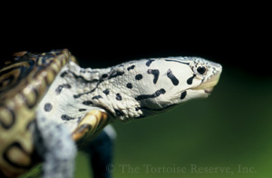
Questions?

