Slide 1

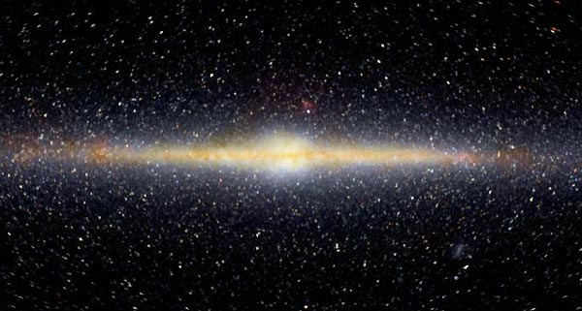
Cosmic Origins – HON 210
  Dr. Russell Herman
  Physics and Physical Oceanography, UNCW
  Mathematics and Statistics, UNCW

Slide 2
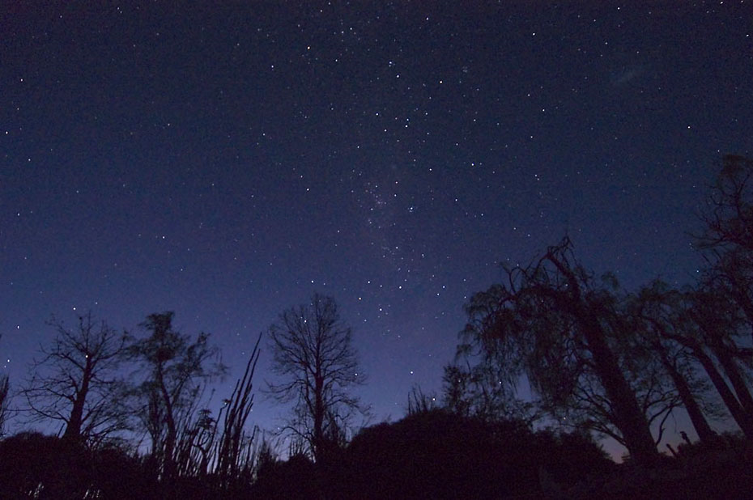
http://www.dimijianimages.com/More-p20-Madagascar-p7/night-sky-from-Madagascar-gallery.htm

Slide 3
Questions?
Is the universe infinite?
How old is the universe?
How did the universe begin?
What is the fate of the universe?
What are the constituents of the universe?
What do you want to know?

Slide 4
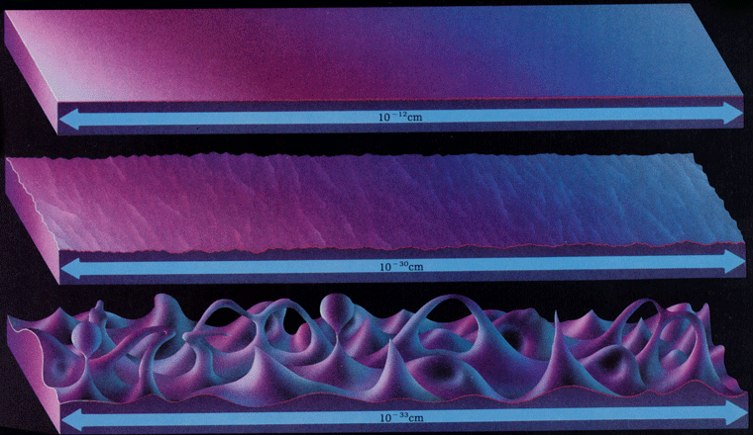
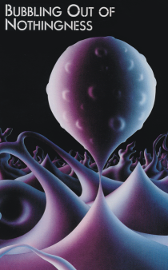
About 13,787,000,000 yrs ago
(plus or minus 20,000,000 yrs)
http://www.zamandayolculuk.com/cetinbal/HTMLdosya1/QuantumFoam.htm
And then ….

Slide 5
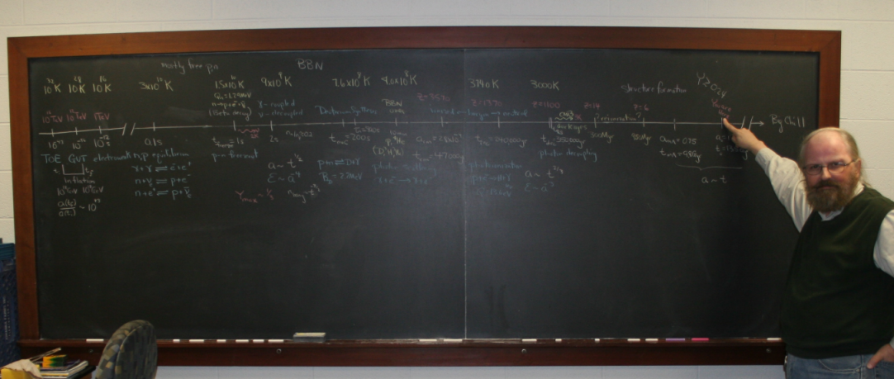
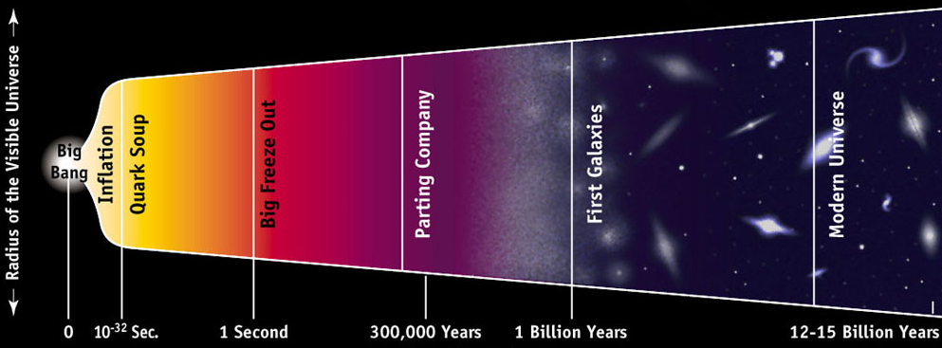
History of the Universe

Slide 6
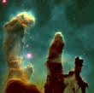
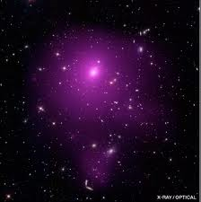
Known Universe
Homogeneous and Isotropic
Expanding, Spatially Flat
Age - 13.787 billion years +/- 20 million
Size - 93 billion lights years (observable)
Density - 9.9 × 10⁻³⁰ gm/cubic centimeter.
About 6 protons/cubic meter
Temperature – 2.72548±0.00057 K
Appears to consist of roughly
70% dark energy,
25% dark matter
5% ordinary matter.
Pillars of Creation in the Eagle Nebula

Slide 7
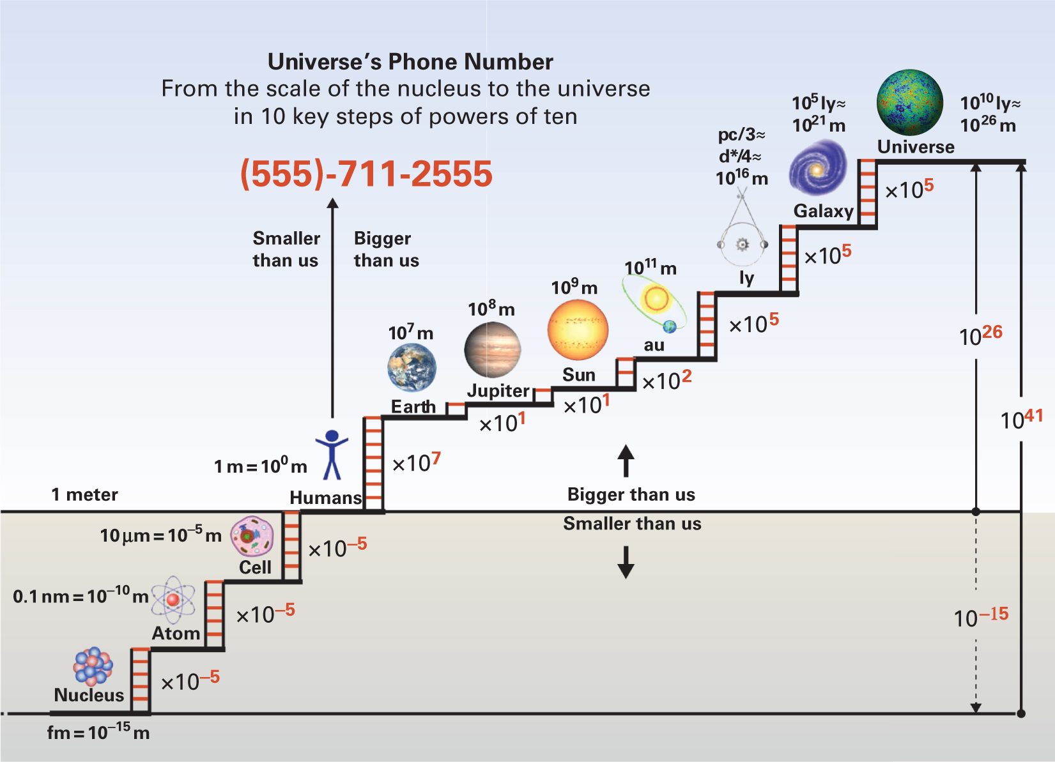
Scales

Slide 8
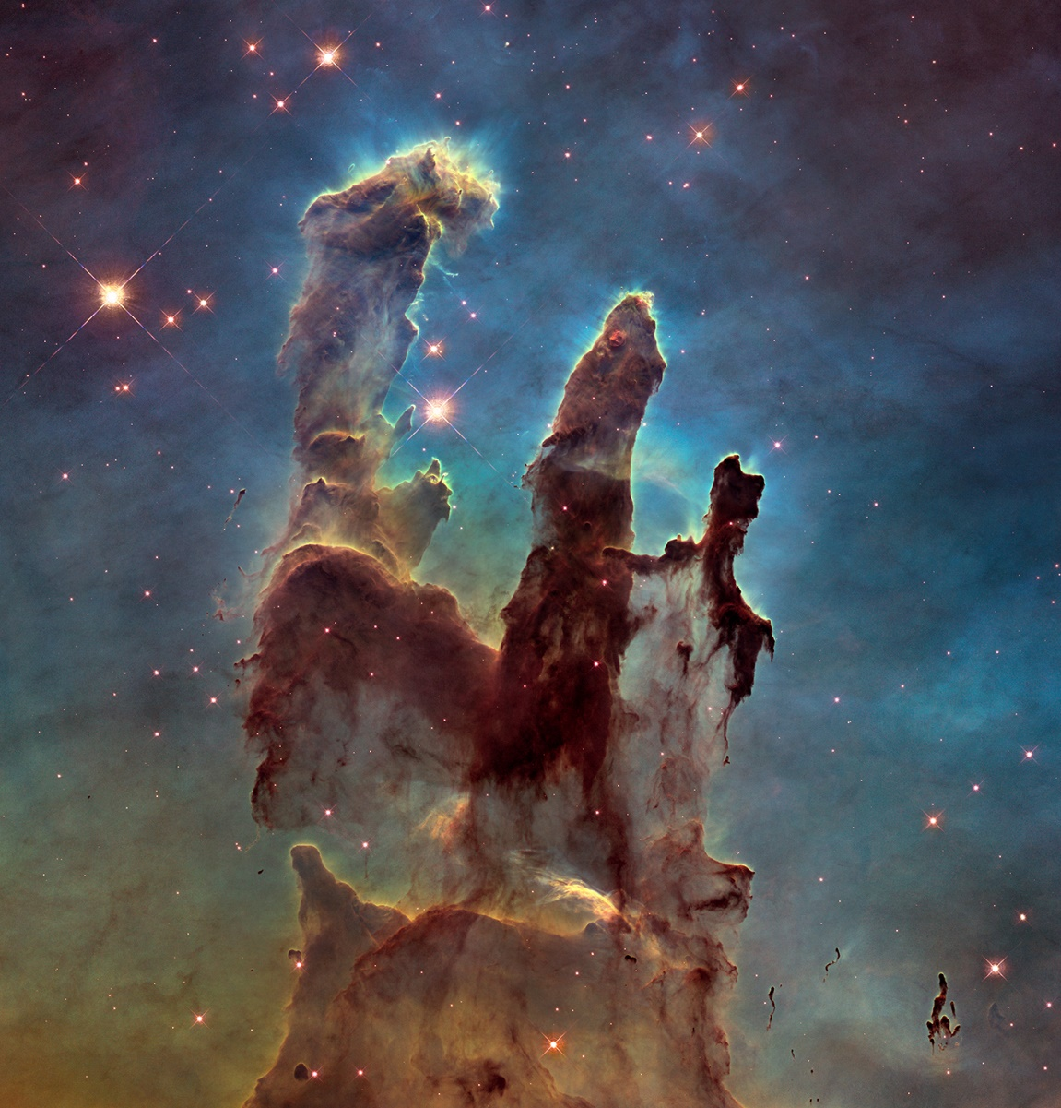
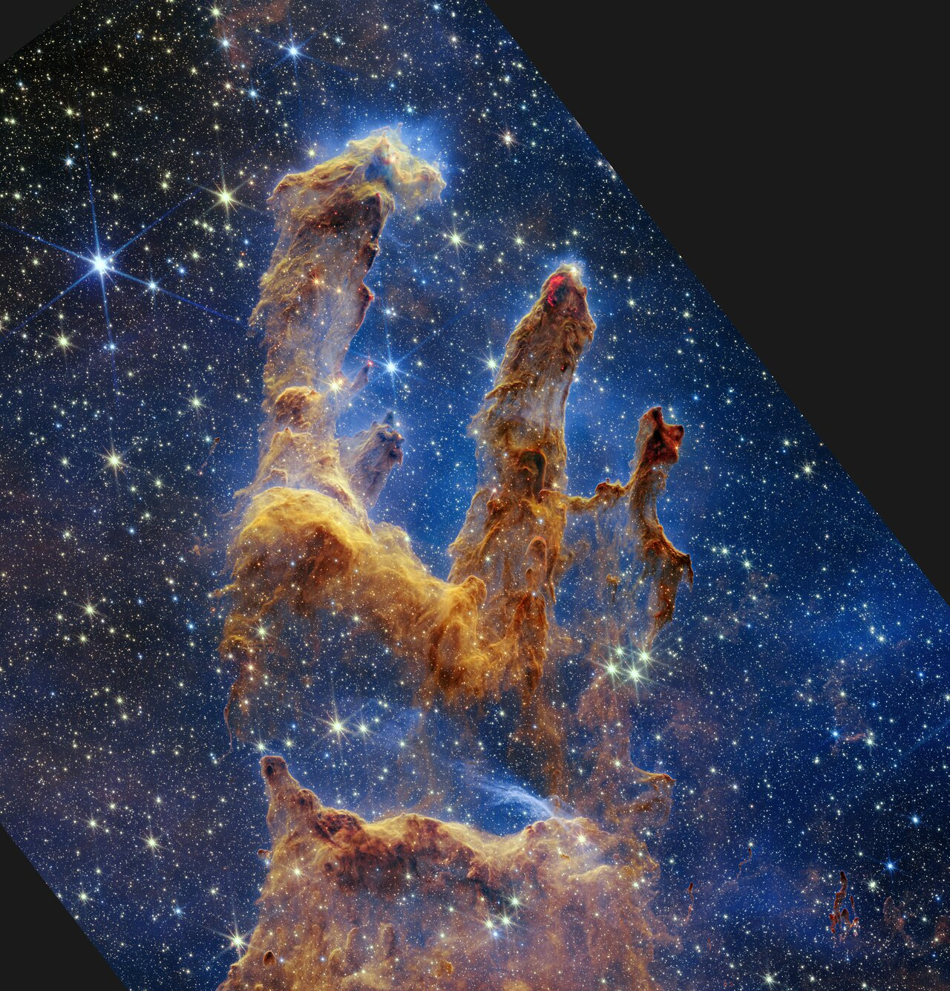
Hubble vs James Webb
Pillars of Creation
Feb 22, 2018
Oct 28, 2022
https://www.nasa.gov/image-feature/webb-reveals-new-details-in-pillars-of-creation

Slide 9
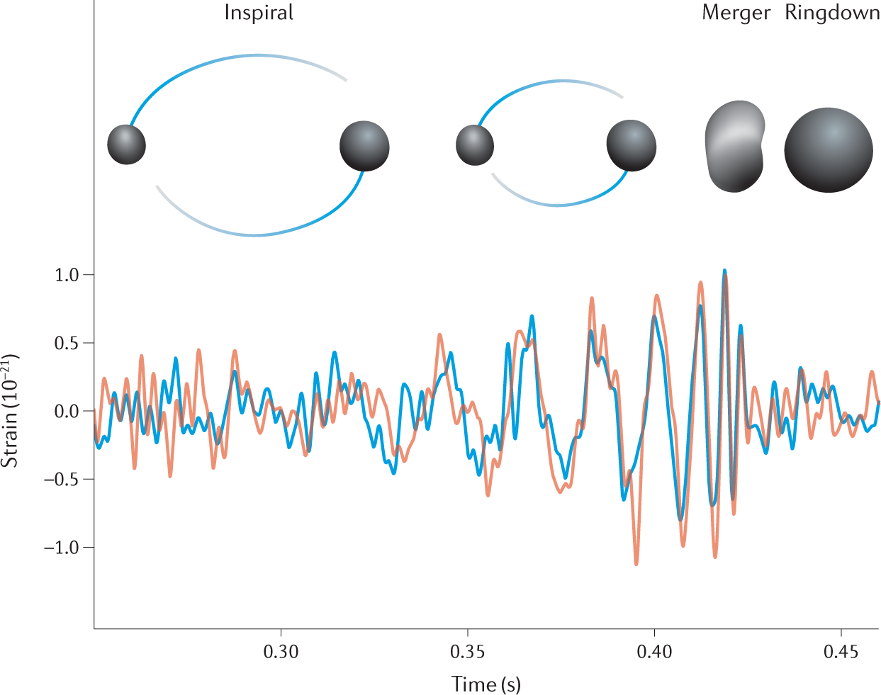
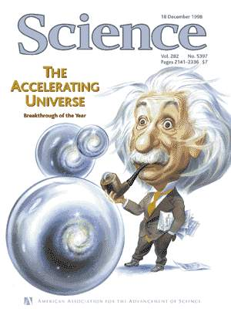
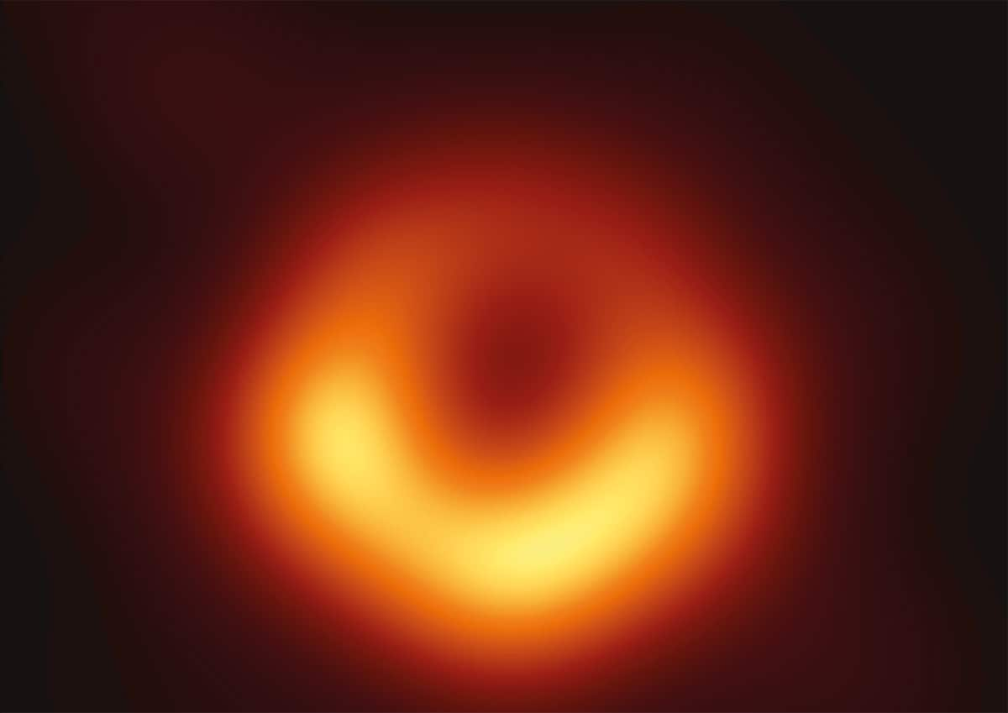
Last Two Decades

Slide 10
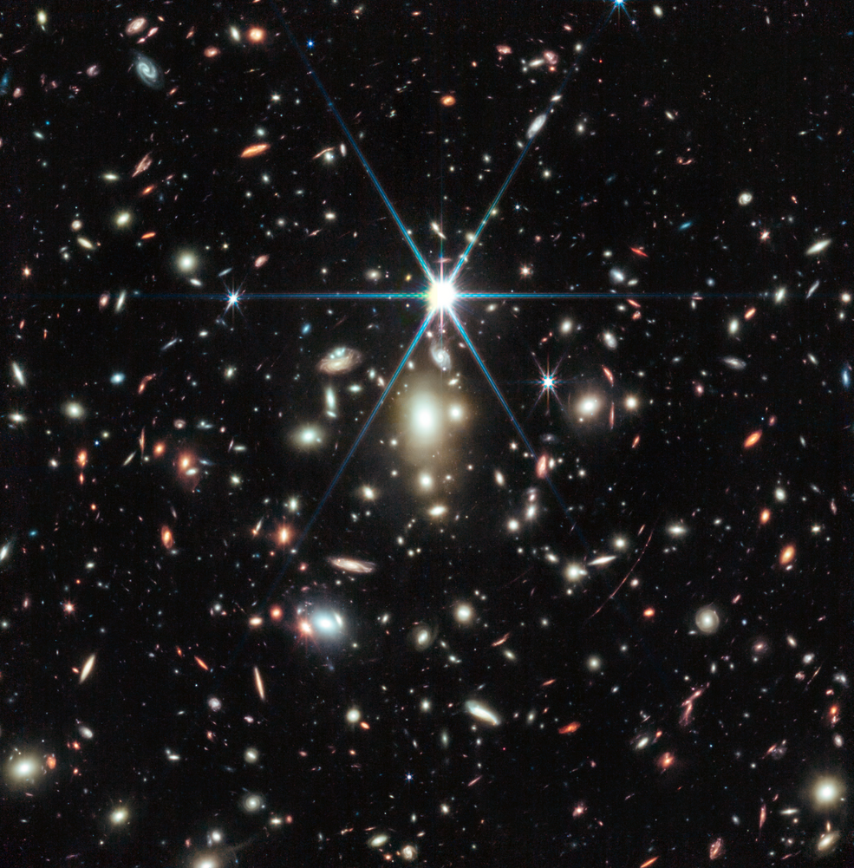
Earendel, The Most Distant Star Ever Detected
Aug 8, 2023
https://www.nasa.gov/feature/goddard/2023/webb-reveals-colors-of-earendel-most-distant-star-ever-detected

Slide 11
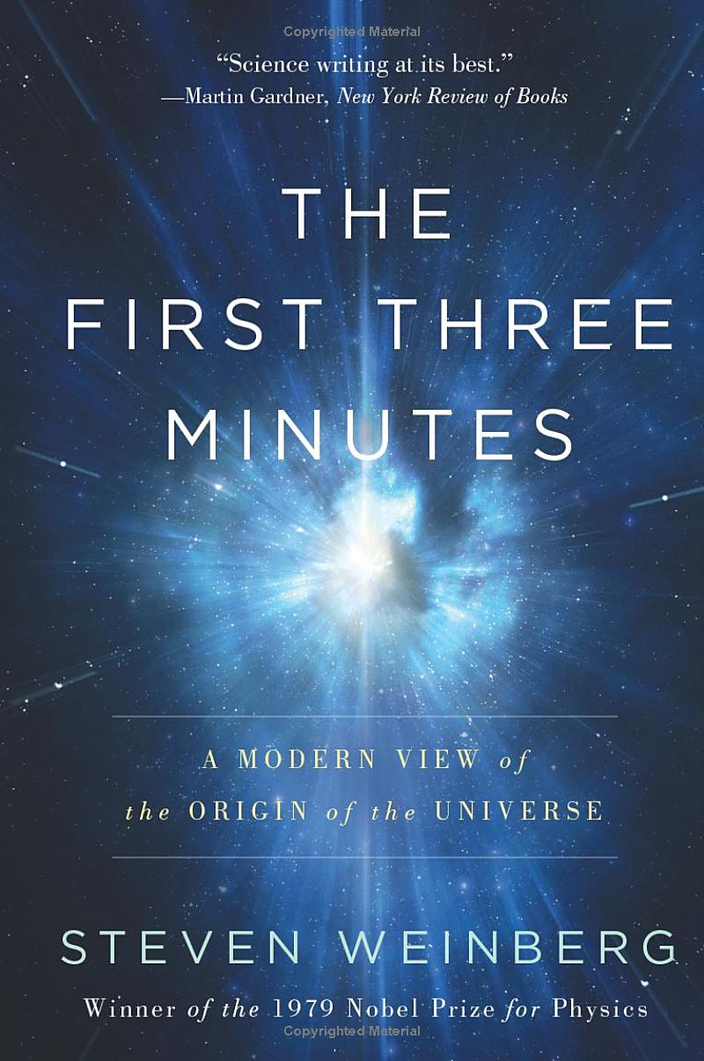

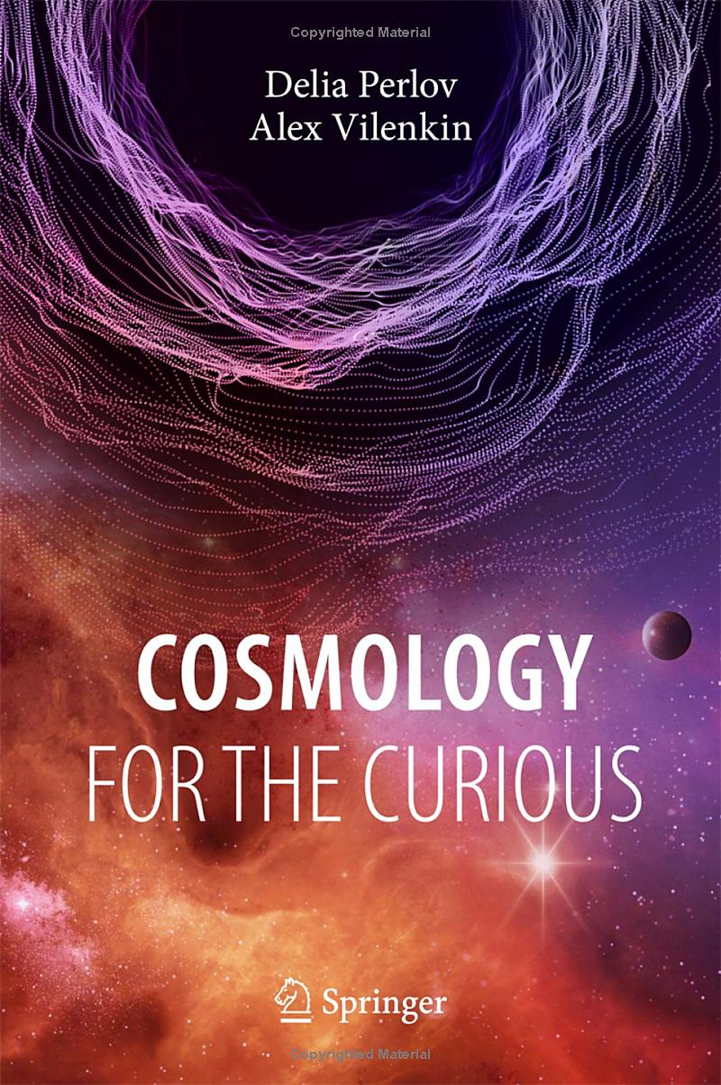
Syllabus
Required Texts:
The First Three Minutes, S. Weinberg,Basic Books; Updated edition (1993).
Big Bang: The Origin of the Universe, S. Singh, Harper Perennial, (2005)
Cosmology for the Curious, D. Perlov and A. Vilenkin, Springer, (2018)
Course Requirements:
Attendance
Assignments – 30%
Paper – 15%
Presentation – 15%
Midterm – 20%
Final – 20%
http://people.uncw.edu/hermanr/Origins/

Slide 12
Topics
Historical Origins
Newton’s Universe
Birth of Modern Astronomy
Life and Death of Stars
Modern Physics
The Expanding Universe
Cosmic Microwave Background
Exploring the Universe
The Dark Universe
Recent Discoveries

Slide 13
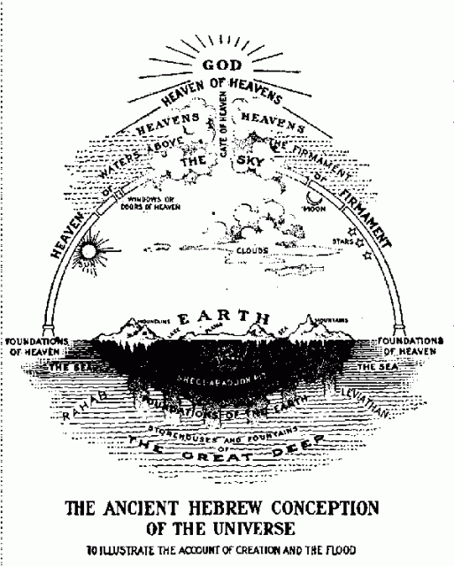
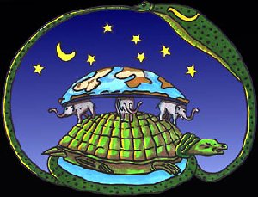
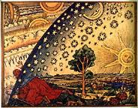
Early Models

Slide 14
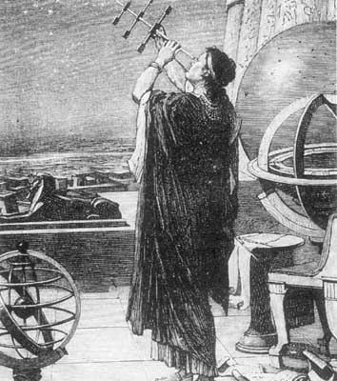
In the beginning ... http://www.spaceandmotion.com/cosmology-history-astronomy-universe-space.htm
Thales of Miletus (624–546 BCE)
Anaximander (610-546 BCE)
Pythagoras (585-497 BCE)
Harmony of the Spheres
Socrates (469-399 BCE)
Democritus (460-370 BCE)
Plato (427-347 BCE)
Eudoxus of Cnidus (408-355 BCE)
- 27 concentric spheres – retrograde motion
Callipus (370-300 BCE) – added 7 more,
lunisolar calendar – modified Meton cycle
Aristotle (384-322 BCE) – 55 rotating spheres

Slide 15
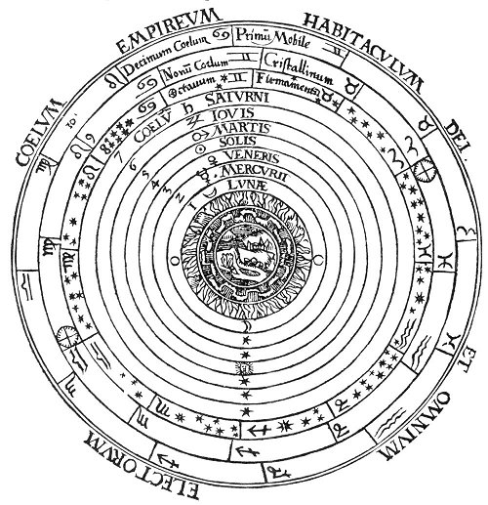
Earth is fixed and immovable, stars fixed in sky, planets = wanderers
Aristarchus (310-230 BCE) heliocentric model
Archimedes (287-212 BCE) referenced Aristarchus modeled sun-planets
Hipparchus (190-120 BCE) seasonal inconsistencies
Antikythera mechanism
http://www.sacred-texts.com/eso/sta/sta03.htm

Slide 16
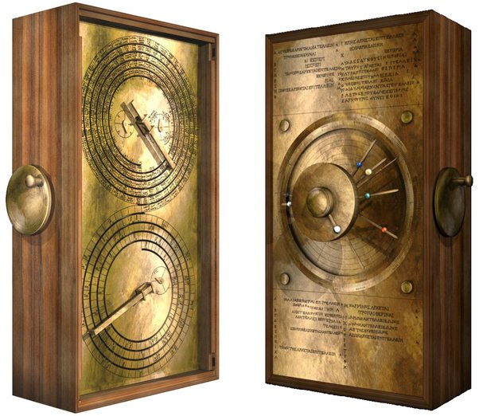
The Antikythera
Mechanism
Found in a wreck in 1900 near Antikythera.
Recovered statues and other items.
Small corroded fragments found.
Fragment A has 27 gears.
100 years later ...
It is an astronomical calculator.
Predicts moon’s position and phase,
solar eclipses, motion of planets, and
more.
Possibly from 1st or 2nd century BCE.
See March 2021 Paper, Freeth, et al.
and correction

Slide 17
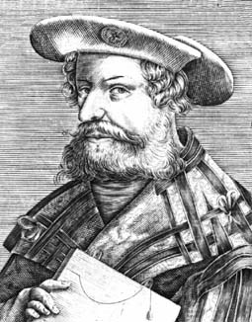
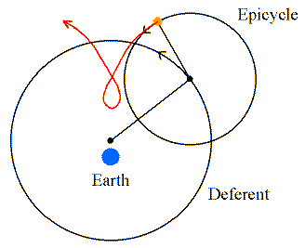
Geocentric System
Ptolemy (85-165) –
eccentric motion
Others proposed spinning Earth – Aryabhata, Ibn al-Haytham, Oresme, Nicholas of Cusa
Nasir al-Din al-Tusi (1201-1274)
Tusi couple – replaced equant
used by Copernicus
http://www.daviddarling.info/images/epicycle.gif

Slide 18
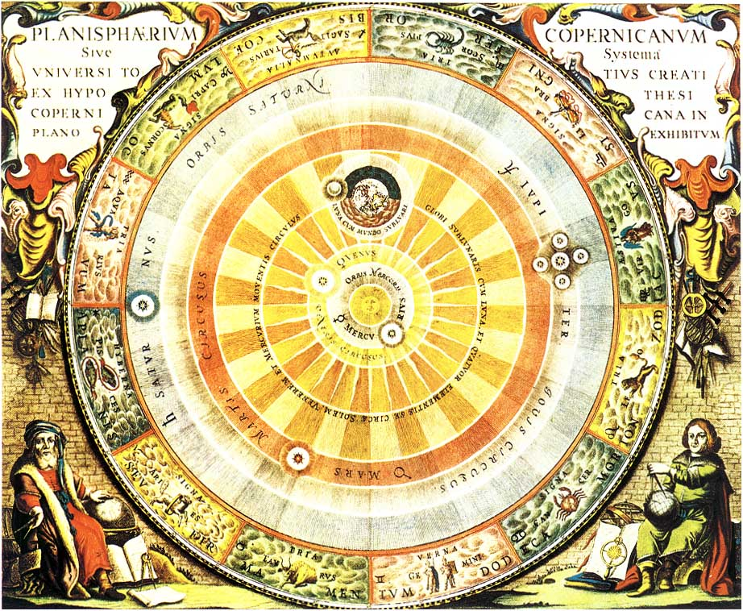
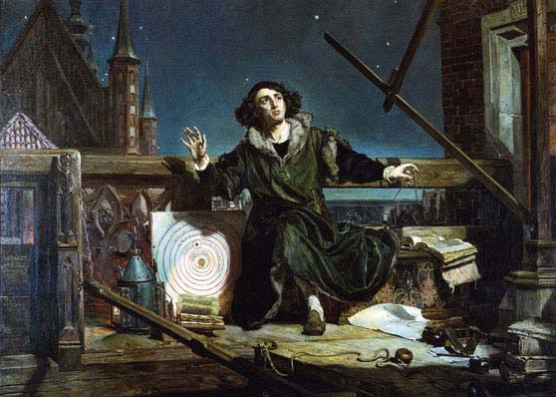
Heliocentric System
Copernicus (1473-1543)

Slide 19
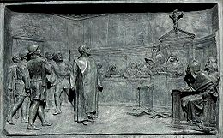
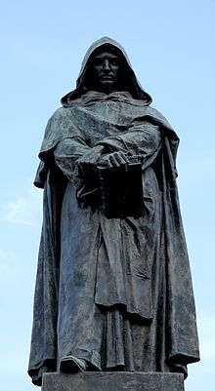
Giordano Bruno (1548-1600)
Heretic
  Supported Copernicus
View of Universe
  Infinite, homogeneous, isotropic
  Stars like our sun – with planets
  Infinite number of inhabited worlds
Burned at stake

Slide 20
  The Rise of Classical Physics
  (1500-1900)

Slide 21
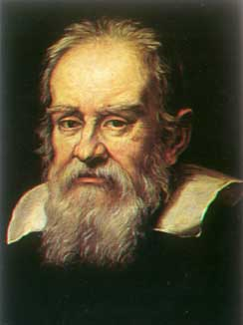
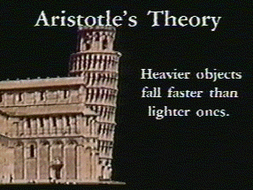
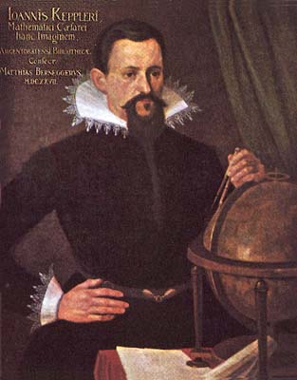
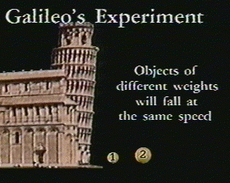
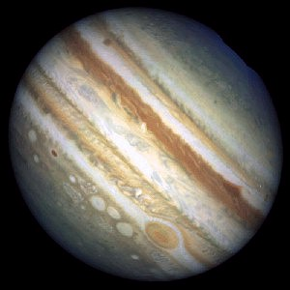

Scientific Deduction
Tycho Brahe
(1546-1601)
Johannes Kepler
(1571-1630)
Galileo Galilei
(1564-1642)

Slide 22
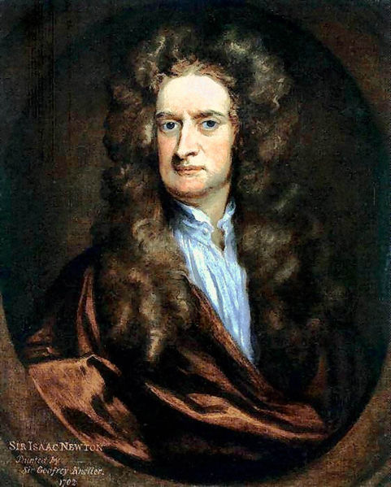
The Clockwork Universe
Sir Isaac Newton (1642-1727)
Principia (July 5, 1687)
Philosophiae Naturalis Principia
Mathematica (Mathematical
Principles of Natural Philosophy)
Laws of Motion
Law of Gravitation
Kepler's Laws Explained
Halley’s Comet – 1759
John Michell (1784-1793)
Forgotten Natural philosopher, clergyman
Applied Newton’s Corpuscular Theory, 1783.
A star’s gravitational pull might be so strong that the escape velocity would exceed the speed of light! -Dark Stars
Pierre-Simon Laplace (1749-1827)
Exposition du Systeme du Monde - 1796
Unification
... the force responsible for bodies falling on the Earth
is the same as that causing the moon to follow its orbit.
http://upload.wikimedia.org/wikipedia/commons/thumb/b/b2/Isaac_Newton.jpeg/481px-Isaac_Newton.jpeg

Slide 23
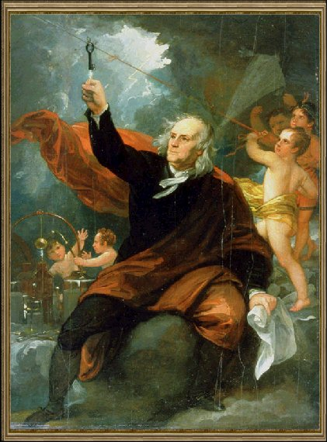
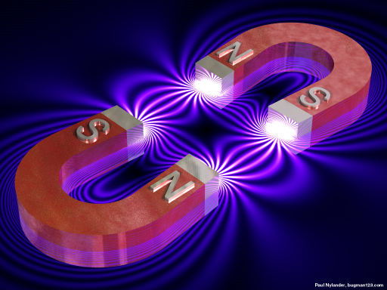
Electricity and Magnetism
Magnetism
  Lode stones
  Compasses
William Gilbert (1544-1603)
electricus – like amber, magnetism
Thomas Browne (1605-1682)
“electricity”
Benjamin Franklin (1706-1790)
Charles-Augustin de Coulomb (1736-1806)
1785 – Coulomb’s Law
Luigi Galvani (1737-1798) - frogs
Alessandro Volta (1745-1827)

Slide 24
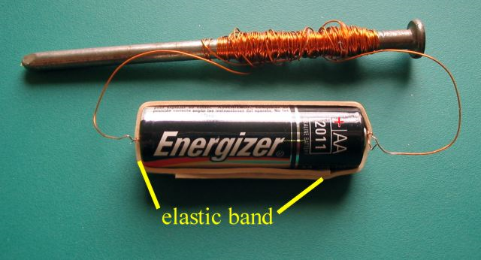
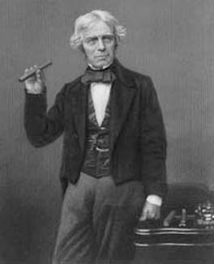
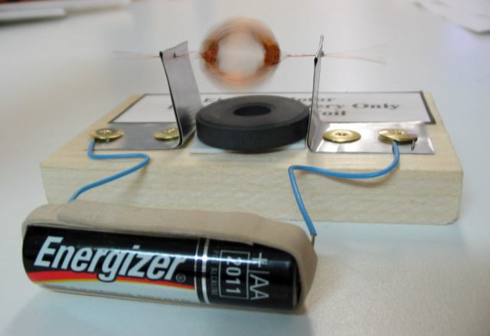
Electromagnetism
André-Marie Ampère, (1775 - 1836)
Hans Oersted (1777-1851)
current deflects compass needles
Georg Simon Ohm (1789-1854)
Joseph Henry (1797-1878)
electromagnetic induction, first motor,
electric relay (used in telegraph of
Morse and Wheatstone)
Michael Faraday (1791-1867)
electrolysis, motors, induction coils, ...
Notion of a field.
http://hilaroad.com/camp/projects/magnet.html

Slide 25
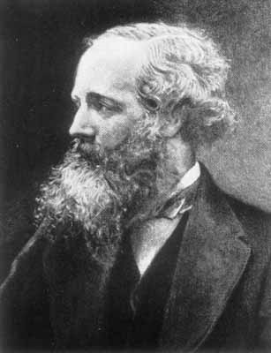
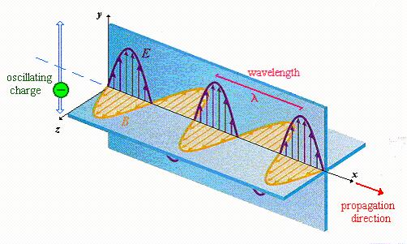
Electromagnetic Waves
James Clerk Maxwell (1831-1879)
- Theory of electromagnetism.
- Predicted the electromagnetic waves.
- Electromagnetic waves travel at
c = 299,792,458 m/s = 186,000 mi/s
Heinrich Hertz (1857-1894)
- sent the first radio waves (1888)
What is the medium?
Luminiferous Aether
Michelson-Morley (1887)
- could not detect it.

