Slide 1

Relativity in the Movies
Dr Russell Herman
Physics and Physical Oceanography
Mathematics and Statistics
UNC Wilmington
Powerpoint Templates

Slide 2
Physics in Film

Slide 3
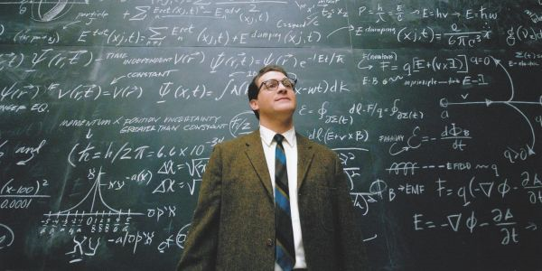
A Serious Man (2009)
Midwestern physics teacher
http://chronicle.com/article/The-Coen-Brothers-Find-Their/64623/

Slide 4

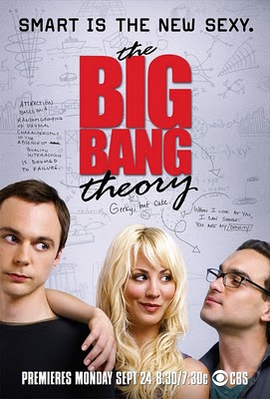
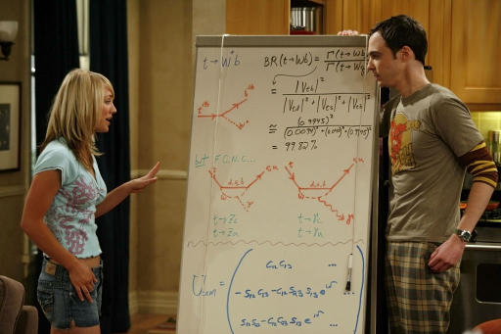
The Big Bang Theory
2007-2019

Slide 5

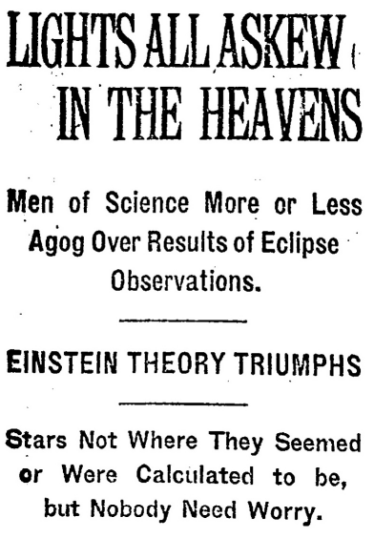
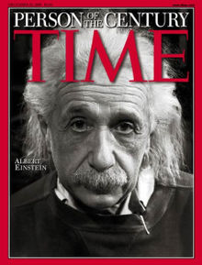


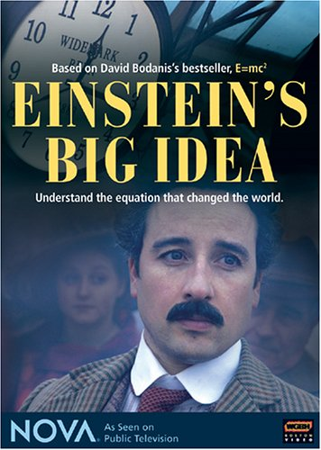
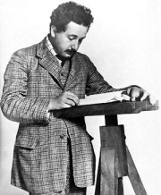
Physicists

Slide 6
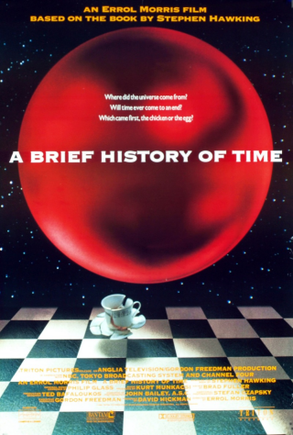
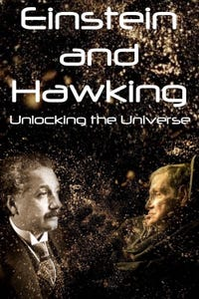
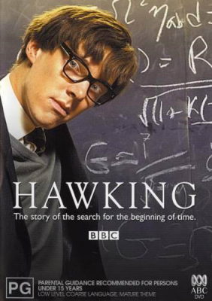
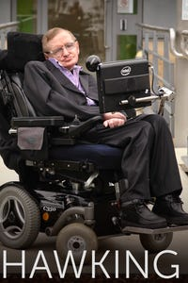
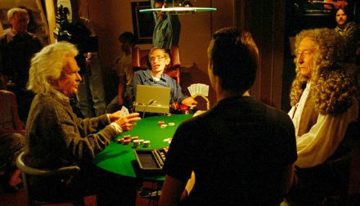
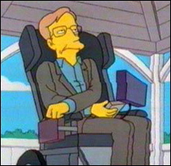
Stephen Hawking

Slide 7
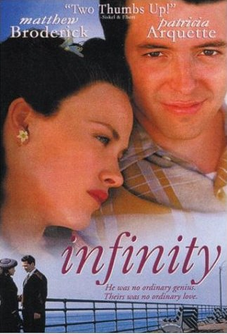
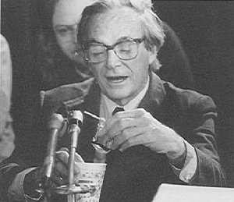
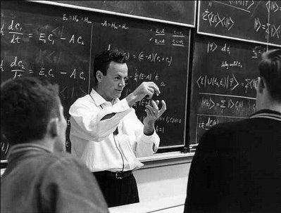
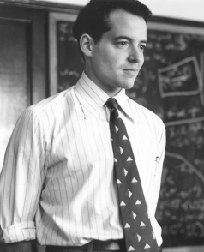
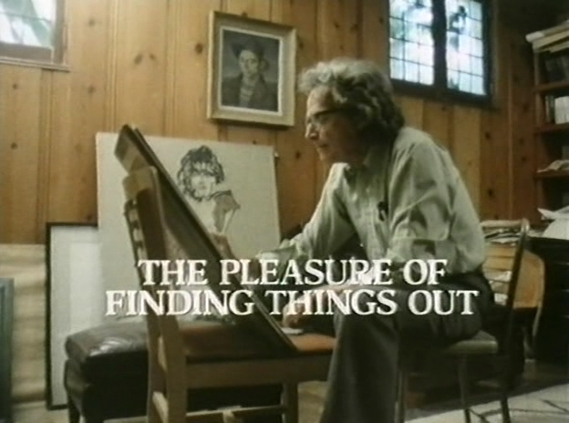
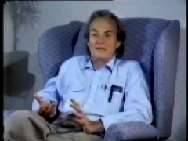
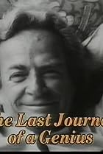

Richard Feynman

Slide 8
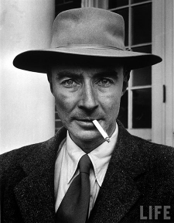

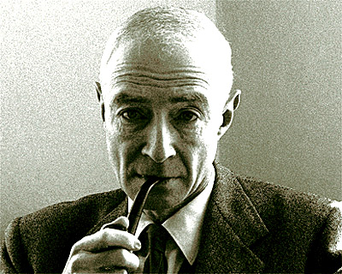
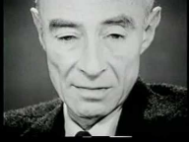



J. Robert Oppenheimer

Slide 9
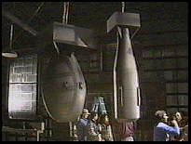

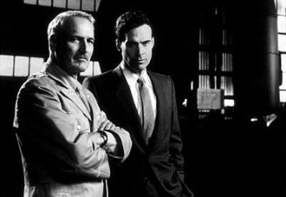
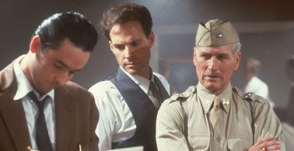
Fat Man and Little Boy

Slide 10





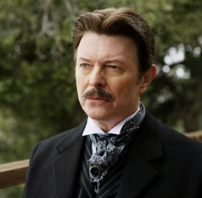
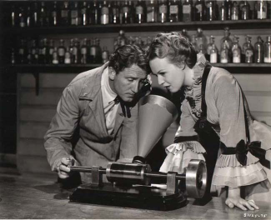


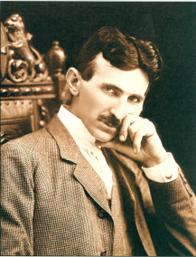
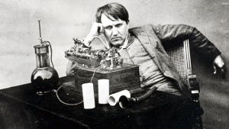
Nikola Tesla vs Thomas Edison

Slide 11
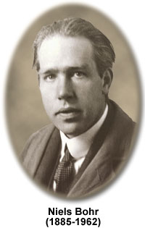
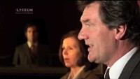
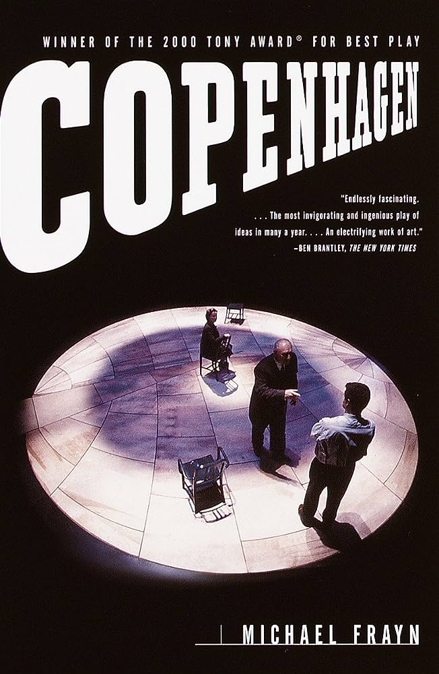
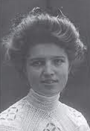

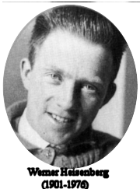
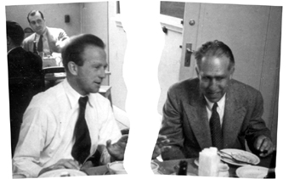

Copenhagen
Bohr and Heisenberg

Slide 12

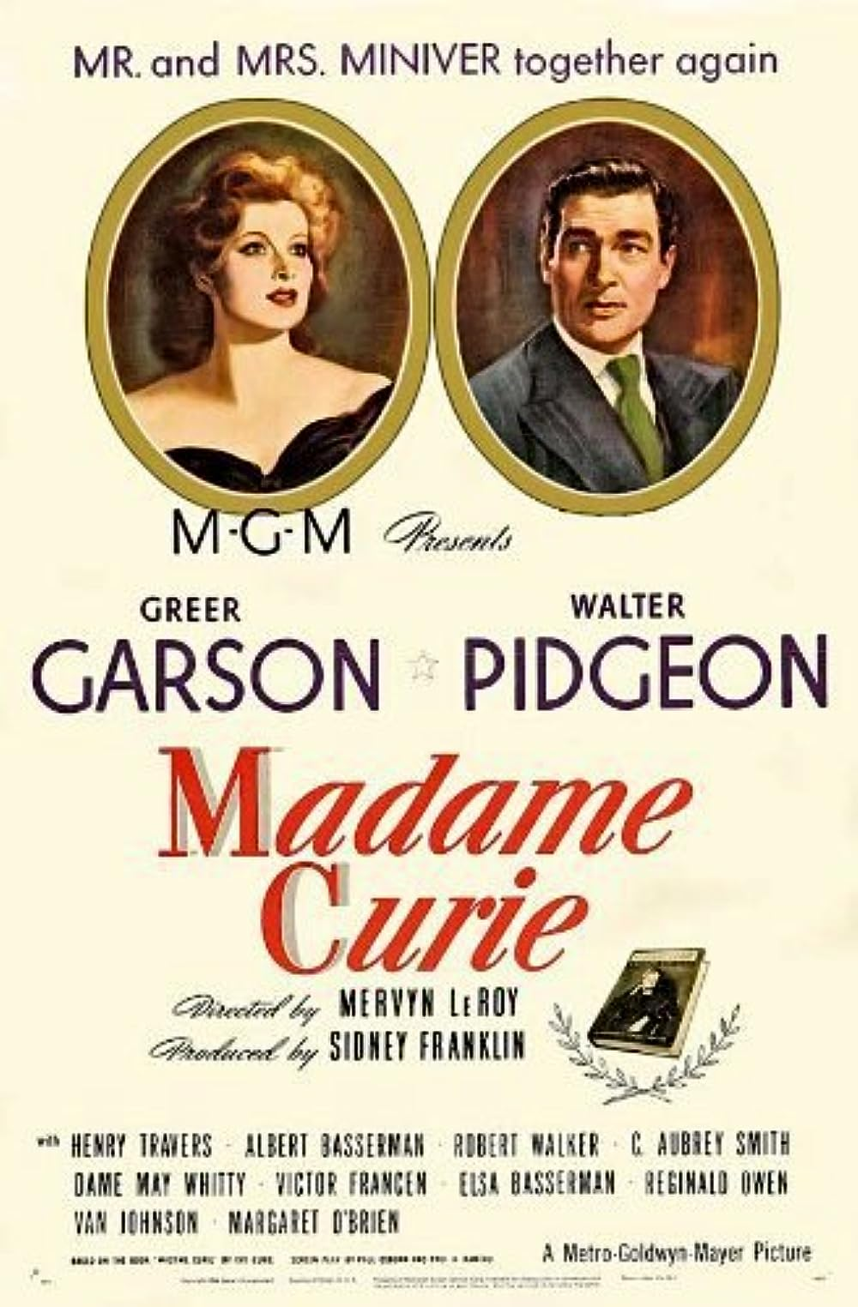


Marie Curie

Slide 13


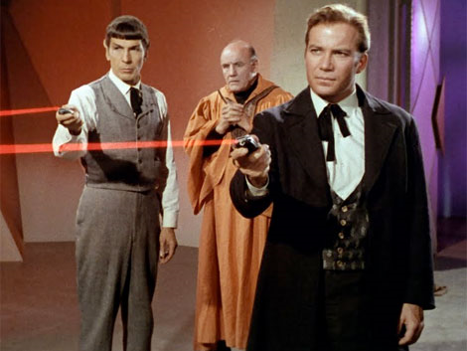
Physics … It’s All Around Us
From bad physics to science fiction

Slide 14
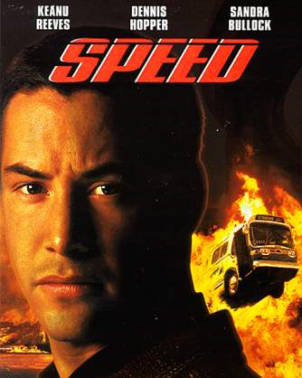
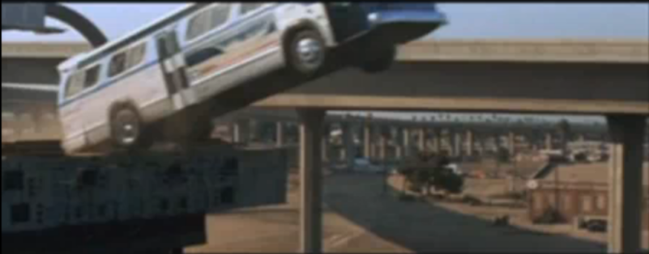
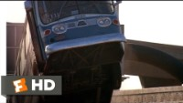
Speed – Bus Jump

Slide 15
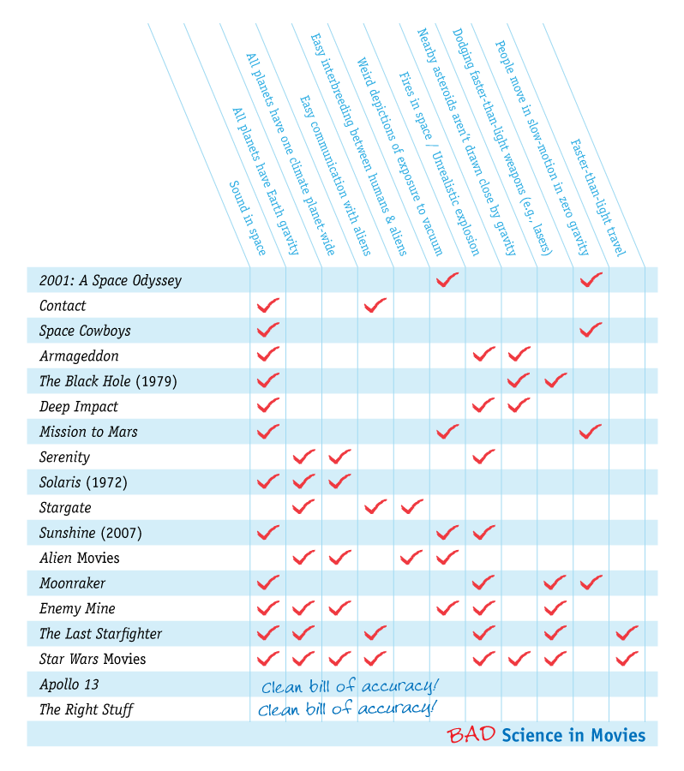

Movie Physics
http://www.intuitor.com/moviephysics/

Slide 16
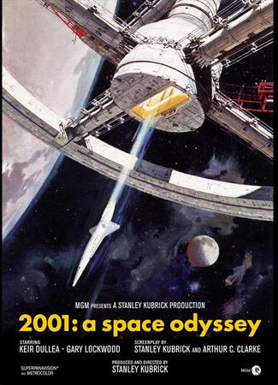
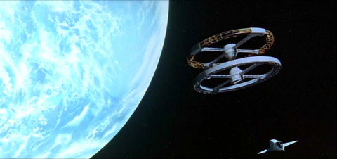
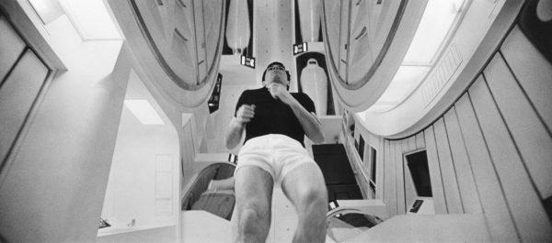
2001 A Space Odessey

Slide 17
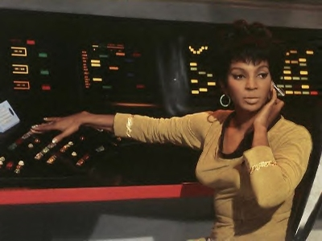
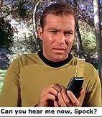
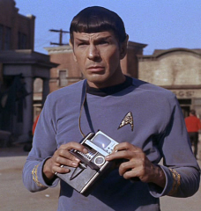
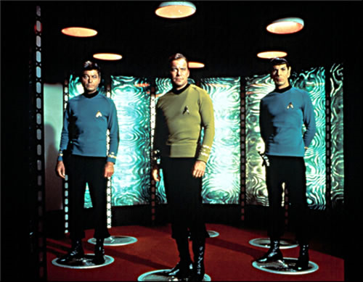
Star Trek – 1966-1969

Slide 18
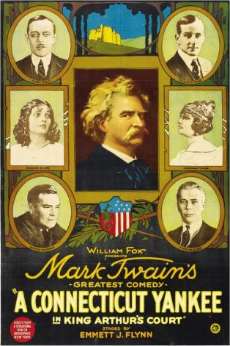


Time Travel in Movies

Slide 19



Light Remakes

Slide 20




Classics

Slide 21








Time Machines

Slide 22







Taking a Quantum Leap

Slide 23




Wormhole Portals

Slide 24


Albert Einstein (1879-1955)
Special Relativity - 1905
  Simultaneity
  Time dilation
  Length contraction

Slide 25

My Now is not Your Now
Simultaneity

Slide 26



Light Clock – Time Dilation
2/16/2017
26

Slide 27





Spacetime
Time travel
Using relativity of time
Wormholes
Δt²
Δτ²
2/16/2017
27

Slide 28
'"—All You Zombies—"'
Robert Heinlein - 1959
On September 20, 1945, the Bartender drops off baby Jane at an orphanage. She grows up there. She dreams of joining one of the "comfort organizations" dedicated to providing R&R for spacemen.
Nearly 18 years later, the man who refers to himself as "an unmarried mother" is dropped off at April 3, 1963, by the Bartender. He meets and after some weeks of dating seduces the 17-year-old Jane, who has an intersex condition. From Jane's point of view, he then disappears; actually, he has been retrieved by the Bartender, and taken to 1985.
Jane becomes pregnant. After giving birth by C-section, she is found to be a "true hermaphrodite" who has been severely damaged by the pregnancy and birth; on waking she learns that she has been subjected (without her consent) to a "sex change" which reassigns her sex to male.
On March 10, 1964, the Bartender steals the baby and takes it back in time to the orphanage. Jane, now male, becomes a stenographer, and then a writer. Whenever he is asked his occupation, he replies, somewhat truculently, "I'm an unmarried mother—at four cents a word. I write confession stories." He becomes a regular at the bar where the narrator, the Bartender, works.
On November 7, 1970, the Bartender meets the Unmarried Mother, conducts him into the back office, and takes him back to 1963 to "find" the man who got him pregnant. He returns to the bar, seconds after going into the back room, and yells at the customer playing "I'm My Own Grandpa". From his own point of view he has carried out his mission of ensuring his existence.
On August 12, 1985, the Bartender brings the Unmarried Mother to the Rockies base and enlists him in the Temporal Bureau.
On January 12, 1993, the Bartender, who is also Jane/mother/father, arrives back at his base from 1970 to think about his life.
    I know where I came from—but where did all you zombies come from?
    I felt a headache coming on, but a headache powder is one thing I do not take. I did once—and you all went away.
    So I crawled into bed and whistled out the light.
    You aren’t really there at all. There isn’t anybody but me—Jane—here alone in the dark.
    I miss you dreadfully!

Slide 29
'"—All You Zombies—"'
Robert Heinlein - 1959
Bartender drops off Jane
Jane gives birth/has sex change
Jane grows up (17)
Baby taken to 1945
1945 1950 1955 1960 1965 1970 1975 1980 1985 1990
U.M. taken to Temporal Bureau
Bartender drops off U.M
Who meets Jane, and …
U.M. taken to 1985
  I know where I came from—but where did all you zombies come from?
Bartender takes U.M. to ’63 to meet baby’s father and returns
Thinks about life in ‘93

Slide 30

Predestination
Spoiler alert!

Slide 31


Grandfather Paradox
5 Bizarre Paradoxes Of Time Travel Explained

Slide 32





Books

Slide 33






Books on Time
2/16/2017
Dr. R. L. Herman – UNCW – Is Time an Illusion – OLLI Presentation
33

Slide 34


Thank you – final clip

Slide 35


Science of Watchmen
Dr. James Kakalios, U. Minnesota,
Author of The Physics of Superheroes

Slide 36


Slide 37






Time Travel

Slide 38



More Time Travel

Slide 39








Slide 40












