Slide 1
Depression
Bracy Heinlein

Slide 2
What is Depression?
Depression: a mood disorder that affects the way you think, feel and behave.
It causes feelings of sadness or hopelessness
Can last a few minutes, hours, days, or years
Mood disorders, such as depression, that hit early in life are often more severe than the forms that hit later in life.
There are different types of depression:
Persistent depressive disorder (dysthymia)
Perinatal depression
Psychotic depression
Season Affective Disorder
Bipolar Disorder
Major Depressive Disorder (MDD) – severe, long lasting, intense form of depression. Also called clinical depression or major depression

Slide 3
Major Depressive Disorder
Average age of onset is 32
~14.8 million adults in the U.S. (over 18) are affected by MDD each year.
Occurs in about 1 in 33 children and 1 in 8 teens.
Symptoms:
Significant interference with daily activities
School, work, social events, etc.
Impact mood and behavior
Impact physical functions
Sleep, appetite, etc.

Slide 4
Diagnosing MDD
Must display five or more of the following symptoms at least once a day over the course of two weeks:
Persistent feelings of sadness or hopelessness
Lack of interest in doing most activities, including those you once enjoyed.
Decrease or increase in appetite accompanied by extreme weight loss or gain.
Sleeping too much or too little.
Restlessness
Fatigue
Excessive or inappropriate feelings of guilt or worthlessness.
Difficulty making decisions, thinking, and concentrating.
Multiple thoughts of death or suicide.
A suicide attempt.

Slide 5
Factors of MDD
Genetics:
people with a family history of MDD are more likely to develop the disorder.
Stress:
a stressful life event can trigger and episode of MDD
Biochemical Reactions:
chemicals in the brains of people with MDD seem to function differently
Hormone Imbalances:
changes in the balance of hormones may trigger MDD

Slide 6
Depression and the Brain
There have been studies that show a change in brain activity when mood shifts, now there are studies that show a change in brain shape associated with severe mood disorders.
If mood symptoms are prolonged and/or severe, areas such as the hippocampus and frontal lobes are shown to shrink
This atrophy has long been associated with Alzheimer’s dementia, but has also been recently shown in cases of obesity, back pain, and very clearly with depression.

Slide 7
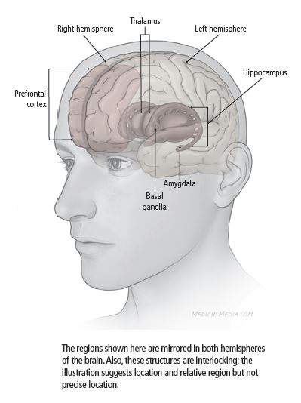
Areas of the Brain Affected by Depression

Slide 8
Brain Regions & Depression - Hippocampus
Hippocampus
Stores memories and regulates the production of hormone cortisol.
Cortisol:
Made by the adrenal glands
Goes up when the pituitary gland releases the hormone ACTH
Helps body use sugar and fat for energy, and to manage stress
Released during times of physical and mental stress, including times of depression.
Problems can occur when excessive amounts are sent to the brain.

Slide 9
Hippocampus Cont.
Healthy Brain: neurons are produced throughout a person’s adult life in a part of the hippocampus called the dentate gyrus.
People with MDD: the long-term exposure to increased cortisol levels can slow the production of new neurons and cause the neurons in the hippocampus to shrink.
Leading to memory problems.

Slide 10
Case Study
In The Journal of Neuroscience, researchers studied 24 women who had a history of depression.
On average, the hippocampus was 9%-13% smaller in depressed women compared with those who were not depressed.
More bouts of depression a woman had, the smaller the hippocampus.
Stress may play a role, experts believe stress can suppress the production of new neurons in the hippocampus.

Slide 11
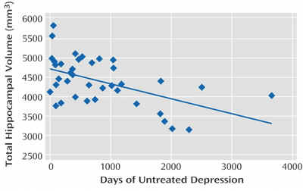

Slide 12
Brain Regions & Depression – Prefrontal Cortex
Prefrontal Cortex
Responsible for regulating emotions, making decisions, and forming memories.
Cortisol:
Excess amounts cause the prefrontal lobe to shrink.

Slide 13
Brain Regions & Depression - Amygdala
Amygdala
Part of the limbic system.
Facilitates emotional responses, such as anger, sorrow, pleasure, fear, and sexual arousal.
Cortisol:
The amygdala becomes enlarged and more active in people with MDD as a result of constant exposure to high levels of cortisol.
Enlarged and hyperactive amygdala, along with abnormal activity in other parts of the brain, can result in:
Disturbances in sleep and activity patterns
Cause the body to release irregular amounts of hormones and other chemicals, resulting in further complications.

Slide 14
Causes of Depression
Depression doesn’t occur from simply having too much or too little of certain brain chemicals. Many factors could be at play as well as many chemicals.
Possible Causes:
Faulty mood regulation by the brain
Genetic vulnerability
Stressful life events
Medications
Medical problems

Slide 15
Causes Cont.
Major impacts on depression:
Nerve cell connections
Nerve cell growth
The functioning of nerve circuits
Chemical Balance within the brain and body

Slide 16
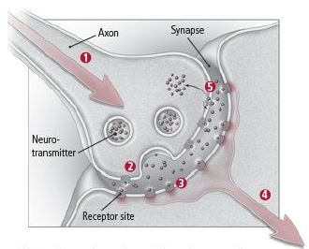
Neurotransmitters

Slide 17
When the Neurotransmitter System Falters
Brain cells usually produce levels of neurotransmitters that keep senses, learning, movements, and moods moving along normally.
For those who are severely depressed or manic, the complex systems that accomplish this balance go awry.

Slide 18
System Falters Cont.
Receptors may become oversensitive or insensitive to a specific neurotransmitter.
causing their response to its release to be excessive or inadequate.
Message might be weakened
if the originating cell pumps out too little of a neurotransmitter
if an overly efficient reuptake removes too much before the molecules have the chance to bind to the receptors on the other neurons.

Slide 19
Neurotransmitters that Play a Role in Depression
Acetylcholine
Serotonin
Norepinephrine
Dopamine
Glutamate
GABA

Slide 20
Genes and Depression
Throughout life, different genes turn off and on, so that, usually, they make the right proteins at the right time.
If these genes get it wrong, however, they can alter a person’s biology in a way that results in their mood becoming unstable.
In a genetically vulnerable person, any stress can then push this system off balance.

Slide 21
Genes and Depression Cont.
Goals of gene research in regards to depression:
To pinpoint the genes involved in mood disorders and better understand their functions.
Treatments can become more individualized and more successful
To understand how, exactly, biology makes certain people vulnerable to depression.
Ex: several genes influence the stress response, leaving us more or less likely to become depressed in response to trouble.

Slide 22
Genes and Depression Cont.
2003: Researchers found that people with a particular variant in serotonin-transporter gene (5-HTT) were more likely to become depressed in response to stress.
The gene comes in “short” (less efficient) and “long (more efficient) versions.
Short versions of the gene tend to put people at a disadvantage if they experience stressful life events.
People with a variation in the DNA sequence named G1463A are more likely to have major depression than those who don’t.

Slide 23
Temperament/World View
Development of view points occur early on.
People learn to automatically fall back on it when loss, disappointment, or rejection occurs.
Temperament is thought to have a hand in depression, although it is not as major as the other possible causes.

Slide 24
Stressful Life Events
Most people who face major stresses do not develop a mood disorder.
Stress itself, however, dose play an important role in depression.
When genetics, biology, and stressful life situations come together, depression can result.

Slide 25
Stress and Depression
Stress triggers a chain of chemical reactions and responses in the body.
If the stress is short-lived, the body usually returns to normal.
When stress is chronic or the system gets stuck in overdrive, changes in the body and brain can be long-lasting.

Slide 26
Stress Response
Stress response:
Signal sent from the hypothalamus through the secretion of corticotrophin-releasing hormone (CRH).
CRH stimulates the pituitary gland’s secretion of adrenocorticotropic hormone (ACTH)
ACTH prompts the adrenal glands’ release of cortisol
Normally, a feedback loop allows the body to turn off “fight-or-flight” defenses when the threat passes.
If the feedback loop is faulty, the cortisol levels end up rising too often or simply staying high.

Slide 27
Seasonal Affective Disorder
Seasonal Depression – affects about 1-2% of the U.S. population, mainly women and young people.
Seems to be triggered by more limited exposure to daylight.
Symptoms:
Lethargy
Loss of interest in activities that were once enjoyed
Irritability
Inability to concentrate
Change in sleep patterns, appetite, or both

Slide 28
Medical Problems and Depression
Medical illnesses or medications are thought to be the root of up to 10-15% of all depressions.
Most common culprits:
Excess of thyroid hormone – leads to manic symptoms
Too little thyroid hormone – leads to exhaustion and depression.
Heart disease
Depression can also exacerbate heart problems as well.

Slide 29
Treatment
Psychological counseling and Psychotherapy
Antidepressants
Electroconvulsive Therapy (ECT)
Transcranial Magnetic Stimulation (TMS)
Balancing the amount of cortisol and other chemicals in the brain can help reverse any shrinkage of the hippocampus and treat memory problems.
Correcting the body’s chemical levels can help reduce symptoms of MDD.

Slide 30
Antidepressants
The medications immediately boost the concentration of neurotransmitters.
Generating new neurons, strengthening nerve cell connections, and improving the exchange of info between nerve circuits.
People usually don’t start feeling better for several weeks.
Reason? May be that mood only improves as nerves grow and form new connections – a process that takes weeks.
2003 study in Science: Found the when neurogenesis is blocked in mice, the benefits of antidepressants seem to disappear.

Slide 31
Common Medications:
Selective serotonin uptake inhibitors (SSRIs)
Serotonin-norepinephrine reuptake inhibitors (SNRIs) and tricyclic antidepressants
Norepinephrine-dopamine reuptake inhibitors (NDRIs)
Monoamine oxidase inhibitors (MAOIs)
Atypical Antidepressants

Slide 32
Other Ways to Improve Brain Health and Recover from MDD
Eat healthy foods and stay active
Stimulates brain cells and strengthens communication between brain cells.
Sleep well
Helps grow and repair brain cells
Avoid alcohol and illegal drugs
Can destroy brain cells

Slide 33
References
“Depression.” National Institutes of Mental Health. U.S. Department of Health and Human Services, Oct. 2016. Web. 10 Apr. 2017.
Legg, Timothy J., PhD. “The Effects of Depression on the Brain.” Healthline. Healthline Media, 29 Feb. 2016. Web. 10 Apr. 2017.
Manji, Husseini, PhD. “Chapter 6: What Happens inside People’s Brains When They’re Depressed?” PsychEducation. James R. Phelps M.D., Dec. 2014. Web. 10 Apr. 2017.
“What Causes Depression?” Harvard Health. Harvard University, June 209. Wed. 10 Apr. 2017.

