Slide 1


Section 14.1 Equilibrium and Oscillation

Slide 2
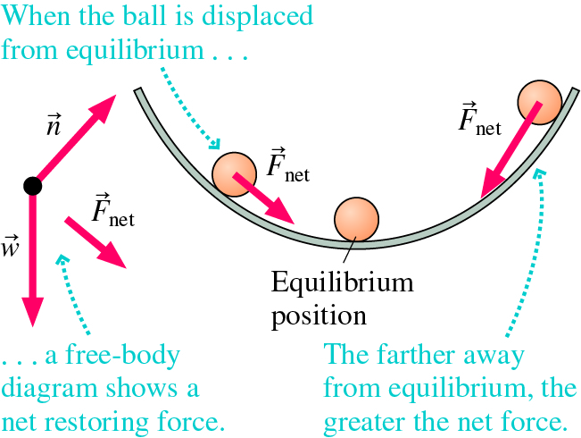
Equilibrium and Oscillation (1 of 2)
A marble at the bottom of a bowl is in stable equilibrium.
Away from equilibrium, there is a net restoring force.

Slide 3




Equilibrium and Oscillation (1 of 2)
Oscillating systems are characterized by:
Amplitude $(A)$: how far it moves from equilibrium
Period $(𝒯):$ how long it takes to complete one cycle, or
Frequency $(f)$: the number of cycles per second (Hz).
$$−A$$
$$x=0$$
$$A$$

Slide 4
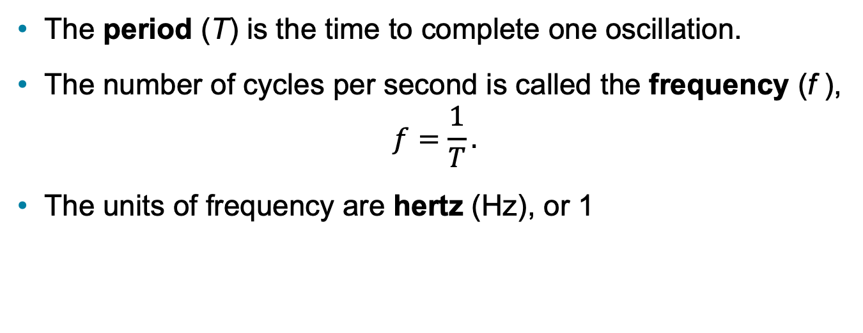
Frequency and Period (2 of 2)
The period (T) is the time to complete one oscillation.
The number of cycles per second is called the frequency (f ),
$f=\frac{1}{T}.$
The units of frequency are hertz (H z), or 1
Table 14.1 Common units of frequency
Frequency | Period
10 cubed hertz = 1 kilohertz = 1 k hertz. | 1 ms
10 to the sixth power hertz = 1 megahertz = 1 uppercase M hertz. | 1 microsecond.
10 to the ninth power hertz = 1 gigahertz = 1 G hertz. | 1 ns

Slide 5
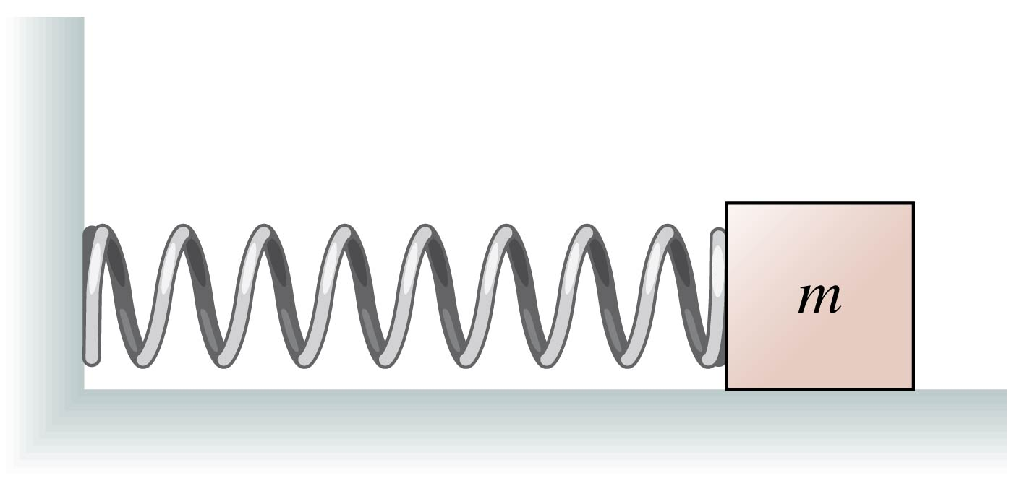
QuickCheck 14.1 (1 of 2)
A mass oscillates on a horizontal spring with period T = 2.0 s. What is the frequency?
  A. 0.50 Hz
  B. 1.0 Hz
  C. 2.0 Hz
  D. 3.0 Hz
  E. 4.0 Hz
Notes:
Answer: A

Slide 6

QuickCheck 14.1 (2 of 2)
A mass oscillates on a horizontal spring with period T = 2.0 s. What is the frequency?
  A. 0.50 Hz
  B. 1.0 Hz
  C. 2.0 Hz
  D. 3.0 Hz
  E. 4.0 Hz

Slide 7

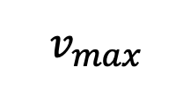
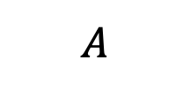
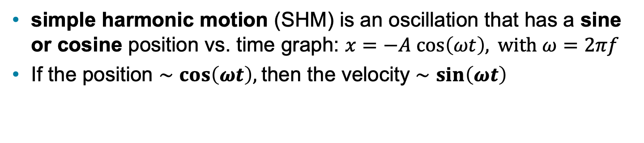

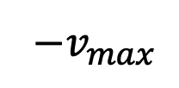







Simple Harmonic Motion (1 of 2)
simple harmonic motion (S H M) is an oscillation that has a sine or cosine position vs. time graph: $x=−A cos\left(ωt\right), \text{with} ω=2πf$
If the position $∼\cos\left(ωt\right),$then the velocity $∼\sin\left(ωt\right)$
$$A$$
$$x=0$$
$$t$$
$$−A$$
$$t=0$$
$$𝒯$$
$$v_{max}$$
$$v=0$$
$$−A$$
$$x=0$$
$$A$$
$$t$$
$${−v}_{max}$$

Slide 8
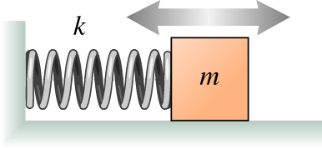
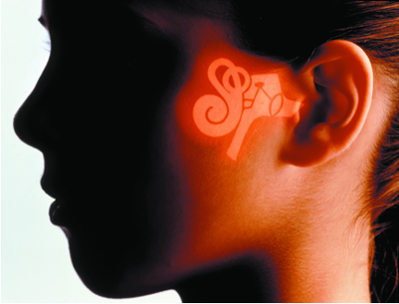
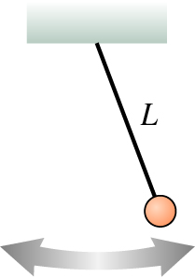
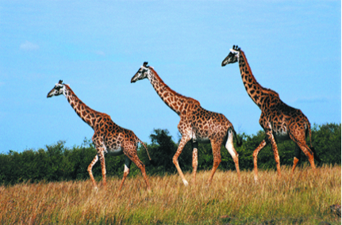
Simple Harmonic Motion (2 of 2)
Most cases of S H M can be modeled as one of two simple systems: A mass on a spring and a pendulum.
Examples of simple harmonic motion
Oscillating system | Blank | Related real-world example BIO | Blank
Mass on a spring Diagram of a spring-mass oscillator with spring labeled k affixed to a board on the left side and block labeled m attached on the right side. | The mass oscillates back and forth due to the restoring force of the spring. The period depends on the mass and the stiffness of the spring. | Vibrations in the ear A photograph shows a girl’s face in profile with an illustration of the inner ear superimposed. | Sound waves entering the ear cause the oscillation of a membrane in the cochlea, part of the inner ear. The vibration can be modeled as a mass on a spring. The period of oscillation of a segment of the membrane depends on mass (the thickness of the membrane) and stiffness (the rigidity of the membrane).
Pendulum A diagram shows a pendulum with length L swinging left and right. | The mass oscillates back and forth due to the restoring gravitational force. The period depends on the length of the Pendulum and the free-fall acceleration g. | Motion of legs while walking A photograph shows giraffes walking across a grassland. | The motion of a walking animal’s legs can be modeled as pendulum motion. The rate at which the legs swing depends on the length of the legs and the free-fall acceleration g.

Slide 9
Section 14.2 Linear Restoring Forces and SHM

Slide 10
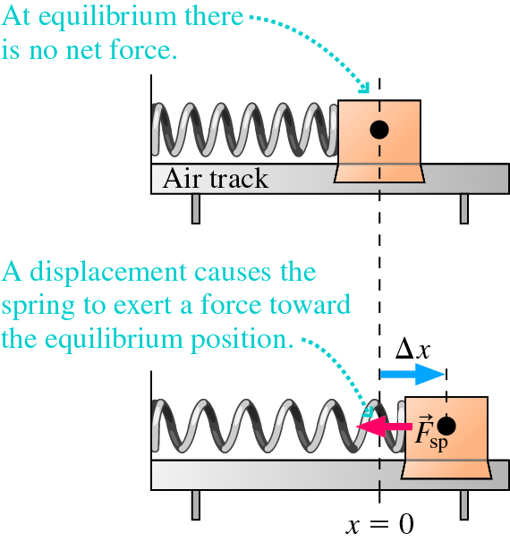
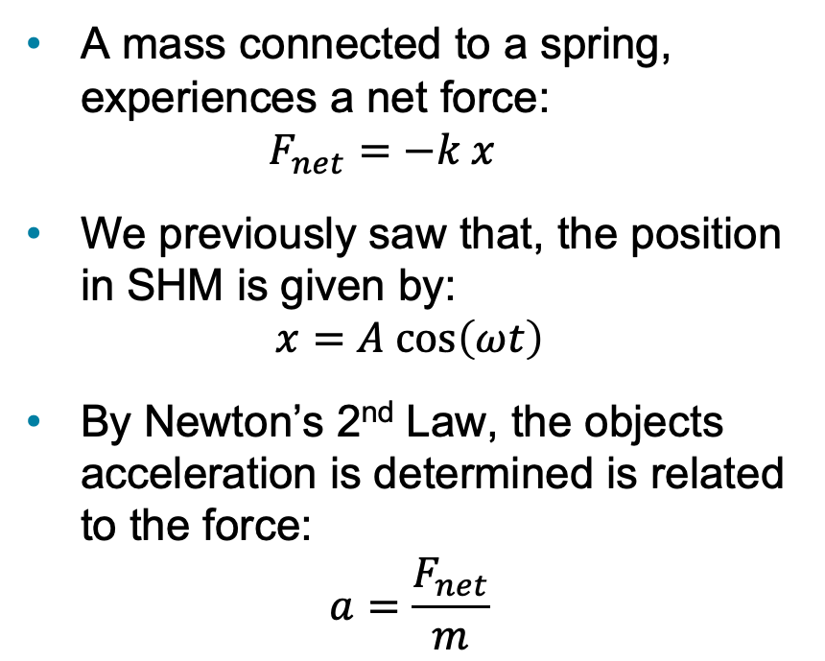

Linear Restoring Force and SHM
A mass connected to a spring, experiences a net force:
$F_{net}=−k x$
We previously saw that, the position in SHM is given by:
$$x=A \text{cos}\left(ωt\right)$$
By Newton’s 2nd Law, the objects acceleration is determined is related to the force:
$$a=\frac{F_{net}}{m}$$
So, the acceleration of a mass on a spring is:
$$a=\frac{F_{net}}{m}=−\frac{k}{m}A\cos{(ωt)}$$

Slide 11
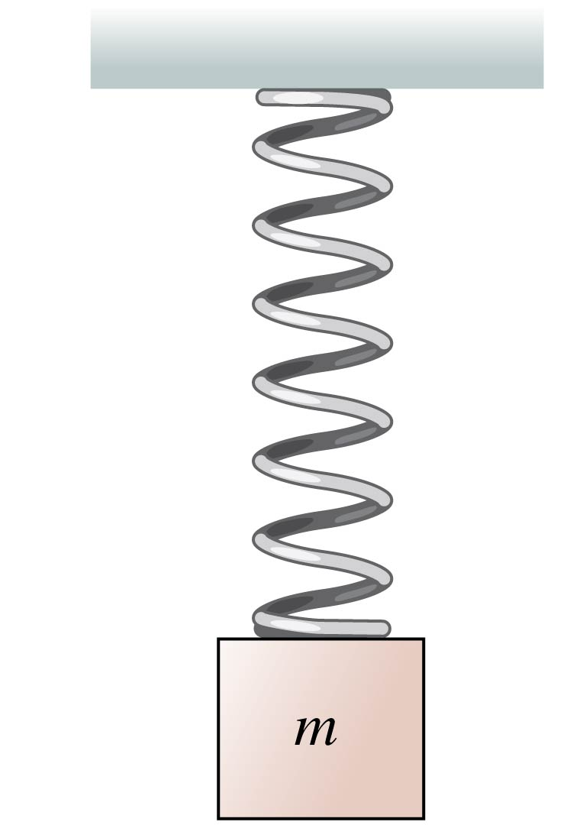
QuickCheck 14.6 (1 of 2)
A block oscillates on a vertical spring. When the block is at the lowest point of the oscillation, it’s acceleration a_{y} is
  A. Negative.
  B. Zero.
  C. Positive
Notes:
Answer: C

Slide 12
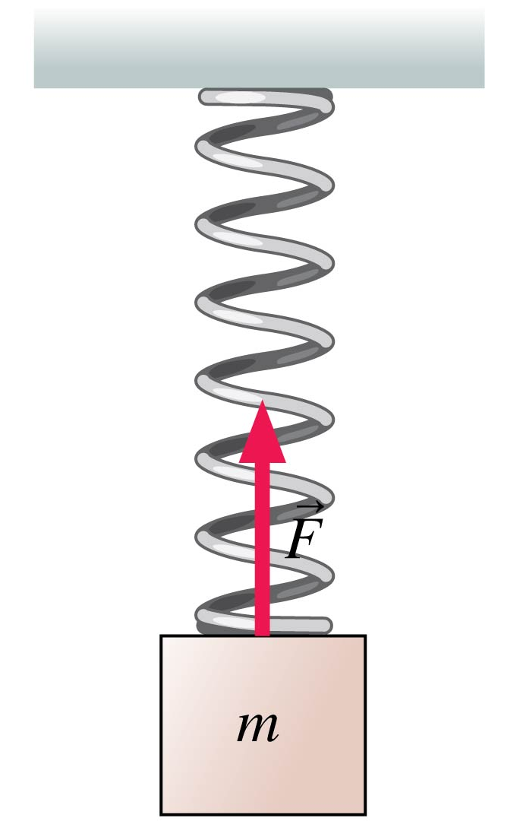
QuickCheck 14.6 (2 of 2)
A block oscillates on a vertical spring. When the block is at the lowest point of the oscillation, it’s acceleration a_{y} is
  A. Negative.
  B. Zero.
  C. Positive

Slide 13
Section 14.3 A Curious Similarity to Uniform Circular Motion
  Prelecture Video: Describing Simple Harmonic Motion

Slide 14
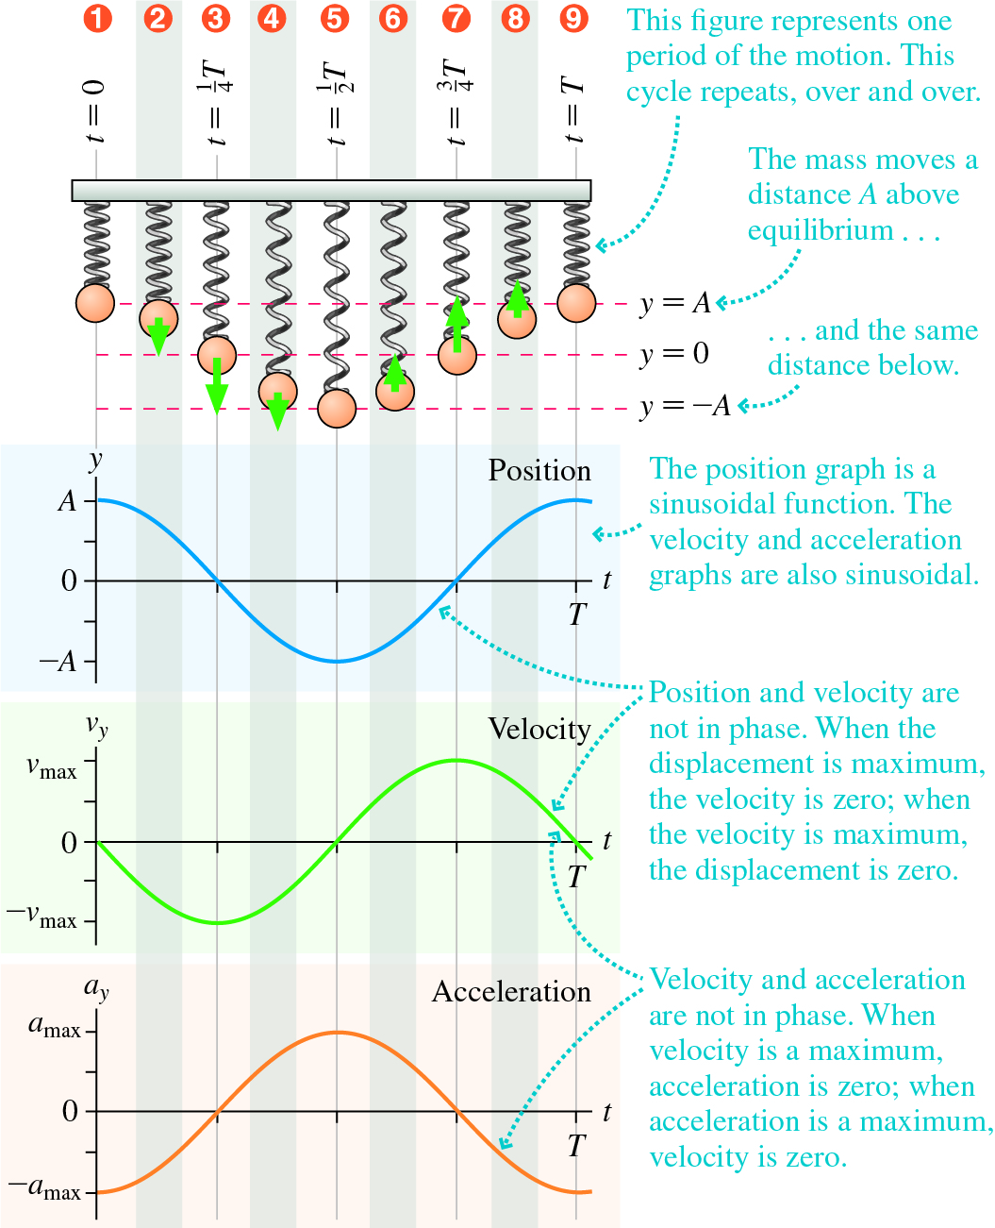
Describing Simple Harmonic Motion (2 of 7)
1. The mass starts from rest at y=A, the acceleration is negative.
3. The mass crosses the equilibrium position with maximum negative speed and zero acceleration.
5. The mass reaches y=-A, is at rest, with maximum positive acceleration…
Text: page 489

Slide 15
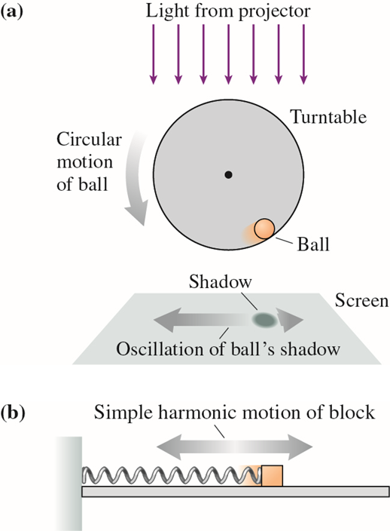
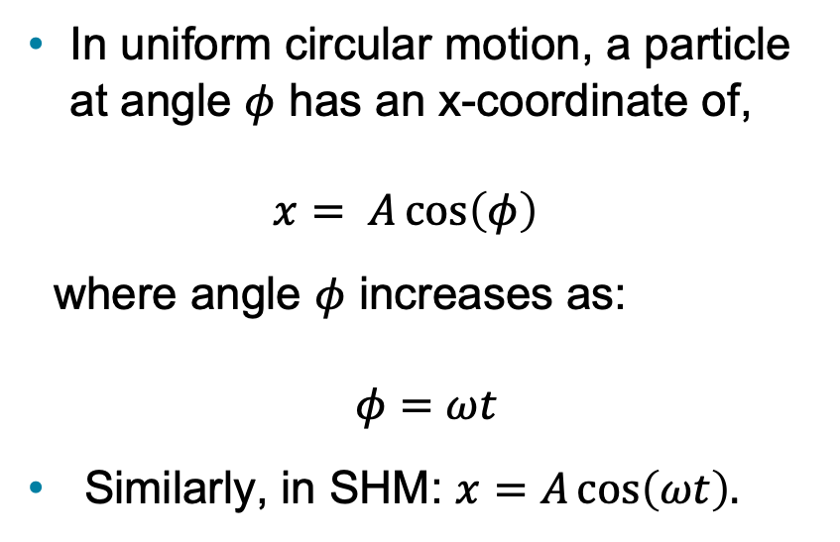

SHM $↔$ Uniform Circular Motion
In uniform circular motion, a particle at angle $φ$ has an x-coordinate of,
$x= A\cos\left(φ\right)$
where angle $φ$ increases as:
$$φ=ωt$$
Similarly, in SHM: $x=A\cos\left(ωt\right).$
Simple harmonic motion is just uniform circular motion projected onto one dimension.

Slide 16
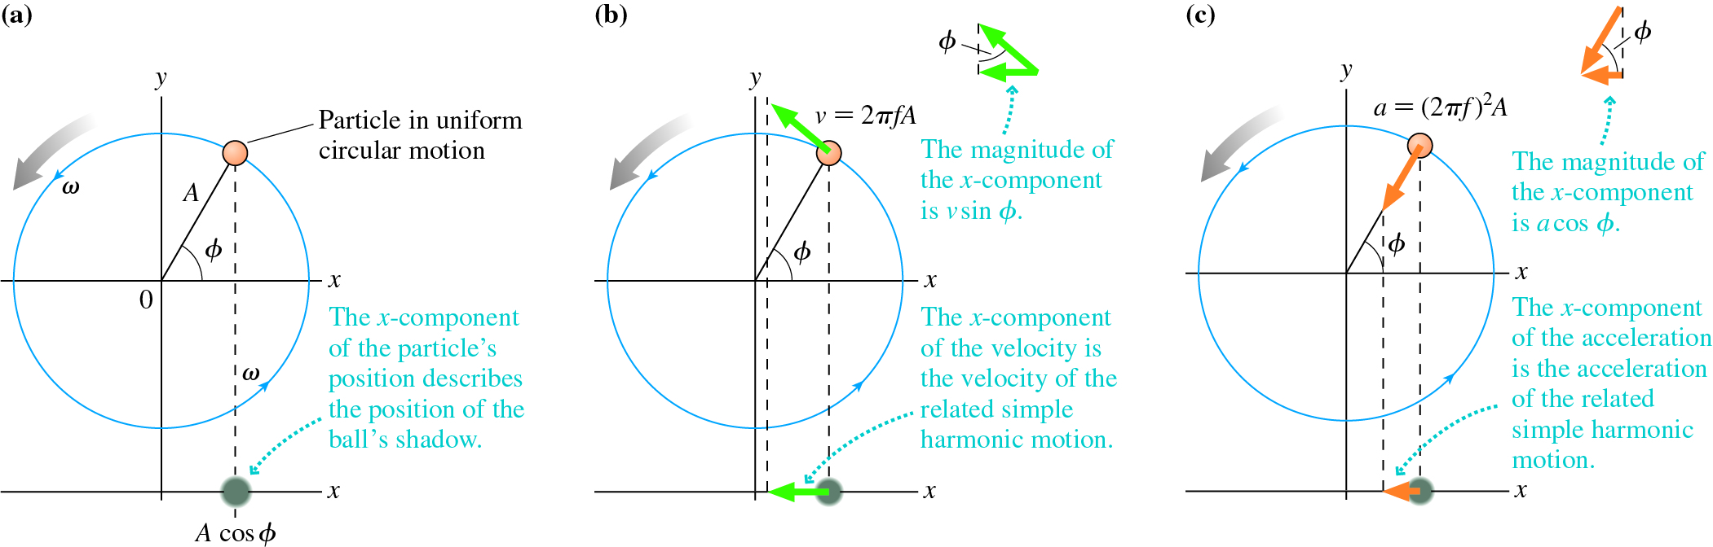
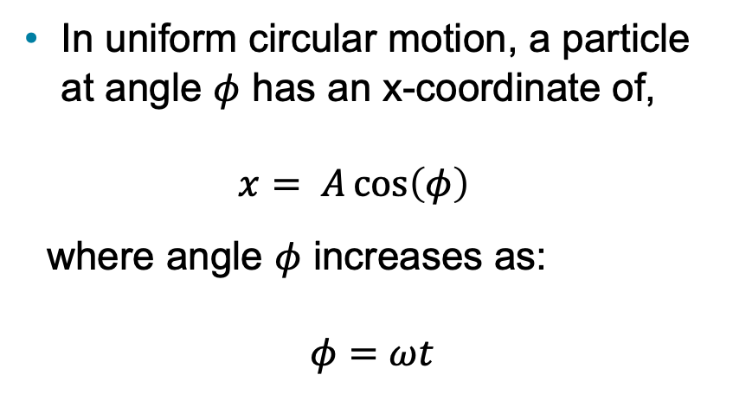

SHM $↔$ Uniform Circular Motion
In uniform circular motion, a particle at angle $φ$ has an x-coordinate of,
$x= A\cos\left(φ\right)$
where angle $φ$ increases as:
$$φ=ωt$$

Slide 17
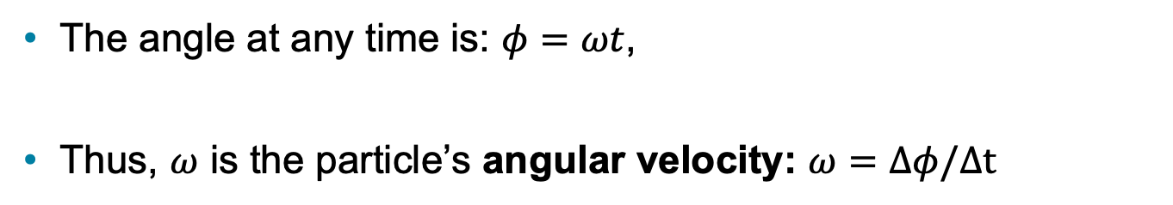
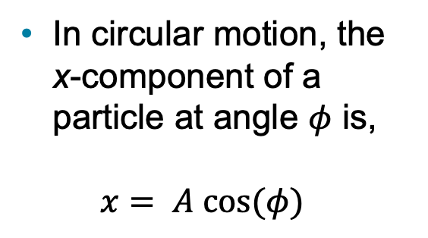
Connecting SHM to Uniform Circular Motion (2 of 5)
In circular motion, the x-component of a particle at angle $φ$ is,
$x= A cos⁡(φ)$
The angle at any time is: $φ=ωt$,
Thus, $ω$ is the particle’s angular velocity: $ω=Δφ/Δt$

Slide 18





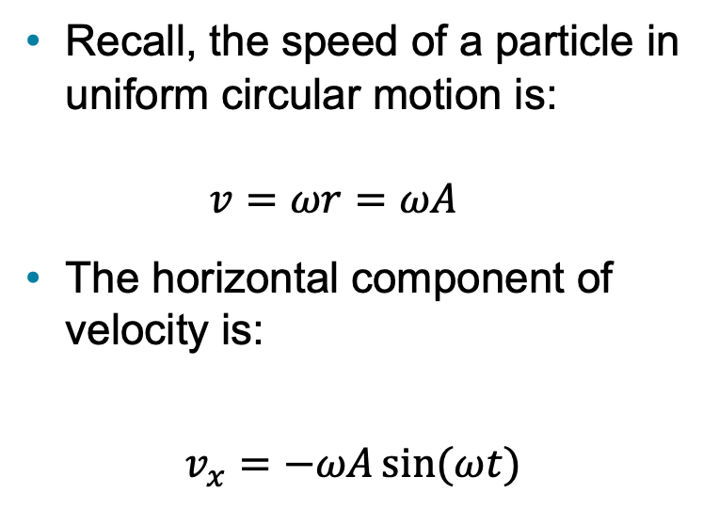

Velocity in SHM $↔$ UCM
Recall, the speed of a particle in uniform circular motion is:
$v=ωr=ωA$
The horizontal component of velocity is:
$$v_{x}=−ωA\sin{(ωt)}$$
$$v$$
$$ω$$
$$v$$
$$v_{x}$$
$$v_{x}$$

Slide 19


Example 14.2 A Glider on a Spring
A mass on a spring oscillates horizontally at a frequency of 0.50 Hz. If the mass was pulled to the right of equilibrium by 12 cm and then released:
Where will the glider be 0.5 s after its release?
What is its velocity at this point?
$$x=0$$
$$v=0.4 \text{m}\text{/}\text{s}$$

Slide 20





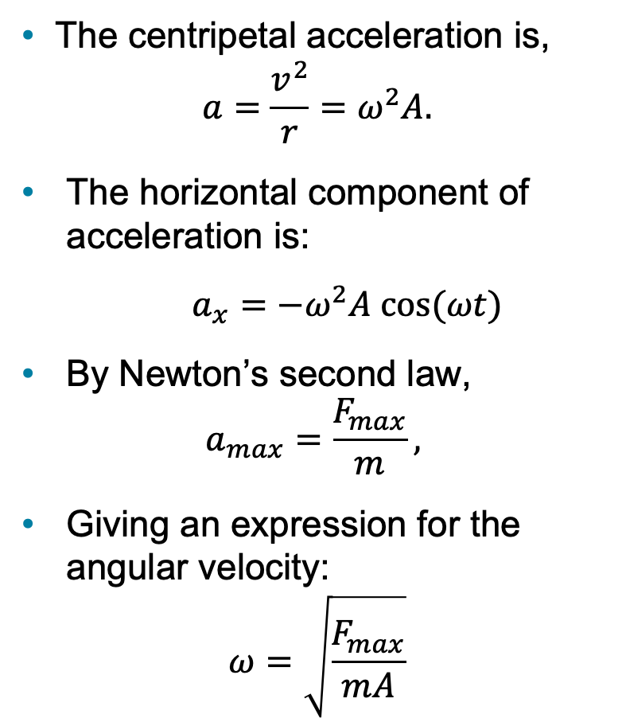

Acceleration in SHM $↔$ UCM
$$a_{c}$$
The centripetal acceleration is,
$$a=\frac{v^{2}}{r}=ω^{2}A.$$
The horizontal component of acceleration is:
$a_{x}=−ω^{2}A cos⁡(ωt)$
By Newton’s second law,
$$a_{max}=\frac{F_{max}}{m},$$
Giving an expression for the angular velocity:
$$ω=\sqrt{\frac{F_{max}}{mA}}$$
$$ω$$
$$a_{x}$$
$$a_{c}$$
$$a_{x}$$

Slide 21


Example 14.2 A Glider on a Spring
A 5 kg mass on a spring oscillates horizontally at a frequency of 0.50 Hz. If the mass was pulled to the right of equilibrium by 12 cm and then released:
What is the mass’s initial acceleration?
What is the spring constant of the mass?
$$a_{i}=−1.2 \text{m}\text{/}{\text{s}}^{\text{2}}$$
$$k=50 \text{N}\text{/}\text{m}$$

Slide 22
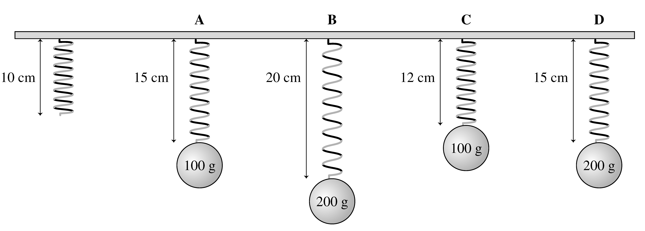
QuickCheck 14.7 (1 of 2)
A set of springs all have initial length 10 cm. Each spring now has a mass suspended from its end, and the different springs stretch as shown below.
Now, each mass is pulled down by an additional 1 cm and released, so that it oscillates up and down. Which of the oscillating systems has the highest frequency?
Notes:
Answer: C

Slide 23
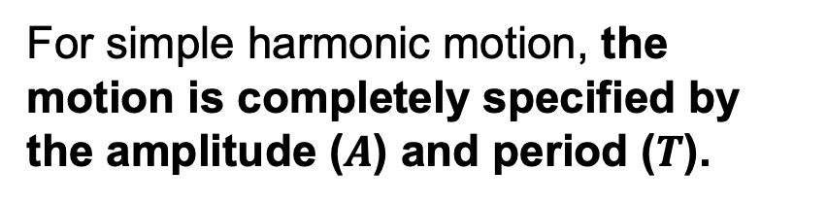
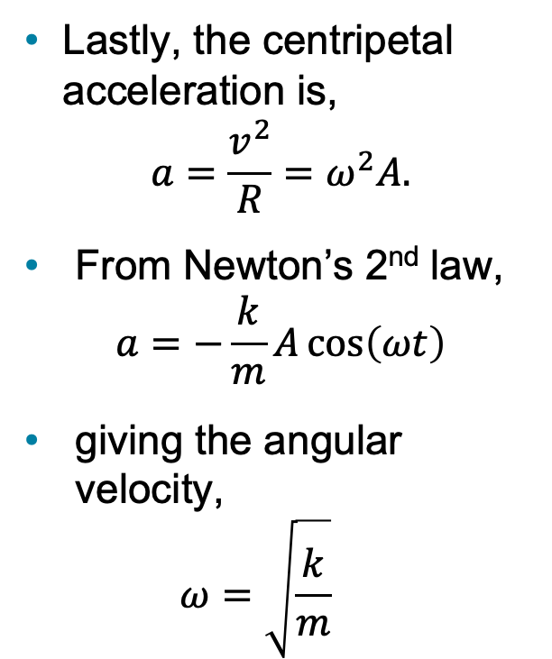
Connecting SHM to Uniform Circular Motion (5 of 5)
Lastly, the centripetal acceleration is,
$$a=\frac{v^{2}}{R}=ω^{2}A.$$
From Newton’s 2nd law,
$a=−\frac{k}{m}A\cos\left(ωt\right)$
giving the angular velocity,
$ω=\sqrt{\frac{k}{m}}$
For simple harmonic motion, the motion is completely specified by the amplitude ($A$) and period ($T$).

Slide 24

Icon of graph showing sinusoidal function Sinusoidal Relationships (2 of 2)
LIMITS If x is a sinusoidal function, then x is:
Bounded—it can take only values between A and −A.
Periodic—it repeats the same sequence of values over and over again.
Whatever value x has at time t, it has the same value at t + T.

Slide 25
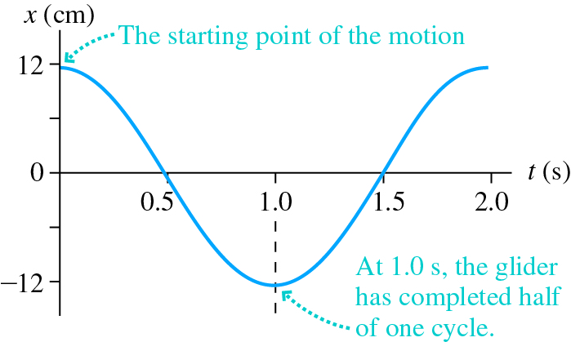
Example 14.2 Understanding the Motion of a Glider on a Spring (2 of 3)
STRATEGIZE The motion of the glider will be sinusoidal. It is released from rest at x = 12 cm, so its amplitude is 12 cm.
PREPARE The frequency is 0.50 Hz, so the period is
The glider is released at maximum extension from the equilibrium position, meaning that we can take this point to be t = 0.

Slide 26
Example 14.2 Understanding the Motion of a Glider on a Spring (3 of 3)
SOLVE 1.0 s is exactly half the period. As the graph of the motion in the figure shows, half a cycle brings the glider to its left turning point, 12 cm to the left of the equilibrium position. The velocity at this point is zero.
ASSESS Drawing a graph was an important step that helped us make sense of the motion.

Slide 27
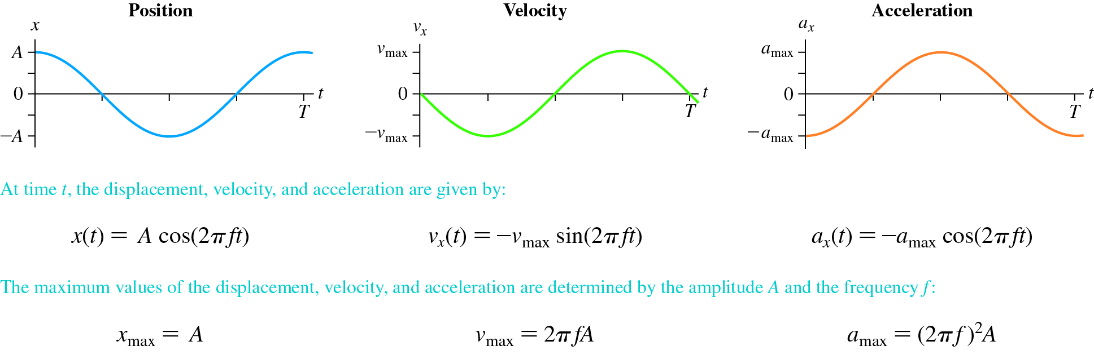
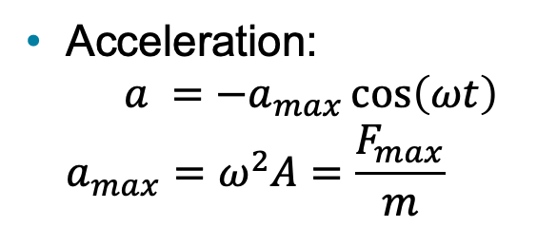
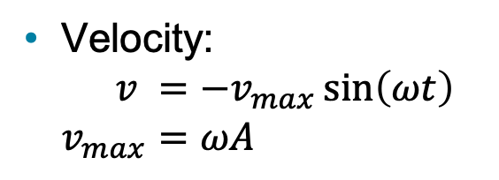
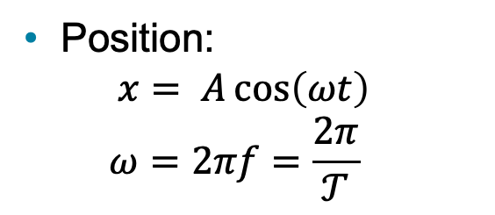
Simple Harmonic Motion
Position:
$x= A\cos\left(ωt\right)$
$ω=2πf=\frac{2π}{𝒯}$
Velocity:
$v ={−v}_{max}\sin\left(ωt\right)$
$v_{max}=ωA$
Acceleration:
$a ={−a}_{max}\cos\left(ωt\right)$
$a_{max}=ω^{2}A=\frac{F_{max}}{m}$

Slide 28
Section 14.4 Energy in Simple Harmonic Motion
  Prelecture Video: Details of Simple Harmonic Motion

Slide 29
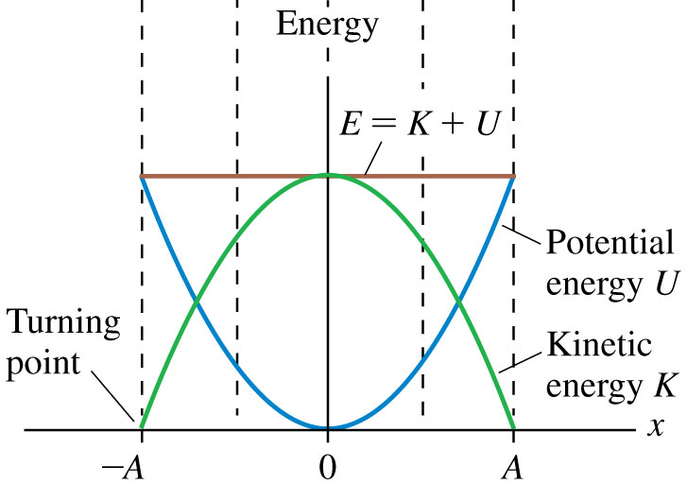
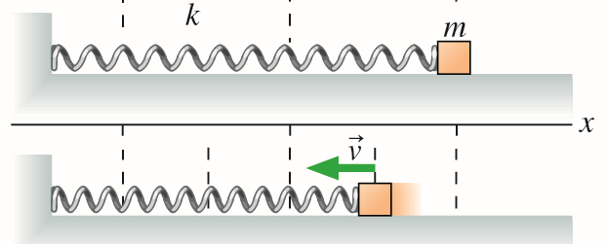
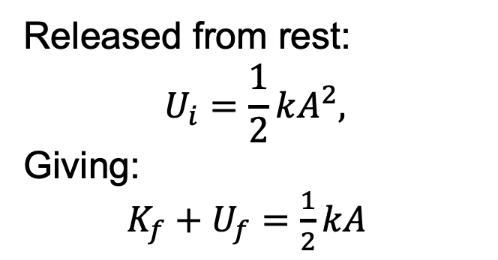


Energy in Simple Harmonic Motion
Total energy is conserved:
$$E_{f} −E_{i}=0, \\ ΔK+ΔU=0,$$
For a spring:
$$U_{sp}=\frac{1}{2}kx^{2},$$
Released from rest:
$$U_{i}=\frac{1}{2}kA^{2},$$
Giving:
$K_{f}+U_{f}=\frac{1}{2}kA$

Slide 30
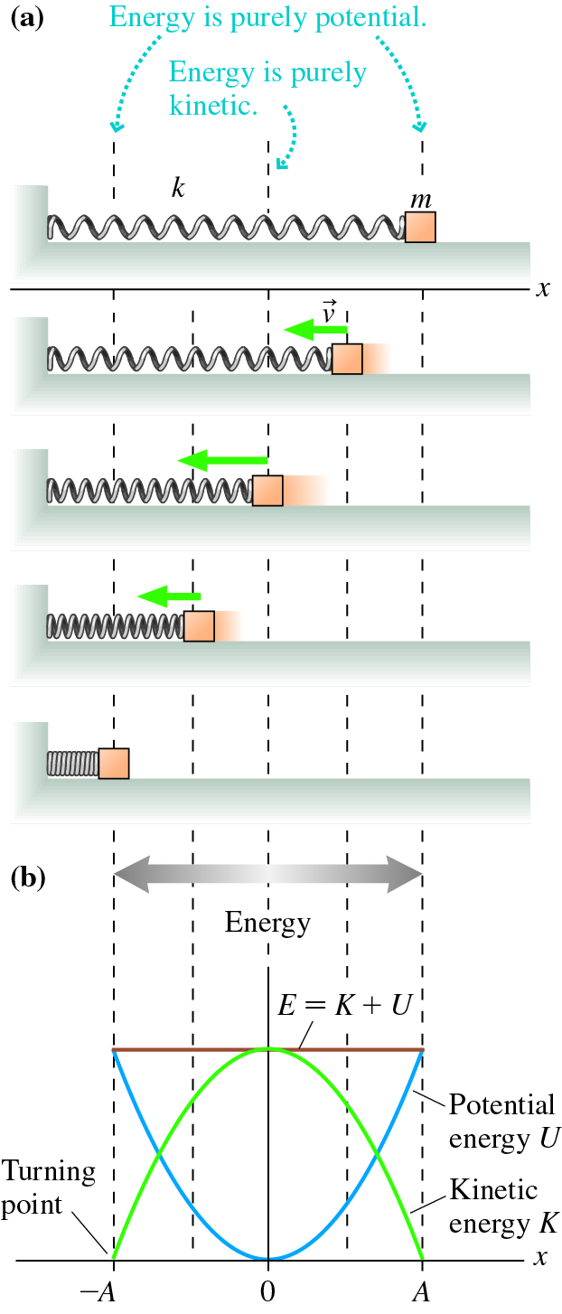


Energy in Simple Harmonic Motion (3 of 4)
For the mass on a spring is:
$$U_{s}=\frac{1}{2}kx^{2}$$
The total energy is conserved:
$$E_{f} −E_{i}=0, \\ ΔK+ΔU=0,$$

Slide 31
Energy in Simple Harmonic Motion (4 of 4)
At maximum displacement, the energy is purely potential:
At x = 0, the equilibrium position, the energy is purely kinetic:

Slide 32
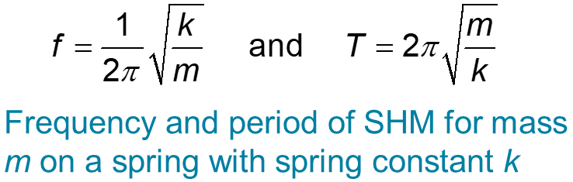
Finding the Frequency for Simple Harmonic Motion (1 of 2)
Because of conservation of energy, the maximum potential energy must be equal to the maximum kinetic energy:
Solving for the maximum velocity we find:
Earlier we found that:

Slide 33
QuickCheck 14.7 (1 of 2)
A set of springs all have initial length 10 cm. Each spring now has a mass suspended from its end, and the different springs stretch as shown below.
Now, each mass is pulled down by an additional 1 cm and released, so that it oscillates up and down. Which of the oscillating systems has the highest frequency?
Notes:
Answer: C

Slide 34
Equilibrium and Oscillation (1 of 2)
Oscillating systems are characterized by:
Amplitude $(A)$: how far it moves from equilibrium
Period $(𝒯):$ how long it takes to complete one cycle, or
Frequency $(f)$: the number of cycles per second (Hz).
$$−A$$
$$x=0$$
$$A$$

Slide 35
Section 14.6 Damped Oscillations
  Prelecture Video: Damping and Resonance

Slide 36
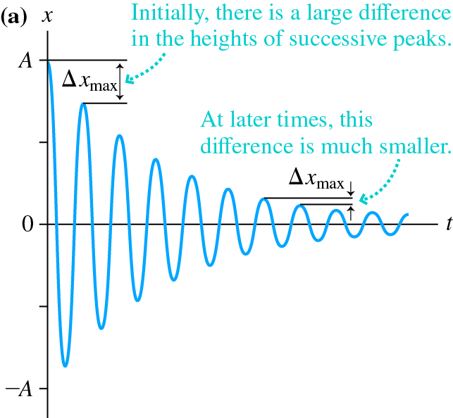




Damped Oscillation
$$A_{0}$$
$$0$$
$$t$$
envelope
$${−A}_{0}$$
Damped oscillations decay and stop due to dissipation.
For a pendulum, energy is lost due to air resistance (drag)
The amplitude oscillations is bounded by an envelope.

Slide 37
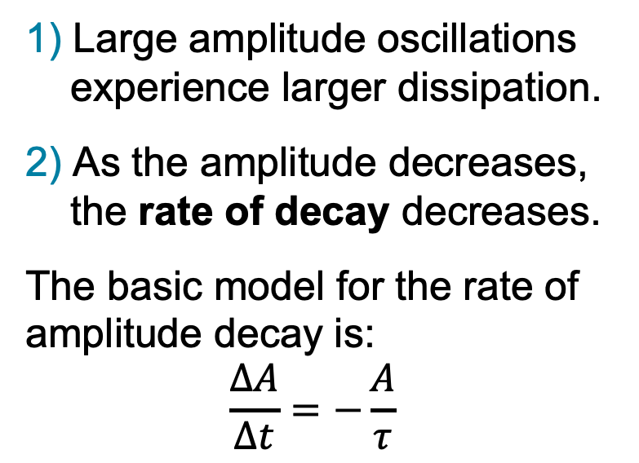

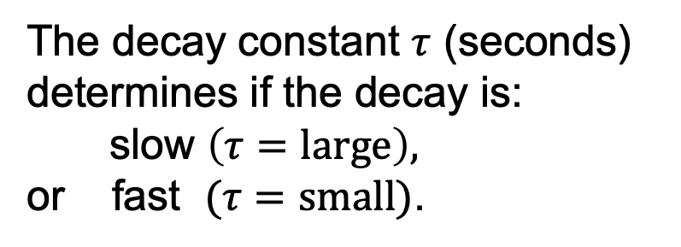




Damped Oscillation
1) Large amplitude oscillations
experience larger dissipation.
2) As the amplitude decreases,
the rate of decay decreases.
The basic model for the rate of amplitude decay is:
$$\frac{ΔA}{Δt}=−\frac{A}{τ}$$
$$A_{0}$$
$$ΔA_{1}$$
$$ΔA_{2}$$
The decay constant $τ$ (seconds) determines if the decay is:
slow $\left(τ=\text{large}\right),$
or fast $(τ=\text{small})$.
$$0$$
envelope
$${−A}_{0}$$

Slide 38



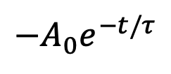




Damped Oscillation
The envelope of a damped-SHO released from rest decays exponentially:
$x_{max}=A_{0}e^{−t/τ}$
and has a position/time graph:
$$x=x_{max}\cos{ωt,}$$
$$A_{0}$$
$$A_{0}e^{−t/τ}$$
Term $e≈2.718$ is the base of the natural logarithm and $A_{0}$ is the initial amplitude.
When $t =τ,$ $x_{max}=\frac{A_{0}}{e}$
$$0$$
$$t$$
$$−A_{0}e^{−t/τ}$$
$${−A}_{0}$$

Slide 39

Example Problem (4 of 4)
A 500 g mass on a string oscillates as a pendulum. The pendulum’s maximum height decays to 50% of its initial value in 30 s. What is the value of the damping constant?
$$τ=43 \text{s}$$
Notes:
Answer: The energy is proportional to the square of the amplitude. The energy decays to 50% in 30 seconds, so the amplitude decays to sqrt(0.5) = 0.71 of its initial value in 30 s. So 0.71 = exp(−30/τ) where τ is the time constant. So: −0.34 = −30/τ gives τ = 30/0.34 = 90 s.

Slide 40
Section 14.7 Driven Oscillations and Resonance

Slide 41




Natural Frequency
Oscillators have a natural frequency f ₀, the frequency of the system if it is displaced from equilibrium and released:
Recall, for simple harmonic motion:
$a_{max}=ω_{0}^{2}A=\frac{F_{max}}{m}$
For a mass on a spring: $ω_{0}=\sqrt{\frac{k}{m}}$
Linear pendulum (swing):
$$→ω_{0}=2πf_{0}=\sqrt{\frac{F_{max}}{mA}}$$
$$ω_{0}=\sqrt{\frac{g}{L}}$$

Slide 42

Driven Oscillation
Driven oscillation is the motion of an oscillator that is subjected to a periodic external force.
The driving frequency f _{ext} of the periodic external force is independent of the natural frequency.
Resonance
Resonance occurs when the driving frequency matches the natural frequency of the oscillator.
When this occurs, the oscillators amplitude will increase.

Slide 43









Response Curve
$$f_{0}≈600\text{Hz}$$
An oscillator’s response curve is the graph of amplitude versus driving frequency.
$$f_{ext}$$
$$400\text{Hz}$$
$$600\text{Hz}$$
$$1000\text{Hz}$$
Tacoma Narrows Bridge
Millennium Bridge

Slide 44




Resonance With Eddy Shedding
What eddy-shedding frequency will resonate with a 5kg beam hung from with cables that have an effective spring constant of 50 N/m?
$$f=0.5 \text{s}$$
Experimental evidence shows the eddy shedding frequency follows: $f≈0.2\frac{v_{w}}{D}$. What is the resonant windspeed ${(v}_{w})$ for a cylinder with diameter $D=12$cm?
$$v_{w}=0.3 m/\text{s}$$

Slide 45
Conceptual Example 14.13 Fixing an Unwanted Resonance in a Railroad Car (1 of 2)
Railroad cars have a natural frequency at which they rock side to side. If a train car begins to sway with a large amplitude of oscillation due to joints in the track that alternate sides. How can the driver correct this potentially dangerous situation?

Slide 46
Conceptual Example 14.13 Fixing an Unwanted Resonance in a Railroad Car (2 of 2)
REASON The large amplitude of oscillation is produced by a resonance, a match between the frequency at which the train car rocks back and forth and the frequency at which the car hits the bumps. To eliminate this resonance, the driver must either reduce the speed of the train—decreasing the driving frequency—or increase the speed of the train—thus increasing the driving frequency.
ASSESS It’s perhaps surprising that increasing the speed of the train could produce a smoother ride. But increasing the frequency at which the train hits the bumps will eliminate the match with the natural rocking frequency just as surely as decreasing the speed.

Slide 47

Resonance and Hearing (1 of 3)
Resonance in a system means that certain frequencies produce a large response and others do not. Resonances enable frequency discrimination in the ear.

Slide 48

Resonance and Hearing (2 of 3)
In a simplified model of the cochlea, sound waves produce large-amplitude vibrations of the basilar membrane at resonances. Lower-frequency sound causes a response farther from the stapes.
Hair cells sense the vibration and send signals to the brain.

Slide 49
Resonance and Hearing (3 of 3)
The fact that different frequencies produce maximal response at different positions allows your brain to very accurately determine frequency because a small shift in frequency causes a detectable change in the position of the maximal response.

Slide 50
Summary
Video Tutor Solution Chapter 14: Mass on a Spring

Slide 51


Summary: General Principles (1 of 3)
Frequency and Period
S H M occurs when a linear restoring force acts to return a system to an equilibrium position. The frequency and period depend on the details of the oscillator, but the frequency and period do not depend on the amplitude.
Mass on spring
Pendulum

Slide 52
Summary: General Principles (2 of 3)
Frequency and Period
The frequency and period of a pendulum depend on the length and the free-fall acceleration. They do not depend on the mass.
The frequency and period of a mass on a spring depend on the mass and the spring constant: They are the same for horizontal and vertical systems.
Text: page 509

Slide 53

Summary: General Principles (3 of 3)
Energy
If there is no friction or dissipation, kinetic and potential energies are alternately transformed into each other in S H M, with the sum of the two conserved.
Text: page 509

Slide 54

Summary: Important Concepts (1 of 2)
Oscillation
An oscillation is a repetitive motion about an equilibrium position. The amplitude A is the maximum displacement from equilibrium. The period T is the time for one cycle. We may also characterize an oscillation by its frequency f.
Text: page 509

Slide 55



Summary: Important Concepts (2 of 2)
Simple Harmonic Motion (SHM)
S H M is an oscillation that is described by a sinusoidal function. All systems that undergo S H M can be described by the same functional forms.
Position-versus-time is a cosine function.
Velocity-versus-time is an inverted sine function.
Acceleration-versus-time is an inverted cosine function.
Text: page 509

Slide 56

Summary: Applications (1 of 3)
Damping
Simple harmonic motion with damping (due to drag) decreases in amplitude over time. The time constant
determines how quickly the amplitude decays.
Text: page 509

Slide 57

Summary: Applications (2 of 3)
Resonance
A system that oscillates has a natural frequency of oscillation f₀. Resonance occurs if the system is driven with a frequency f_{ext} that matches this natural frequency. This may produce a large amplitude of oscillation.
Text: page 509

Slide 58

Summary: Applications (3 of 3)
Physical Pendulum
A physical pendulum is a pendulum with mass distributed along its length. The frequency depends on the position of the center of gravity and the moment of inertia.
The motion of legs during walking can be described using a physical pendulum model.
Text: page 509

Slide 59

Copyright
This work is protected by United States copyright laws and is provided solely for the use of instructors in teaching their courses and assessing student learning. Dissemination or sale of any part of this work (including on the World Wide Web) will destroy the integrity of the work and is not permitted. The work and materials from it should never be made available to students except by instructors using the accompanying text in their classes. All recipients of this work are expected to abide by these restrictions and to honor the intended pedagogical purposes and the needs of other instructors who rely on these materials.

