Slide 1
Symmetry Tests of Rare η Decays to All Neutral Final States:
The Jlab Eta Factory (JEF) Experiment
Liping Gan
University of North Carolina Wilmington
Physics Motivation
  Why the η is unique for symmetry tests
  ChPT, C-violating and P-conserving new physics
Proposed experiment in Hall D
Response to PAC39 Comments
Summary
Outline

Slide 2
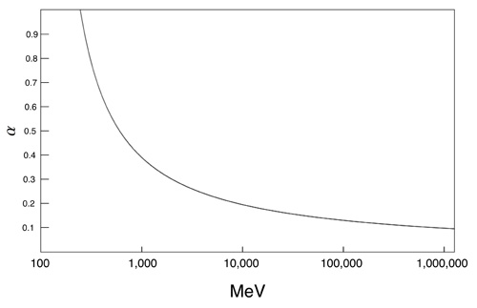
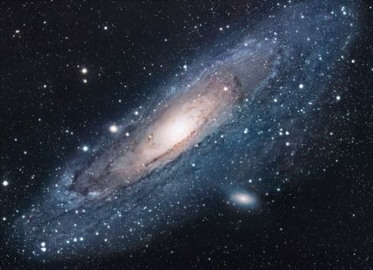
  Challenges in Physics
Confinement QCD
  Chiral perturbation theory (ChPT)
  Lattice QCD
QCD at different energies
New physics beyond the Standard Model (SM)
  New sources of symmetry violation
  Dark matter
  Dark energy
“As far as I see, all a priori statements in physics have their origin in symmetry”. By H. Weyl

Slide 3
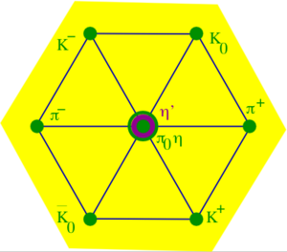

Why η is a unique probe
A Goldstone boson due to spontaneous breaking of
QCD chiral symmetry
η is one of key mesons bridging our
understanding of low-energy hadron dynamics
and underlying QCD
η decay width Γ_{η} =1.3KeV is narrow (relative to Γ_{ω}=8.5 MeV)
    The lowest orders of η decays are filtered out, enhancing the contributions from higher orders by a factor of ~7,000 compared to ω decays.
Eigenstate of P, C, CP, and G:
Study violations of discrete symmetries
The η decays are flavor-conserving reactions effectively free of
SM backgrounds for new physics search.

Slide 4
η Neutral Decays
Mode | Branching Ratio (PDG) | Physics Highlight
π⁰ 2γ | ( 2.7 ± 0.5 ) × 10 ⁻ ⁴ | χPTh @ Ο(p⁶)
3γ | <1.6 × 10 ⁻ ⁵ | C
2π⁰ | <3.5 × 10 ⁻⁴ | CP, P
4γ | <2.8 × 10 ⁻⁴ | Suppressed (<10⁻¹¹)
2π⁰ γ | <5 × 10 ⁻ ⁴ | C
π⁰ γ | <9 × 10 ⁻ ⁵ | C, L, gauge inv.
3π⁰ γ | <6 × 10 ⁻ ⁵ | C
4π⁰ | <6.9 × 10 ⁻ ⁷ | CP, P
3π⁰ | (32.57±0.23)% | Quark mass m_{d}-m_{u}
2γ | (39.31±0.20)% | Anomaly, η−η’ mixing
Physics goal
determine two
O(p⁶) LEC’s in the
chiral Lagrangian.
directly constrain
C-violating and
P-conserving new
physics
parasitically collect data for other channels

Slide 5
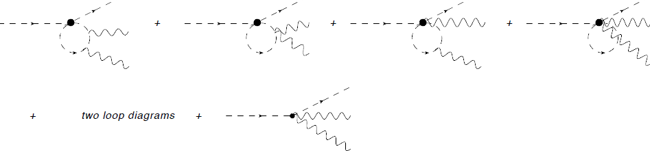
Allowed Rare Decay η→π⁰γγ
ChPT is highly developed and well-tested in the domain of pionic and kaonic
reactions. η →π⁰γγ is one of a few important channels to benchmark the success
of ChPT in the η-sector.
The major contributions to η →π⁰γγ are two O(p⁶) counter-terms in
the chiral Lagrangian a rare window for the high order ChPT contributions.
L. Ametller, J. Bijnens et. al., Phys. Lett., B276, 185
O(p⁶)
counter-term
Precision measurements of both the branching ratio and the Dalitz distribution
of η →π⁰γγ are critical to model-independently determine two Low Energy
Constants (LEC’s) of the O(p⁶) counter-terms in the chiral Lagrangian.

Slide 6


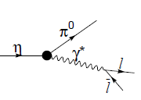
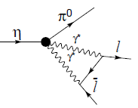
η→π⁰γγ and Other Rare Decays
η →π⁰γγ is an important “door-way” channel for interpretation of other rare
decays searching for new sources of C- or CP-violation
K_{L} Sector: CP violation search K_{L} →π⁰l⁺l⁻
CP conserving background
η
L.M. Sehgal, Phys. Rev., D38, 808 (1988)
K_{L} →π⁰ 2γ was recently measured by KTeV to estimate the CP conserving contributions
η Sector: C and CP search η →π⁰l⁺l⁻
C and CP violating
C and CP conserving background
J.N. Ng, et al., Phys. Rev., D46, 5034 (1992)
A cross-check of LEC's with different processes
test the foundations of ChPT.

Slide 7
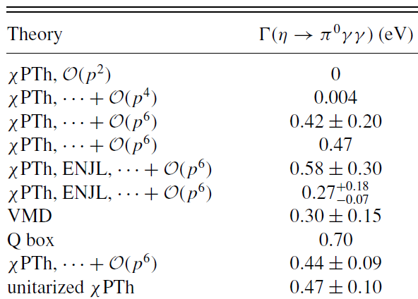
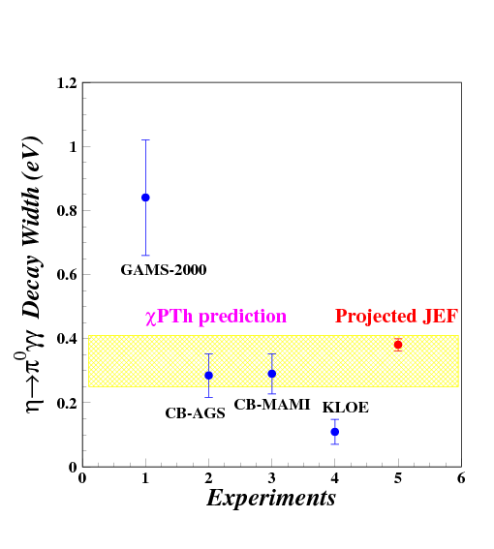

Status of η→π⁰γγ: Partial Decay Width
There have been about 20 experiments since 1966.
Experiments After 1980
Average ~0.44 eV
χPTh by Oset et al., Phys. Rev. D77, 07300 (2008)

Slide 8
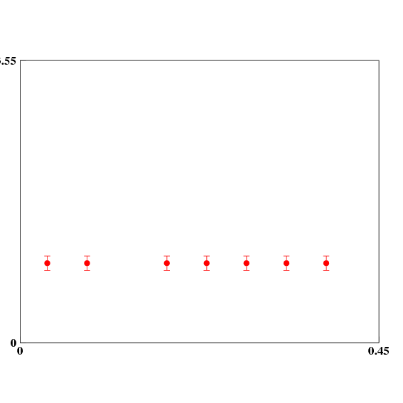
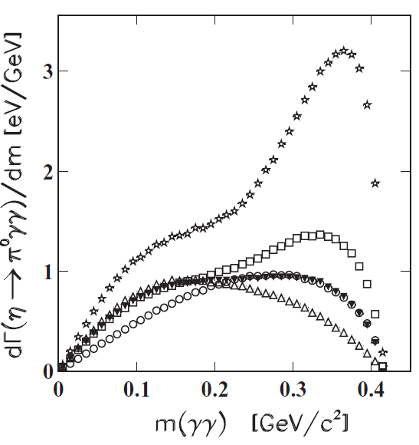
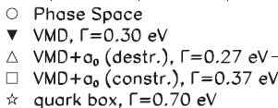
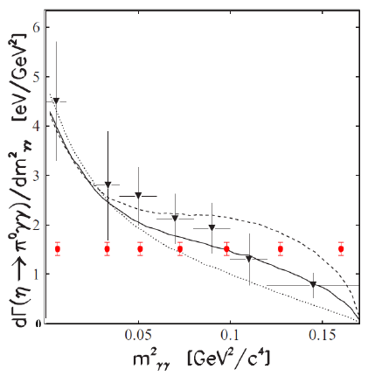
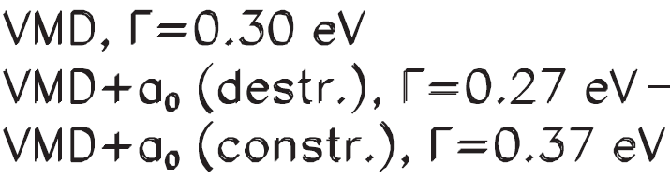
Status of η→π⁰γγ: Dalitz Distribution
Prakhov et al., Phys. Rev. C78, 015206 (2008)
CB-AGS
Projected JEF
Combined BR and Dalitz measurement
model-independent determination of two LEC’s of the O(p⁶)
counter- terms in the chiral Lagrangian

Slide 9
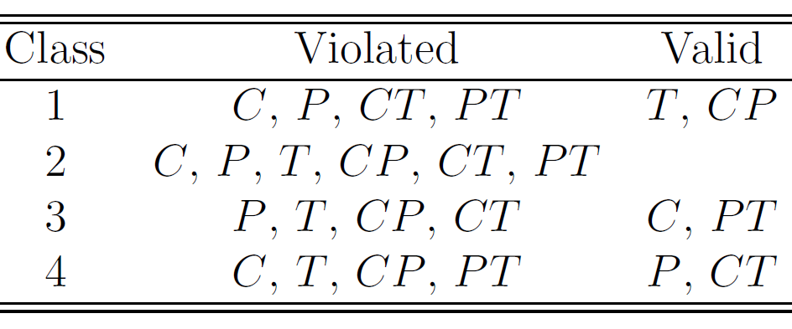
The Four Classes of C, P, and T Violations
Assuming CPT Invariance
B. Nefkens and J. Price, Phys. Scrip., T99, 114 (2002)
Experimental tests
P-violating exp.,
β-decays,
K-, B-, D-meson decays
EDM, η→even π’s
tests involving η, η’, π, ω, J/ψ decays
For class 4:
few tests available
not well tested experimentally for EM and strong interactions
The current constraint: Λ≥ 1 GeV
EDMs place no constraint on the new T-violating and P-conserving
physics; “new TVPC physics could arise at scales as light as a few GeV” .
(A. Kurylov, G. Mclaughlin and M. Ramsey-Musolf, phys. Rev., D63, 076007 (2001) )

Slide 10
C Invariance
Maximally violated in the weak interaction and is well tested.
Assumed in SM for both the electromagnetic (EM) and strong interactions, but it is not experimentally well tested.
C-violating η decays will provide unambiguous, direct constraints on new C-violating and P-conserving physics.
Testing C-invariance will provide a better understanding of
  origin of CP violation
  asymmetry in SM:
  left handed doublets and right-handed singlets.
C Violating η neutral decays
Final State | Branching Ratio (upper limit) | Gammas in Final State
3γ | < 1.6•10⁻⁵ | 3
π⁰γ | < 9•10⁻⁵
2π⁰γ | < 5•10⁻⁴ | 5
3γπ⁰ | Nothing published
3π⁰γ | < 6•10⁻⁵ | 7
3γ2π⁰ | Nothing published

Slide 11
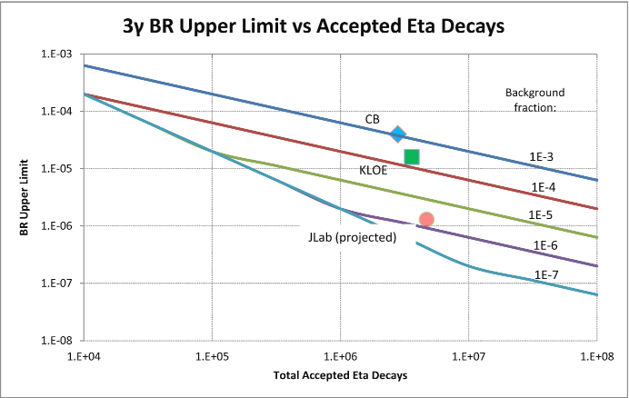
Experimental Improvement on η→3γ
SM contribution:
BR(η→3γ) <10⁻¹⁹ via P-violating
weak interaction.
A new C- and T-violating, and
P-conserving interaction was
proposed by Bernstein, Feinberg
and Lee
(Phys. Rev.,B139,1650).
A calculation due to such new
physics by Tarasov suggests:
BR(η→3γ)< 10⁻²
(Sov.J.Nucl.Phys.,5,445)
Improve BR upper limit by one
order of magnitude to tighten
the constraint on C-violating,
P-conserving new physics
Proj. JEF
The upper limit for the branching ratio at ~90% CL is estimated by:

Slide 12
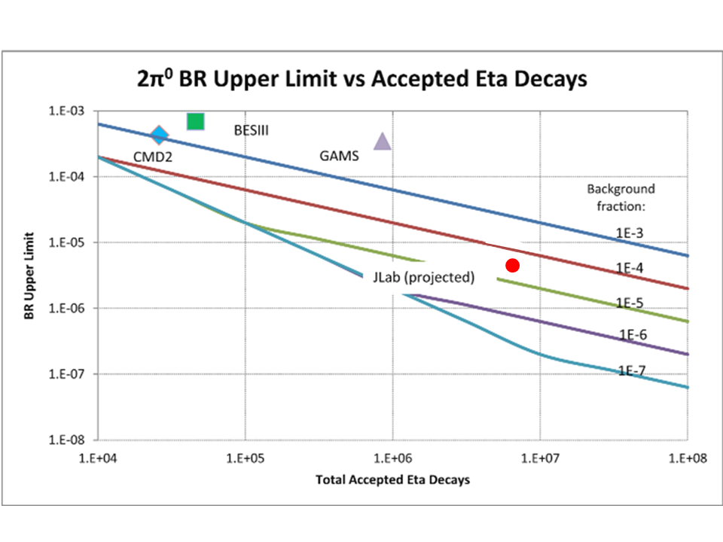
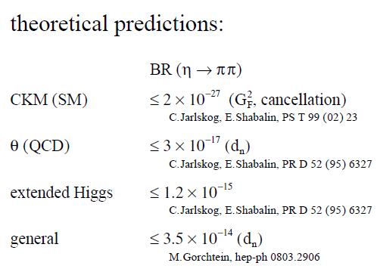
P and CP Violating η→π⁰ π⁰
Proj. JEF
The nEDM measurements access the static property of the particle. A non-
zero nEDM violates P and T directly, and indirectly violates CP under the
assumption of CPT conservation.
The η →2π⁰ decay is related to a dynamic process and it violates P and CP
directly.
η →2π⁰ is flavor-conserving counterpart of the corresponding
flavor-changing CP-violating K_{L} →2π⁰.

Slide 13
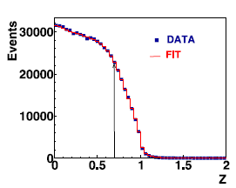
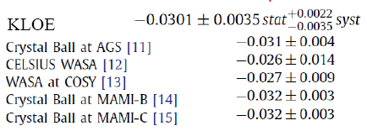
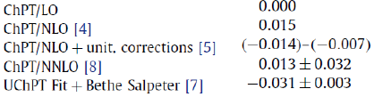
Measurement of η→3π⁰
Phys. Lett., B694, 16 (2010)
η →3π⁰ is the most promising channel
to determine an accurate light quark
mass ratio.
Existing data are from the low energy
η-production facilities and more
sensitive to the threshold effect in
the γ-detection.
Proposed measurement at high
energy will be comparable to existing
data in statistics but different
systematics.
Offers an independent experimental
verification.
Exp.
Slope α
Theory

Slide 14
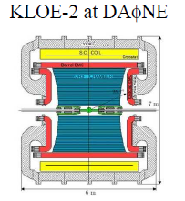
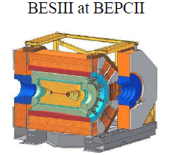
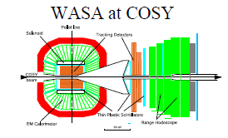
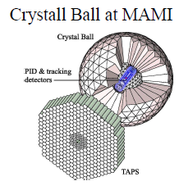
World Competition in η Decays
e⁺e⁻
Collider
Low energy
η-facilities
High energy η-facility
Fixed-target
hadroproduction
CBELSA/TAPS at ELSA
JEF at Jlab
photoproduction

Slide 15
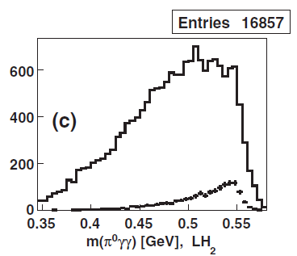
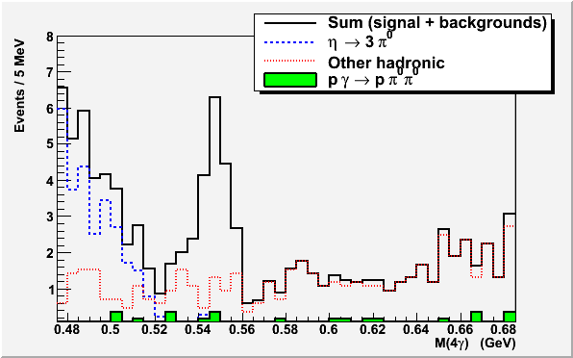
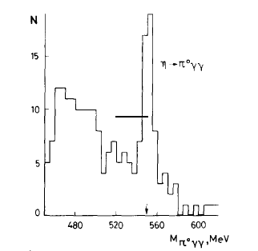
Filter Background with η Energy Boost (η→π⁰γγ)
CB-AGS Experiment
π⁻p→η p (E_{π}=730 MeV)
Jlab: γp→ηp (E_{γ} = 9-11.7 GeV)
η →π⁰π⁰π⁰
GAMS Experiment
π⁻p→η p ( E_{π}= 30 GeV )
Major Background
η →π⁰π⁰π⁰→6γ
π⁻p→ π⁰π⁰ + neutron

Slide 16
Proposed Experiment in Hall D
FCAL-II
Simultaneously measure η neutral decays: η→π⁰γγ, η→3γ, and …
η produced on LH₂ target with 9-11.7 GeV tagged photon beam:
γ+p → η+p
Reduce non-coplanar backgrounds by detecting recoil p’s with GlueX detector
Upgraded Forward Calorimeter with High resolution, high granularity
PbWO₄ (FCAL-II) to detect multi-photons from the η decays
16

Slide 17
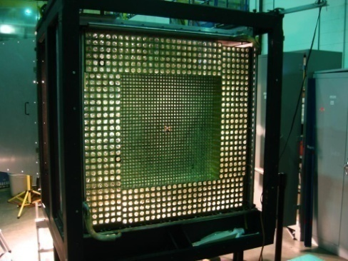
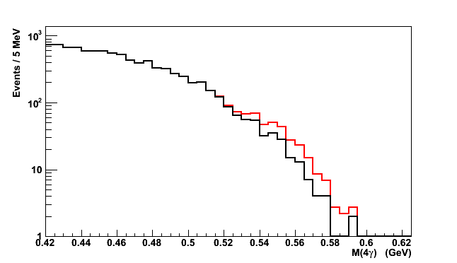
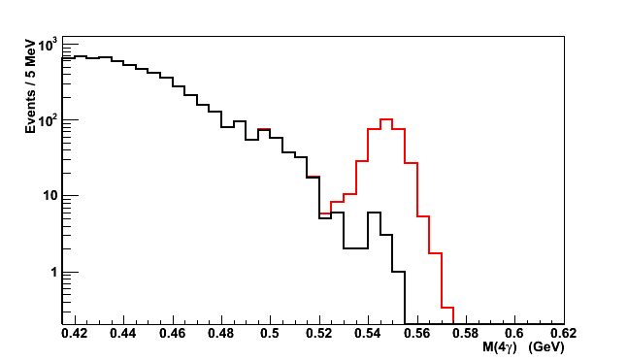
New Equipment: FCAL-II
PrimEx HyCal
FCAL-II:
118x118 cm² in Size (3445 PbWO₄)
2cm x 2cm x 18cm per module
S/N Ratio vs. Calorimeter Types
signal: , background:
FCAL (Pb glass)
FCAL-II (PbWO₄) vs. FCAL (Pb glass)
S/N=0.1:1
Property | Improvement factor
Energy σ | 2
Position σ | 2
Granularity | 4
Radiation-resistance | 10
FCAL-II (PbWO₄)
S/N=10:1

Slide 18
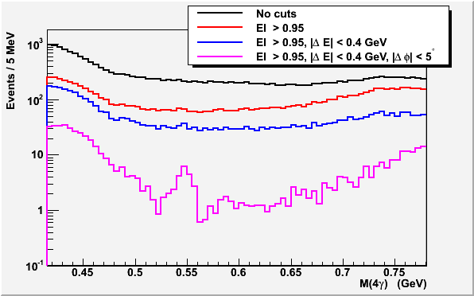
Hadronic Backgrounds Reduction in 4γ States
Event Selection
Elasticity is
EL=ΣE_{γ}/ E_{tagged-γ}
Energy conservation
for γ+p → η+p reaction:
ΔE=E(η)+E(p)-E(beam)-M(p)
Co-planarity Δφ= φ(η)- φ(p)
Note:
Statistics is normalized to
1 beam day.
BG will be further reduced
by requiring that only one
pair of γ’s have the π⁰
invariant mass.
Signal: η→π⁰γγ

Slide 19
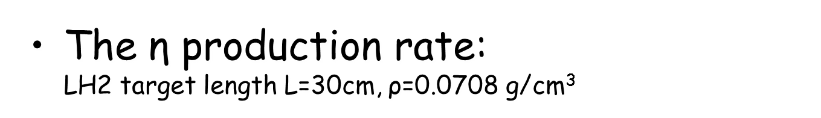
Rate Estimation
The γ+p→η+p cross section ~70 nb (J.M. Laget , Phys.Rev. , C72, 022202 (2005) and A. Sibirtsev et al. Eur.Phys.J., A44, 169 (2010))
Photon beam intensity N_{γ}~4x10⁷ Hz (for E_{γ}~9-11.7 GeV)
Jlab Eta Factory (JEF)
The η→π⁰γγ detection rate:
  BR(η→π⁰γγ )~2.7x10⁻⁴
  Average geometrical acceptance is ~20% (118x118 cm² FCAL-II)
  Event selection efficiency ~70%

Slide 20
Beam Time Request
Run type | Beam Time (days)
LH₂ Production | 100
Empty target and target out | 7
Tagger efficiency, TAC runs | 3
FCAL-II commissioning, Calibration | 12
Luminosity optimization | 14
Total | 136

Slide 21
Response to PAC39 Comments
Issues:
“The PAC has concerns about costs and people-power. “
Estimated cost is ~$5M. We will apply for MRI grant (up to
$4M) from US NSF and Chinese funding (up to $1M)
Proposal adds ~50 new participants in Hall D
“The PAC also felt that the physics case for this large instrument could be strengthened. … —testing the standard model —would be sharpened by… concentrating on the cleanest standard model tests. On the other side, the PAC would like to see more exploration of the broader, secondary physics program that the new calorimeter could support, e.g. what could be learned from the angular distributions of other (non-forbidden) all-neutral final states as measured by this high-resolution device? ”
Physics priority:
  η→π⁰γγ determines two LEC’s in chiral Lagrangian.
  η→3γ and other C-violating channels directly constrain C-violating
  and P-conserving new physics.
Broader program:
  η→2π⁰ direct constraint on P- and CP-violation
  η→3π⁰ improves the determination of light quark mass ratio.

Slide 22
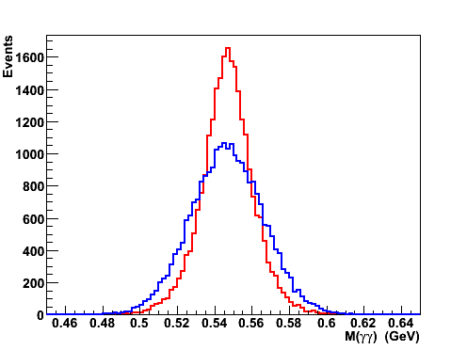
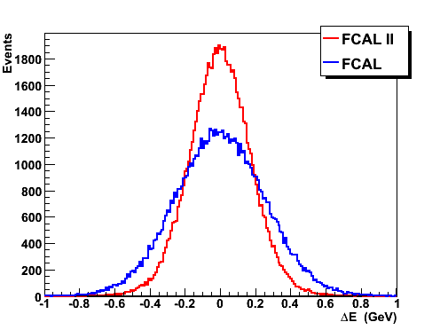
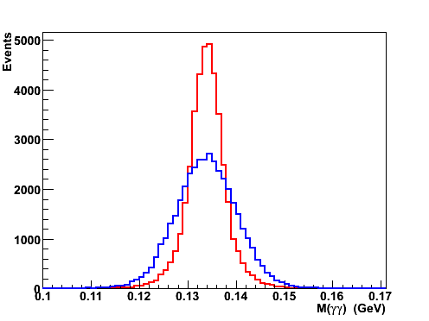
Benefits of FCAL-II to Hall D Physics Program
Consider a hybrid calorimeter with PbWO₄ crystal insertion to provide sufficient acceptance for GlueX.
Impact on GlueX Spectroscopy program:
  Better neutral particle identification for PWA.
  More radiation-resistant calorimetry for high intensity runs
Invariant Mass: η → γ γ
p + γ → p + X(1400)
X(1400) → η π⁰
σ _{FCAL} / σ _{FCAL II} ~ 1.6
σ _{FCAL} / σ _{FCAL II} = 1.5
Invariant Mass: π⁰→ γ γ
σ _{FCAL} / σ _{FCAL II} ~ 1.9
ΔE = E_{ηπ} + E_{p} – m_{p} – E_{beam}
Important for Primakoff experiments on Γ(η→γγ) and Γ(η’→γγ).

Slide 23
Summary
12 GeV tagged photon beam with GlueX setup will provide a great opportunity for precise measurements. It offers two orders of magnitude reduction of the backgrounds of neutral rare η decays compared to other facilities in the world.
136 days of beam time is requested to perform a simultaneous measurement of η decays to all neutral final states:
  η→π⁰γγ model-independently determines two LEC’s of the O(p⁶) counter-terms in the chiral Lagrangian.
  η →3γ and other C-violating neutral channels offer the best window for C-violating and P-conserving new physics.
  η →π⁰π⁰ is a direct P- and CP-violation test, and a flavor-conserving counterpart of the corresponding flavor-changing P- and CP-violating K_{L} →2π⁰ .
  η →3π⁰ is potentially the best way to determine the light quark mass ratio.
Upgraded FCAL-II will have significant positive impact on other approved experiments in Hall D: GlueX and PrimEx-η

Slide 24
The End
Thanks you!

Slide 25
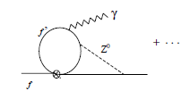
EDM Indirect Constraints on New TV, PC Interactions
(equivalent to CV, PC under CPT)
EDMs should be produced by new TVPC interactions plus the SM weak interaction, potentially indirectly constraining the existence of new TVPC forces.
An Effective Field Theory evaluation finds the constraints depends on the scenario:
Kurylov, McLaughlin, and Ramsey-Musolf,
PRD 63, 076007
 | Scenario A: Λ_{TVPC} Λ_{PV} (parity symmetry restored) | Scenario B: Λ_{PV} (parity symmetry remains broken) Λ_{TVPC}
EDM expression in Effective Field Theory (Unknown short distance physics is in Ci’s. β’s are calculable.) | d ~ β₇C₇ M²/Λ³_{TVPC} | d ~ β₅C₅ /Λ_{TVPC} + β₆C₆ M/Λ²_{TVPC} + β₇C₇ M²/Λ³_{TVPC}
In A, EDMs would tightly constrain new TVPC interactions at loop level in the C7 coefficient.
In B, it’s ambiguous. EDMs arise from a combination of potential TVPV and TVPC operators.
Loop corrections could be as large as tree level.
η rare decays will provide unambiguous, direct
constraints on new TVPC interactions.

Slide 26
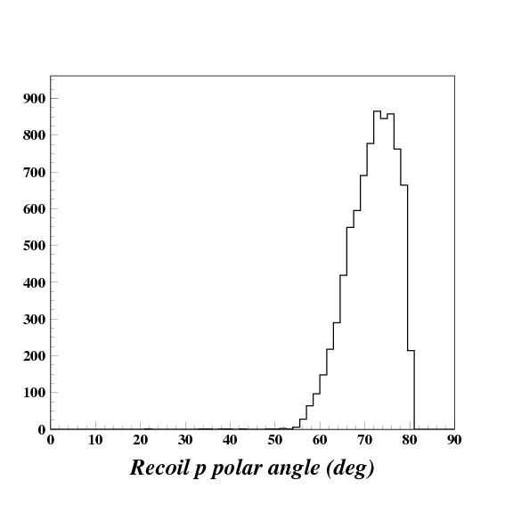
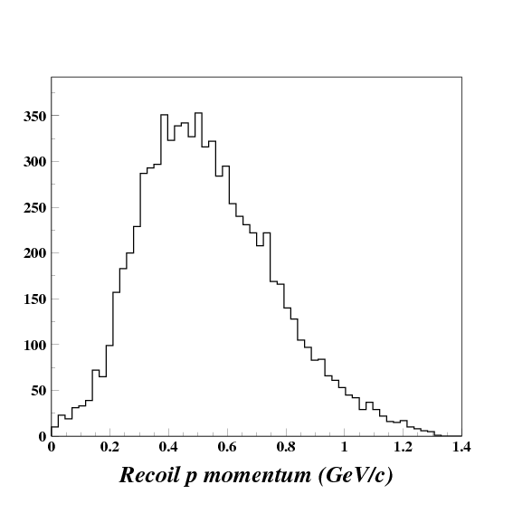
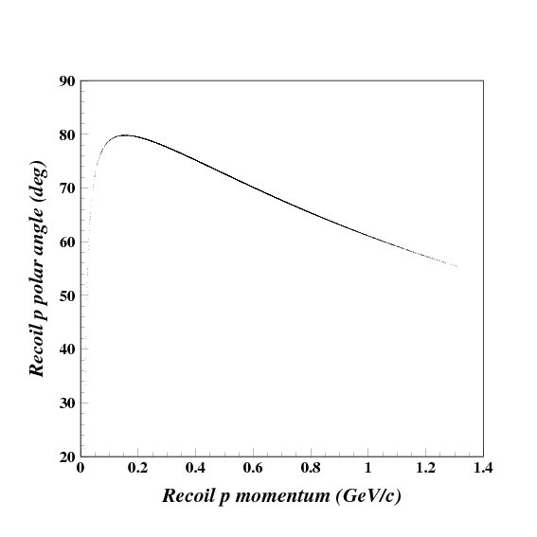
Detection of Recoil Proton with GlueX
Recoil proton kinematics
Polar angle ~55º-80º
Momentum ~200-1200 MeV/c

Slide 27
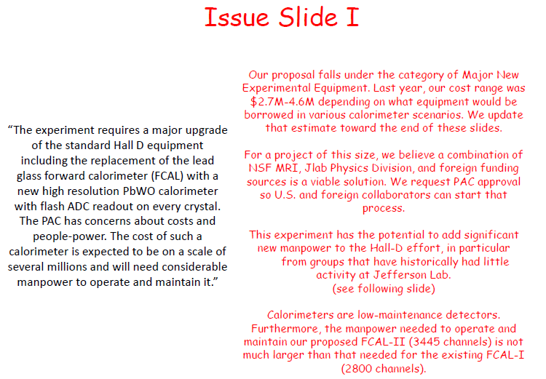

Slide 28
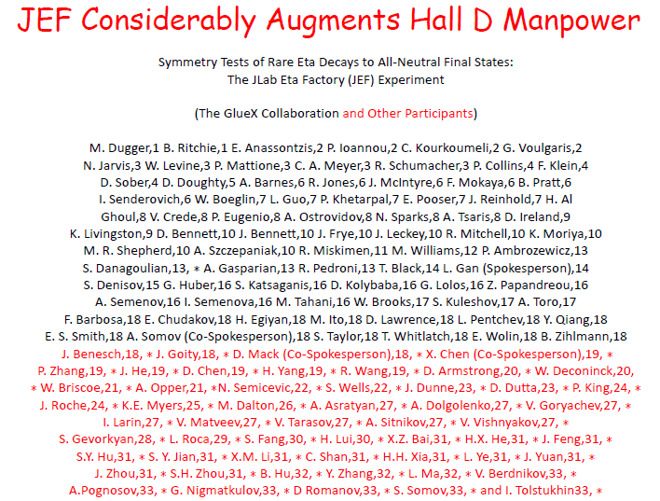

Slide 29
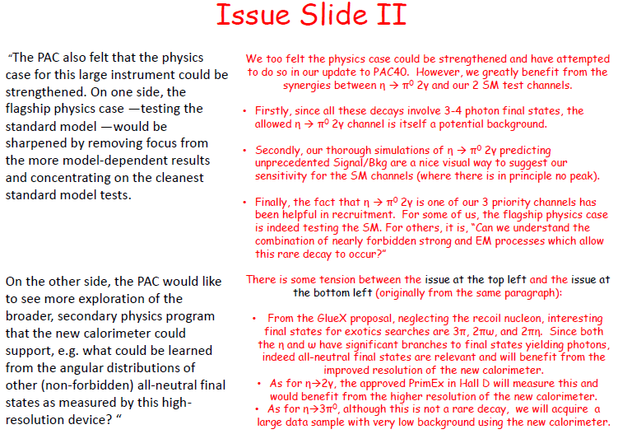

Slide 30
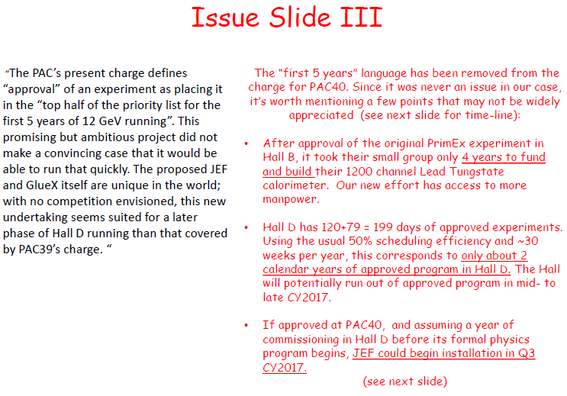

Slide 31
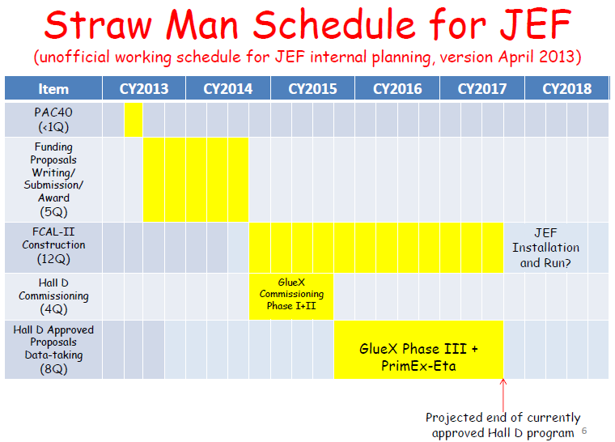

Slide 32
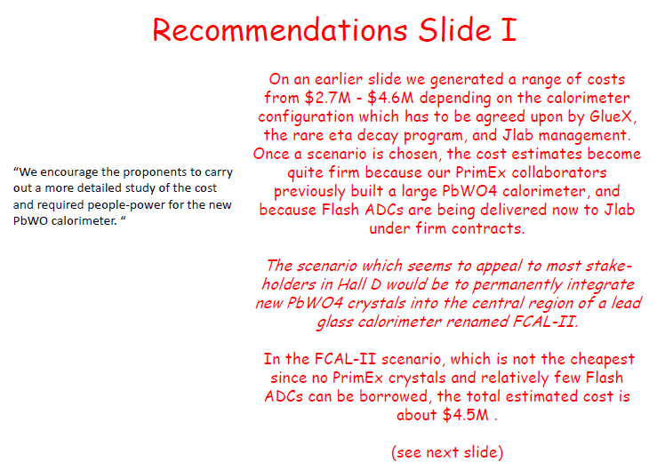

Slide 33
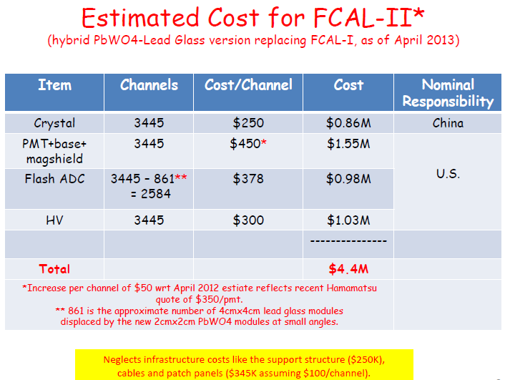

Slide 34
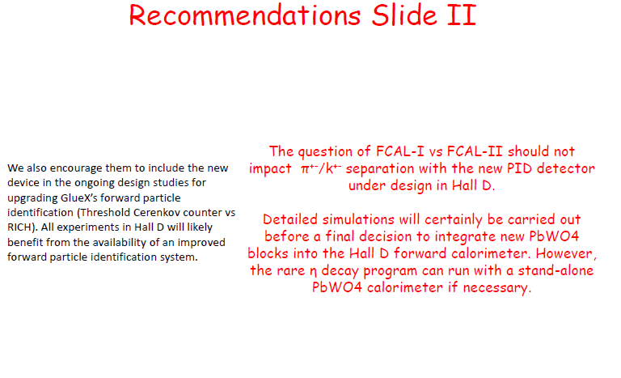

Slide 35
Determination of O(p⁶) Low Energy Constants
The total amplitude for the decay η(P) → π⁰(p) + γ(q1) + γ(q1) is
where A,B are two kinematically different amplitudes, and the a,b are the coefficients for tree level, π loops, and k loops contributions.
Expanding as O(p²) + O(p⁴) + O(p⁶) … many terms vanish or are very small:
M = (a₄^{π} + a₄^{k})A + a₆^{tree} A + b₆^{tree} B + suppressed O(p⁶) loops + HOT
small,known dominant, unknown
The dominant coefficients a₆^{tree} and b₆^{tree} depend on two low energy constants d₁, d₂:
Hence a precise η→π⁰2γ measurement provides a unique window into
O(p⁶) of ХPT, determining the low energy constants d₁,d₂ model independently.

Slide 36
Comparison of different crystals
(From R. Y. Zhu)

Slide 37
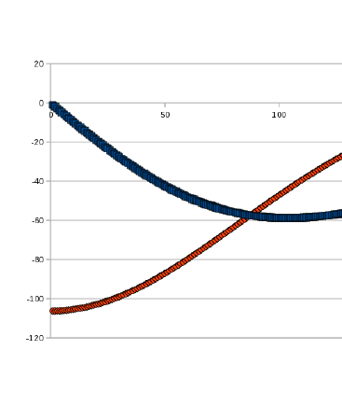
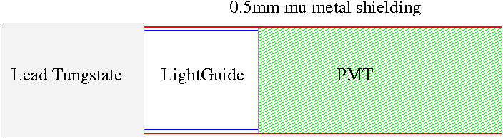
Magnetic Shielding of FCAL-II PMTs
The transverse shielding factor of a cylinder
of material with permeability μ is
SF_{T} = H_{out}/H_{in} = ¾ (t/r) μ
where t is the thickness, and r is the radius.
(The longitudinal shielding factor is 10x smaller.) The field is not high enough to saturate mu metal, so a single layer is sufficient. Assuming 0.5mm of co-netic (μ = 50,000) we estimate:
B Field
(G)
B_{X}
SF_{T} | B_{T}^{max} | Shielded Field = B_{T}^{max}/SF_{T}
2000 | 55 G | 0.03 G (negligible)
B_{Z}
Radial Distance from Solenoid Z axis (cm)
SF_{L} | B_{L}^{max} | Shielded Field = B_{L}^{max}/SF_{L}
200 | 105 G | 0.5 G (acceptable)
For R_{calorimeter} = 0 to 83cm:
B_{x} = 0-55 Gauss
B_{z} = 60-105 Gauss
B field must be mitigated. The small diameter of our PMTs helps a lot (18.6mm or 0.75”).
Note the new lightguide.

Slide 38
Probability of two-cluster separation vs. distance between hits
Study done by using PrimEx-II snake scan data
First cluster: “permanent” with energy 5 GeV
Second cluster: “moving” with energy 1-5 GeV
Artificially split events are counted as
missing
Reconstruction efficiency (100%)
PWO
Pb glass
Reconstruction efficiency (100%)
Separation distance (cm)
Separation distance (cm)

Slide 39
Can we use existing FCAL located at 10 m?
Z=6 m
PWO
σ=6.7 MeV
Pb glass
σ=14.5 MeV
Invariant Mass of 4γ (GeV)
Z=6 m
Pb glass
Invariant Mass of 4γ (GeV)
σ=16.2 MeV
Invariant Mass of 4γ (GeV)

Slide 40
Invariant Mass and Elasticity Resolutions
PWO
σ=3.2 MeV
σ=6.9 MeV
σ=0.0121
Mγγ
Mγγπ⁰
Elasticity
Pb glass
σ=15 MeV
σ=6.6 MeV
Mγγπ⁰
σ=0.0257
Mγγ
Elasticity

Slide 41
Figure of Merit
150x150 cm² PWO Cal.
Signal is η→π⁰γγ
Background is η→3π⁰
Signal window is ±3σ
118x118 cm² PWO Cal.

Slide 42
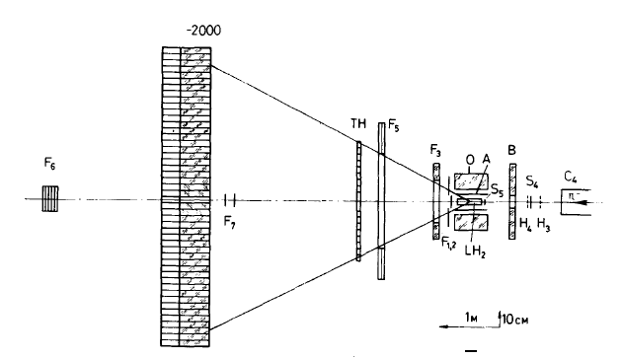

High Energy η Production
GAMS Experiment at Serpukhov
D. Alde et al., Yad. Fiz 40, 1447 (1984)
Experimental result was first published in 1981
The η’s were produced with 30 GeV/c π⁻ beam in the π⁻p→ηn reaction
Decay γ’s were detected by lead-glass calorimeter
1981
1984
Final result:
Γ(η→π⁰ γγ) = 0.84±0.17 eV
40 η→π⁰ γγ events
Major Background
π⁻p→ π⁰π⁰n
η →π⁰π⁰π⁰

Slide 43



Low energy η production
CB experiment at AGS
S. Prakhov et al. Phy.Rev.,C78,015206 (2008)
NaI(T1)
η →π⁰π⁰π⁰
The η’s were produced with 720 MeV/c π⁻ beam through the π⁻p→ηn reaction
Decay γ’s energy range: 50-500 MeV
Final result:
Γ(η→π⁰ γγ) = 0.285±0.031±0.061 eV

Slide 44


Low Energy η Production Continue
KLOE experiment
B. Micco et al., Acta Phys. Slov. 56 (2006) 403
Produce Φ through e⁺e⁻ collision at √s~1020 MeV
The decay η→π⁰γγ proceeds through: Φ→γη, η→π⁰γγ, π⁰→γγ
Final result:
Γ(η→π⁰γγ)=0.109±0.035±0.018 eV
η→π⁰ γγ events

Slide 45


Acceptance of FCAL-II
3γ final state
4γ final state
~30%
~20%

Slide 46

Tests of C Violation
C-violating η decays are among the few opportunities nature has
provided to directly test C invariance in the P conserving EM
interaction (class #4).
PDG 2012
η decays
Γ_{tot}(η)=1.3 KeV
Γ_{tot}(ω)=8.5 MeV
Γ_{tot}(η’)=194 KeV
Γ_{tot}(J/ψ)=93 KeV

Slide 47
Jlab Eta Factory Overview
We propose a rare η decay experiment at Jlab that will
constrain new sources of C, P, and CP violation at the “micro-strong” scale (using anomalous decays), and
continue to extend tests of Chiral Perturbation Theory to heavier mesons (with allowed rare decays)
by assembling a low-background facility for detecting η decays to final states consisting of multiple photons with x100-1000 higher figure of merit than previous datasets.
Spin-offs:
Decays of the π⁰, ω, η’, etc. to photons measured parasitically.
Decays involving virtual photons γ*→e⁺e⁻ measured parasitically.
Extends Jlab’s 12 GeV science program to rare decays.
New calorimeter would benefit rest of Hall D program.
New collaborators would strengthen overall Hall D effort.

Slide 48
Technical Highlights
More η’s helps:
Hall D will provide a competitive rate of η’s by tagged γ+p→η+p.
Better background reduction is essential:
  Recoil proton detection in the GluEx detectors ensures the η production is exclusive (very helpful for background reduction).
  As for the “lost” photon bkgs from η→3π⁰ (BR=33%)→6γ :
  Boosting the η’s using high energy photoproduction reduces opportunities for photons to be lost while still passing signal cuts.
  Detecting decay photons in a new PWO calorimeter improves energy and invariant mass resolution, while reducing the probability of photon merging.
An order of magnitude reduction in BR upper limits to all-neutral final states is expected, including 3 we have highlighted: η→π⁰γγ, π⁰π⁰, 3γ.
An upgraded FCAL-II will have significant impact on other approved experiments in Hall D: GlueX and PrimEx-η .

Slide 49
C Violation Basics
The charge conjugation operator C reverses all generalized charges, effectively replacing a particle by its anti-particle.
C violation is known only in
  Weak interactions at tree level which violate P (hence conserving CP)
  Weak interactions at loop level which conserve P (hence violating CP)
Everybody knows strong and EM forces conserve C …. but bounds on C violation in these amplitudes are only ~0.5%. How to improve these limits?
It is surprisingly hard to improve experimental bounds on C violation:
Only a few neutral particles are states of good C and thus suitable for tests
(γ, π⁰, η, J/ψ, or a self-conjugate system like e⁺e⁻).
Most of the above particles aren’t easy to make in large quantities (and with sufficiently low backgrounds).
Notes:
J. McDonough et al, PRD 38 (1988) 2121-2128. This is an exceptionally good paper.

Slide 50

C Violation in the SM: Theory
Some calculations exist for the C violating decay π⁰ → 3γ which we will cautiously use as an analog of η→3γ.
A weak interaction model of C violation in π⁰→3γ by Dicus (1975) assuming CP conservation (hence P violation) found the highly suppressed value
BR(π⁰→3γ)/BR(π⁰→2γ) = 10^{-31±6}
The form of the amplitude is highly constrained by both Bose statistics and the requirement for parity violation. Equation 17 in that paper suggests the corresponding η decay would be larger by (m_{η}/m_{π})¹²
BR(η→3γ)/BR(η→2γ) ~ 10⁻²⁴
Although an enormous enhancement is expected due to the larger mass of the η, the SM background remains negligible.
Notes:
D. A. Dicus, PRD 12 (1975) 2133-2136.

Slide 51

Lessons From RadPhi
JEF bears a more-than-superficial resemblance to the RadPhi experiment that ran in Hall B.
RadPhi also used a tagged photon beam, forward calorimeter, proton recoil detection, and boost.
The pioneering RadPhi measurement encountered severe pile-up by apparent neutrals:
e.g., about half their π⁰→2γ events ended up classified as “3γ” events.
They were able to extract a Φ →ηγ signal (BR ~ 1.3%), but no truly rare decays.
An insightful NIM article resulted but no other publications. (NIM A 570 (2007) 384-398)
JEF advantages that address accidentals and/or pile-up relative to RadPhi:
TDC on every channel of calorimeter improves time resolution by x100.
Trigger based on low rate of > 8 GeV energy sum in forward calorimeter.
Luminosity lower by a factor of x2.8
No backgrounds from photon beam interactions in helium or air.
LH2 target instead of Be (reducing any potential neutron background)
5x better energy resolution, 10x better invariant mass resolution.
(RadPhi’s lead glass energy resolution was 10.8% at 1 GeV, and was located only 1m from the target.)
other JEF offline cuts that improve Signal/Bkg
JEF sensitivity projections only take credit for η’s produced at small angles in the exclusive γ+p→η+p reaction.
  Recoil proton detection with co-planarity cut helps suppress multi-step continuum backgrounds like γ+p→π⁰ + Δ⁺ → 2π⁰ + p.
  Missing energy cut helps suppress feed-down from γ+p→X+p where M_{X} > M_{η} and X decays with photons lost out of the acceptance.

Slide 52

Constraints In Terms of C Violating Amplitudes

Slide 53

Constraints inTerms of CP Violating Amplitudes

Slide 54


Slide 55

Background in η→3γ from ρ(Tail) through ρ→π⁰γ

Slide 56
Background in η→3γ from ρ(Tail) through ρ→ηγ
1b) ρ→ηγ continuous background to the charge symmetry violating η→3γ:
ρ→ηγ may mimic η→3γ through ρ→ηγ followed by η→2γ. This mechanism can be suppressed by rejecting the events with a photon pair with reconstructed invariant mass equal to the η mass. Since our shower reconstruction threshold will be several times our energy resolution, such events would also be rejected by our elasticity cut.

Slide 57

Background in η→π⁰γ from ρ(Tail) through ρ→π⁰γ

Slide 58


Slide 59
p + γ → p + X(1400), X(1400) → η π⁰
Resolution of the reconstructed total energy:
ΔE = E_{ηπ} + E_{p} – m_{p} – E_{beam}
σ _{FCAL} / σ _{FCAL II} = 1.5

Slide 60



Invariant Mass: η → γ γ
All reconstructed η
γ in FCAL
σ _{FCAL} / σ _{FCAL II} ~ 1.3
σ _{FCAL} / σ _{FCAL II} ~ 1.6
γ in FCAL and
BCAL
γ in BCAL
σ _{FCAL} / σ _{FCAL II} ~ 1.2

Slide 61



Invariant Mass: π⁰→ γ γ
All reconstructed π⁰
γ in FCAL
σ _{FCAL} / σ _{FCAL II} ~ 1.6
σ _{FCAL} / σ _{FCAL II} ~ 1.9
γ in FCAL and
BCAL
γ in BCAL
σ _{FCAL} / σ _{FCAL II} ~ 1.1

Slide 62
p + γ → p + X(1400), X(1400) → η π⁰
 | π⁰ |  |  |  | η
 | FCAL |  | FCAL II |  | FCAL |  | FCAL II
Overall γγ mass resolution, MeV | 6.6 |  | 4.1 |  | 22.3 |  | 17
Both photons in Forward Calorimeter
Fraction of events |  | 52 % |  |  |  | 32 %
γγ mass resolution, MeV |  | 6.2 |  | 3.2 |  | 19 |  | 12
One photon in Forward Calorimeter and one in BCAL
Fraction of events |  | 19.8 % |  |  |  | 55 %
γγ mass resolution, MeV |  | 7.0 |  | 6.2 |  | 22.9 | 19.5

Slide 63

p + γ → p + X(1600), X (1600) → η π⁰ π⁰
Resolution of the reconstructed energy in the event
σ _{FCAL} / σ _{FCAL II} = 1.35
ΔE = E_{ηπ} + E_{p} – m_{p} – E_{beam}

Slide 64
Invariant Mass: η → γ γ
All reconstructed η
γ in FCAL
σ = 19.1 MeV
σ = 13.3 MeV
σ = 23.1 MeV
σ = 19.3 MeV
σ _{FCAL} / σ _{FCAL II} ~ 1.2
σ _{FCAL} / σ _{FCAL II} ~ 1.5
γ in FCAL and
BCAL
γ in BCAL
σ = 20.5 MeV
σ = 24 MeV
σ _{FCAL} / σ _{FCAL II} ~ 1.1
σ ~ 25 MeV

Slide 65
Invariant Mass: π⁰→ γ γ
All reconstructed π⁰
γ in FCAL
σ = 3.5 MeV
σ = 4.8 MeV
σ _{FCAL} / σ _{FCAL II} ~ 1.8
σ _{FCAL} / σ _{FCAL II} ~ 1.5
σ = 6.4 MeV
σ = 7.4 MeV
γ in FCAL and
BCAL
γ in BCAL
σ _{FCAL} / σ _{FCAL II} ~ 1.15
σ = 6.7 MeV
σ ~ 8.2 MeV
σ =7.7 MeV

Slide 66
S/N Ratio vs. Calorimeter Types signal: , background:
S/N=0.5:1
S/N=10:1
Major improvement
Granularity
Energy and position resolutions.
PWO
Invariant Mass of 4γ (GeV)
Invariant Mass of 4γ (GeV)
Event selection cuts:
Elasticity
Invariant mass.
PWO
Elasticity
Elasticity
Pb Glass FCAL
Z= 9m
Invariant Mass of 4γ (GeV)
Invariant Mass of 4γ (GeV)

Slide 67
S/N Ratio vs. Calorimeter Types signal: , background:
FCAL-II
FCAL-I
S/N=10:1
S/N=0.1:1
Major improvement:
Granularity
Energy and position resolutions.
PWO
FCAL-II
Pb Glass
FCAL-I
Elasticity
Event selection
Elasticity=ΣE_{γ}/E_{tag-γ}
Invariant mass.
Elasticity
Invariant Mass of 4γ (GeV)
Invariant Mass of 4γ (GeV)

