Slide 1
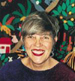

Lois Ehlert
Presentation By: Jenny Hawkins , Joe Mincey, and Lynn Streeter
"Art and text flow hand in hand"
“Art and text flow hand in hand”

Slide 2

Born: November 9, 1934, in Beaver Dam, Wisconsin
Graduated from University of Wisconsin – Madison with a degree in English and Psychology.
Attended Layton School of Art in Milwaukee, Wisconsin
She had a younger brother and sister.
Her mother, a good seamstress, shared her fabric scraps with her and
taught her to use the sewing machine when she was about eight years old.
Her dad had a basement workshop, which supplied her with scrap lumber and nails.
Because of her parent’s influence, she always had a ready supply of art materials,
but not necessarily traditional ones like paper and paint.
She thought colored construction paper was pale in tone compared to her bright cloth scraps.
While growing up, she worked on a folding table. Her mom and dad allowed her to leave her projects spread out on this table as long as she continued to work in her free time. It was her own spot.
About
Lois Ehlert

Slide 3

Why Lois Ehlert writes the way she writes
She likes to think of each book she creates as a total unit; the typography, text, and art flow together hand in hand. This is why she both writes and illustrates her books.
She likes to tell or teach the reader something from the books she creates.
She likes to inspire little people and big people to explore activities together through the subjects she writes about in her books.
She doesn’t put people in her books because she believes that the reader is the actress or actor in the book. She wants the reader to participate in the book.
She doesn’t like to do sequels because she loves to experiment and each book has its own personality. She feels that she would get bored if she did not create each book uniquely.
She is fascinated by folk tales and several of her books were written from folk tales she collected while traveling in Mexico and Central America.

Slide 4
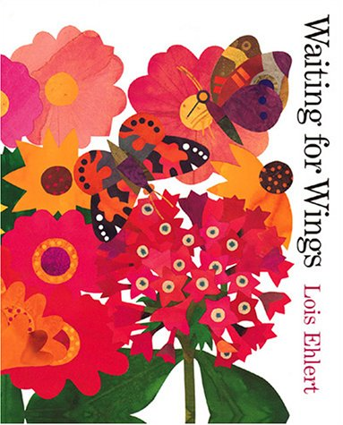
Trends
Manipulates pages (intricate page cuts)
Characterizes nature, animals, things
Uses labels and includes activity ideas
2-D, 3-D elements
All mediums (painting, photographed collages)
Vivid/bold colors
Unique book shapes/sizes according to story
Rhythmic words
Uses real experiences to create pictures and stories
No sequels, loves to experiment

Slide 5


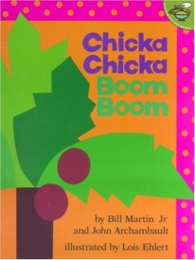



Awards and Honors
Color Zoo - Caldecott Honor Book, 1989
Chicka Chicka Boom Boom –
American Library Association Notable Children's Book
Boston Globe-Horn Book Honor Award
Snowballs - A Publishers Weekly Best Book of the Year, 1995
Cuckoo: A Mexican Folktale – Booklist Editors’ Choice
Feathers for Lunch –
IRA Teachers' Choice and
NCTE Notable Children's Trade Book in the Language Arts

Slide 6
2nd Grade Extension Lesson Plan to follow the reading of Planting a Rainbow by Lois Elhert
Focus and review: Have different colored flowers and seeds. Ask students; “Where do
you think these flowers came from?” and “Where do you think these seeds came
from?” Talk about connection between seeds and flowers.
Objective:
Students will plant and care for their seeds/plants.
Students will observe and record their observations in their journal over the next 4 weeks. They can either draw or write to record their observations.
Students will write a story to represent the growing cycle of their seed/plant.
Students will collect data by counting the number of seeds in each packet.
Students will represent data in a bar graph.
Teacher input: Teacher will:
Read Planting a Rainbow by Lois Ehlert.
Explain that each child will be given seeds, pot and potting soil and they will be responsible for planting and taking care of their plants.
Explain how to make and record observations.

Slide 7
Guided practice: Teacher will:
Divide the class into five groups with four students in each group. Each group will count the number of seeds in their designated packet.
Discuss how the students will display and record their data onto the class graph.
Demonstrate the proper method for planting seeds.
Assist the students as they prepare their pots for the seeds and plant them. The students will label their pots similar to that in the book.
Independent practice: Students will:
Research and get pictures that show how their seeds will look when they become flowers.
Bring pictures in to share with the rest of the class.
Observe and record their observations in their journal.
Assessment and closure: Students will use their observation journals to write a story
that represents the growing cycle of their plants. Students will present their seed data
and update the classroom seed graph. Teacher and students will discuss what the data
represent such as which seed packets had the most and least amount of seeds.

Slide 8
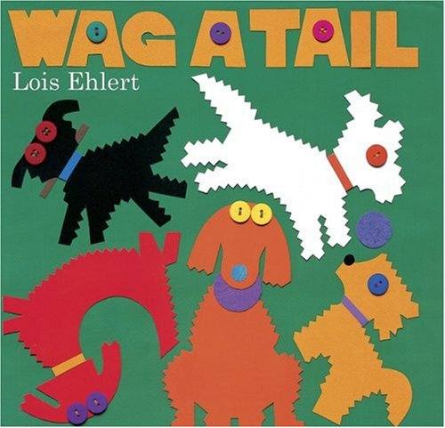
References
http://www.edupaperback.org/showauth.cfm?authid=379
http://www.readingrockets.org/books/interviews/ehlert

