Slide 1
Interaction Analysis
… to evaluate and improve the verbal interaction of leaders... focus:
questioning and answering

Slide 2
Interaction Analysis:
Interdisciplinary method for empirical investigation of interaction of human beings with each other and in select settings in their environment
Investigates human activities such as talk, nonverbal interaction, and the use of artifacts and technologies
Identifies verbal practices, concerns, and issues; Provides ideas for possible solutions to improve verbal interaction.
Interaction Analysis is difficult to describe and is best learned by direct participation.
Group work is also essential… verbal discourse can be learned and improved.

Slide 3
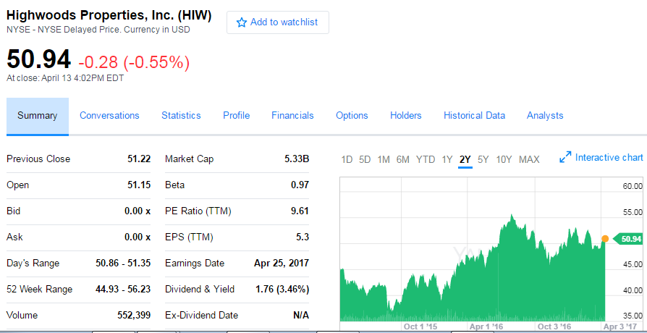
CFA Team
Jessica Fusaro
Corban Penland
Laton Russell
Andy Tate
North Carolina Finals:
Tied with Appalachian State
Paper, Presentation: A+ - App & UNCW
Break Tie - Answers: App A+, UNCW A- or B

Slide 4
What are the basic components for the equity analyst final?
FIN 440
1. Paper
2. Presentation
3. __________
4. __________
Notes:
3. questions by the Board
4. Acceptance of your recommendations by the Board.

Slide 5
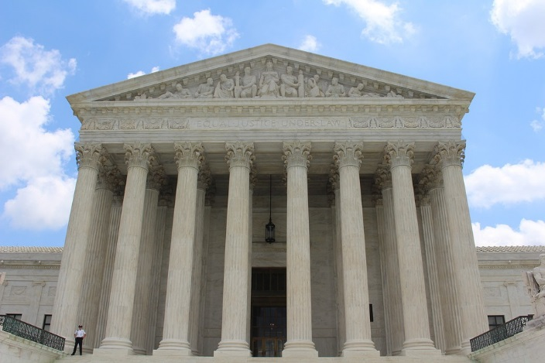
Questioning:
Basic Skill - Leaders
Closed-ended questions - simple "yes" or "no“
Open-ended questions - require more thought
Show cause questions – explain, justify or prove something
Compound questions – two or more ?’s
Questions essential to plan, create ideas, organize, implement, evaluate, and redesign to move forward.
Notes:
Connie Quick and Warren Buffett

Slide 6
In the Answer:
use the foundation (basics) of question
repeat the question or questions (1 then 2)
cite a rhetorical question with explanation
acknowledge, clarify the idea in positive way
clarify feeling tone, if included in question
explain understanding and complexity of issue
Answering: Is An Important & Critical Skill

Slide 7
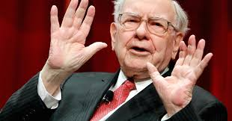
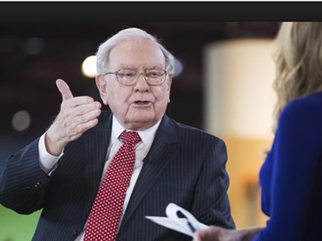

How do you know
if the answer was
great?
Answer’s great if question creates discussion,
conversation, debate, other alternatives.
OK - I am not certain, or I do not know,
however… Am I responding accurately to
question?
Question made
me think different.
Excellent Question.
That’s interesting, I am glad you brought that up…

Slide 8

Interaction
Indirect
Direct
Interpersonal (informal)
Inter-role (formal)
Defense
Offense
Continuum

Slide 9
Leader Talk…
Direct Influences:
Increases Control of Leader and
Reduces Freedom
Focus on Role
Category 5
Category 6
Category 7
Lecture, Provide Info
Directions, Commands Justify, Establish Authority

Slide 10
Leader Talk
Indirect Influences:
Increases Participator Talk and Expands Freedom, confidence
Powerful Recognition
Category 4
Category 3
Category 2
Category 1
Questions Use of ideas
Praise, release tension
Feelings

Slide 11
Participant Talk
Quality of Leader Info or Questions When Participants Respond / Talk
Conference, Meeting, Management
Category 8
Category 9
Response Initiation
Category 10 Silence or Confusion
Learning, ideas, innovations, new directions may begin during confusion, and may not.

Slide 12
Event (hypothetical): Professor and student in Finance Course
Leader: Lecture - (5) Today we’re going to talk (lecture) about sector rotation investing strategies.
Leader: Question - (4) What have you, to date, read or learned about sector rotation investing strategy?
Silence 3 seconds - (10)
Leader: Directions - (6) Write this down… Sector rotation is an investment strategy when investors have [place on Bk Bd] overweight positions in strong sectors onboard] and underweight positions in weaker.
Leader: Question - (4) OK, you’re familiar with sectors, think about this?

Slide 13
Event (hypothetical)
L. _ Today we’re going to talk about sector rotation investing strategies.
L - What have you, to date, read or learn about sector rotation investing strategy?
- Silence for 3 seconds.
L - Write this down… Sector rotation is an investment strategy when investors have
[pace on bk board] overweight positions in strong sectors and underweight positions in weaker.
L - OK, you’re familiar with sectors, what do you think about this?
P - We’ve talked about sector rotation theory but not about sector investment strategy’
L - Very good… how can we extrapolate and take this to market potentials.
L - How can we determine long sectors?
P - It seems that the sector rotation cycle might determine when to invest in certain sectors and leading industries.
L- Let me restate this… what’s in the news that might suggest sectors?
P - When S&P sectors are growing
- Silence
New P- Well we know that the current administration may focus on increasing jobs, lowering taxes, and developing the infrastructure.
P - Consumer Discretionary might be long…
L - What else might the administration do that may impact other sectors?
P - More jobs may increase new home sales and financials.
L - Great!
Notes:
Many investors are interested in investing and diversifying their portfolio in various global and local sectors, but are often unsure of where to start. Sector rotation is a strategy used by investors whereby they hold an overweight position in strong sectors and an underweight positions in weaker sectors. (ETFs) that concentrate on specific industry sectors offer investors a straightforward way to participate in the rotation of an industry sector. ETFs also allow an investor to take advantage of the investment opportunities in many industry groups throughout the world.

Slide 14
Participant: (8) We’ve talked about sector rotation theory but not about sector investment strategy
Participant: (8) We’ve talked about sector rotation theory but not about sector investment strategy
Leader: Reinforce - (2) Very good …
Leader: Question - (4) How can we determine long sectors?
Participant: (8) It seems that the sector rotation cycle might determine when to invest
in certain sectors and leading industries.
Leader: Use Idea - (3) Yes, I can use that idea…
Leader: Question - (4) Let me restate this… what’s in the news that might suggest sectors?
Participant, New: (9) When S&P sectors are growing
Silence (10)
Participant, New: (9) Well we know that the current administration may focus on increasing jobs, lowering taxes, and developing the infrastructure.

Slide 15
Participant, New: (9) Well we know that the current administration may focus on increasing jobs, lowering taxes, and developing the infrastructure.
Participant: (8) Consumer Discretionary might be long…
Leader: Question - (4) What else might the administration do that may impact other sectors?
Participant: (8) More jobs may increase new home sales and financials.
Leader: Reinforce - (2) Great! We’re having a conversation

Slide 18
Interpretation: Verbal Interaction…
Green – Positive Improvement
Red – < or No Change
1, 2, 3
4
5
6, 7
8, 9
10
i/d = 2/1 = 2, LT .57, PT .28; I/D = 7/2 = 3.3, Lecture .06

Slide 19
Observations (Data Collection)
Sit in (conference, meeting, seminar, appointment) tape / video recorder
Record 1 category every 3 seconds… computer automatic
Notes: Expanding or contracting or balance the environment
Silence / Confusion / Commentary
Protocol For Observes (Lightest product)

Slide 20
Positive Outcomes
Significant modifier of behavior:
  positive action and success
Leadership:
  important attribute of manager, executive, director, chair, coordinator…
Can be learned, practiced and improved:
  Establishes excellence and positive movement in corporate settings

Slide 21
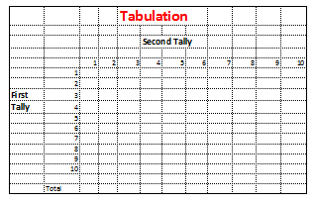

Slide 23
IA Event: Ready for Paragraph Code
Hypothetical Company somewhat similar to Pilot Flying J or CASY’s Convenience, Gas, Food stores.
Meeting Objective: Management’s (CFO, CEO and CIO) quarterly meeting with Division Directors (Active Participants 3, with 20 others at the meeting) regarding quarterly outcomes and tack to take to boost earnings next quarter.

Slide 24
Management:
_____ Thanks and Good morning. Today we’re going to review our results for the quarter ended January 31.
Before we begin, I'll remind you that we can use certain ideas and thoughts that may constitute forward-looking statements. These forward-looking statements include any statements relating to possible or assumed future results of operations, business strategies, growth opportunities and performance improvements at our stores.
_____ Please compile a list of descriptors (one or two words) that indicates your thoughts about the discussions. Tally one descriptor about every 5 minutes… our meeting will last for 50 minutes today. Anonymously leave you descriptors in my box.

Slide 25
_____ As most of you know, diluted earnings per share for the third quarter were $0.58 compared to $0.97 a year ago. The primary reason was attributable to a combination of increases in operating expenses and depreciation offset by increase in gallons sold and inside sales.
The quarter started very strong in November with same-store sales either inline or above our annual goals across all areas with customer count at its highest point in nearly a year, then tapering off during the back half of the quarter. Same-store sales were further impacted during January by calendar shift as well as inclement weather. The calendar shift in the month represented approximately 50 basis points to 180 basis points to same-store sales depending on the category.
_____ What are your thoughts? Let’s get going with some questions: John, let’s start with you.

Slide 26
_____ L How can we determine long sectors?
_____ New P It seems that the cycle might determine when to invest in what.
_____ L Let me put it this way what’s in the news that might suggest sectors?
_____ P When S&P sectors are growing
_____ Silence
_____ New P Well we know that the current administration may focus on increasing jobs, lowering taxes.
_____ L Great! That’s super! Consumer Discretionary might be long.
_____ L What else might the administration that may impact other sectors?

