Slide 2

FINANCIAL MODEL ANALYSIS (FMA) ©
Notes:
Project conducted after Spring 17 graduation. ~ intensive 3 weeks, daily
Finish Presentation then go to the Lab to used the Models.

Slide 3
Objectives (09.06.2017):
Classroom: Observe/Review FMA Slides
Lab: Observe demo of using Blackboard/Bloomberg process
Groups: Produce Watch List of 1 stock; save to PDF or attachment to Blmbg.
Using EPV Identify the MOS and Target Price for 1 stock.
Notes:
I was correct about plugging in the cord to the instructor's station, and Robb also reminded me that you will have to select "from laptop" and "to projector" on the touch screen. I hope this helps!

Slide 4
FMA Process
Financial Model Analysis (FMA):
Developed Value-based, eclectic system
Designed with API language, Interface…
Extracts data from Bloomberg Terminals… Produces ‘dynamic’ Excel market models… Determines Graham-Dodd essentials Margin of safety (MOS)
Target Price, and supportive metrics…
Notes:
FMA Mission: The Financial Model Analysis (FMA) is a value-based, eclectic system using API languages to interact with Bloomberg Terminals producing dynamic Excel market models for equity analysts to determine Graham-Dodd essentials including margin of safety (MOS), Target Price, and supportive metrics.

Slide 5

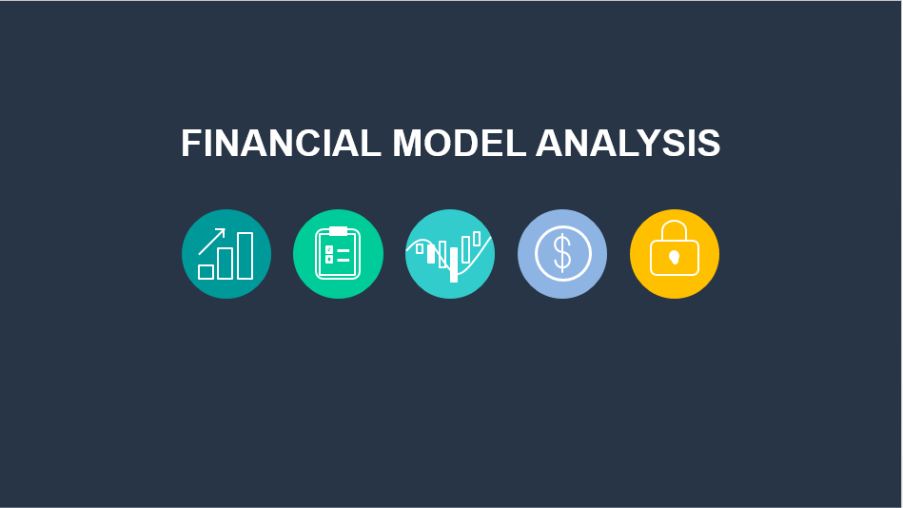
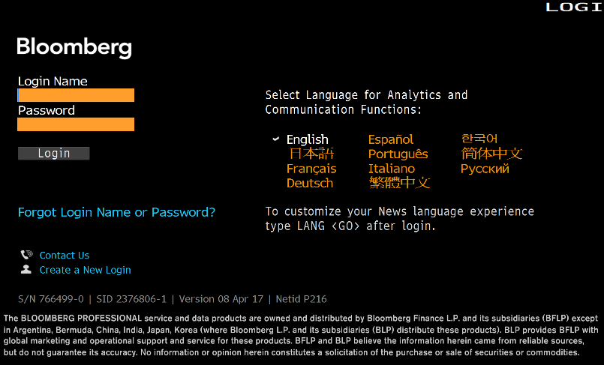
Download files from Blackboard
William Sackley, PhD, CFA Director
Mckenzie Messer, BS, Finance Developer
Darwin Dennison, EdD, CNS Editor
Jacob Thompson, Senior, Finance Consultant
©
Notes:
NTT Data Service – IT transformation (Bank moves or consolidates, NCC conducts that transfer of data. Bank to new bank. Top auto company, health care.
Up to speed in API <Go>Application Programming Interface (API) is a set of subroutine definitions, protocols, and tools for building application software. Bloomberg terminal to Excel.

Slide 6
FMA Objectives:
Provide computer-assisted, human interface to determine financial model basics and dynamic analysis
Identify stock opportunities for long-term growth while reducing portfolio turnover
Establish basis for portfolio rebalancing and entry level opportunities
Produce more money via growth in dividends, capital gains, and expansion in P/E multiple
Notes:
FMA Objectives:
Provide computer-assisted, human interface to determine financial model basics and dynamic analysis
Identify stock opportunities for long-term growth while reducing portfolio turnover
Establish a basis for portfolio rebalancing and entry level opportunities
Produce more money via growth in dividends, capital gains, and expansion in P/E multiple
P/E ratios can be used to determine a company’s perceived under or overvaluation.
But you can also use the P/E ratio to determine upside and downside price targets as well.
First, the P/E ratio is simply price divided by (/) earnings. For example; if a stock’s price is $30 and its earnings are $1.25, its P/E would be 24. ($30 price or ‘P’ / $1.25 earnings or ‘E’ = 24 P/E ratio)
If that stock’s earnings rose to $2.00, the P/E would now be 15.
($30 price / $2.00 earnings = 15 P/E)
And the most logical conclusion would be to see the stock’s price rise until its most recent multiple (or P/E ratio) of 24 was hit again. Why is this so ‘logical’? Because people had just been willing to pay 24 times a Company’s earnings and they probably still are, if there’s reason to believe the Company’s earnings will continue to improve.
So $2.00 (earnings) x 24 (the previous multiple or P/E ratio) = $48 (price). So the price target I’d have for that stock would now be $48. (And you could do the same thing on the downside too.)
However, P/E ratios will often times increase or decrease based on macro-economic reasons too, and not just on the stock’s own numbers. By macro-economics, I’m referring to the economy, the Indexes (broader market) and the Industries, etc.
For instance, as the economy gets better, companies will do better, and vice versa. So as things get better, an increase in earnings can be anticipated.

Slide 7
FMA OUTLINE:
1
Bloomberg Terminals
2
Watch list
3
Earnings Power Value
4
Dividend Discount Model (Bloomberg)
5
Free Cash Flow
6
Market Multiples
7
Modified Graham
8
Ethics
9
Summary
Notes:
Current topics… Ethics under development.
5 models plus watch list

Slide 8
Download files from Blackboard
Download Files from Blackboard
API – extracts precise data from Bloomberg
Provides Watch List, MOS and Target Prices from 5 models
©
Notes:
NTT Data Service – IT transformation (Bank moves or consolidates, NCC conducts that transfer of data. Bank to new bank. Top auto company, health care.
Up to speed in API <Go>Application Programming Interface (API) is a set of subroutine definitions, protocols, and tools for building application software. Bloomberg terminal to Excel.

Slide 9

WATCH LIST
FINANCIAL MODEL ANALYSIS
Notes:
Spelling Watch List or watchlist… underlined in red in Word and Powerpoint

Slide 10

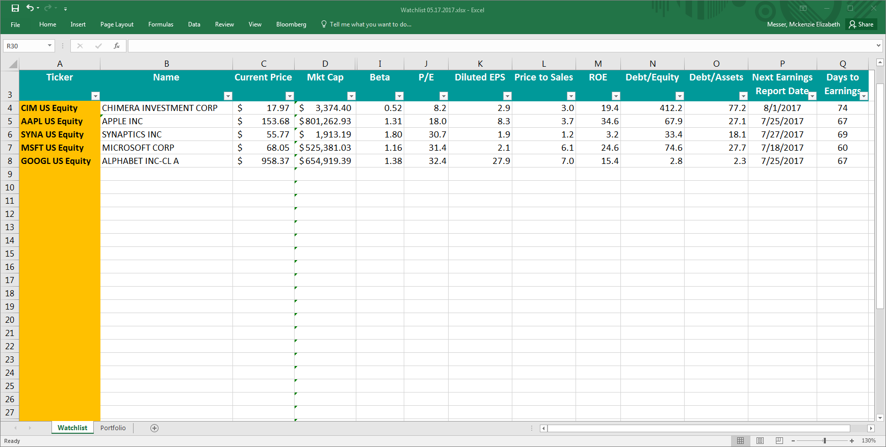
Watch List
Watch List:
Develop a watch list to keep track of companies of interest through the semester
Step 1:
In any of the yellow input cells type ticker symbol, country code, and “equity”
Step 2:
Sort any column by selecting drop-down arrow
Add tickers of stocks in your industry you plan to follow.
Notes:
WATCH LIST & SEAHAWK LLC
Lab 3 in Blackboard… due September 13
Watch list:
Develop a watch list to keep track of companies of interest from your sector and industries through the semester
Step 1:
In any of the yellow input cells type ‘ticker’ symbol, country code ‘US’, and “equity”
Step 2:
Sort any column by selecting drop-down arrow.
By selecting “Sort A to Z”, the column will reorder from least to greatest. By selecting “Sort Z to A”, the column will reorder from greatest to least.
According to the Seahawk Investment Management, LLC investment policy requirements, all equities added to the portfolio must have a market capitalization that exceeds $2B. Students can utilize the filter feature by selecting the drop down arrow and selecting “sort A to Z” to view all equities in order from least to greatest market capitalization. Using this feature, a student would recognize that CASY US Equity does not meet the market cap requirement.

Slide 11
Watchlist
Name:
Returns the name of company
Current Price:
Shows the last price the
equity sold for
Market Capitalization: Value of the company, calculated by:
𝑴𝒌𝒕 𝑪𝒂𝒑 = 𝑪𝒖𝒓𝒓𝒆𝒏𝒕 𝑷𝒓𝒊𝒄𝒆 × 𝑺𝒉𝒂𝒓𝒆𝒔 𝑶𝒖𝒕𝒔𝒕𝒂𝒏𝒅𝒊𝒏𝒈
Mkt Cap must be > $2B
Price is dynamic… save and compare overtime.
Notes:
Current price dynamically shows the current price. Save the Watch List and overtime notice trends.
Investment Policy Statement indicates greater that $2 Billion

Slide 12
Watch List
Beta:
Measures volatility or systematic risk of security
Beta=1, moves w/ market Beta<1, less volatile Beta>1, more volatile
P/E:
Measures current share price relative to per-share earnings. -
Diluted EPS:
Portion of company profit allocated to each diluted outstanding share. +
Notes:
Beta: 1 or less better.
Measures volatility or systematic risk of security
Beta=1, moves w/ market
Beta<1, less volatile
Beta>1, more volatile
P/E:
Measures current share price relative to per-share earnings. The P/E ratio should be compared with the industry average… a lower P/E ratio is generally more attractive.
Generally a high P/E ratio means that investors are anticipating higher growth in the future. The average market P/E ratio is 20-25 times earnings. The P/E ratio can use estimated earnings to get the forward looking P/E ratio.
Diluted EPS:
Portion of company profit allocated to each diluted outstanding share. Earnings per share serves as an indicator of a company’s profitability. A higher EPS is generally more attractive.
Dilution can also occur when holders of stock options, such as company employees, or holders of other optionable securities exercise their options. When the number of shares outstanding increases, each existing stockholder owns a smaller, or diluted, percentage of the company, making each share less valuable. Diluted shares are at a lower value that shares outstanding.

Slide 13
Watchlist
Price to Sales: Compares company’s stock price to revenues
ROE:
Amount of net income returned as percentage of shareholders’ equity…+
Debt/Equity: Measure of financial leverage…-
P/S: market cap/total sales 12 mos
ROE: net income as % of equity
Debt/Equity: financial leverage
Notes:
Price to Sales:
Compares company’s stock price to revenues. The price/sales ratio is an indicator of the value placed on each dollar of a company’s sales or revenues. It can be calculated either by dividing the company’s market capitalization by its total sales over a 12-month period, or on a per-share basis by dividing the stock price by sales per share for a 12-month period.
ROE:
Amount of net income returned as percentage of shareholders’ equity. A higher ROE is generally better.
Debt/Equity:
Measure of financial leverage. A lower debt/equity ratio is generally more attractive.

Slide 14
Watchlist
Debt to Assets: Leverage ratio that allows for comparisons of leverage to be made across companies… -
Next Earnings Date: Returns the expected date of the company’s earnings report
Days to Earnings: Counts the number of days until earnings report
Higher ratio, the higher the risk.
Net Earning Report… read
Notes:
Debt to Assets:
Leverage ratio that allows for comparisons of leverage to be made across companies. The higher the ratio, the higher the degree of leverage, and consequently, financial risk.
Lower ratio is better.
The higher the ratio, the higher the degree of leverage, and consequently, greater financial risk.
Sackley - PEG ratio, where the ‘G’ stands for expected growth rate of earnings. [no decimals…want ‘low’]
Days to Earnings Report. Good idea to use latest when working on the company / equity thesis.

Slide 15
DIVIDEND DISCOUNT MODEL-BLOOMBERG
FINANCIAL MODEL ANALYSIS

Slide 16
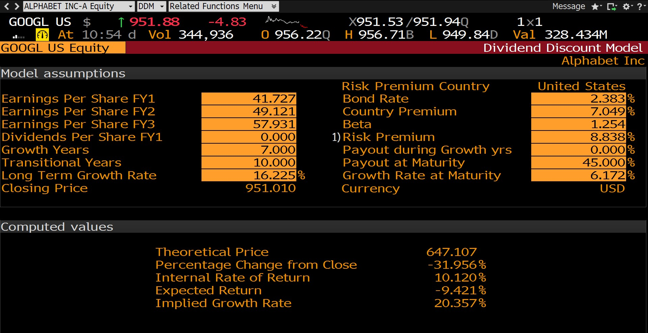
Dividend Discount Model
DDM:
Use when company has at least ten years of dividend payout history
Dividends must be increasing or the same year-over-year
Notes:
DDM
The dividend discount model (DDM) is appropriate to use when:
1) company has extensive dividend payout history (ten years)
2) increasing dividends.

Slide 17
Dividend Discount Model
Step 1:
In the Bloomberg command line, type “DDM” and press GO.
Step 2:
In the upper, right side of the screen, identify which equity you would like to evaluate.
Notes:
Step 1: In the Bloomberg command line, type “DDM” and press GO.
Step 2: In the upper, left side of the screen, identify which equity you would like to evaluate.
You can calculate margin of safety by using the following formula:
$$MOS=\frac{(Target Price −Closing Price)}{Target Price}$$

Slide 18
Dividend Discount Model
Step 3:
Locate the Theoretical Price on the screen.
This is your target price.
Step 4:
MOS formula:
(𝑇𝑎𝑟𝑔𝑒𝑡 𝑃𝑟𝑖𝑐𝑒 − 𝐶𝑙𝑜𝑠𝑖𝑛𝑔 𝑃𝑟𝑖𝑐𝑒)
𝑀𝑂𝑆 =
𝑇𝑎𝑟𝑔𝑒𝑡 𝑃𝑟𝑖𝑐𝑒
Notes:
Locate the Theoretical Price on the screen. This is your target price.
You can calculate margin of safety by using the following formula:
$$MOS=\frac{(Target Price −Closing Price)}{Target Price}$$

Slide 19
Dividend Discount Model
MOS Example:
(𝑇𝑎𝑟𝑔𝑒𝑡 𝑃𝑟𝑖𝑐𝑒 − 𝐶𝑙𝑜𝑠𝑖𝑛𝑔 𝑃𝑟𝑖𝑐𝑒)
𝑀𝑂𝑆 =
𝑇𝑎𝑟𝑔𝑒𝑡 𝑃𝑟𝑖𝑐𝑒
(647.12 − 951.01)
𝑀𝑂𝑆 =
647.12
𝑴𝑶𝑺 = −𝟒𝟕%
Notes:
Theoretical price if lower that the current price provides a potential entry price for the equity.
Locate the Theoretical Price on the screen. This is your target price.
You can calculate margin of safety by using the following formula:
$$MOS=\frac{(Target Price −Closing Price)}{Target Price}$$

Slide 20
EARNINGS POWER VALUE
FINANCIAL MODEL ANALYSIS

Slide 21
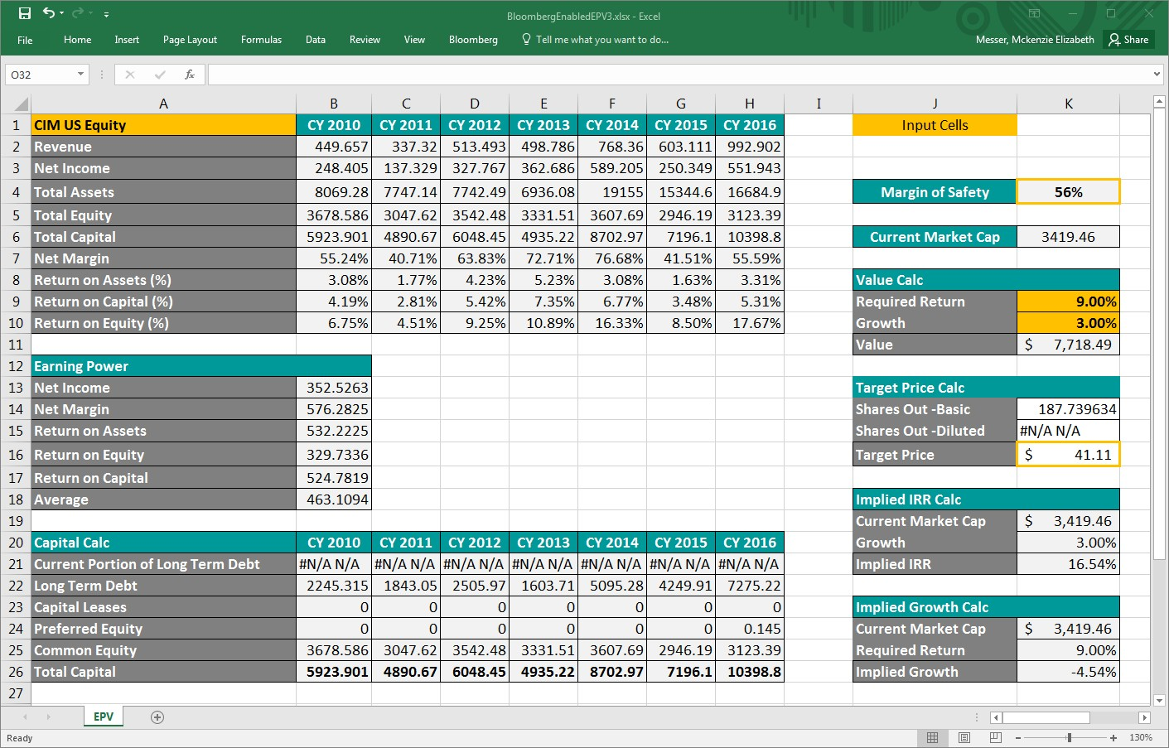
Earnings Power Value Model
EPV:
•Value-based model
•Excludes unreliable estimates of potential growth
•Assumes current sustained profitability
•Utilizes seven-year history to encompass economic downturn
Notes:
EPV
The EPV model is a value-based investing model that excludes unreliable estimates of potential growth, assuming only that current profitability is sustainable. The model utilizes a ten-year history to encompass at least one economic downturn.
Step 1: Identify the cells highlighted in yellow. These are input cells. You must manually type the desired values into these cells.
Step 2: Identify the cells that are boxed in yellow
These are output cells that contain the values you need to complete your analysis.
Step 3: Identify cell A1, it is highlighted in yellow.
In this input cell, you may change the stock you wish to evaluate. The model is not case sensitive, but must contain the country code and the word “equity” following the ticker symbol.
Step 4: You may establish a required rate of return and growth rate that best fits with your expectations of growth for the company and desired return amount to the portfolio.
Growth: While it is appropriate to use a growth rate that reflects your estimate of the company’s growth potential within the year, a conservative alternative is to use a growth amount of 0%. This will allow you to determine the company’s value under without unreliable growth estimates.
Step 5: To arrive at a target price, simply divide the value amount by the company’s diluted shares outstanding.
Step 6: The company’s margin of safety (MOS) is calculated differently in the EPV model than in other models. The MOS formula for the EPV model is:
$${MOS}_{EPV}=\frac{(Value −Market Cap)}{Value}$$
The interpretation of MOS is still the same. A MOS greater than 10% is good. A MOS greater than 30% is excellent.

Slide 22
Earnings Power Value Model
Step 1:
Identify input cells highlighted in yellow. Enter desired values into these cells.
Step 2:
Cells boxed in yellow are output cells containing values for analysis.
Notes:
Margin of Safety is the Top Arrow
Target Price is the Lower Arrow

Slide 23
Earnings Power Value Model
Step 3:
Cell A1 highlighted
In this input cell, place ticker symbol, country code, and “equity”

Slide 24
Earnings Power Value Model
Step 4:
MOS >10% fair
MOS >20% good
MOS >30% excellent
Step 5:
Simply divide value amount by diluted shares outstanding or basic shares outstanding
𝐼𝑉
𝑇𝑎𝑟𝑔𝑒𝑡 𝑃𝑟𝑖𝑐𝑒 =
𝑆ℎ𝑎𝑟𝑒𝑠 𝑂𝑢𝑡
7718.49
𝑇𝑎𝑟𝑔𝑒𝑡 𝑃𝑟𝑖𝑐𝑒 =
187.74
𝑇𝑎𝑟𝑔𝑒𝑡 𝑃𝑟𝑖𝑐𝑒 = 41.11

Slide 25
Earnings Power Value Model
Step 6:
MOS formula for the
EPV model:
(𝑽𝒂𝒍𝒖𝒆 − 𝑴𝒂𝒓𝒌𝒆𝒕 𝑪𝒂𝒑)
𝑴𝑶𝑺_{𝑬𝑷𝑽} =
𝑽𝒂𝒍𝒖𝒆
(𝟕𝟕𝟏𝟖. 𝟒𝟗 − 𝟑𝟒𝟏𝟗. 𝟒𝟔)
𝑴𝑶𝑺_{𝑬𝑷𝑽} =
𝟕𝟕𝟏𝟖. 𝟒𝟗
𝑴𝑶𝑺_{𝑬𝑷𝑽} = 𝟓𝟔%

Slide 26
EV TO EBITDA
FINANCIAL MODEL ANALYSIS

Slide 27
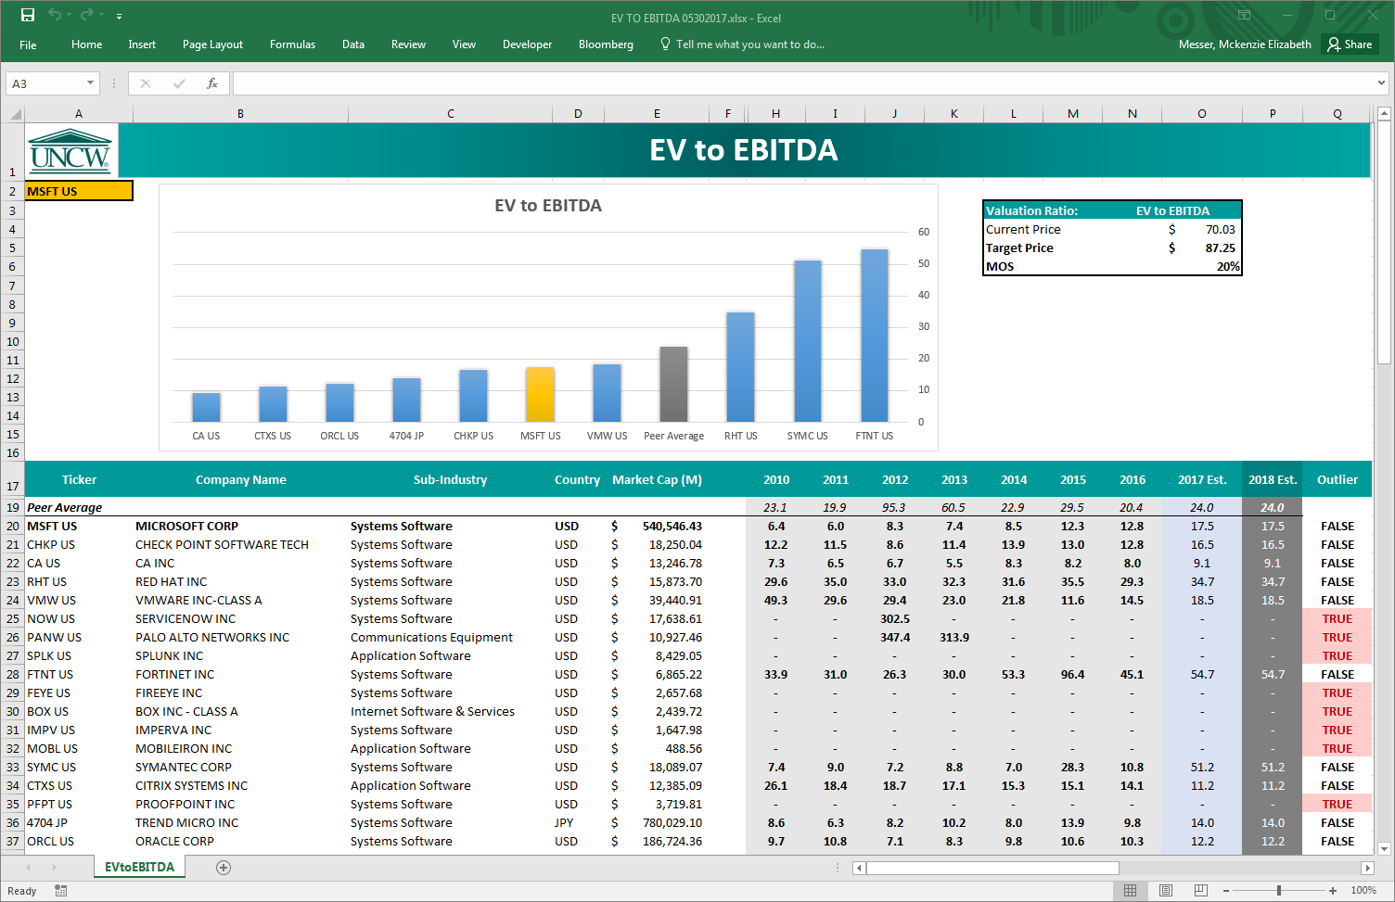
EV to EBITDA
EV/EBITDA:
The EV/EBITDA multiple has become extremely popular on Wall Street in the past 8 - 10 years
Notes:
EV/EBITDA
The EV/EBITDA multiple has become extremely popular on Wall Street in the past 8 - 10 years. The numerator, EV, is calculated as:
$$EV=Market Value of Equity+Market Value of Debt−Cash on Balance Sheet$$
The denominator, EBITDA, represents earnings before interest, taxes, depreciation, and amortization.
The most common way to utilize this multiple is to determine the average EV/EBITDA multiple for the industry, and then take that multiple times the expected EBITDA for your subject company for the upcoming year.
The second way that this multiple might be used would be to see what range the firm has traded at using this multiple over the past five years, and then to assume that the firm should trade at the average of that range. While some analysts perceive this second approach to be a conservative valuation technique, we will use the first one.
Step 1: Identify cell A2; it is highlighted in yellow.
In this input cell, you may change the stock you wish to evaluate. The model is not case sensitive, but must contain the country code following the ticker symbol.
Step 2: Compare the company EV/EBITDA to the Peer Average. The company we are evaluating will be highlighted in yellow within the chart. The peer average will be represented by the gray bar in the bar chart.
The model only shows the top 10 peers by default. If you do not see the company or peer average you are analyzing, simply highlight rows 30-117, by placing your mouse on the row number, right clicking, and selecting “unhide” from the drop-down menu.
Step 3: Identify the target price and MOS for your analysis.

Slide 28
EV to EBITDA
Step 1:
In this input cell, place ticker symbol and country code
Step 2:
Compare company EV/EBITDA to the Peer Average
Notes:
The number of peers may indicate the number of competitors. Depending… fewer competitors may be an advantage.

Slide 29
EV to EBITDA
Step 3:
Identify Target Price and MOS for analysis
Notes:
In this example Microsoft is in a good position that is competitive with the peer ev/ebitda multiple average.

Slide 30
FREE CASH FLOW MODELS
FINANCIAL MODEL ANALYSIS

Slide 31
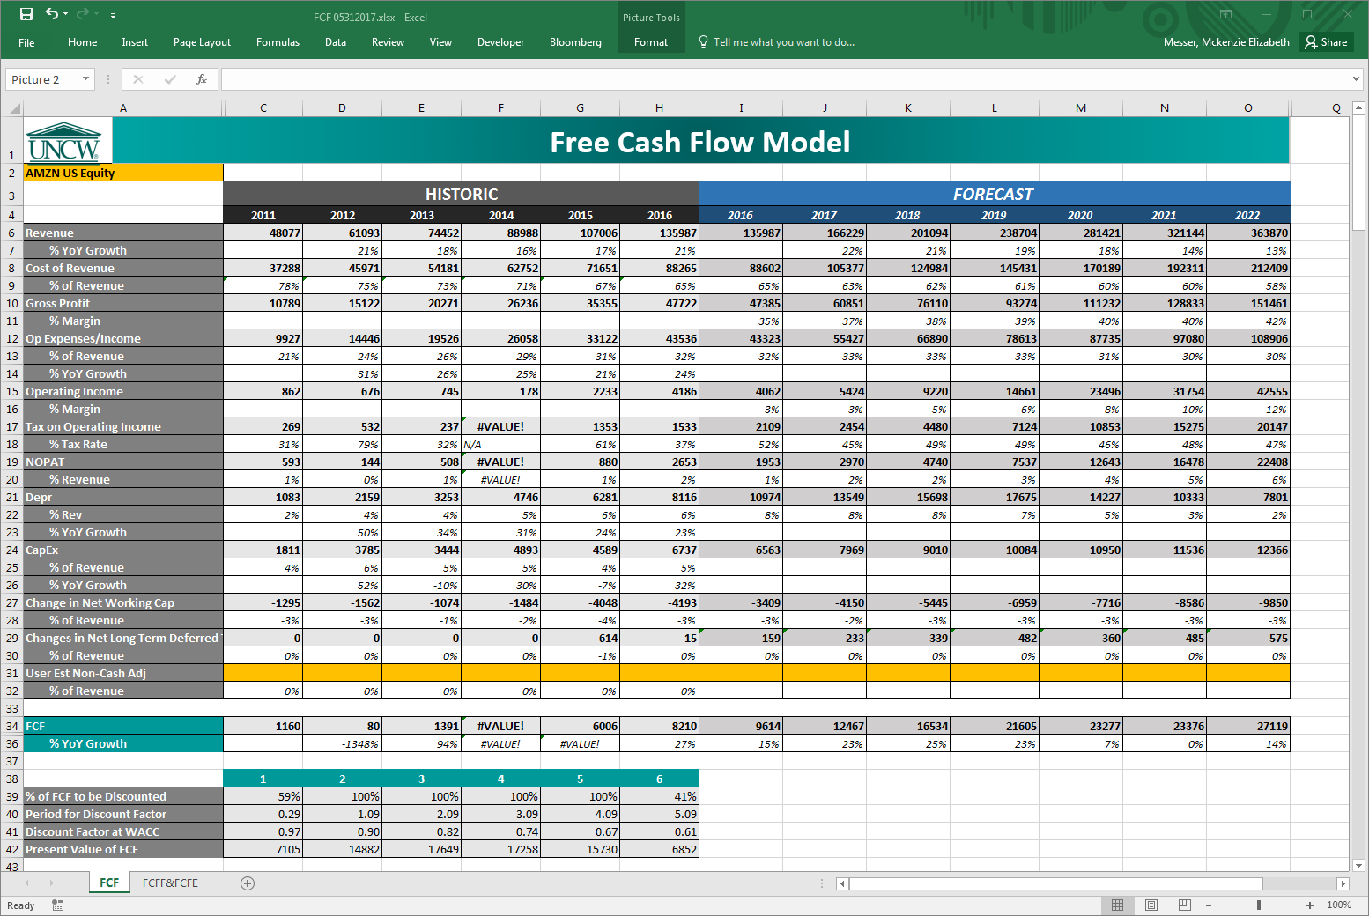
Free Cash Flow Models
FCF:
Can be used directly in a discounted
cash-flow framework
to value equity
Notes:
FCF
Using free cash flow (FCF) instead of other cash-flow concepts to value equities is useful as FCF can be used directly in a discounted cash-flow framework to value equity.
Free cash flow to the firm (FCFF) represents is the cash flow available to all the firm’s suppliers of capital once the firm pays all operating expenses (including taxes) and expenditures needed to sustain the firm’s productive capacity. The expenditures include what is needed to purchase fixed assets and working capital, such as inventory. The firm’s suppliers of capital include common stockholders, bondholders, and preferred stockholders (if the firm has preferred stock outstanding). Free cash flow to equity (FCFE) is the cash flow remaining for equity holders after all other claims have been satisfied.
Step 1: Identify cell A2; it is highlighted in yellow.
In this input cell, you may change the stock you wish to evaluate. The model is not case sensitive, but must contain the country code and the word “equity” following the ticker symbol.
Step 2: Determine the appropriate long-term growth rate, and place them in input cells C12 and G9. A conservative growth estimate of 3% represents the company growing at the rate of the US economy. A value-based growth estimate of 0% will derive the value of the company if no growth occurs.
Step 3: Evaluate the discrepancies in target price and MOS between the two models.
There are two ways to estimate the equity value using free cash flows:
An entire firm and all its cash flows (FCFF) are discounted, with the relevant discount rate being the weighted average cost of capital (WACC) because it reflects all the firm’s sources of capital. The value of the firm’s debt is then subtracted to calculate the equity value.
Only the FCFE are discounted, with the relevant discount rate being the required return on equity. This provides a more direct way of estimating equity value.
In theory, both approaches should yield the same equity value if the inputs are consistent. However, the FCFF approach would be favored in two cases:
The firm’s FCFE is negative.
The firm’s capital structure (mix of debt and equity financing) is unstable.
The FCF with EBIT approach is favored here because (1) the required return on equity used in the FCFE approach will be more volatile when the firm’s financial leverage (use of debt) is unstable and (2) when using historical data to estimate free cash flow growth, FCFF growth might reflect the firm’s fundamentals better than FCFE growth, which would fluctuate as debt fluctuates.
The following formulas are used to calculate FCF with EBIT:
$$FCFF=EBIT×\left(1−Tax Rate\right)−∆CapEx−∆Working Capital$$
$$Firm Value=\frac{FCFF}{\left(WACC−LT Growth\right)}$$
$$Equity Value=Firm Value−Market Value of Debt$$
$$Target Price=\frac{Equity Value}{Diluted Shares Outstanding}$$
The following formulas are used to calculate FCF with Historic Growth Estimate:
$$FCFF={FCFF}_{t−1}×\left(1+ST Growth\right)$$
t-1 represents last year’s FCFF.
ST Growth represents the average 10 year growth rate of FCFF.
$$Firm Value=\frac{FCFF}{\left(WACC−LT Growth\right)}$$
$$Equity Value=Firm Value−Market Value of Debt$$
$$Target Price=\frac{Equity Value}{Diluted Shares Outstanding}$$
The market value of debt is calculated by taking the weighted average sum of all long-term debt the firm has. This is done by multiplying the amount of debt by the year it matures in years 1, 2, 3, 4, 5, and thereafter. The sum of the amounts multiplied by the year of maturity is divided by the sum of the total debt to find the weighted average maturity year. The Market Value of Debt is found using the following formulas:
$$WAD=Σ\left(Debt Maturing in year t×t\right)$$
$$TD=Σ\left(Debt\right)$$
$$WAM=\frac{WAD}{TD}$$
$$MVD=i×\left\{1−\left[\frac{\left(\frac{1}{{(1+CD)}^{WAM}}\right)}{CD}\right]\right\}+\left[\frac{TD}{{(1+CD)}^{WAM}}\right]$$
WAD stands for Weighted Average Debt
TD represents Total Debt summation
WAM is the weighted average maturity years
MVD stands for Market Value of Debt
i represents the interest expense
CD represents the cost of debt to the firm

Slide 32
Free Cash Flow Models
Step 1:
In this input cell, place ticker symbol, country code, and “equity”
Step 2:
Determine non-cash adjustments to FCF

Slide 33
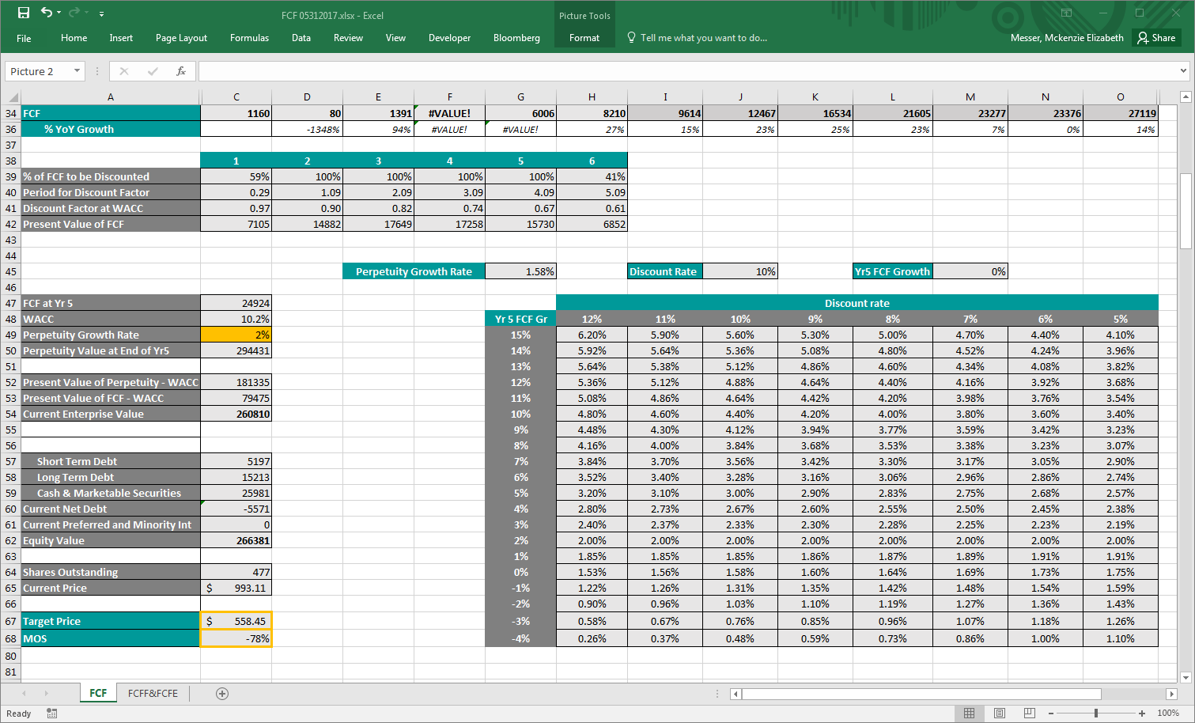
Free Cash Flow Models
Step 3: Determine appropriate perpetuity growth rate; place in call C49
Step 4:
Evaluate target price
and MOS.

Slide 34
Free Cash Flow Models
Step 5:
Click the FCFF&FCFE tab to switch to the FCFF and FCFE
portion of the workbook.

Slide 35
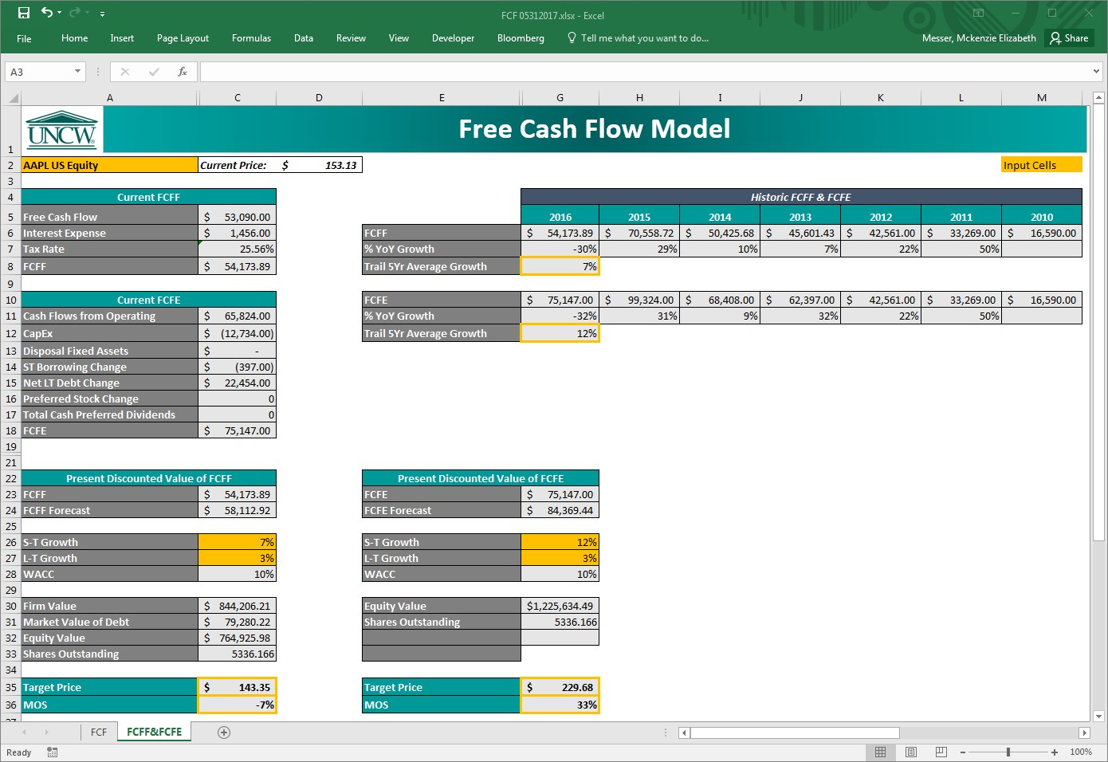
Free Cash Flow Models
FCFF:
Represents cash flow available to all firm’s suppliers of capital
Discount FCFF using the WACC, subtract firm debt from discounted FCFF to attain equity value

Slide 36
Free Cash Flow Models
FCFE:
Cash flow remaining for equity holders after all other claims are satisfied
The FCFE method is the preferred measure, as FCFE is a more direct method of estimating equity value

Slide 37
Free Cash Flow Models
Step 1:
In this input cell, place ticker symbol, country code, and “equity”
Step 2:
Determine appropriate short-term growth rates

Slide 38
Free Cash Flow Models
Step 3:
Determine appropriate long-term growth rates
Step 4:
Evaluate discrepancies in target price and MOS between the two models

Slide 39
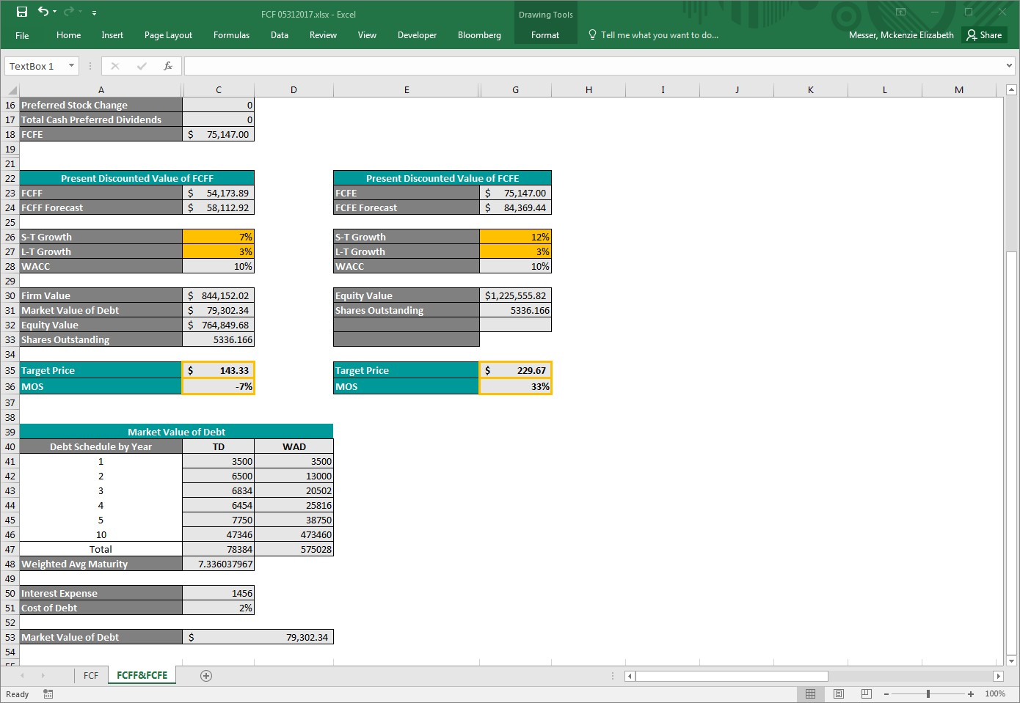
Free Cash Flow Models
Market Value of Debt:
𝑾𝑨𝑫 = 𝚺 𝑫𝒆𝒃𝒕 𝑴𝒂𝒕𝒖𝒓𝒊𝒏𝒈 𝒊𝒏 𝒚𝒆𝒂𝒓 𝒕 × 𝒕
𝑻𝑫 = 𝚺 𝑫𝒆𝒃𝒕
𝑾𝑨𝑴 =
𝑾𝑨𝑫
𝑻𝑫
𝟏
𝑴𝑽𝑫 = 𝒊 × 𝟏 −
(𝟏 + 𝑪𝑫)^{𝑾𝑨𝑴}
+
𝑻𝑫
𝑪𝑫
(𝟏 + 𝑪𝑫)^{𝑾𝑨𝑴}
WAD stands for Weighted Avg Debt
TD represents Total Debt
WAM is the Weighted Avg Maturity
MVD stands for Market Value of Debt
i represents the interest expense
CD represents the cost of debt

Slide 40
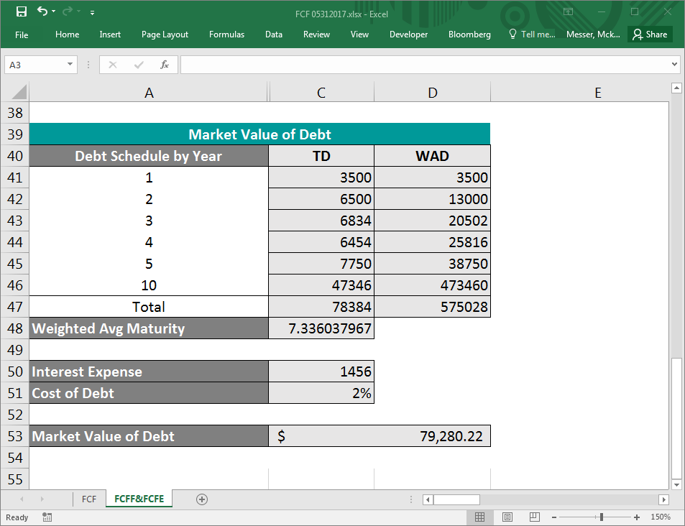
Free Cash Flow Models
Market Value of Debt:
𝑾𝑨𝑫 = 𝚺 𝑫𝒆𝒃𝒕 𝑴𝒂𝒕𝒖𝒓𝒊𝒏𝒈 𝒊𝒏 𝒚𝒆𝒂𝒓 𝒕 × 𝒕
𝑊𝐴𝐷 = 1 ∙ 3500 + 2 ∙ 6500 + 3 ∙ 6834 …
𝑊𝐴𝐷 = 575028
𝑻𝑫 = 𝚺 𝑫𝒆𝒃𝒕
𝑇𝐷 = 3500 + 6500 + 6834 + 6454 + 7750 + 47346
𝑇𝐷 = 78384
𝑾𝑨𝑴 = ^{𝑾𝑨𝑫} _{𝑻𝑫}
_{𝑊𝐴𝑀 =} 575028 ₇₈₃₈₄
𝑊𝐴𝑀 = 7.3360
𝟏
(𝟏 + 𝑪𝑫)^{𝑾𝑨𝑴}
𝑴𝑽𝑫 = 𝒊 × 𝟏 −
+
𝑻𝑫
𝑪𝑫
(𝟏 + 𝑪𝑫)^{𝑾𝑨𝑴}
1
(1 + 0.02)^{7.3}
𝑀𝑉𝐷 = 1456 × 1 −
+
78384
0.02
(1 + 0.02)^{7.3}
𝑀𝑉𝐷 = 79280.22

Slide 41
PRICE TO EARNINGS RATIO
FINANCIAL MODEL ANALYSIS
Notes:
PRICE/EARNINGS
Evaluates relative attractiveness of company’s stock price compared to current earnings of a firm. Generally, the lower the P/E ratio, the more attractive the equity is to an investor. However, there are exceptions.
Step 1: Identify cell A2; it is highlighted in yellow.
In this input cell, you may change the stock you wish to evaluate. The model is not case sensitive, but must contain the country code following the ticker symbol.
Step 2: Compare the company P/E to the Peer Average. The company we are evaluating will be highlighted in yellow within the chart. The peer average will be represented by the gray bar in the bar chart.
The model only shows the top 10 peers by default. If you do not see the company or peer average you are analyzing, simply highlight rows 30-117, by placing your mouse on the row number, right clicking, and selecting “unhide” from the drop-down menu.
Step 3: Identify the target price and MOS for your analysis.

Slide 42
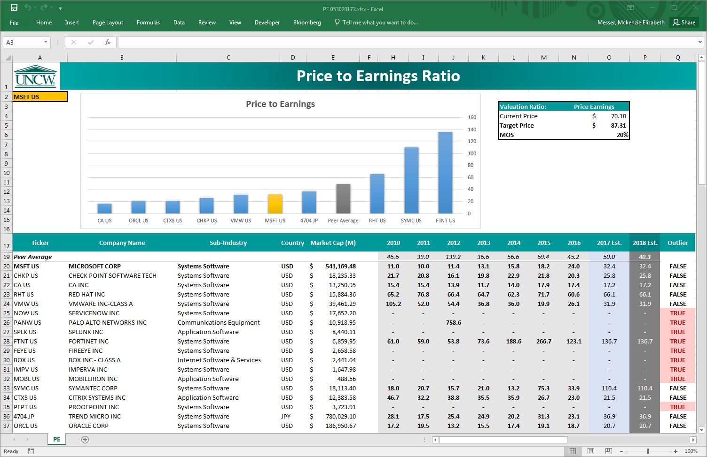
Price to Earnings
P/E:
Evaluates relative attractiveness of company’s stock price compared to current earnings of a firm

Slide 43
Price to Earnings
Step 1:
In this input cell, place ticker symbol and country code
Step 2:
Compare company P/E to the Peer Average

Slide 44
Price to Earnings
Step 3:
Identify Target Price and MOS for analysis

Slide 45
MODIFIED GRAHAM
FINANCIAL MODEL ANALYSIS

Slide 46
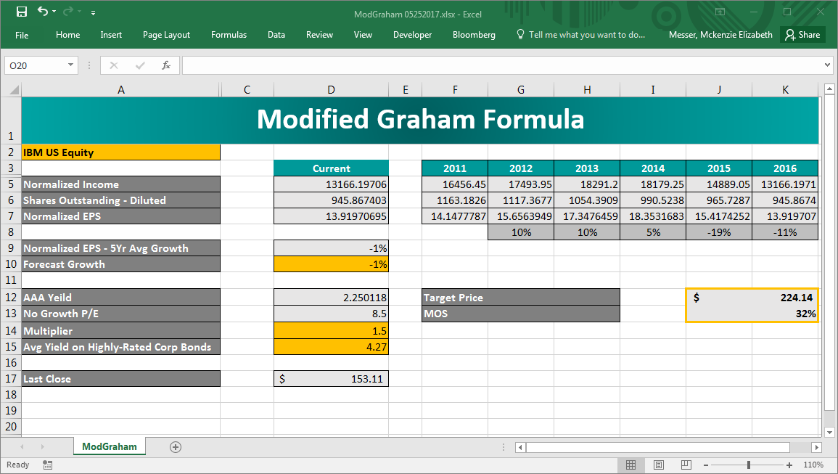
Modified Graham Formula
Modified Graham:
Value-based analysis
Allows for quick estimation of a company’s value
•Formula:
𝐸𝑃𝑆 8.5 + 2 ∗ 𝑔
∗ 4.4
𝑇𝑎𝑟𝑔𝑒𝑡 𝑃𝑟𝑖𝑐𝑒 =
𝐴𝐴𝐴 𝑌𝑖𝑒𝑙𝑑
Notes:
MODIFIED GRAHAM
The Modified Graham Formula allows for quick estimation of a company’s value and is not intended to be an exact science. The target price that the model produces should be viewed as a general estimate and not an exact value.
The formula assumes:
the average yield on a highly rated corporate bond of 4.4%
the base PE ratio of a no-growth company to be 8.5
a multiplier to the growth rate of 2
The inputs in the formula are already pulled in from the Bloomberg database and will not require any additional adjustments:
the EPS in the formula represents the company’s current earnings per share
the g in the formula represents the company’s 5-year earnings growth estimate
the AAA Yield represents the current yield on AAA corporate bonds
Step 1: Identify cell A2; it is highlighted in yellow.
In this input cell, you may change the stock you wish to evaluate. The model is not case sensitive, but must contain the ticker symbol, country code, and the word “equity.”
Step 2: Identify the target price and MOS for your analysis.

Slide 47
Modified Graham Formula
Step 1:
In this input cell, place ticker symbol, country code, and “equity”
Step 2: Determine growth forecast. Usually,
growth forecast will equal the 5 year avg. normalized EPS growth

Slide 48
Modified Graham Formula
Step 3:
Determine appropriate multiplier for industry. A multiplier of 2 is usually appropriate. Update the average yield on highly- rated corporate bonds
Step 4:
Identify Target Price and MOS for analysis
Notes:
When you first complete a model enter the information from Bloomberg, check it. Then apply the Dynamic Model.

Slide 49
New Position
Applied Learning Teams
Goldman Sachs San Francisco, California Street
Managed ‘value’ .5
Vanguard ‘passive .5
Clients: Seahawk Investment Management, LLC
Product: Seahawk Investment Portfolio: $1.5 M
Objectives :
review the portfolio to determine if current equities need to be sold or held plus establish Investment Policy Statement,
conduct a top-down identification of value-oriented stocks to identify new purchase opportunities that meet portfolio policies,
compile a comprehensive written report for the clients including sector overview, valuation of each equity, and rebalance rationale,
create interactive slides to present to clients detailing your ‘buy’ ‘hold’ and ‘sell’ recommendations and justifications.
Notes:
2.5 K + 10% if over S&P 500 (sector), bonus .5 K if clients accept recommendations.
Goldman Sachs San Francisco, California Street .5
Vanguard .5
50% Managed and 50% Passive
Group Oriented Process and Management (Center for Entrepreneurial Leadership)
Established IPS (investment policy statements)
Identify new purchase opportunities
Written Report
Meet to rebalance then
Support ‘buy, hold or sell’ recommendation.

