Slide 1

Dips

Slide 2
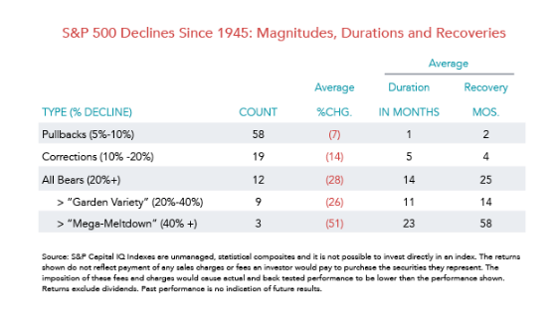

Slide 3
1987, 1992, 1997, 2000, 2008, 2016, 2017?
2017 Trump Tweets 1.8% Drop 373 points (May 16), Rift: Business Leaders, G. Cohn resigns
2016 Trump Post Election Transition, Power Plus Jared Kushner Re: Russian Probe November
2016 Brexit: Britain's Exit from the European Union (6/24/2016)
2016 Oil Oversupply, World Volatility (January February)
2008 Meltdown Global Issues (40% Drop: 1929 80% Drop)
2000 Dot Com Bubble
1997 Asian financial crisis
European Exchange Rate unable to keep agreed lower limit.
1987 SEC Investigations of Crooked Gains and Junk Bonds
Notes:
Trump down <1% Less than a pull-back – 5%; Son-in-law did better

Slide 4
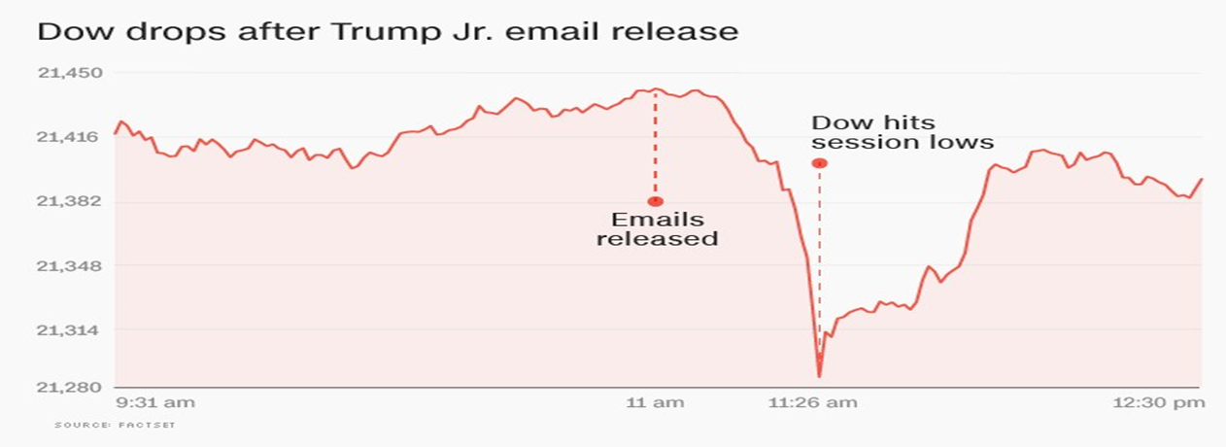
Notes:
Quant Based Pullback

Slide 5
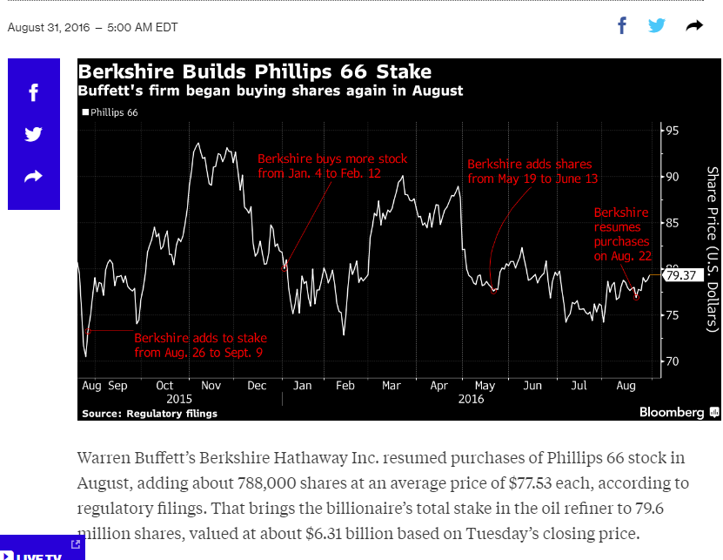

Slide 6
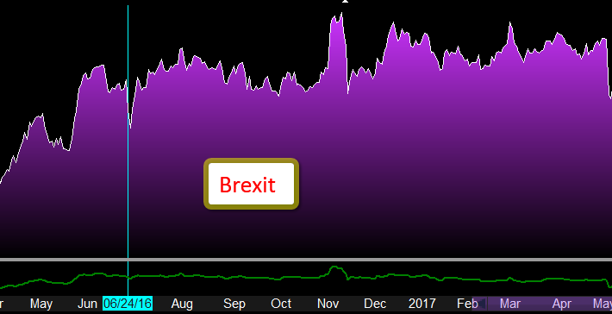

Slide 7
BREXIT Purchase June 24, 2016
Symbol Name Last Purchase % Annual Dividend
XLI SELECT SECTOR SPDR INDUSTRIAL TRUST 72.69 53.01 0.371250707 1.2636
XLB SELECT SECTOR SPDR MATERIALS TRUST 58.57 44.44 0.317956796 1.2076
VFH VANGUARD FINANCIALS INDEX FUND 67.21 43.00 0.563023256 1.2200
XLE SELECT SECTOR SPDR ENERGY TRUST 67.54 55.74 0.211697165 3.4616
XLK SELECT SECTOR SPDR TECHNOLOGY FUND 61.09 41.75 0.463353293 0.8368
XLV SPDR SELECT SECTOR HEALTHCARE FUND 83.73 63.95 0.309304144 1.2192
XLY SPDR SELECT SECTOR CONSUMER DISCRET 91.39 73.00 0.251917808 1.2716
502.22 374.89 0.35550 10.4804
0.339659633
Notes:
At that time, was not prepared to seek Value stocks,
purchased leading passive funds.
Increased 35% in 16 months.

Slide 8
Buffett’s Index Investing Challenge
In 2008, Buffett challenged the hedge fund industry – the quintessential active investors – to a 10-year contest.
Buffett - 1million dollars in Vanguard's S&P 500 Admiral Fund
Protégé Partners LLC, the hedge fund that took him up on his challenge, picked ‘most perfect’ managed funds …
End of 2016: Buffett 66%, Protégé's 22%.
Challenge Ends 2018 with the winner paying off to a charity.

Slide 9
Purchased on Dips |  | Basis |  | 3-Jan |  | Current
IBM |  | $ 144.70 | IBM | $ 167.19 | Technology | 162.07
JNJ |  | $ 55.28 | Johnson & | $ 115.84 | Health Care | 142.4
MSFT |  | $ 45.70 | Microsoft | $ 62.58 | Technology | 78.81
MTGE |  | $ 17.70 | Mortgage | $ 16.50 | Real Estate | 19.75
T |  | $ 33.70 | AT&T | $ 43.02 | Telecomm. | 35.54
USM |  | $ 34.20 | US Cellular | $ 45.67 | Telecomm. | 36.78
WFC |  | $ 45.25 | Wells Fargo | $ 56.00 | Financials | 54.92
WMT |  | $ 68.00 | Wal-Mart | $ 68.66 | Consum. Staple | 87.44
XOM |  | $ 42.82 | Exxon | $ 46.19 | Energy | 83.11
PEP |  | $ 47.50 | Pepsi | $ 56.64 | Consum. Desc. | 111.61
SRE |  | $ 35.73 | Sempra Engy | $ 104.65 | Energy | 114.13
JNJ |  | $ 71.96 | Johnson & | $ 101.13 | Health Care | 142.4
NFG |  | $ 25.85 | National Fuel | $56.78 | Energy | 57.62
ADM |  | $ 20.00 | Archer Daniels | $ 45.58 | Health/Food | 43.49
V
A
R
S
I
T
Y
VALUE BASED
MOS
Target $
Debt / Equity
P/E P/B ROE
Thesis Forward Long term
Basis to Jan. 3, 2017 | 58.52 % n=14
January 3 to Oct. 22, 2017 (YTD) | 19.84 %
Basis to Current Price | 78.81 %
Notes:
Exclude bottom 5 Legacy Stocks – Gain in the other Value-based is greater than Passive-based portfolio.

Slide 11
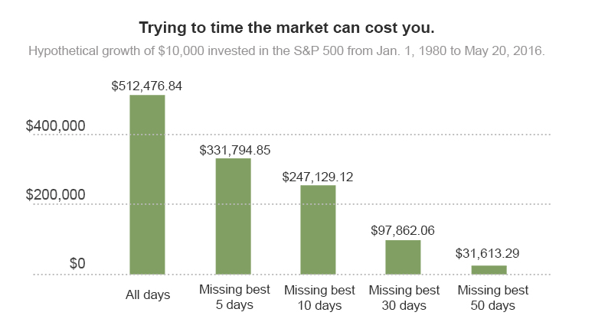

Slide 12
