Slide 1
Board - Final Exam: Fall 2017
Report
Presentation
Questions
Board Acceptance

Slide 2
Board of Directors: Seahawk Investment Management, LLC
William H. Sackley, Ph.D., CFA, CFP®
Professor of Finance
J. William (Bill) Coleman, III
First Vice President, BB&T
Scott and Stringfellow
Jay McClung
BB&T Wealth
Senior Vice President
Regional Director of Portfolio Management
David White, CEO
Absolute Alpha Capital Management
Roberta LaSure
Director, Foundation Endowment.
Nivine F. Richie, PhD
Department Chair – Economics / Finance
Darwin Dennison, EdD, MS, CNS
Director of Finance Lab

Slide 6
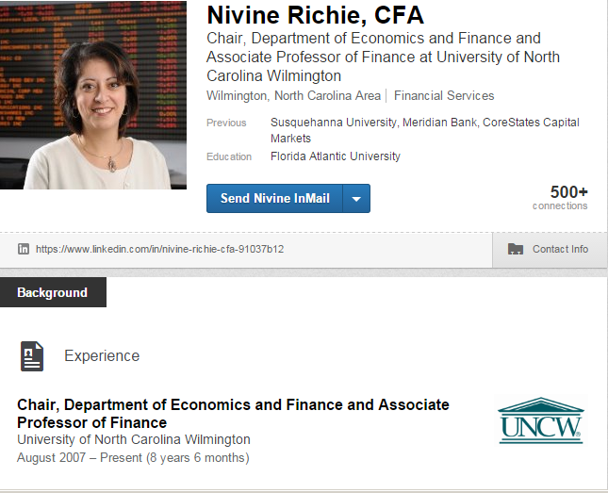
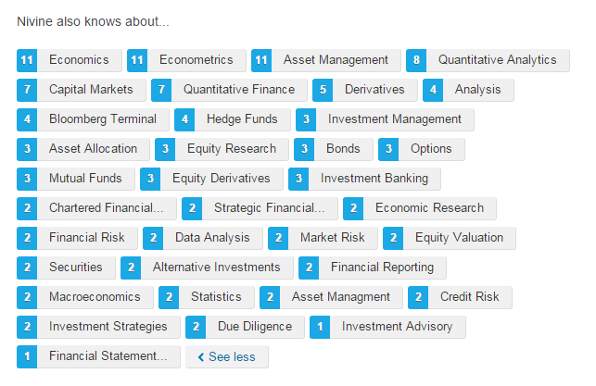
Notes:
Copies from LinkedIn. Notice all the topics Dr. Richie is knowledgeable about. Investment Banking; credit risk.

Slide 7
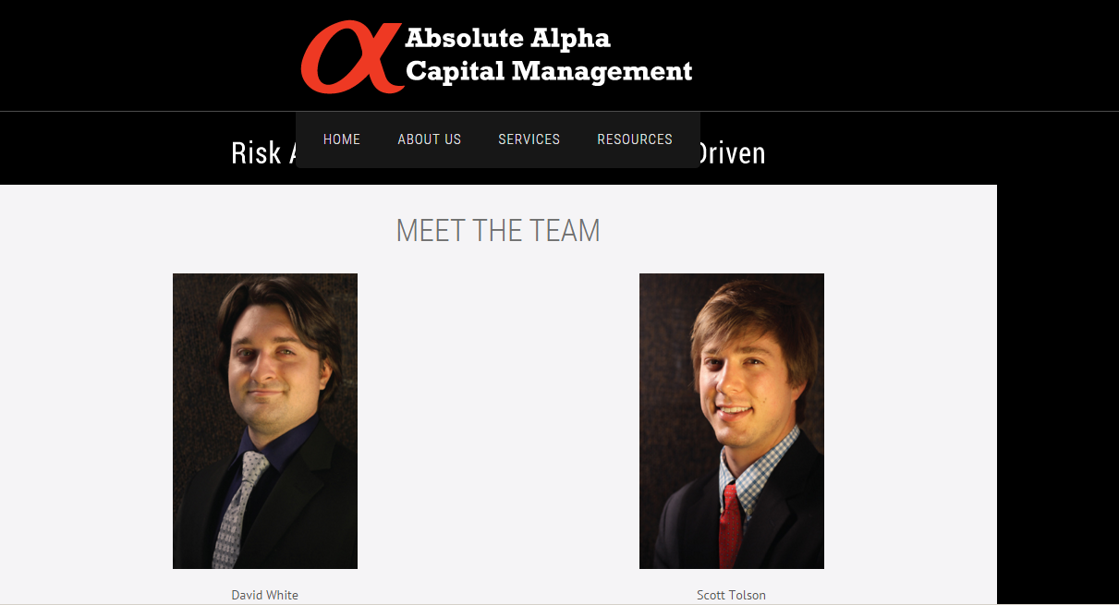
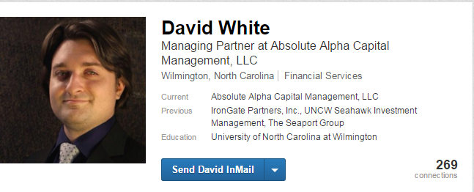
Notes:
Mission to become the next Warren Buffett.
Absolute knowledge of S&P stocks and beyond.
Read the annual report of all the S&P 500 companies and is knowledgeable about all the sectors.
Provides leadership and advise regarding your stock selections
Questions were helpful, clarifying, positive.

Slide 8
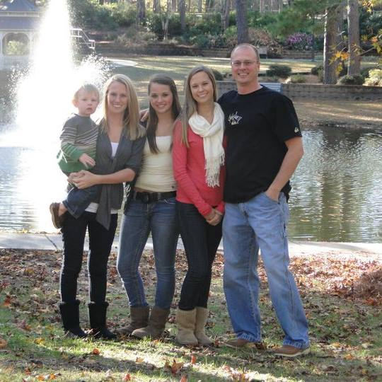

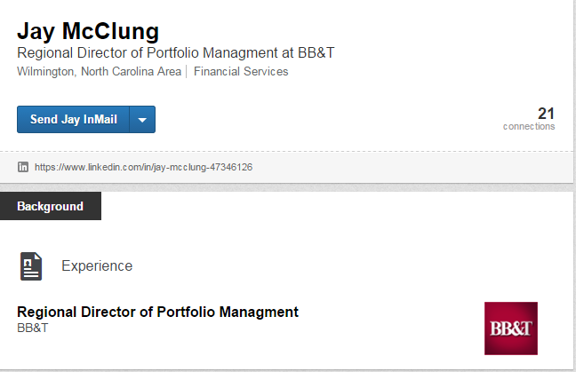
Notes:
Jay McClung is the second most frequent ‘questioner.’
Regional Director of Portfolio Management – 556,000,000 under investment… not sure how many portfolio managers.
Has an advertisement in his Facebook. (Social Media)
Indexed $$, Managed $.
Check out indexed funds – lower expense ratios (research, transaction expenses).
Spiders are a portfolio of stocks that you purchase with 1 transaction.
Exchange Traded Funds (ETFs) are usually divided into S&P sectors.
Vanguard started in 1975. Bob Brinker radio show 1986…
Reviewed financial sector – Bank of America, Charles Schwab, Goldman Sachs, J.P. Morgan, AIG.
Purchased VFH (vanguard) 5 year average return 10 % top holdings Wells Fargo, J P Morgan, Berkshire Hathaway – Price 43.

Slide 9
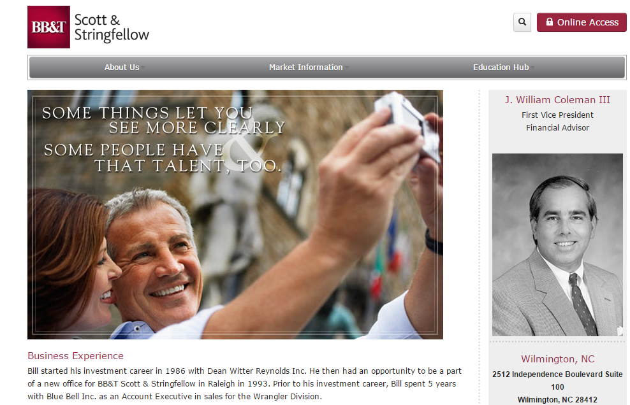
Notes:
Bill Coleman – First Vice President, BB&T
Built business cold calling.
$93,000,000 manages 60 families. 1.5/family. Estimated 12% fees… 11 million.
Elon College (Private 50% acceptance);
Some occasions visits the corporate head quarters (tax deductible).
Newest member of the Board
Most frequent ‘questioner’ at the Final Exam.
Use of dividends, hypothetical questions,
margin levels (compared to industry)
Meet him…

Slide 10
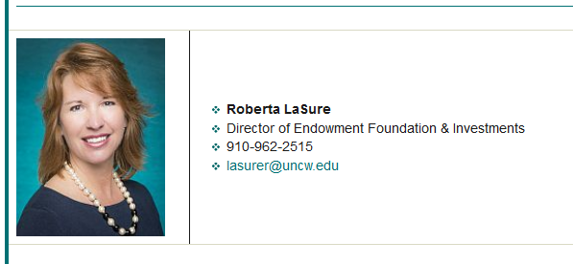
Roberta LaSure
Located in the Associate Vice Chancellor’s Office

Slide 11
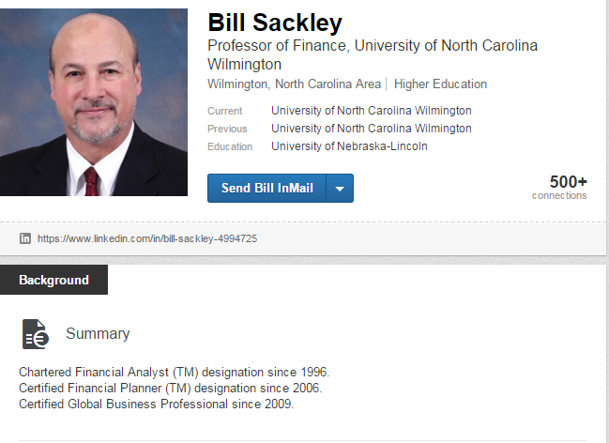
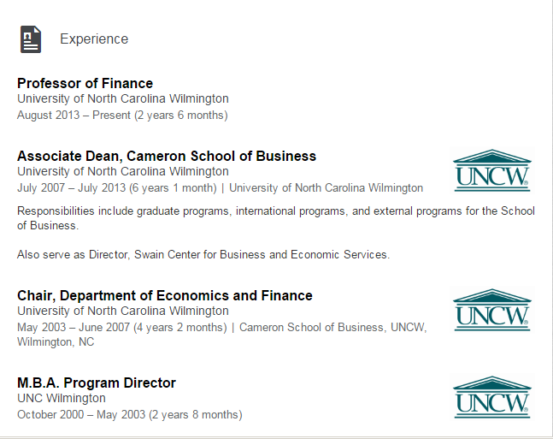
What he does, cannot be taught.
The consummate professional.
Shows a high degree of skill, flair; that is complete or perfect for
course management… Wall Street firm. (Chase or Goldman Sachs)
Notes:
Linkedin –based. Hobby reading.
Selected by Dean Rob Burrus to accompany students on banking enterprise experience.
Chartered Financial Analysis; Certified Financial Planner;
Certified Global Business Planner.
Leadership Positions (UNCW) Associate Dean;
Chair Economics and Finance,
Director of MBA Program.
These achievements are not easy, not guaranteed, often not available.
Chartered Financial Analysis CFA – Currently 135,000 world wide (pass rate us 42% world 39%; 21,000 in the US.
Components of Institute: ethics, commitment to professional integrity, education and trust in finance,
investors’ interests come first,
markets function at their best w/o intervention, and economies grow.
Active in CFA Institute, assists in test review and correction.
Compare to 200,000 per year graduate with MBA… Schools of Business graduates 23% of total graduates. Millions with MBA.
CNS (Certified Nutrition Specialist) American College of Nutrition, 1,800 World Wide. Board for Certification of Nutrition Specialists.

Slide 12
General Questions (conceptual basis)…
Two negative margins of safety (MOS). Why was this stock selected?
What kind of screening did you use to select this stock?
What other equities did you compare this equity with? What are the comps?
Generally, walk through how you came up with the enterprise value of the company… are you high or low?
Is it acceptable to use a market price that exceeds the target?
This equity appears to have issues at both top and bottom lines or at the bottom line. Why?
What is your thought regarding the future of this company?
Can you explain the business plan for this company?

Slide 13
What competitors does this company have? … were their market caps higher or lower?
Is the acquiring of these two companies accretive or will it take a few years to increase the bottom line?
You are selling. What was the stock price (%) increase of this company during the last year?
Regarding the cash flow from this company – is it steady or cyclical?
When cost of materials go down, do not credit margins also go down?
What future factors may impede or assist this equity?
This equity reports inconsistent dividends and increasing debt… why are you holding?
What are the major factors that led you to recommend purchasing this company?

Slide 14
On the equities you compared did you select the equity with the PEG as low as possible?
What will occur if the merger does not occur?
Do you think that the price will go up or stay the same if a merger occurs?
Does the company have a business strategy for an upturn or a downturn in the market?
Remember these question are concept based… try to think of questions that you and your team might ask about your equities. Think team!
Keep in mind: dimensions – quantitative and qualitative

Slide 15
Be knowledge about…
Market forecast and market in general
Proposed tax rate change (good or bad)
Change in SEC leadership
Federal Interest Rate (December?)
World economy and world political status
Current news regarding the companies Buy Sell Hold… SA

Slide 16
Anomalies…
How did you explain the declining revenues? Increasing debt? Reducing dividends?
Equity is dependent upon government funds…
Can the business grow… larger market share with acquiring debt?
Credit margins down – European market, China, Asia and Japan
What’s driving the decline or increase in utilities?
Target prices different in report to slides. Thank you, class decision, report date, presentation date

Slide 17
Interaction Analysis…
Leaders: Students Analysts [ x ];
Participants: Board Members [Learners]. Category 4
1 positive expansion of freedom, thoughtful
2 reinforce the point/significance
3 clarify idea as positive
Divide
1 quantitative: data: MOS, metrics, ratios and
2 qualitative (information: annual report, earnings call, business plan)
Discussion increased as time moved forward x ; conversation is better but best when short and leading to resolve or new directions.
Final Spring 2017: 2 or 3 discussions and 1 conversation.
Avoid 10 s or c.

Slide 18
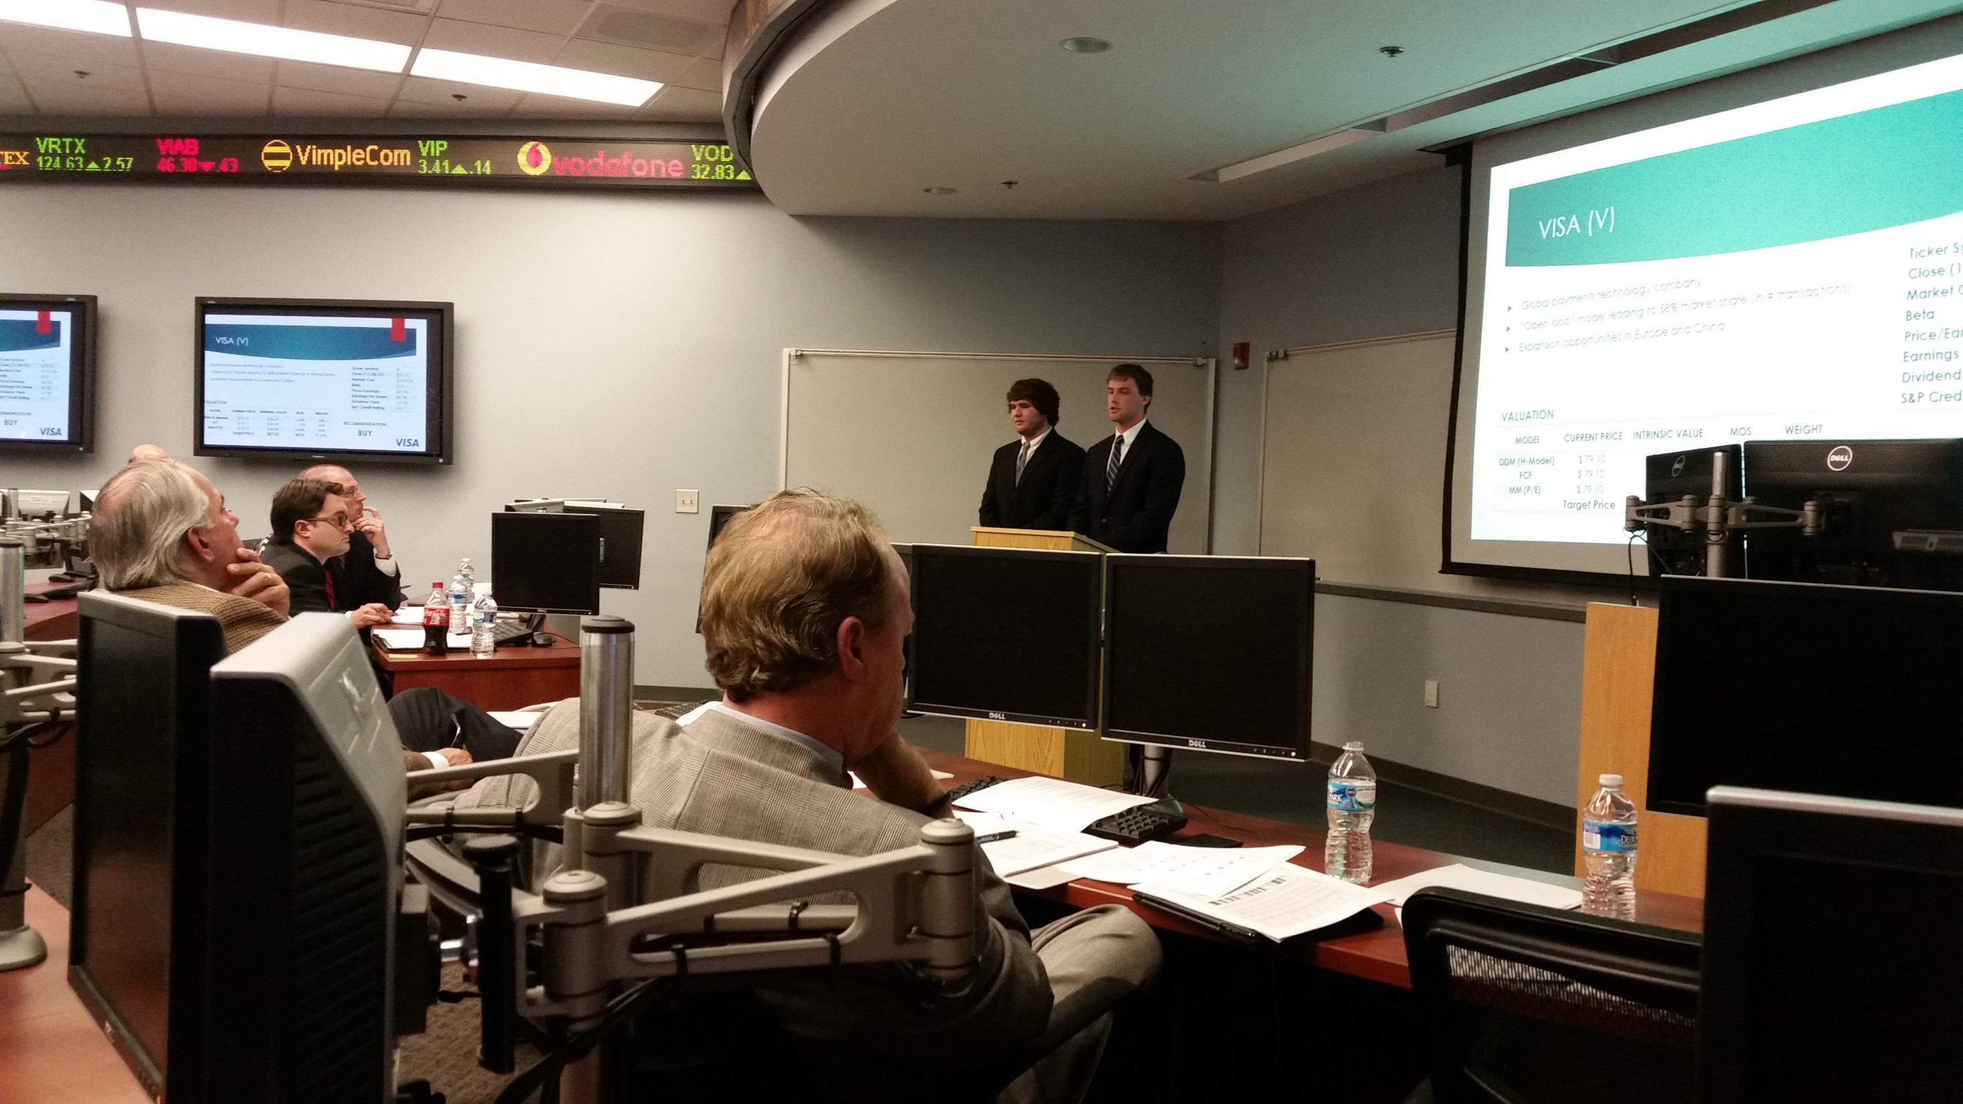

Slide 19
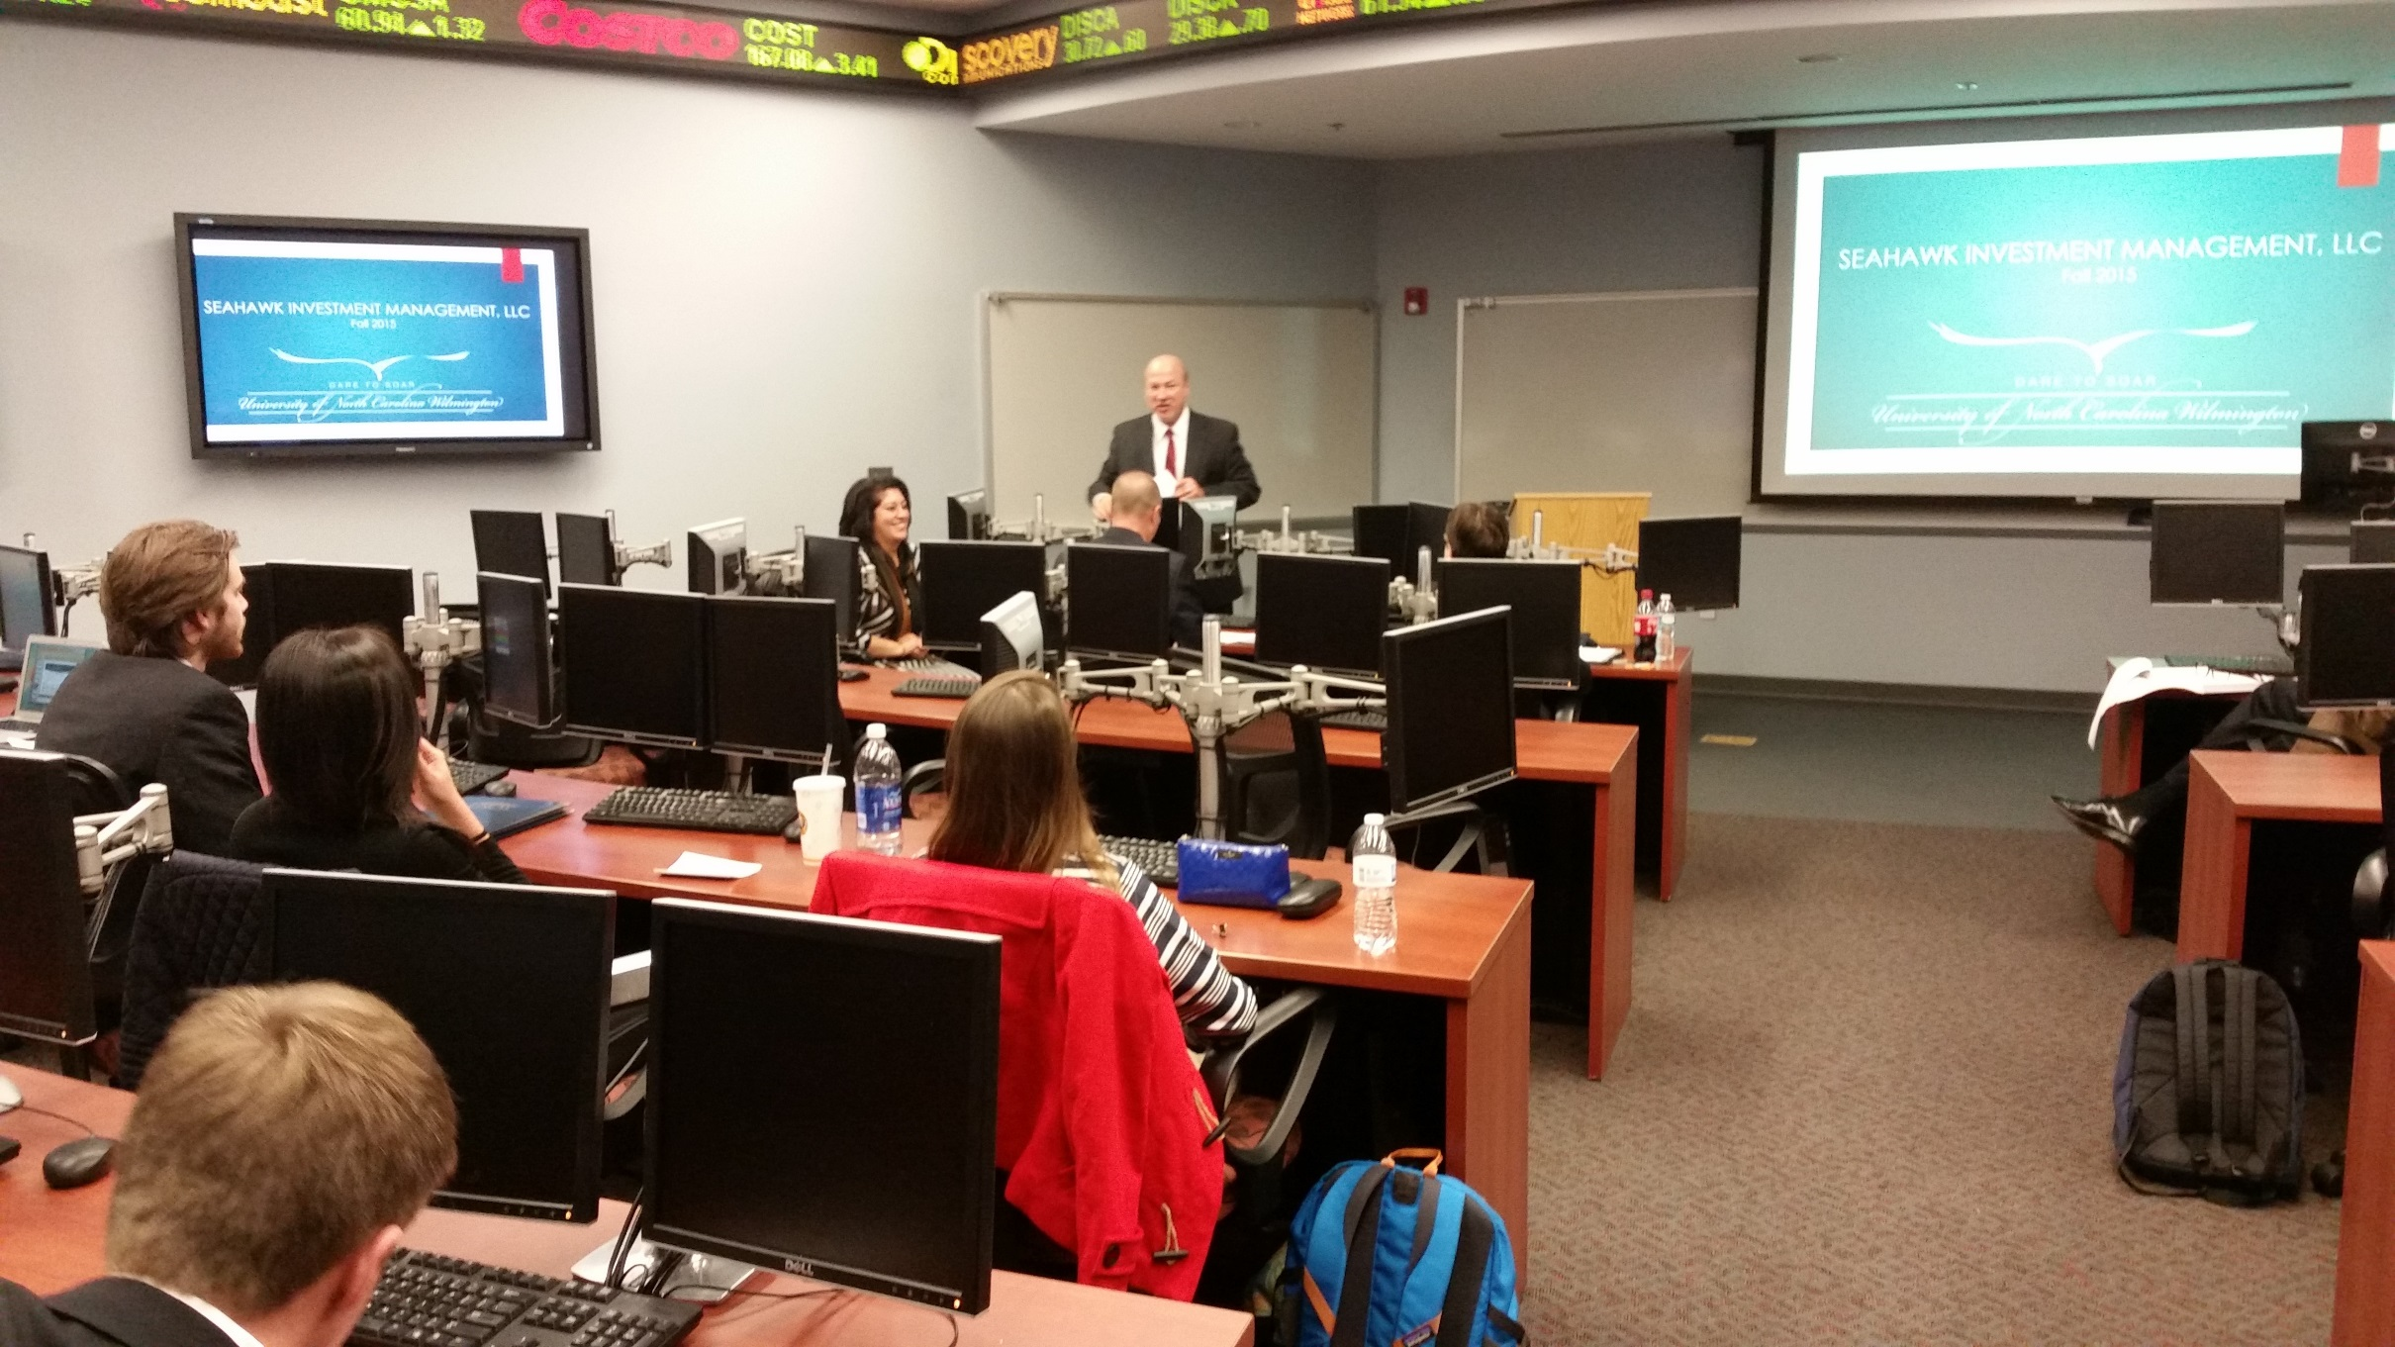

Slide 20
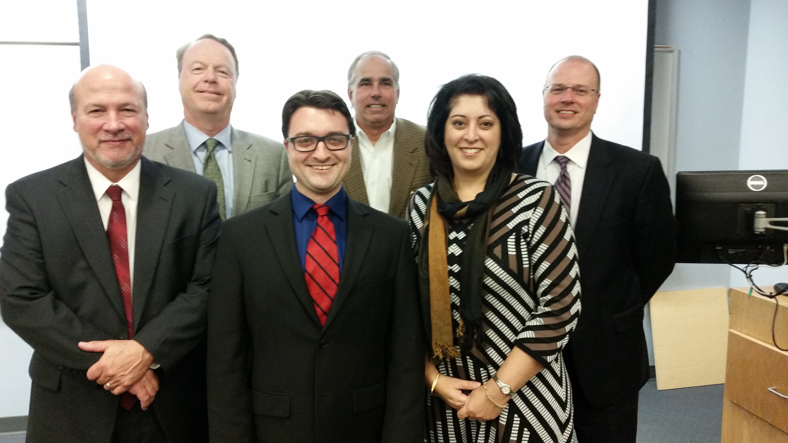
Photo Album 440 12042015
by William Sackley

Slide 21
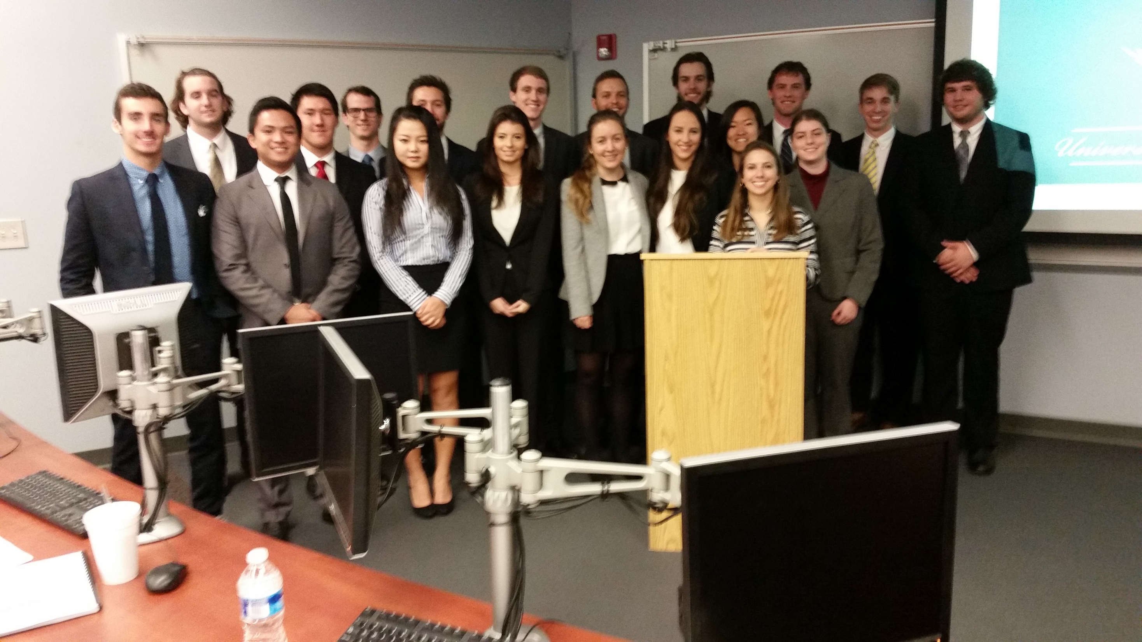

Slide 22
