Slide 1
Step It Up with Math
Sharon Bennett
Cumberland County Schools
AIG Teacher- Vanstory Hills Elementary

Slide 2
Most gifted students could take the End of Grade Math Test for their current grade level the first week of school and score a 3 or 4. Some could probably teach most of the math lessons. What can we do to challenge these students and keep them interested in math?

Slide 3
Let’s begin with a little math magic!
1. Write a three digit number with the largest number in the hundreds place.
2. Reverse the digits and subtract the two numbers to find the difference.
Example 624
- 426
_______

Slide 4
Name This Number
I am a three digit number.
I am an odd number.
I have a value greater than 150 but less than 340.
The sum of my digits is 8.
One of my digits is repeated.
The number in the hundreds place is one less than the
number in the ones place.
The number in the tens place is less than 5 but more than 2.
What number am I?

Slide 5
Strategy
List all of the possible digits for each place.
Eliminate possibilities.
_______________ __________________ _________________
1
2
3
1
3
5
7
9
3
4

Slide 6
Name This Number!
This number has 8 digits.
It is a whole number.
It is an even number.
The sum of the digits is 27.
It has a value that is more than 30 million but less than 33 million.
The tens place and the ones place have a value of zero, and they are the only repeating digits.
The digit in the thousands place is an odd number greater than 7.
The digit in the hundreds place and the digit in the hundred thousands place are multiples of 2.
The digit in the hundred thousands place has twice the value of the digit in the hundreds place.
The digit in the ten thousands place is one less than the digit in the millions place.
What is this number?

Slide 7
Strategy
____ _____ _____ _____ _____ _____ _____ _____

Slide 8
Template for Writing Name This Number Problems
Name This Number
Clue 1: I am a ____ digit number.
Clue 2 : I am a(n) _________ number. (odd or even)
Clue 3: I have a value more than _____ but less than ______.
Clue 4 : The sum of my digits is ______.
Clue 5: The number in the _____ place is ______ than the number
in the _______ place.
Clue 6 : The number in the _____ place is ______ than the
number in the ________ place.
Clue 7 : ______________________________________________
Clue 8:________________________________________________
What number am I ?
Clues 7 & 8 are optional. You are only required to have 6 clues.

Slide 9
Geocaching Through Problem- Solving
This activity is a problem-solving “scavenger hunt “with electronic devices.
Small teams of students use handheld GPS units to locate caches. Each cache has a challenging word problem to be solved.
Student record their thought processes with a voice recorder as they work out the problem on paper.
When the team has a correct answer, they are given another cache to locate. The first team to find all of the caches and solve the problems correctly wins the challenge!

Slide 10
Math Journals
At least three days out of a week students are given a word problem to solve. As they work through the problem, they record their thoughts in the math journal.
Example:
Five students (Amy, Beth, Corey, Diego, Emily) sit in that order in a circle, counting down to 1. Amy starts by saying, “34”. Then Beth says, “33”, and so on. They continue around the circle to count down by ones. Who says, “1”?

Slide 11
Student A
Journal Response : I decided to create a table to solve this problem because it would be easier to see the answer.
Amy | Beth | Corey | Diego | Emily
34 | 33 | 32 | 31 | 30
29 | 28 | 27 | 26 | 25
24 | 23 | 22 | 21 | 20
19 | 18 | 17 | 16 | 15
14 | 13 | 12 | 11 | 10
9 | 8 | 7 | 6 | 5
4 | 3 | 2 | 1
Diego said 1. I also noticed a pattern on the table. Diego started with 31 and there are five students so the pattern was minus 5 each time. Since Diego started with 31, he also said 21 and 11 so he ended up saying 1.

Slide 12
Student B
Journal Response: I divided 5 into 34 since there were 5 students and 34 numbers. 34 divided by 5 is 6 with a remainder of 4. That let me know that each students would count down 6 numbers and the last 4 students would count an extra number. Since Diego was the 4th student in the circle, he would be the last one to say a number.
So Diego said 1.

Slide 13
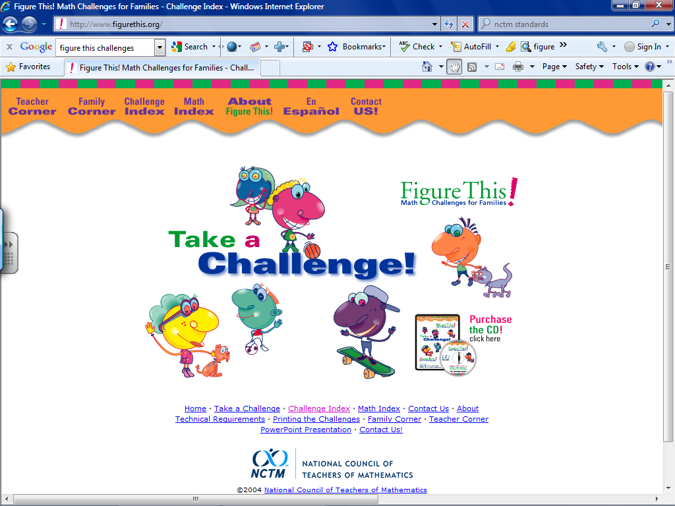

Slide 14
http://www.figurethis.org/challenges/math_index.htm

Slide 15
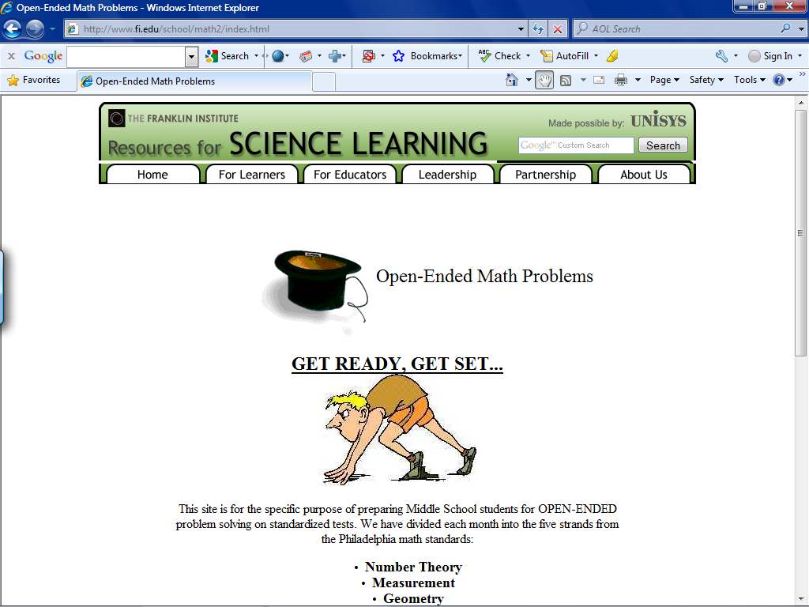
http://www.fi.edu/school/math2/index.html

Slide 16
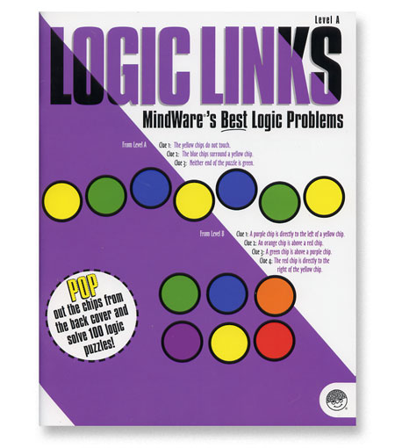
Logic Links
by Mindware

Slide 17
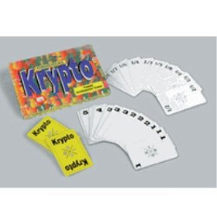
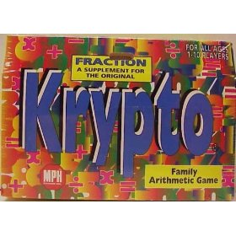
Krypto- a card game to reinforce orders of operations
Purchase from Amazon.com for $7.90 or
make your own

Slide 18
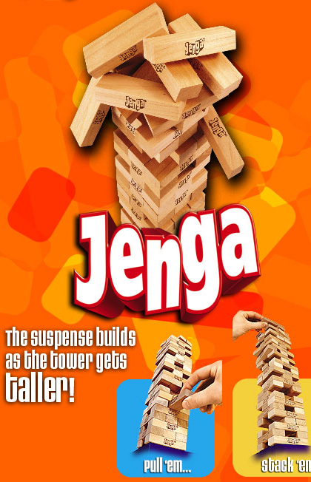
Jenga Math

Slide 19

Galactic Travels
Test your math skills as you establish a business in outer space.

Slide 20

More Math Magic!
Student writes any 3 digit number.
Teacher write a 3 digit number
Student write a three digit number
Teacher write a three digit number.
Student write a three digit number.
145
854
637
362
567
After the numbers are written, the teacher instantly announces the sum of the 5 numbers. How can she do this without adding the numbers???

Slide 21
Let’s play 1 -21!
Rules:
You can say 1 or 2 numbers during your turn.
You cannot skip numbers.
Begin with 1.
Count up to 21.
The person who says 21 wins the game.

