Slide 1

Beauty in Recursion, Fractals
Gur Saran Adhar
Computer Science Department

Slide 2
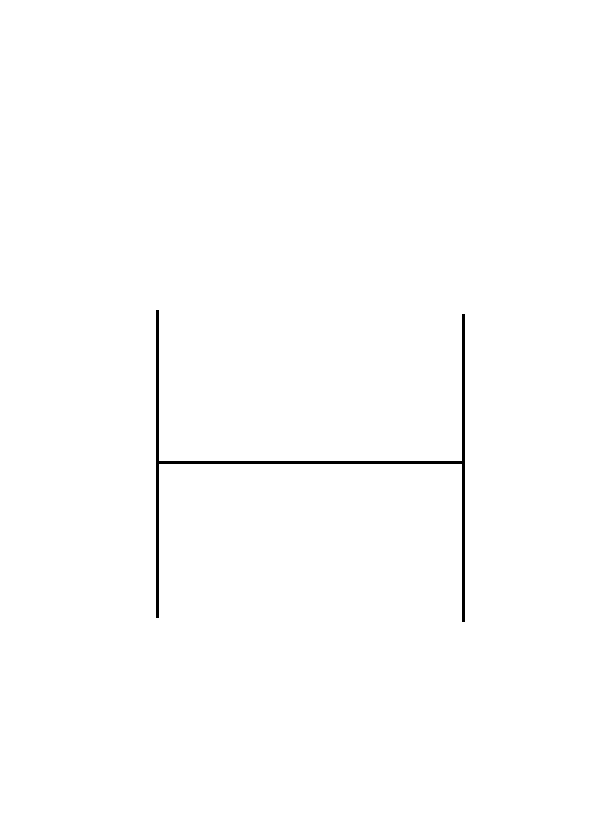
A simple example in Recursion
‘H-tree’

Slide 3
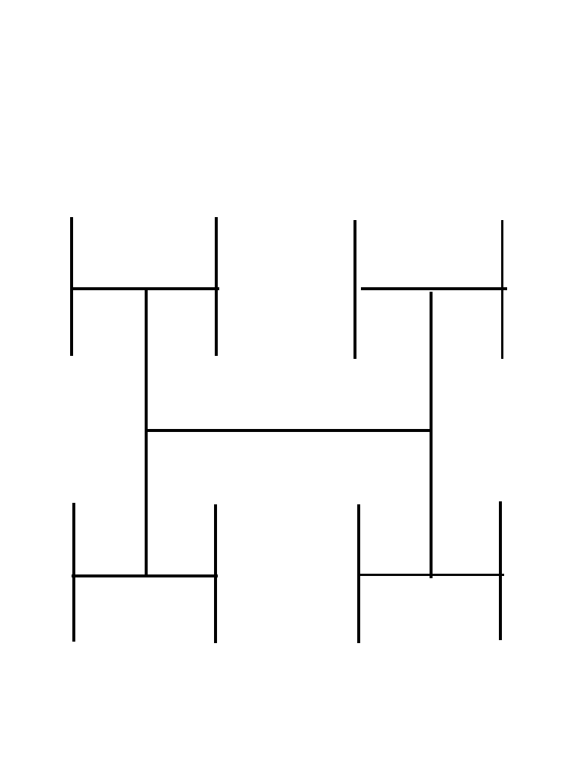
H-tree level 2

Slide 4
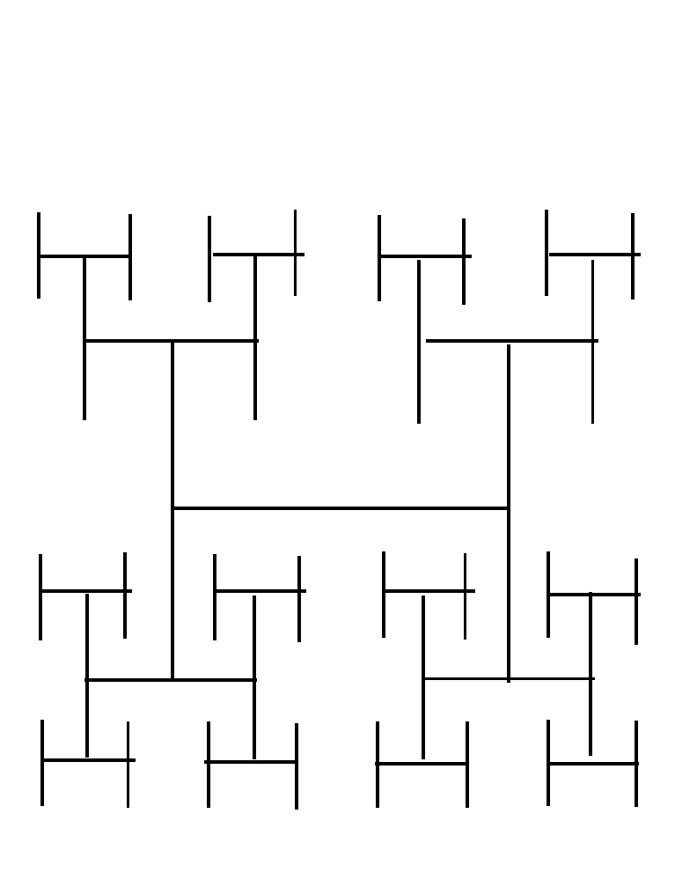
H-tree level 3

Slide 5
Recursion (key idea)
Letter ‘H’ is an H-tree
An H-tree attached to each end of an H-tree is also an H-tree
Define an object in terms of copies of itself

Slide 6
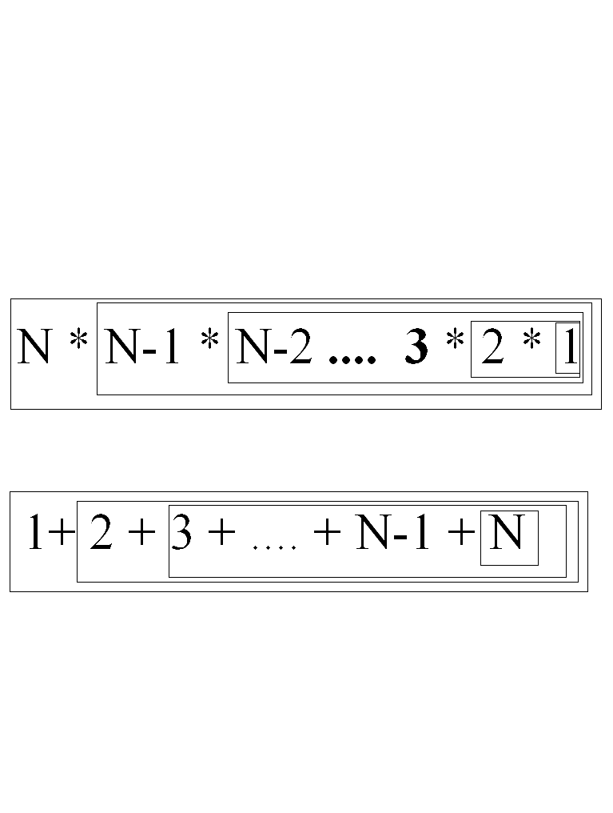
Recursion in Mathematics

Slide 7
Iteration vs. Recursion
int Product(int n) //iteration
{
int i, result =1;
for ( i = 1; i <= n; i++)
result = result*i;
return(result)
}
int Product(int n)//recursion
{
if ( n ==1) return (1);
else
return(n*Product(n-1));
}

Slide 8
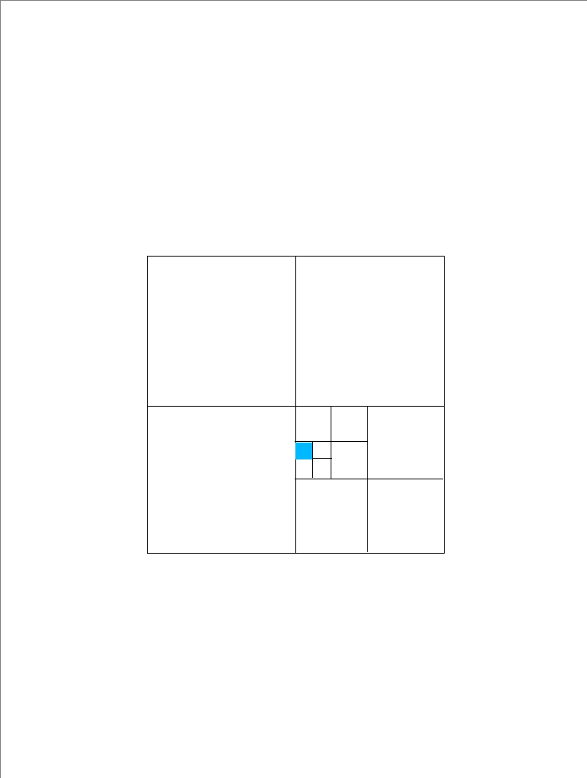
Quad Tree Representation of a region

Slide 9
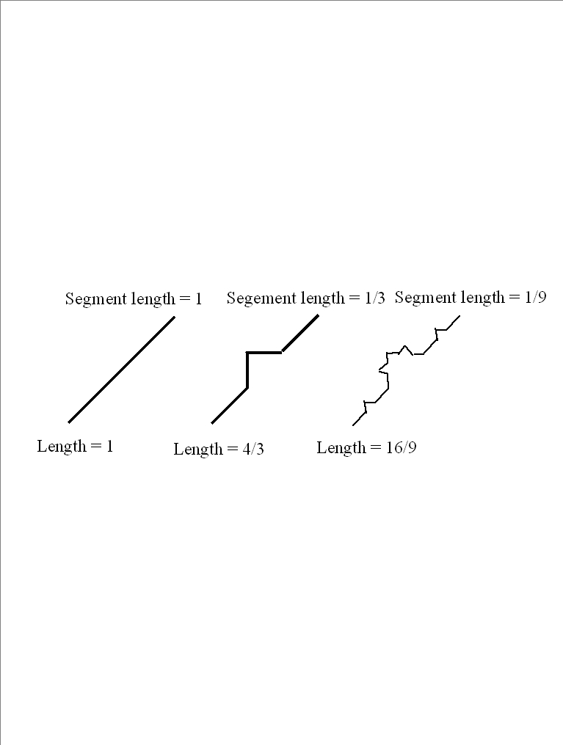
Snowflake (Koch Curve)

Slide 10
Fractal Dimension
  D = ln(n)/ ln(1/s)
  Higher dimension exhibits more jagged surfaces
  For snowflake D = ln(4)/ln(3) = 1.26

Slide 11
Fern

Slide 12
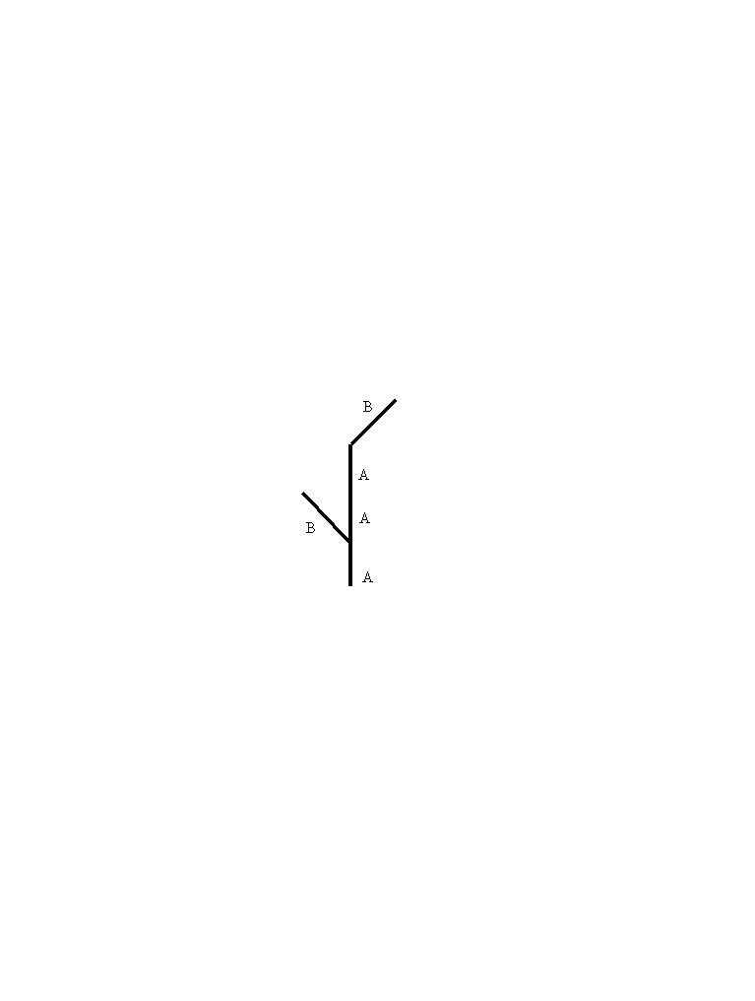
Describing a Branch
B A[B]AA(B)

Slide 13
Language of Recursion
Describing a tree
Rules
A AA
B A[B]AA(B)

Slide 14
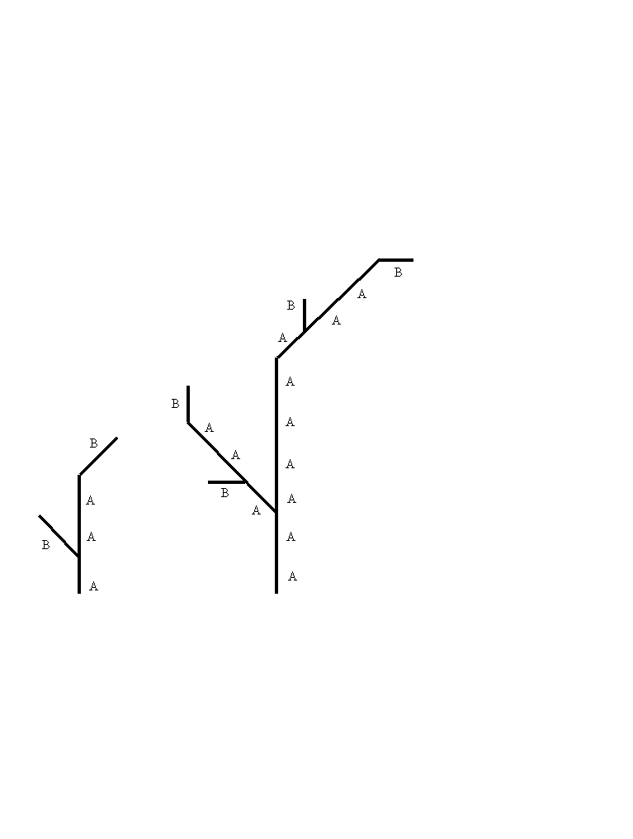
First Tree from grammar

Slide 15
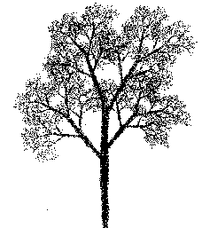
Trees

Slide 16
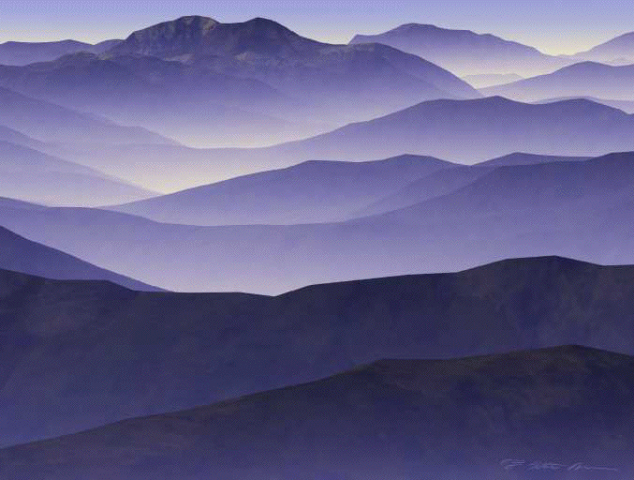
Mountains

Slide 17
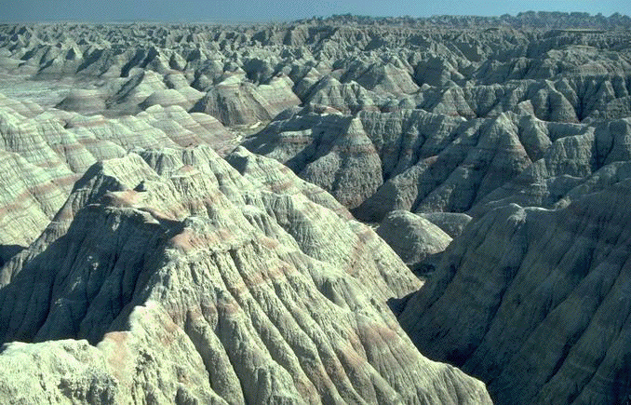
More mountains

Slide 18
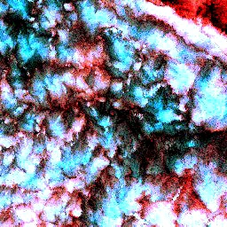
Structure of Clouds (NASA)
in marine stratocumuluson on July 7, 1987. First few frames showing the transition from GOES 1 km to Landsat 0.03 km resolution, and then zoom in by 7 successive factors of 2, to see that what's inside a GOES pixel can look rather similar to what's inside the full 500 km gridbox. This so-called "self-similarity" of clouds is characteristic of fractals.

Slide 19
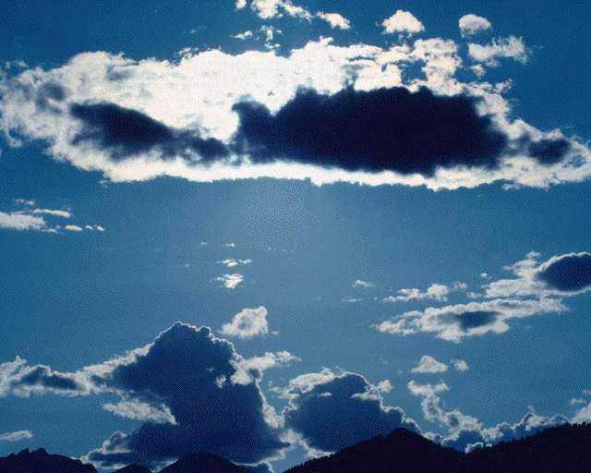
Clouds

Slide 20
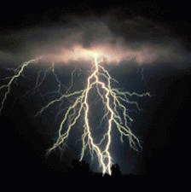
lightening

Slide 21
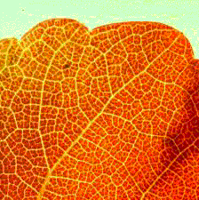
Leaf

Slide 22
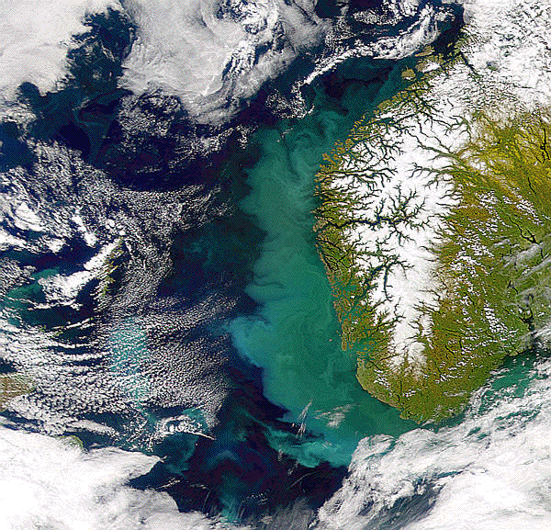
Coastline

Slide 23
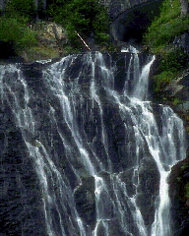
waterfall

